Slide 1



Are Journalists opinions influenced by short sale data?
Final Project Presentation
Opencampus: Machine Learning with TensorFlow
Robert Hennings
27.06.2023

Slide 2
Agenda
Project Description
Project Conditions
Project Steps
Data Research
Data Aggregation
Data Cleaning/Formatting
Data Selection
Data/ Feature Engineering
Model Setup: NLP Classification
Model Training
Model Optimization
Inference, Statistics and Robustness Tests

Slide 3
Agenda
Project Scope – To Dos
Project Structure
Final Results and Models overview/ comparison

Slide 4


I. Project Description
Bildquelle:
https://www.google.com/url?sa=i&url=https%3A%2F%2Fme2be.de%2Fhochschulen%2Fcau-christian-albrechts-universitaet-zu-kiel%2F&psig=AOvVaw3pyzL9cEIYeIjpIqHRPR5F&ust=1667135603618000&source=images&cd=vfe&ved=0CAoQjRxqFwoTCKDeyqLChfsCFQAAAAAdAAAAABAM

Slide 5
I. Project Description
Main Research Question: Based on publicly published short interest data, can one infere if and if, how strong jounalists opionion is influenced by it regarding the company coverage?
What consequences does this have for the considered listed companies? (In terms of rate or return and/or associated risk?)

Slide 6
III. Project Steps
Bildquelle:
https://www.google.com/url?sa=i&url=https%3A%2F%2Fme2be.de%2Fhochschulen%2Fcau-christian-albrechts-universitaet-zu-kiel%2F&psig=AOvVaw3pyzL9cEIYeIjpIqHRPR5F&ust=1667135603618000&source=images&cd=vfe&ved=0CAoQjRxqFwoTCKDeyqLChfsCFQAAAAAdAAAAABAM

Slide 7
III. Project Steps
Data Research
Data Aggregation
Data Cleaning/Formatting
Data Selection
Model training
Model setup: NLP Classification
Data/Feature Engineering
Model optimization
Inference, Statistics and Robustness Tests
Test ChatGPT against Model

Slide 8
III. Project Steps
Data Research
Bildquelle:
https://www.google.com/url?sa=i&url=https%3A%2F%2Fme2be.de%2Fhochschulen%2Fcau-christian-albrechts-universitaet-zu-kiel%2F&psig=AOvVaw3pyzL9cEIYeIjpIqHRPR5F&ust=1667135603618000&source=images&cd=vfe&ved=0CAoQjRxqFwoTCKDeyqLChfsCFQAAAAAdAAAAABAM

Slide 9
III. Project Steps
Data Research
Data Aggregation
Data Cleaning/Formatting
Data Selection
Model training
Model setup: NLP Classification
Data/Feature Engineering
Model optimization
Inference, Statistics and Robustness Tests

Slide 10
Data Research
III. Project Steps
NLP Classification
Develop the whole model on our own
Use a pretrained model and optimize it
Need of labeled dataset
No need of labeled dataset
Categorical labels (good, neutral, bad)
Numerical labels (good: 70-100, neutral: 40-60, bad: 0-40)
Tweak Model output to satisfy the needed numerical scale

Slide 11
Data Research
III. Project Steps
NLP Classification
Develop the whole model on our own
Use a pretrained model and optimize it
Need of labeled dataset
No need of labeled dataset
Short Sale Data
Long history of stock specific time series
News Data
Full news article body
Long history of news articles in multiple languages
Numerical Labels for classification

Slide 12
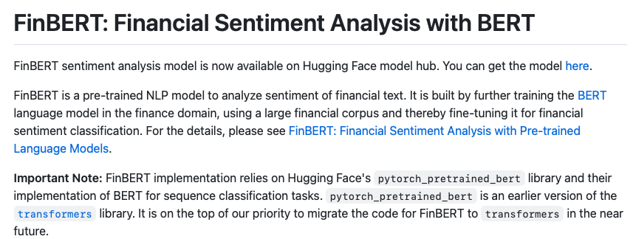
Data Research
III. Project Steps
News Data
FinBERT

Slide 13
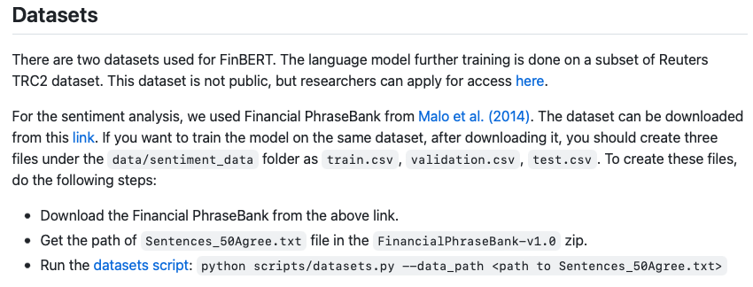
Data Research
III. Project Steps
News Data
FinBERT

Slide 14
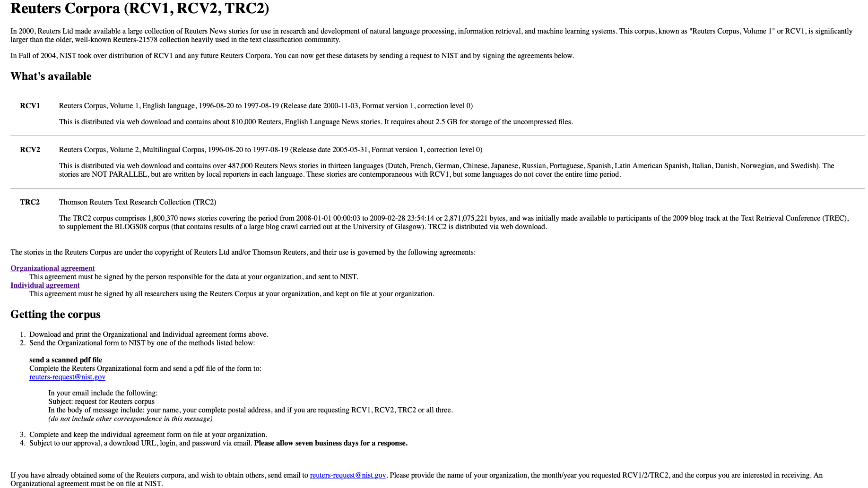
Data Research
III. Project Steps
News Data
Reuters Data Set

Slide 15
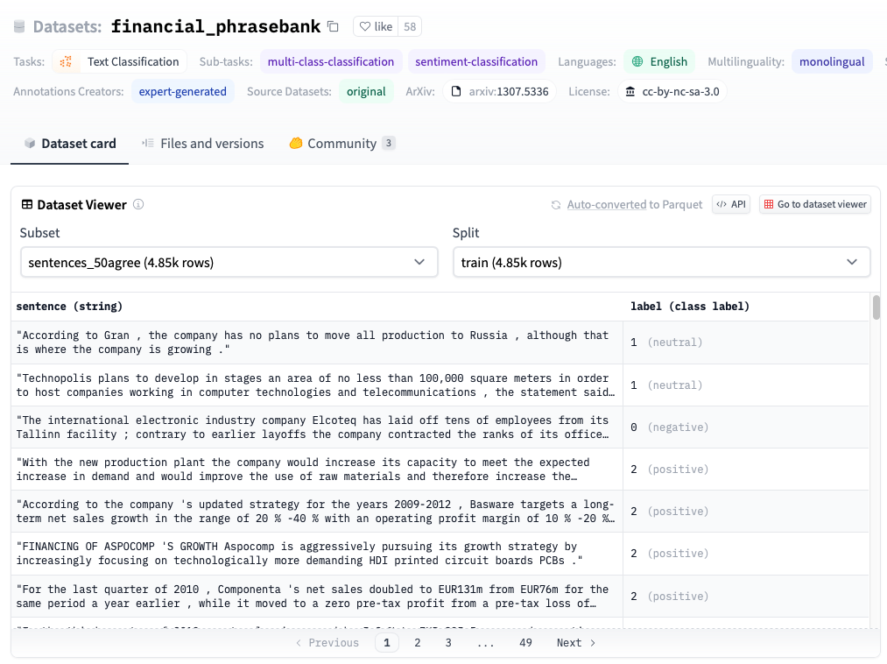
Data Research
III. Project Steps
News Data
FinPhrase Data Set
Categories
2: Positive
1: Neutral
0: Negative

Slide 16
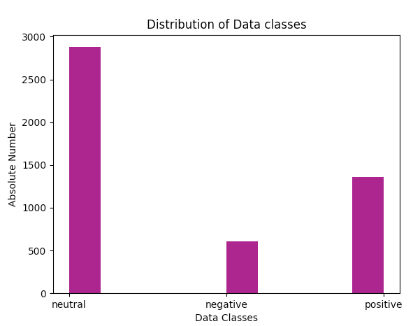
Data Research
III. Project Steps
News Data
FinPhrase Data Set
Categories
Positive: 1363 (28,1%)
Neutral: 2879 (59,4%)
Negative: 604 (12,5%)

Slide 17

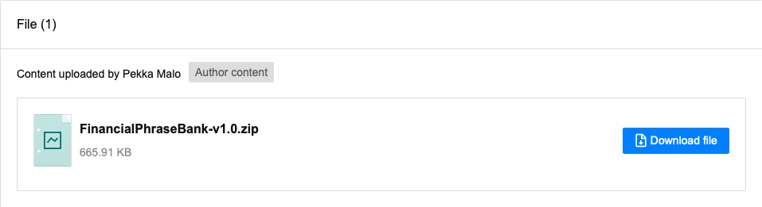
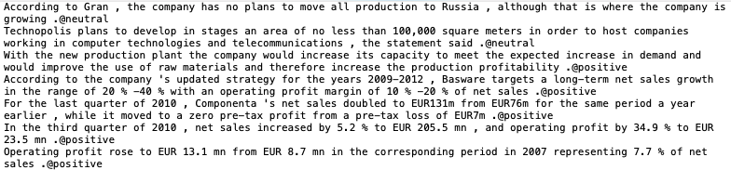
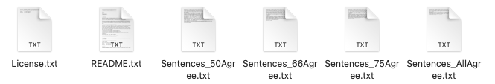
Data Research
III. Project Steps
News Data
FinPhrase Data Set

Slide 18

Data Research
III. Project Steps
News Data

Slide 19
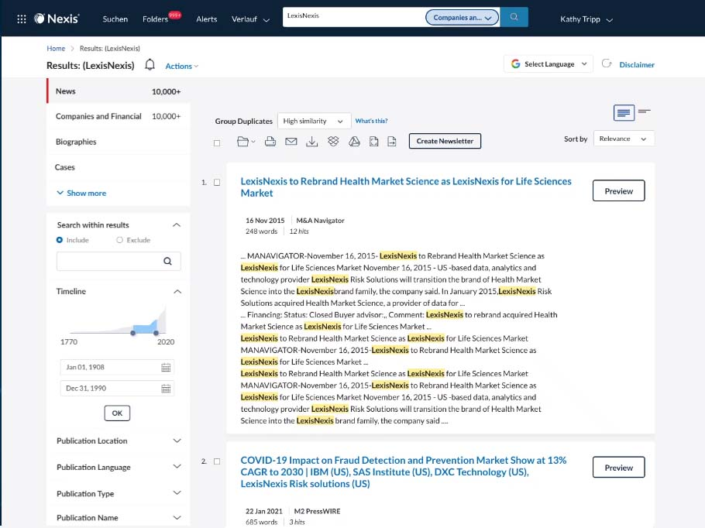
Data Research
III. Project Steps
News Data

Slide 20
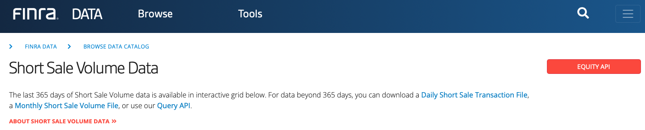
Data Research
III. Project Steps
Short Sale Data
FINRA Data Set

Slide 21
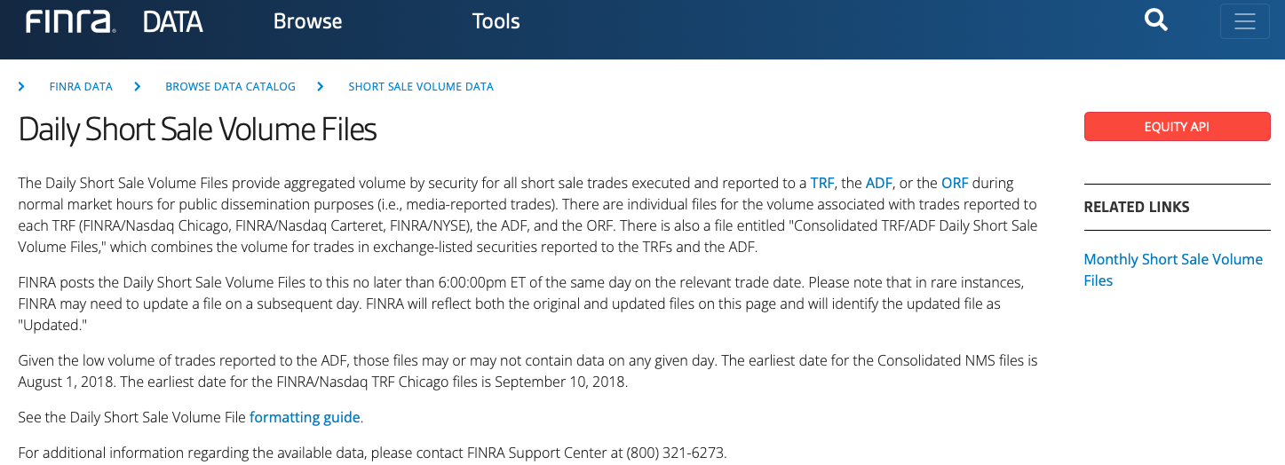
Data Research
III. Project Steps
Short Sale Data
FINRA Data Set

Slide 22
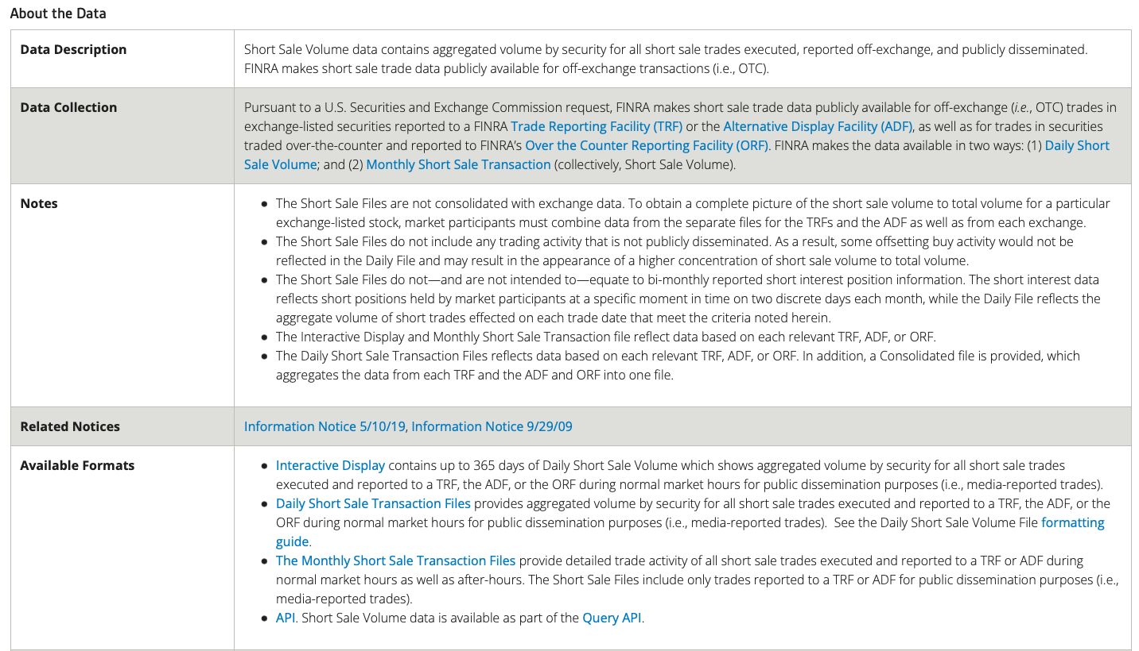
Data Research
III. Project Steps
Short Sale Data
FINRA Data Set

Slide 23
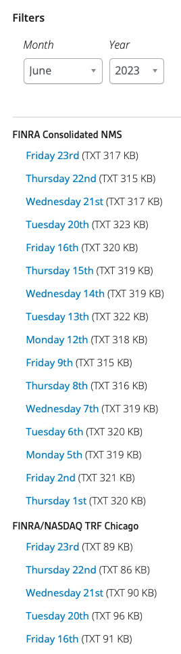
Data Research
Date range:
Jan 2010 – Jun 2023
III. Project Steps
Short Sale Data
12 Years, 6 Months:
(12 * 6) + 6 = 78 months
78 months * 21 days = 1638 single files for each reporting facility
FINRA Data Set
Reporting Market places:
Consolidated Numbers
NASDAQ TRF Chigaco
ADF
NASDAQ TRF Carteret
NYSE TRF
ORF

Slide 24
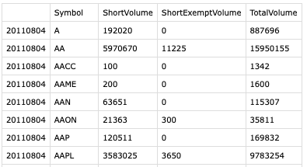
Data Research
III. Project Steps
Short Sale Data
Date (day)
Stock Ticker
Total Traded Volume on reporting Facility
FINRA Data Set

Slide 25
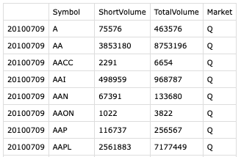
Data Research
III. Project Steps
Short Sale Data
Date (day)
Stock Ticker
Total Traded Volume on reporting Facility
FINRA Data Set

Slide 26
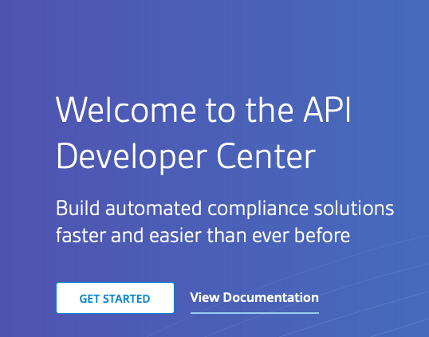
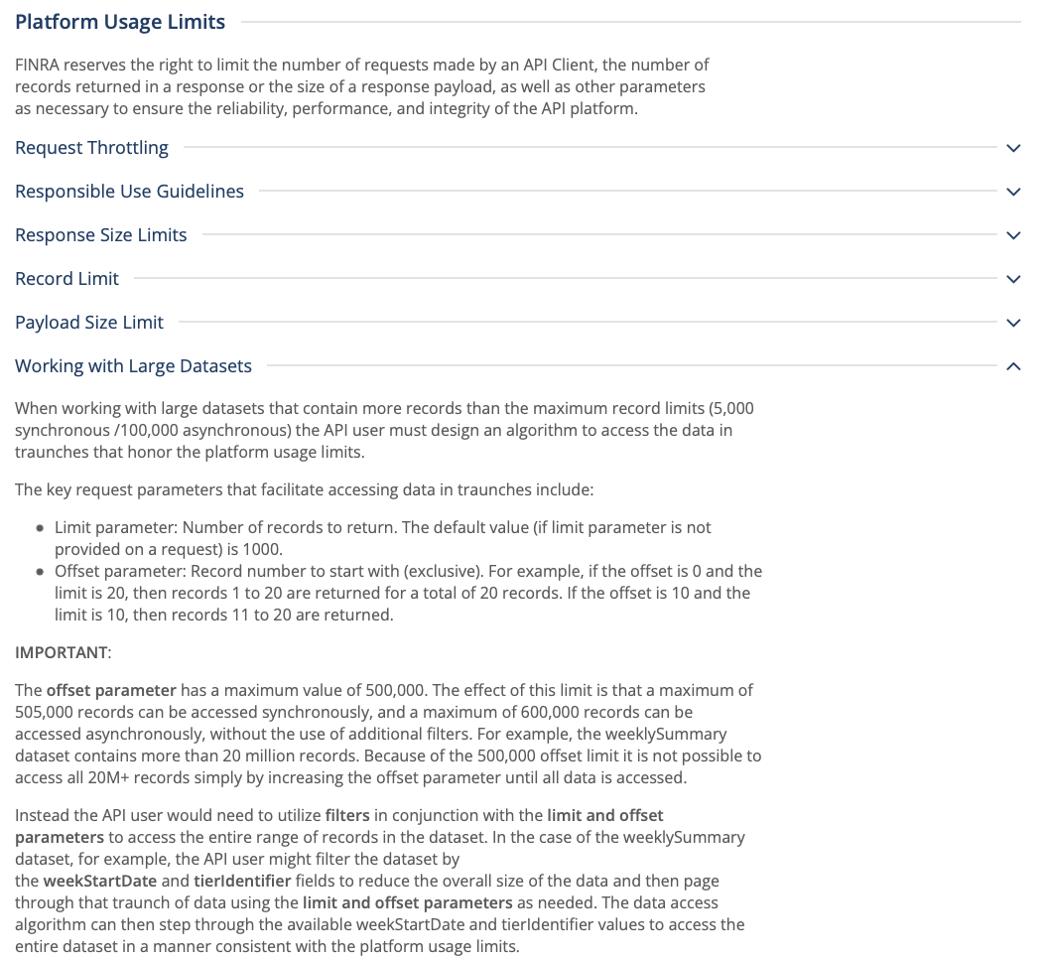
Data Research
III. Project Steps
Short Sale Data
FINRA Data Set

Slide 27
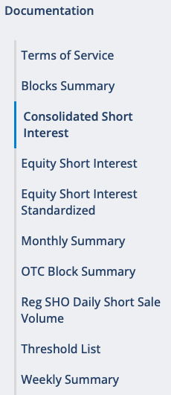
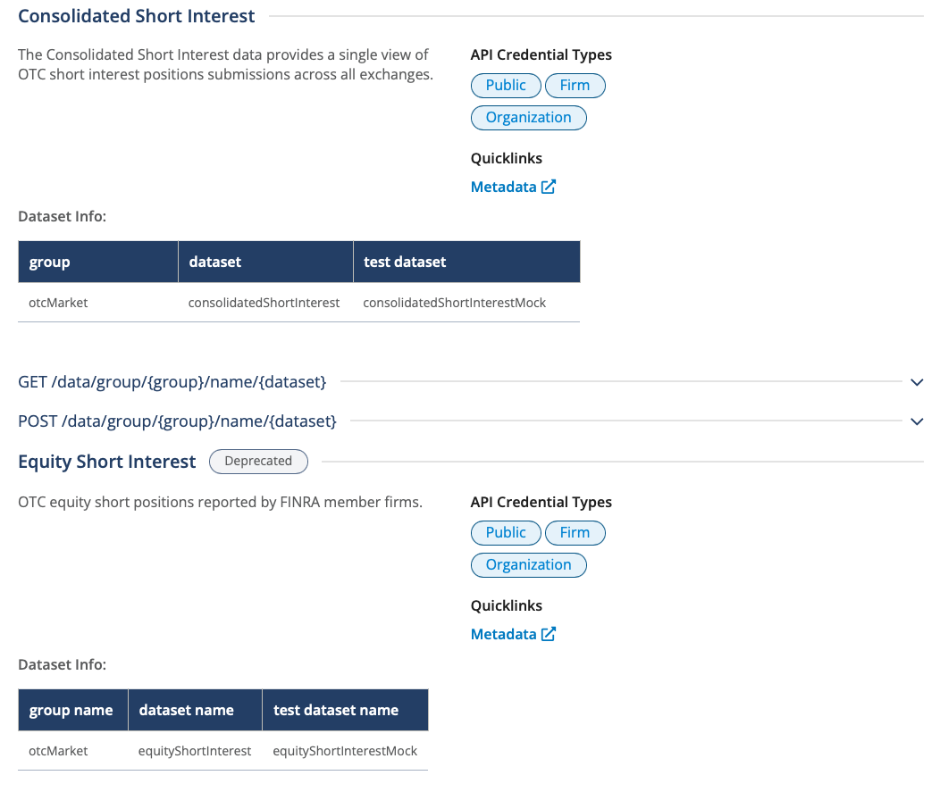
Data Research
III. Project Steps
Short Sale Data
FINRA Data Set

Slide 28
III. Project Steps
Data Aggregation
Bildquelle:
https://www.google.com/url?sa=i&url=https%3A%2F%2Fme2be.de%2Fhochschulen%2Fcau-christian-albrechts-universitaet-zu-kiel%2F&psig=AOvVaw3pyzL9cEIYeIjpIqHRPR5F&ust=1667135603618000&source=images&cd=vfe&ved=0CAoQjRxqFwoTCKDeyqLChfsCFQAAAAAdAAAAABAM

Slide 29
III. Project Steps
Data Research
Data Aggregation
Data Cleaning/Formatting
Data Selection
Model training
Model setup: NLP Classification
Data/Feature Engineering
Model optimization
Inference, Statistics and Robustness Tests

Slide 30

Data Aggregation
III. Project Steps
Short Sale Data

Slide 31
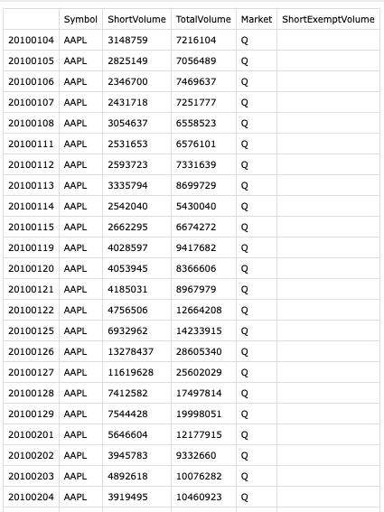

Data Aggregation
III. Project Steps
Short Sale Data

Slide 32
III. Project Steps
Model setup: NLP Classification
Bildquelle:
https://www.google.com/url?sa=i&url=https%3A%2F%2Fme2be.de%2Fhochschulen%2Fcau-christian-albrechts-universitaet-zu-kiel%2F&psig=AOvVaw3pyzL9cEIYeIjpIqHRPR5F&ust=1667135603618000&source=images&cd=vfe&ved=0CAoQjRxqFwoTCKDeyqLChfsCFQAAAAAdAAAAABAM

Slide 33
III. Project Steps
Data Research
Data Aggregation
Data Cleaning/Formatting
Data Selection
Model training
Model setup: NLP Classification
Data/Feature Engineering
Model optimization
Inference, Statistics and Robustness Tests

Slide 34
Model setup
III. Project Steps
NLP Classification
Develop the whole model on our own
Use a pretrained model and optimize it
Need of labeled dataset
No need of labeled dataset
Categorical labels (good, neutral, bad)
Numerical labels (good: 70-100, neutral: 40-60, bad: 0-40)
Tweak Model output to satisfy the needed numerical scale
Fin Phrase Dataset
Pretrained FinBert Model

Slide 35
Model setup
III. Project Steps
Pretrained FinBert Model
FinBERT

Slide 36
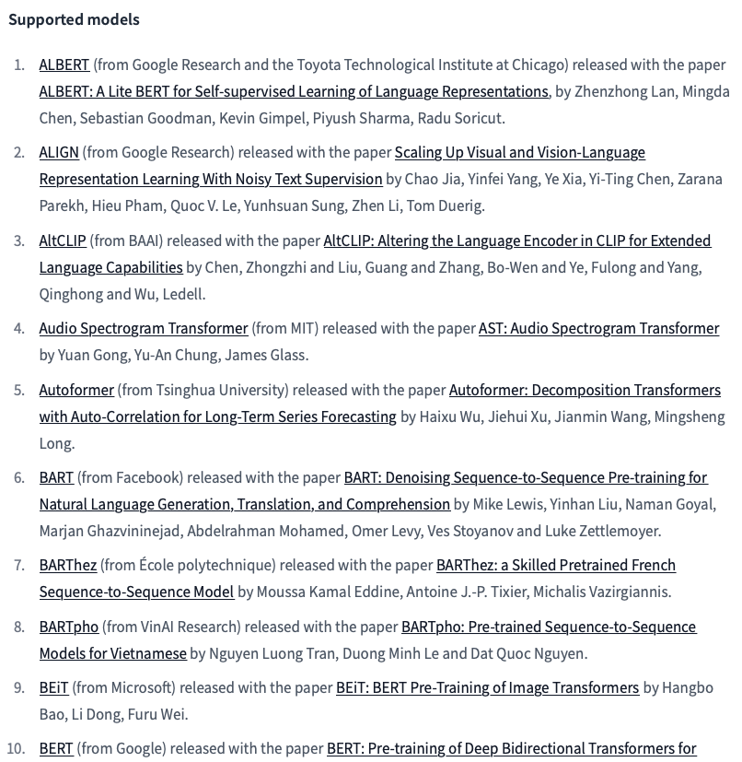
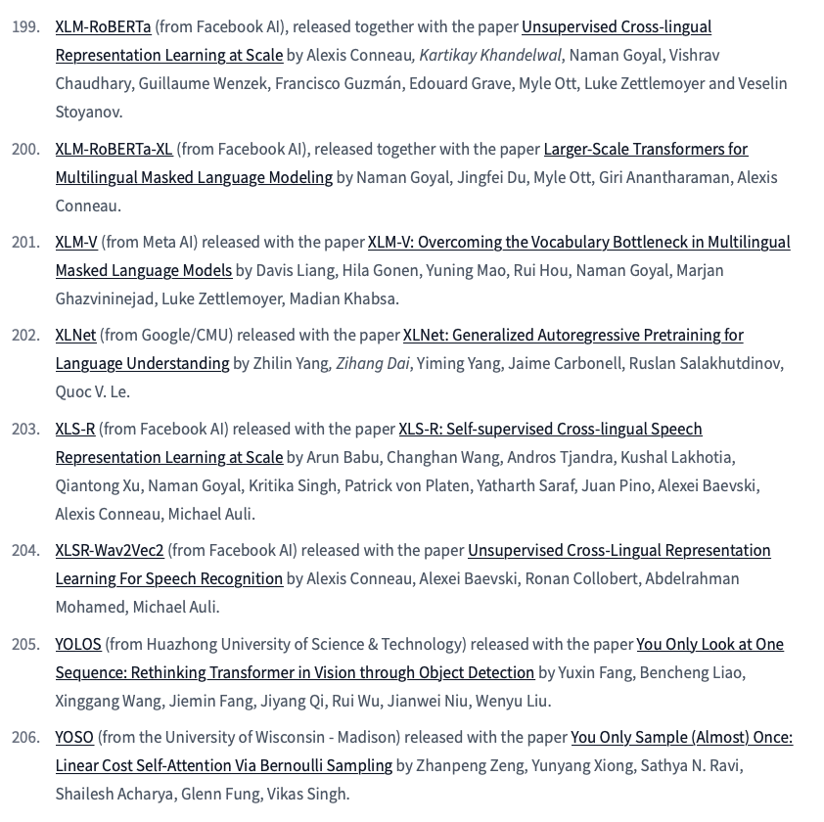
Model setup
III. Project Steps
Models

Slide 37
Model setup
III. Project Steps
Trained Models
Default Model
Self-trained on Fin Phrase Dataset
Tuned FinBert Model
Tuned BertBaseUnCased Model
Hugging Face Pipeline: distilbert-base-uncased-finetuned-sst-2-english
Hugging Face:
ProsusAI/finbert
Hugging Face:
bert-base-uncased
nlp_sentiment_model_pretrained_2.py
nlp_sentiment_model.py
nlp_sentiment_model_FinBert.py
nlp_sentiment_model_pretrained_1.py

Slide 38
III. Project Steps
Model training
Bildquelle:
https://www.google.com/url?sa=i&url=https%3A%2F%2Fme2be.de%2Fhochschulen%2Fcau-christian-albrechts-universitaet-zu-kiel%2F&psig=AOvVaw3pyzL9cEIYeIjpIqHRPR5F&ust=1667135603618000&source=images&cd=vfe&ved=0CAoQjRxqFwoTCKDeyqLChfsCFQAAAAAdAAAAABAM

Slide 39
III. Project Steps
Data Research
Data Aggregation
Data Cleaning/Formatting
Data Selection
Model training
Model setup: NLP Classification
Data/Feature Engineering
Model optimization
Inference, Statistics and Robustness Tests

Slide 40
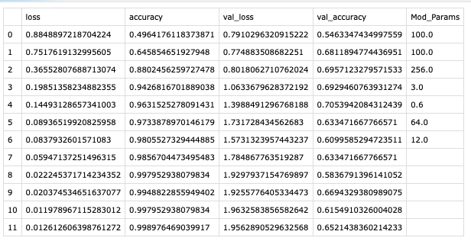

Model training
III. Project Steps
Self-trained on Fin Phrase Dataset

Slide 41
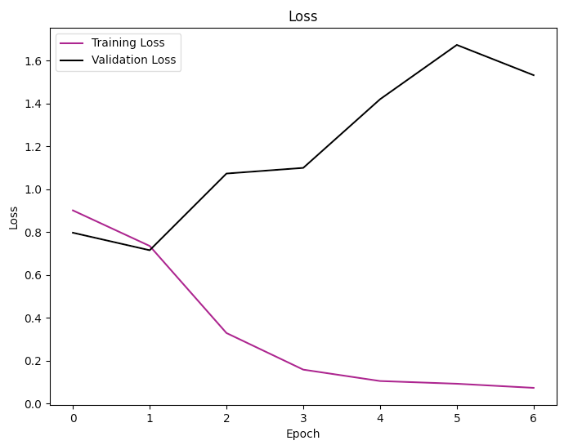
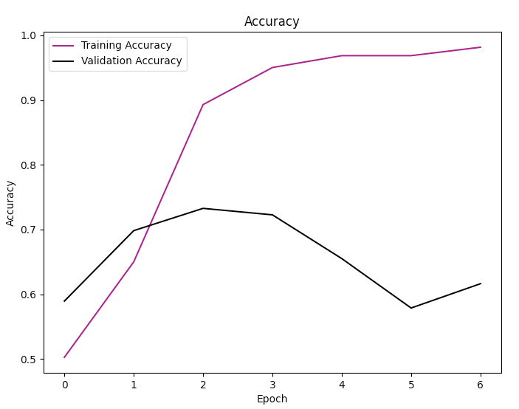
Model training
III. Project Steps
Self-trained on Fin Phrase Dataset
Hidden Dim: 256 Dropout: 0.6 Batch Size: 64. Epochs: 7

Slide 42
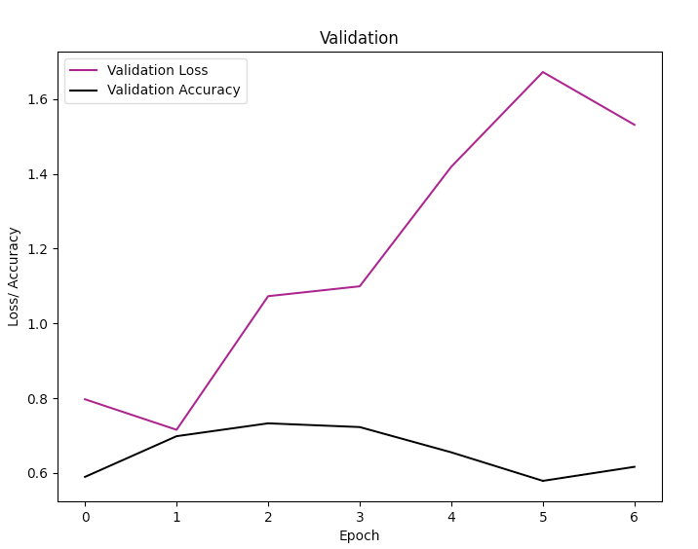
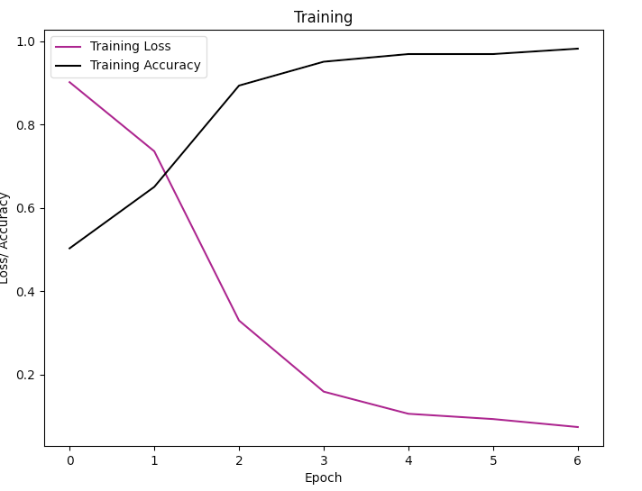
Model training
III. Project Steps
Self-trained on Fin Phrase Dataset
Hidden Dim: 256 Dropout: 0.2 Batch Size: 64. Epochs: 7

Slide 43
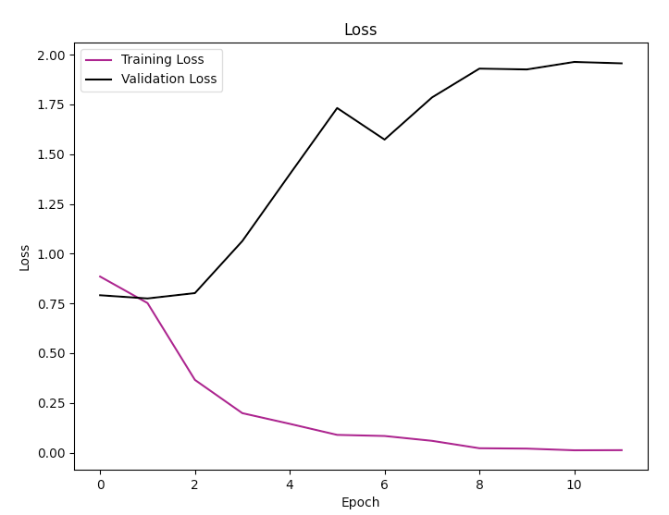
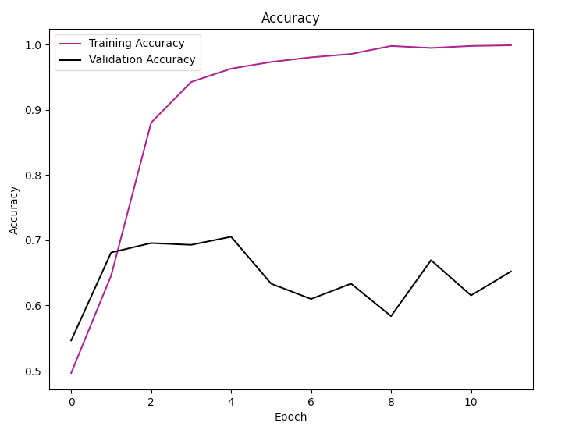
Model training
III. Project Steps
Self-trained on Fin Phrase Dataset
Hidden Dim: 256 Dropout: 0.6 Batch Size: 64. Epochs: 12

Slide 44
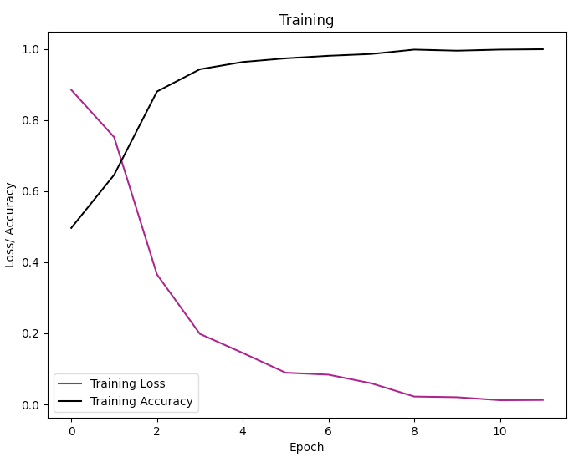
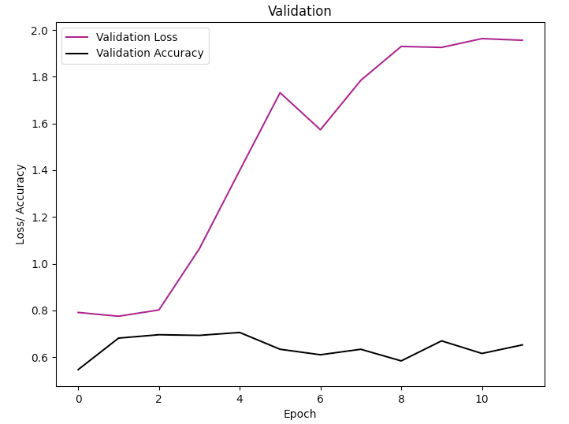
Model training
III. Project Steps
Self-trained on Fin Phrase Dataset
Hidden Dim: 256 Dropout: 0.6 Batch Size: 64. Epochs: 12

Slide 45
IV. Project Scope
To Dos
Bildquelle:
https://www.google.com/url?sa=i&url=https%3A%2F%2Fme2be.de%2Fhochschulen%2Fcau-christian-albrechts-universitaet-zu-kiel%2F&psig=AOvVaw3pyzL9cEIYeIjpIqHRPR5F&ust=1667135603618000&source=images&cd=vfe&ved=0CAoQjRxqFwoTCKDeyqLChfsCFQAAAAAdAAAAABAM

Slide 46
IV. Project Scope
Main Tasks:
Find granular data on short interest (for the German/US stock market)
Find appropriate news sources covering the respective companies (RSS Feeds, Google News)
-> LexisNexis
Create a news sentiment score (compare different available vocabularies, classification) from the categorical encoding of the models
Classify the articles as a whole
Evaluate Score from model over time – Compare different architectures
Tweak and optimize the model
Draw inferences and conduct statistical robustness tests

Slide 47
IV. Project Scope
Potential Problems:
Data availability – long enough continously ongoing time series on short interest
Media article – company matching
NLP Classification: Variations and Vocabularies, extensiveness of classification

Slide 48
V. Project Structure
Bildquelle:
https://www.google.com/url?sa=i&url=https%3A%2F%2Fme2be.de%2Fhochschulen%2Fcau-christian-albrechts-universitaet-zu-kiel%2F&psig=AOvVaw3pyzL9cEIYeIjpIqHRPR5F&ust=1667135603618000&source=images&cd=vfe&ved=0CAoQjRxqFwoTCKDeyqLChfsCFQAAAAAdAAAAABAM

Slide 49
V. Project Structure
/Project Folder/
exceptions.py
/Data/
/NLP_Model/
requirements.txt
get_data_short.py
nlp_sentiment_model.py
common_utils.py
get_data_news_articles.py
nlp_sentiment_model_pretrained_1.py
retrieve_data.py
nlp_sentiment_model_pretrained_1.py
secrets.yml
nlp_sentiment_model_FinBert.py
ReadMe.md
data_base.py
comp_classifier.py
/Summary/
/Raw_Data/
/Version_Control/
/GermanMarket/
Weights_ModelName
SentimentAnalysisOutline.pptx
/USMarket/
SentimentAnalysisFinal.pptx
/Text_Classification/
/Logs/
/Sentiment Index/
/News_Articles pdf/
sentiment_index.csv
/Log1_06062023_ModelName/
article_1.pdf
Mod_27-06-2023_13/41/25
article_2.pdf
/Literature/
/Short_Volume/
paper_1.pdf
01012020.csv
paper_2.pdf

Slide 50
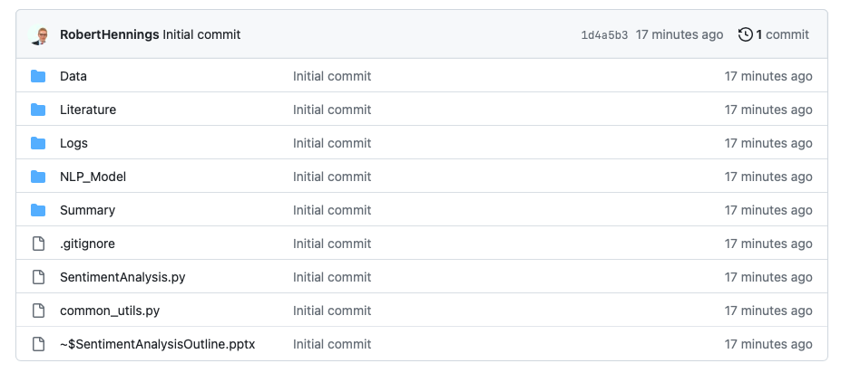
V. Project Structure
https://github.com/RobertHennings/OpenCampus_Sentiment_Project/tree/master

