Slide 1


Non-linear effects of energy commodities on the EUR/USD rate: An Oil and Gas Perspective on UIP.
Seminar in Applied Financial Economics by Professor Reitz
Josef Fella and Robert Hennings
Christian-Albrechts-University of Kiel
josef.fella@stu.uni-kiel.de and robert.hennings@stu.uni-kiel.de
GitHub: https://github.com/RobertHennings
Kiel - 14.11.2025

Slide 2
Outline
Modern Energy Commodites
Research Hypothesis
Literature
Theoretical Framework
Methodology Overview
Data
Results
Conclusion and Discussion.

Slide 3
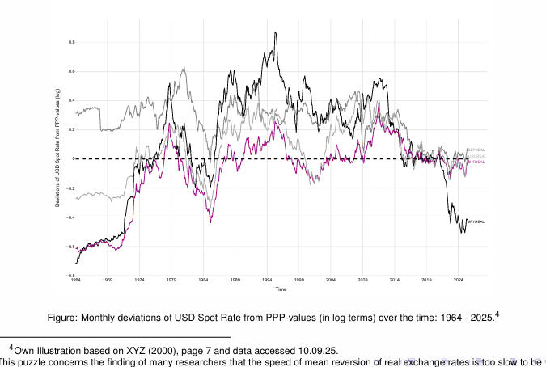


Recap: The PPP puzzle, Uncovered Interest Partity & Regime switching
Dynamic equilibrium condition of Uncovered Interest Parity (UIP):
$$E_{t}\left[∆s_{t+1}\right]=i_{t}−i_{t}^{∗}$$
With $∆s_{t+1}=α+β\left(i_{t}−i_{t}^{∗}\right)+ε_{t+1}$
Markov switching (Engel & Hamilton 1990)
$$− Regime1: μ_{1t}=α_{1t}+β_{1t}(i_{t−1}−i_{t−1}^{∗})$$
$$− Regime2: μ_{2t}=α_{2t}+β_{2t}(i_{t−1}−i_{t−1}^{∗})$$
But how about different cluserting and additional variables?
Notes:
´Mental recap:
PPP = On the Long-term prices and exchange rate are in an equilibrium (high price increase in foreign country = deacrease of exchange rate) → inflation mechanism; BUT empiric shows slow very convergence
UIP = A higher foreign interest rate implies an expected depreciation of the foreign currency.
In reality: UIP often fails due to risk premia, expectation errors, and the slow PPP adjustment → the UIP puzzle.
i = domestic rate, i* = foreign rate, st = spot exchange rate; kinda no-arbitrage here

Slide 4
Linkage between Energy Commodities and Exchange Rates
“This has led some to suggest that an unidentified real factor may be causing persistent shifts in real equilibrium exchange rates.”
~ R.A. Amano, S. van Norden1
“The long-run real exchange rate of these ‘commodity currencies’ is not constant (as would be implied by purchasing power parity-based models) but is time varying, being dependent on movements in the real price of commodity exports.”
~ P. Cashin, L. F. Cespedes, R. Sahay3
“This may in fact be the case or it is also possible that the relationship between exchange rates and oil shocks is non-linear and not being detected by a linear regression framework.”
~ S.A. Basher, A. A. Haug, P. Sadorsky2
1Oil prices and the rise and fall of the US real exchange rate, R.A. Amano, S. van Norden, Journal of International Money and Finance 17 (1998) 299-316, p.301
2The impact of oil shocks on exchange rates: A Markov-switching approach, S. A. Basher, A. A. Haug, P. Sadorsky, Energy Economics 54 (2016) 11–23, p.17
3Commodity currencies and the real exchange rate, P. Cashin, L. F. Cespedes, R. Sahay, Journal of Development Economics 75 (2004) 239–268, p.239

Slide 5
1. US Energy Commodity Market: Current state

Slide 6
Describes commodites used for energy production such as oil and gas.
For over 50% of US power production either resource where used. → Stong importance for US economy. (source: EIA 2024)
Due to „petrodollar“ oil with historical link to USD.
→ Idea: underlyine importance of Energy commodites and it‘s link to FX (especially oil)

Slide 7
2. Research Hypothesis

Slide 8
- Is there an energy commodity based influence of the (non-) profitability of the USD/EU spot rate uncovered interes parity? How significant is this effect?
How are different clustering algorithms lead to different regimes?
Are energy commodites improving the regression?

Slide 9
3. Literature Review

Slide 10
Context: Energy Commodities and Exchange rates
Energy prices have been a significant driver of inflation in recent years, particularly due to geopolitical tensions and supply chain disruptions.
The volatility in energy markets has led to increased costs for transportation, manufacturing, and household energy consumption.
Central banks face challenges in managing inflation expectations, while considering the transitory nature of energy price shocks.

Slide 11
Systematic Literature Overview: Main Approaches
The relationship between Energy Commodity Prices and exchange rates: Transmission channels¹
Datafrequency
Daily, Weely, Monthly
Monthly, Quarterly
Annually
Timeframe
Short Run Dynamics
Mid-term fluctuations
Relationship Type
Long Run Relationship
Financial Transmission Channels
Macroeconomic Transmission Channels
Fundamental Transmission Channels
Linear
Wealth Transfer Effect
(Risk Parity) Portfolio Rebalancing Effect
Monetary Policy
Present Value Approach
Inflation
Expectation Effects
Oil export and import
Denomination (Numeraire) Effect
Commodity Currencies
Dominant Pricing Effect
Non-Linear
Volatility and Risk Spillover Effects
(US) Terms of Trade Effect
Financialization Effects
Oil price shock affecting exchange rate through two channels (see impact of oil shocks Markov Switching)
Notes:
Sources:
1) Own illustration based on The relationship between oil prices and exchange rates: Revisiting theory and evidence
(Energy Economics 88 (2020) 104772), pages 3-8.

Slide 12
4. Theoretical Framework

Slide 13
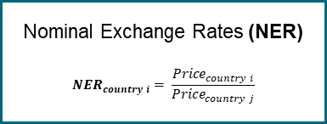
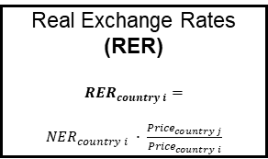
Prices and measurements, understanding the bigger picture
Nominal terms
Real terms
Nominal Exchange Rates (NER)
$${NER}_{country i}= \frac{{Price}_{country i}}{{Price}_{country j}}$$
Real Exchange Rates
(RER)
$${RER}_{country i}=$$
${NER}_{country i} ∙ \frac{{Price}_{country j}}{{Price}_{country i}}$
Price variables:
GDP deflator
Unit labor costs
Spot or Futures Markets (prices)
Consumer prices
Producer prices
Real exchange rates in external terms: CPI/PPI
Inflation/Relative Consumer Prices
Nominal Energy commodity prices
Export prices
Real exchange rates in internal terms/terms of trade: Ratio tradable and non-tradable goods
Spot or Futures Markets (prices)
Real Energy commodity prices

Slide 14
No. | Exchange Rate | Basket | Data Frequency | Data availability | Exchange Rate Type | Bilateral or Multilateral | Source | Data ID | Link
1 | Real effective exchange rate | broad | monthly | starting from 1994-01 | REER | Multilateral | BIS | M.R.B.US | https://data.bis.org/topics/EER/BIS,WS_EER,1.0/M.R.B.US
2 | Real effective exchange rate | narrow | monthly | starting from 1964-01 | REER | Multilateral | BIS | M.R.N.US | https://data.bis.org/topics/EER/BIS,WS_EER,1.0/M.R.N.US
3 | Nominal effective exchange rate | broad | monthly | starting from 1994-01 | NEER | Multilateral | BIS | M.N.B.US | https://data.bis.org/topics/EER/BIS,WS_EER,1.0/M.N.B.US
4 | Nominal effective exchange rate | narrow | monthly | starting from 1964-01 | NEER | Multilateral | BIS | M.N.N.US | https://data.bis.org/topics/EER/BIS,WS_EER,1.0/M.N.N.US
5 | Nominal effective exchange rate | narrow | daily | starting from 1983-10-03 | NEER | Multilateral | BIS | D.N.N.US | https://data.bis.org/topics/EER/BIS,WS_EER,1.0/D.N.N.US
6 | Nominal effective exchange rate | broad | daily | starting from 1996-04-11 | NEER | Multilateral | BIS | D.N.B.US | https://data.bis.org/topics/EER/BIS,WS_EER,1.0/D.N.B.US
7 | USD-EUR Spot Rate | - | daily | starting from 1999-01-04 | NER | Bilateral | FRED | DEXUSEU | https://fred.stlouisfed.org/series/DEXUSEU
8 | Nominal Broad U.S. Dollar Index | broad | daily | starting from 2006-01-02 | NEER | Multilateral | FRED | DTWEXBGS | https://fred.stlouisfed.org/series/DTWEXBGS
9 | Real Broad Dollar Index | broad | monthly | starting from 2006-01-01 | REER | Multilateral | FRED | RTWEXBGS | https://fred.stlouisfed.org/series/RTWEXBGS

Slide 15
Heavily affect importing and exporting economies
Fundamental
Shock
Adjusted Future Expectations for Demand-Supply Levels
(Spot) Price Adjustments
Increased
Volatility
Inflationary Pressure driving up prices
Monetary Policy:
Rate Hikes
Interest Rate Differentials
Parity Conditions
(PPP/UIP/CIP)
Derived proxy variables
Identify regimes
CBOE Crude Oil ETF Volatility Index
Crude Oil WTI Front Month Future Price
Crude Oil WTI Spot Price
Transmission depending on degree of financial integration
Open Interest in oil futures markets¹
Notes:
Sources:
https://www.bis.org/ifc/events/6ifcconf/takats_pres.pdf
https://data.bis.org/topics/EER

Slide 16
5. Methodology

Slide 17
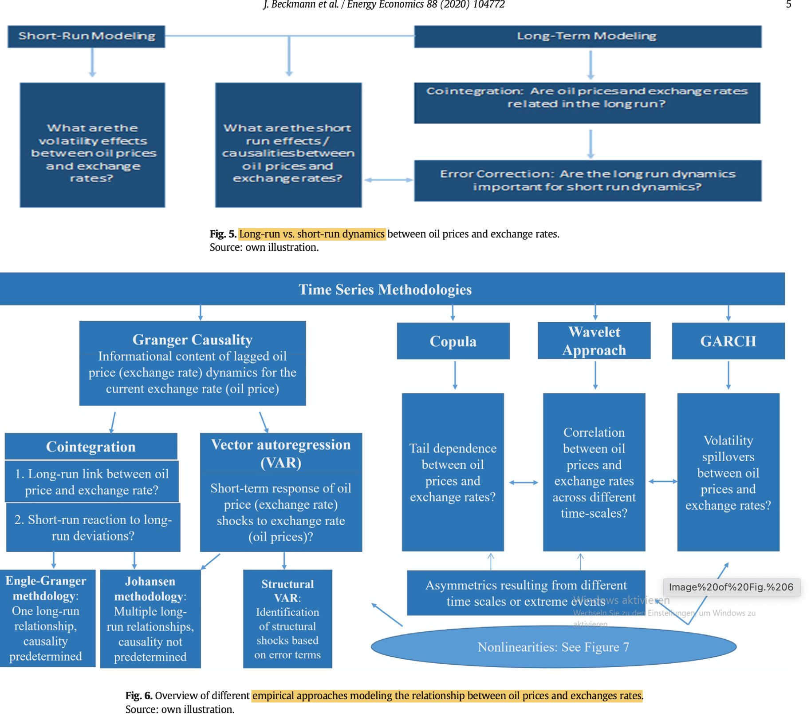
Overview data
Datafrequency
Daily, Weely, Monthly
Monthly, Quarterly
Annually
Timeframe
Short Run Dynamics
Mid-term fluctuations
Relationship Type
Long Run Relationship
Financial Transmission Channels
Macroeconomic Transmission Channels
Fundamental Transmission Channels
Linear
Wealth Transfer Effect
(Risk Parity) Portfolio Rebalancing Effect
Monetary Policy
DCC - GRACH
SVAR
Inflation
VAR
Expectation Effects
Oil export and import
Denomination Effect
Commodity Currencies
Dominant Pricing Effect
Non-Linear
Volatility and Risk Spillover Effects
(US) Terms of Trade Effect
Notes:
Sources:
Own illustration based on The relationship between oil prices and exchange rates: Revisiting theory and evidence
(Energy Economics 88 (2020) 104772), pages 3-8.

Slide 18
The relationship between Energy Commodity Prices and exchange rates: Econometric modelling
Relationship Type
Linear
Non-linear
Timeframe
Relationship
Correlation
When we find a certain relationship we can proceed further
Linear Pearson Correlation
Non-linear rank correlation
Granger-Causality
Rolling Correlation
ECM
Time-varying causality
Regime Switching
Clustering techniques
Markov-Switching
MS-VAR
DCC - GRACH
Long Run Relationship
SVAR
Cointegration
Connectedness
VAR
VECM
Vector Autoregression (VAR)
Notes:
Sources:
Own illustration based on The relationship between oil prices and exchange rates: Revisiting theory and evidence
(Energy Economics 88 (2020) 104772), pages 3-8.

Slide 19
5. Data and stylized facts

Slide 20
Stationary transformation

Slide 21
5. Data and stylized facts

Slide 23
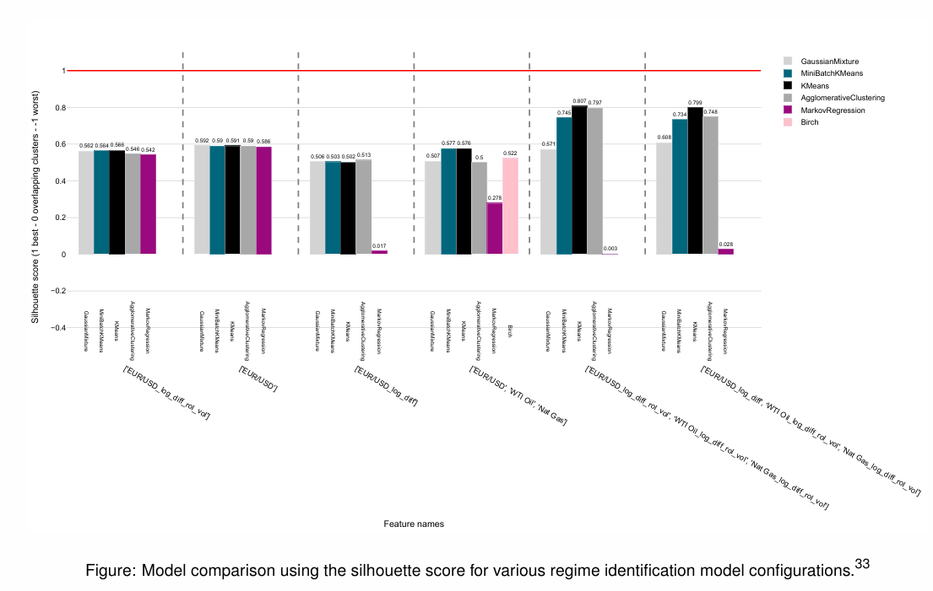
Model comparison and selection

Slide 24
...

