Slide 1
Plan Libraries for Rapid Replanning
Robert H. Holder, III
MAPLE Colloquium
Feb 26, 2010

Slide 2
Motivation
Reduce reaction time of real-time planners
Real-time planning problems
  Unmanned Vehicle Routing
  Mobile Sensor Scheduling
  Shipboard Computing Resource Allocation
  Wireless Sensor Network (WSN) Reconfiguration

Slide 3
Motivation
For planning problems in a real-time environment,
A plan library is a means of rapidly adapting to a new environment.
Hypothesis:
Plan Library: Problem space analysis can inform the efficient creation of a plan library.
Problem Space Analysis: A sampling of problem instances and their solutions can lend insight into the underlying structure of the domain.

Slide 4
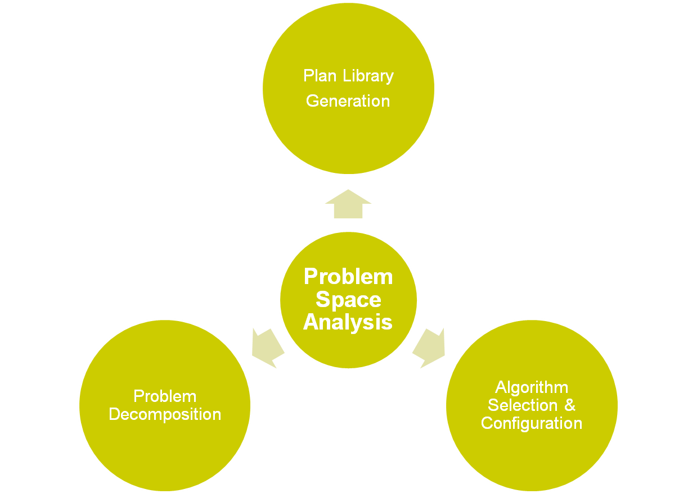
Motivation
Additional benefits of problem space analysis

Slide 5
Dynamic Vehicle Routing Problem
Three vehicles to visit twelve destinations

Slide 6
Dynamic Vehicle Routing Problem
Static solution for known destinations

Slide 7
Dynamic Vehicle Routing Problem
Consideration for potential additional destination
Notes:
Anything could happen. A vehicle could break down, a customer could cancel, or, as in this example, a new destination could become necessary

Slide 8
Dynamic Vehicle Routing Problem
X
X
X
Contingency solution for additional destination

Slide 9
Dynamic Vehicle Routing Problem
Implementation of contingency solution

Slide 10
Dynamic Vehicle Routing Problem
How to plan contingencies for arbitrary possibilities?

Slide 11
Traveling Salesperson Problem
4
2
1
3
Four fixed cities
Central starting point
Unknown fifth city

Slide 12
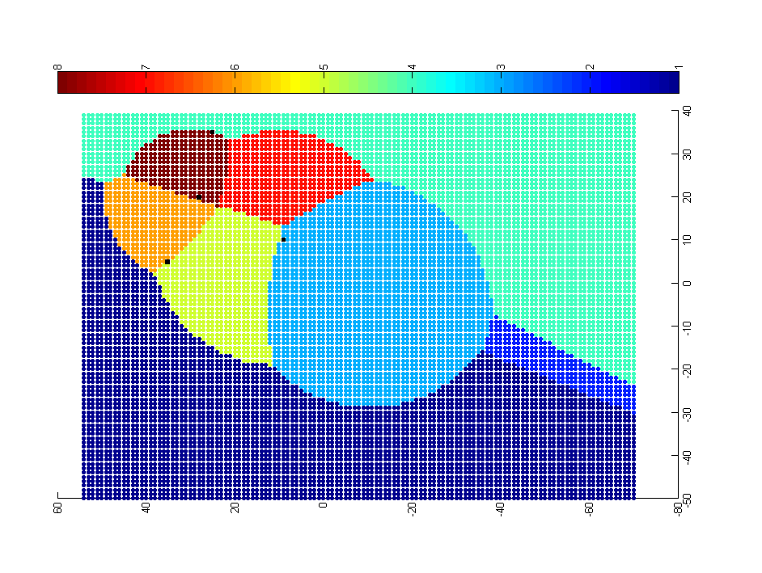
Approach:
Problem-Solution Map
4
0-1-3-2-5-4
0-1-5-4-2-3
0-1-3-2-4-5
2
1
0-1-3-5-2-4
3
0-1-5-3-2-4
0-5-1-3-2-4
0-3-2-4-1-5
0-1-4-2-3-5
Each point represents a potential location of the fifth city. The color of the point represents the optimal solution for the resulting 5-city TSP.

Slide 13
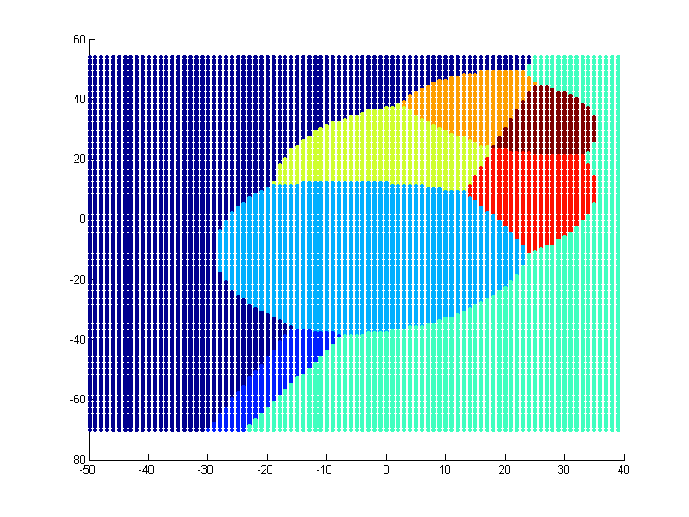
Map Generation
5-city TSP (1 unknown city)
  small problem with two degrees of freedom
  12k TSP instances
  naive solver
  fast runtime
5-city TSP (2 unknown cities)
  larger problem with four degrees of freedom
  311k TSP instances
  naive solver
  ~20 minutes runtime

Slide 14
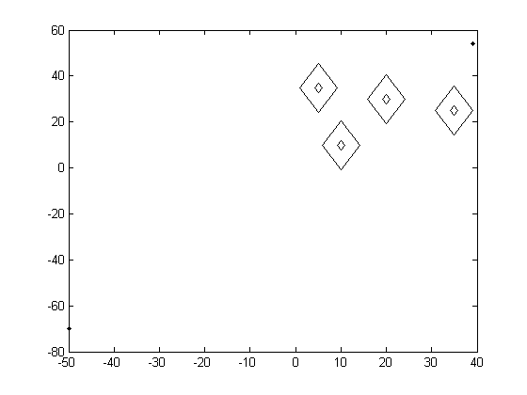
Map Generation
Initial view of solution space topology

Slide 15
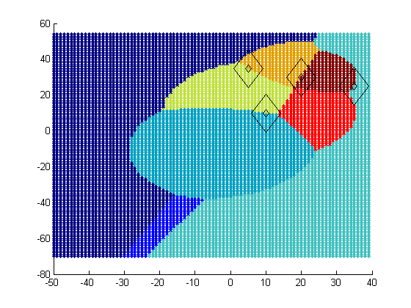
Map Generation
Ideal view of solution space topology

Slide 16
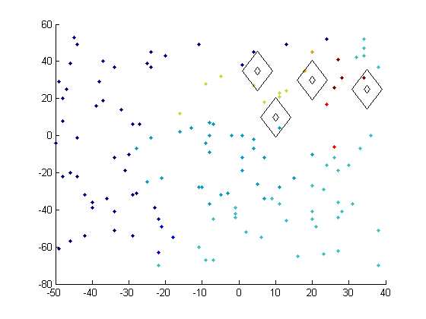
Map Generation
Preliminary experiment with random sampling and nearest neighbor classification

Slide 17
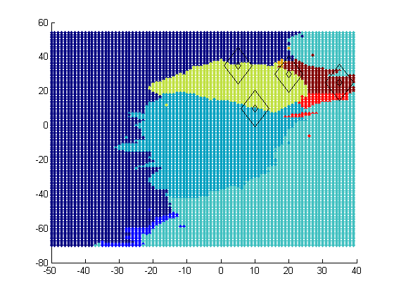
Map Generation
Ideal PS Map
Approximated PS Map
Preliminary experiment with random sampling and nearest neighbor classification

Slide 18
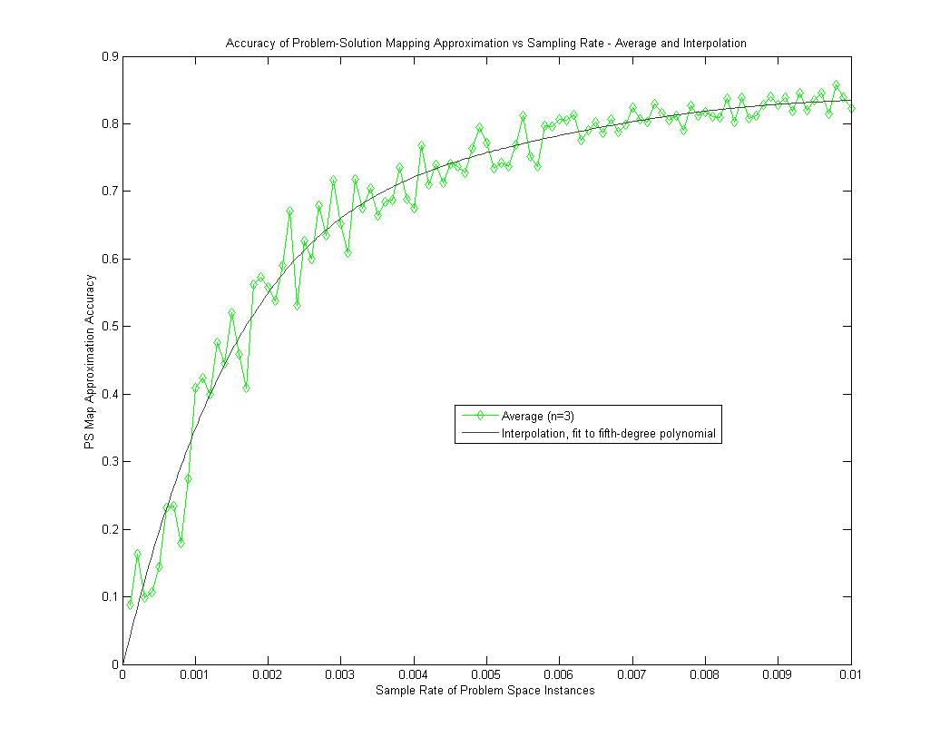
Map Generation
Preliminary experiment with random sampling and nearest neighbor classification demonstrates
75% accuracy from a 0.5% sample rate.

Slide 19
Domain-Based Hints
All the fixed points lie on regional boundaries

Slide 20
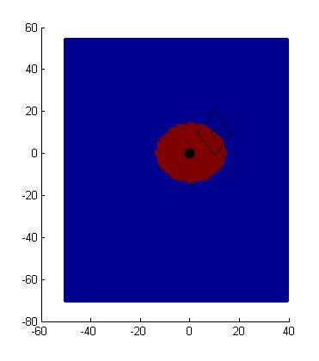
Solution Border Estimation
P1
P0 – P1 – Px
P0 – Px – P1
P0
Px?

Slide 21
Solution Border Estimation
P1
P0 – P1 – Px
P0 – Px – P1
P0
Px
dist(P0,P1) + dist(P1,Px) = dist(P0,Px) + dist(Px,P1)
dist(P0,P1) = dist(P0,Px)
dist(Px,P0) = C

Slide 22
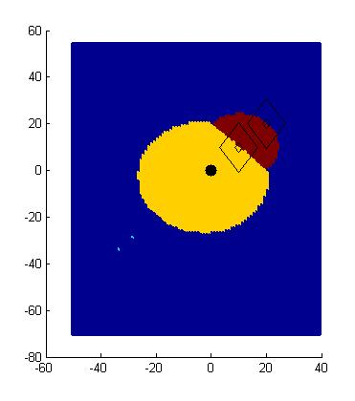
Solution Border Estimation
P0 – P1 – P2 – Px
P0 – P1 – Px – P2
P0 – P2 – P1 – Px
P0 – P2 – Px – P1
P0 – Px – P1 – P2
P0 – Px – P2 – P1
P2
P1
P0
Px?

Slide 23
Solution Border Estimation
P0 – P1 – P2 – Px
P0 – P1 – Px – P2
P0 – P2 – P1 – Px
P0 – P2 – Px – P1
P0 – Px – P1 – P2
P0 – Px – P2 – P1
P2
P1
P0
Px
dist(P0,P1) + dist(P1,P2) + dist(P2,Px) = dist(P0,P1) + dist(P1,Px) + dist(Px,P2)
dist(P1,P2) = dist(P1,Px)
dist(Px,P1) = C

Slide 24
Solution Border Estimation
P0 – P1 – P2 – Px
P0 – P1 – Px – P2
P0 – P2 – P1 – Px
P0 – P2 – Px – P1
P0 – Px – P1 – P2
P0 – Px – P2 – P1
P2
P1
P0
Px
dist(P0,P1) + dist(P1,Px) + dist(Px,P2) = dist(P0,Px) + dist(Px,P1) + dist(P1,P2)
dist(P0,P1) + dist(Px,P2) = dist(P0,Px) +dist(P1,P2)
dist(Px,P2) = dist(Px,P0) + C

Slide 25
Solution Border Estimation
P0 – P1 – P2 – Px
P0 – P1 – Px – P2
P0 – P2 – P1 – Px
P0 – P2 – Px – P1
P0 – Px – P1 – P2
P0 – Px – P2 – P1
P2
P1
P0
Px
dist(P0,P1) + dist(P1,P2) + dist(P2,Px) = dist(P0,Px) + dist(Px,P1) + dist(P1,P2)
dist(P0,P1) + dist(P2,Px) = dist(P0,Px) + dist(P1,Px)
ugly

Slide 26
Solution Border Estimation
P0 – P1 – P2 – Px
P0 – P1 – Px – P2
P0 – P2 – P1 – Px
P0 – P2 – Px – P1
P0 – Px – P1 – P2
P0 – Px – P2 – P1

Slide 27
Experiment
DTSPs of 5, 10, 20, 50, and 100 cities
90 x 90 grid
3 instances of each
Brute force generation of ideal PS Maps
SBE generation
Sample rates ranging from 10 to 1000 samples per 100K
10 runs per instance and sample rate pair

Slide 28
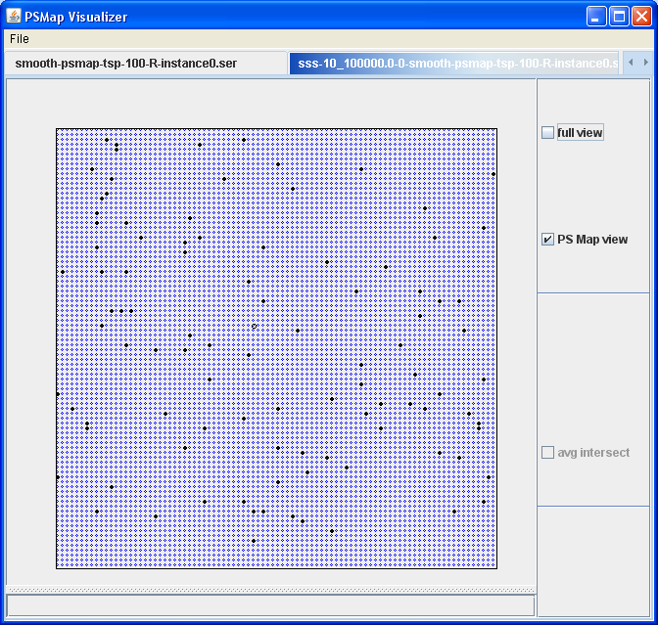

Sample rate 10/100K

Slide 29
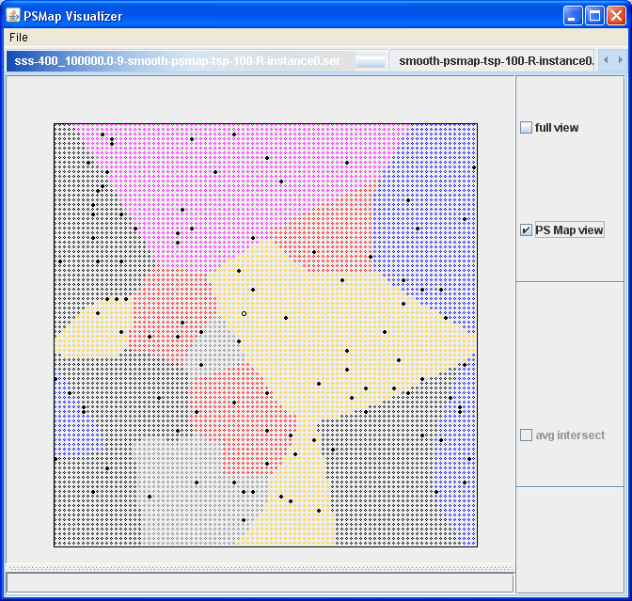
Sample rate 400/100K (.004)

Slide 30
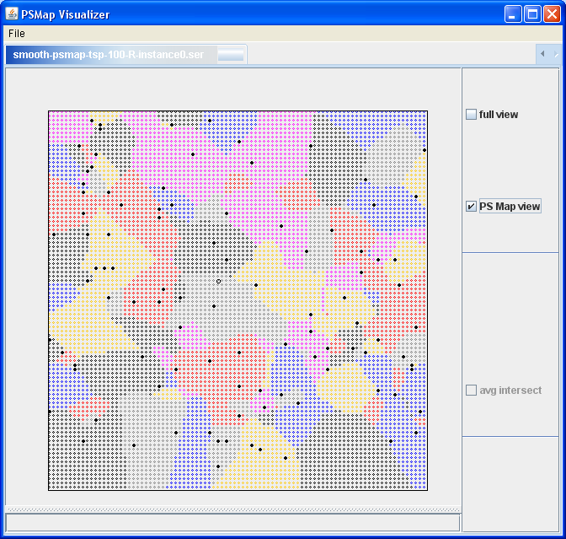
Ideal Map

Slide 31
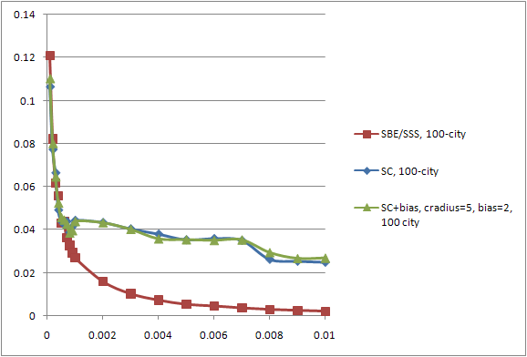

Slide 32
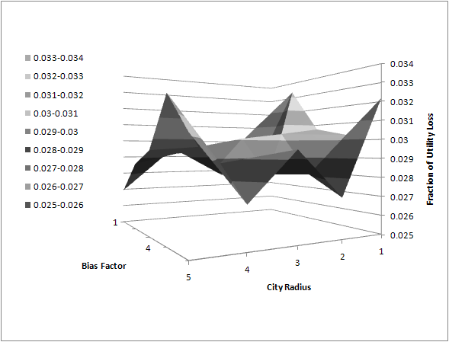
Notes:
SC+bias for 100 city TSP at .005 sample rate. Fraction utility loss for SC for 100 city TSP at .005 sample rate of ~0.032

Slide 33
Results
Accurate with low sample rate
Relies on ability to find representatives for each solution
Unexpected benefits
  because we can mathematically show that certain problem instances MUST have the same solution, we can find noise in the solver (led to smoothing technique)

Slide 34
Open questions
Is there a better way to do this?
Can this be applied to domains with higher dimensionality?
How to sample most efficiently such that
  a sample has a high chance of discovering a new solution
    is there utility in addl samples? where do we sample?
  the solution that is discovered has a high chance in increasing the accuracy of the approximation
    the solution has a large region

Slide 35
Next steps – try on something real!
Application relevance
  dynamic, real time systems
  event reaction time is less than planning time
  time available to strategize between event
Examples
  Distributed systems with little or no communication
  Uncertainty in results of action
  Decide when to decide
Concrete
  WSN
  Flow tubes

Slide 36
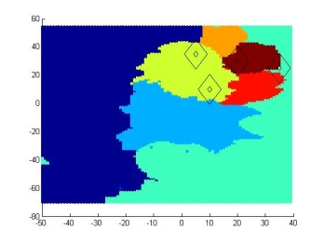

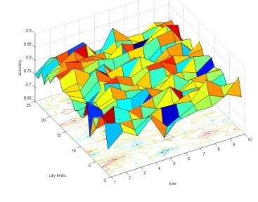
Summary
Basic
Sampling
Smart
Sampling
Border
Estimation
Motivation
Approach

Slide 37
Backup

Slide 38

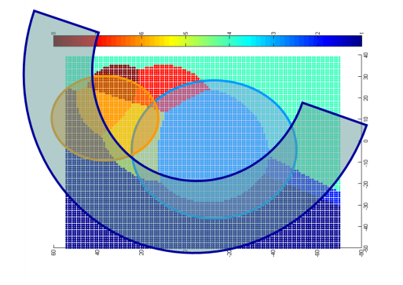
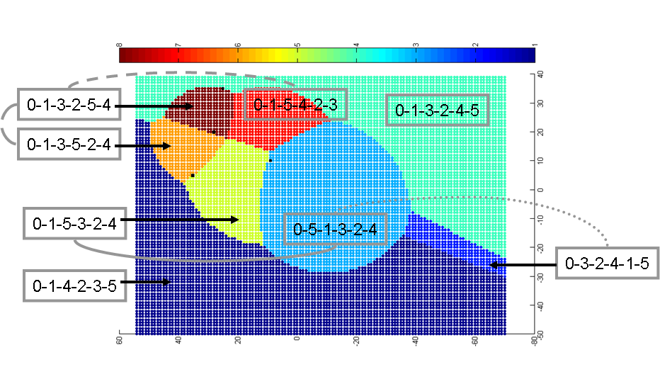
Thank you
Questions…
Suggestions…
Comments…

