Slide 1
Rapid Replanning in Dynamic Environments
Robert Holder
University of Maryland Baltimore County

Slide 2
Dynamic Vehicle Routing Problem
Three vehicles to visit twelve destinations

Slide 3
Dynamic Vehicle Routing Problem
Static solution for known destinations

Slide 4
Dynamic Vehicle Routing Problem
Consideration for potential additional destination
Notes:
Anything could happen. A vehicle could break down, a customer could cancel, or, as in this example, a new destination could become necessary

Slide 5
Dynamic Vehicle Routing Problem
X
X
X
Contingency solution for additional destination

Slide 6
Dynamic Vehicle Routing Problem
Implementation of contingency solution

Slide 7
Dynamic Vehicle Routing Problem
How to plan contingencies for arbitrary possibilities?

Slide 8
Traveling Salesperson Problem
4
2
1
3
Four fixed cities
Central starting point
Unknown fifth city

Slide 9
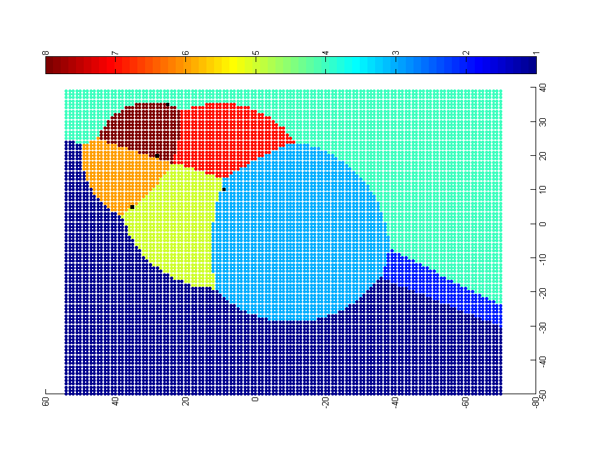
Approach: Problem-Solution Map
4
0-1-3-2-5-4
0-1-5-4-2-3
0-1-3-2-4-5
2
1
0-1-3-5-2-4
3
0-1-5-3-2-4
0-5-1-3-2-4
0-3-2-4-1-5
0-1-4-2-3-5
Each point represents a potential location of the fifth city. The color of the point represents the optimal solution for the resulting 5-city TSP.

Slide 10
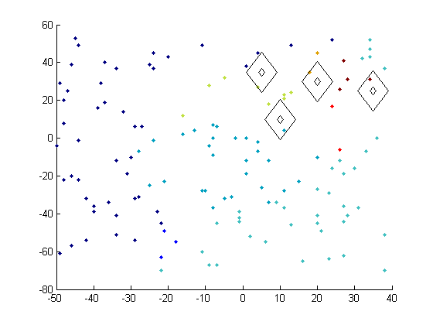
Map Generation – Sampling & Classification
Preliminary experiment with random sampling and nearest neighbor classification

Slide 11
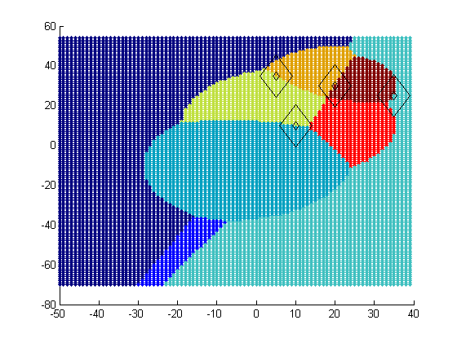
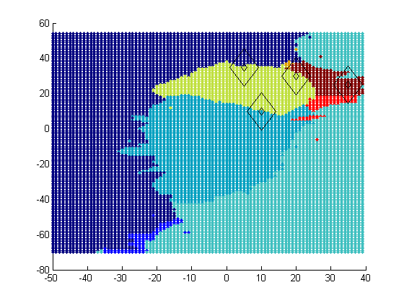
Map Generation – Sampling & Classification
Ideal PS Map
Approximated PS Map
Preliminary experiment with random sampling and nearest neighbor classification

Slide 12
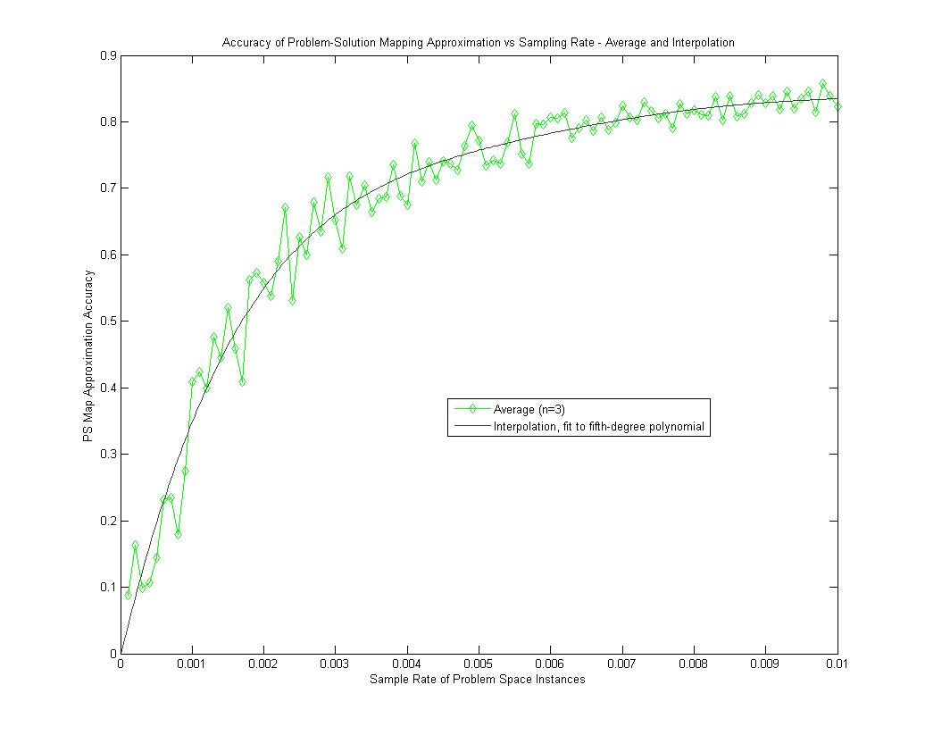
Map Generation
Preliminary experiment with random sampling and nearest neighbor classification demonstrates
75% accuracy from a 0.5% sample rate.

Slide 13

Ideal PS Map – Knapsack problem initial slack = 4 dag, new item’s weight and value vary from 1 to 100
1,1
weight
Solutions that do not include the new item
value

Slide 14
Map generation technique comparison
fraction of utility loss from optimal
typical utility loss by online plan repair strategies
sample rate

