Slide 1
Extending Solution Border Estimation
MAPLE Lab meeting
16 Feb 2011

Slide 2
Preplanned libraries as alternative to traditional online plan repair
Leverage larger amount of offline time to save small amount of online time.

Slide 3
Dynamic Vehicle Routing Problem
Three vehicles to visit twelve destinations

Slide 4
Dynamic Vehicle Routing Problem
Static solution for known destinations

Slide 5
Dynamic Vehicle Routing Problem
Consideration for potential additional destination
Notes:
Anything could happen. A vehicle could break down, a customer could cancel, or, as in this example, a new destination could become necessary

Slide 6
Dynamic Vehicle Routing Problem
X
X
X
Contingency solution for additional destination

Slide 7
Dynamic Vehicle Routing Problem
Implementation of contingency solution

Slide 8
Dynamic Vehicle Routing Problem
How to plan contingencies for arbitrary possibilities?

Slide 9
Traveling Salesperson Problem
4
2
1
3
Four fixed cities
Central starting point
Unknown fifth city

Slide 10
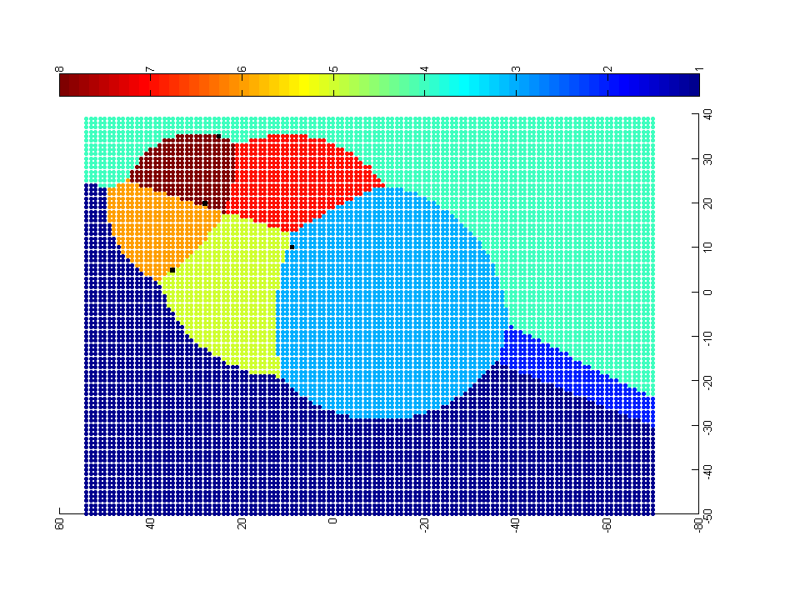
Approach: Problem-Solution Map
4
0-1-3-2-5-4
0-1-5-4-2-3
0-1-3-2-4-5
2
1
0-1-3-5-2-4
3
0-1-5-3-2-4
0-5-1-3-2-4
0-3-2-4-1-5
0-1-4-2-3-5
Each point represents a potential location of the fifth city. The color of the point represents the optimal solution for the resulting 5-city TSP.

Slide 11
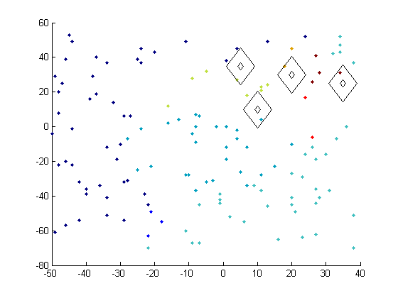
Map Generation – Sampling & Classification
Preliminary experiment with random sampling and nearest neighbor classification

Slide 12
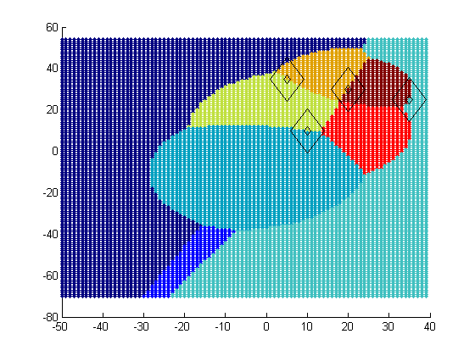
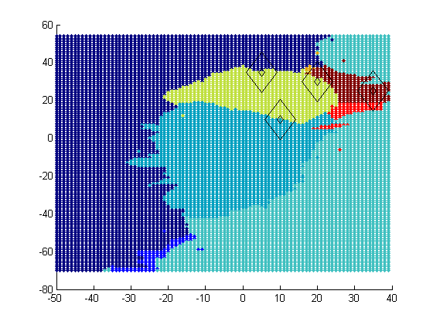
Map Generation – Sampling & Classification
Ideal PS Map
Approximated PS Map
Preliminary experiment with random sampling and nearest neighbor classification

Slide 13
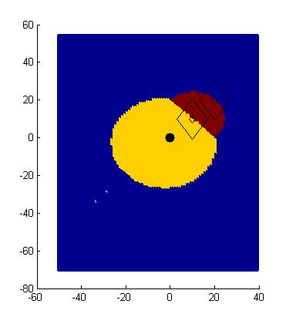
Map Generation- Solution Border Estimation
P0 – P1 – P2 – Px
P0 – P1 – Px – P2
P0 – P2 – P1 – Px
P0 – P2 – Px – P1
P0 – Px – P1 – P2
P0 – Px – P2 – P1
P2
P1
P0
Px
dist(P0,P1) + dist(P1,Px) + dist(Px,P2) = dist(P0,Px) + dist(Px,P1) + dist(P1,P2)
dist(P0,P1) + dist(Px,P2) = dist(P0,Px) +dist(P1,P2)
dist(Px,P2) = dist(Px,P0) + C

Slide 14
Map Generation- Solution Border Estimation
P0 – P1 – P2 – Px
P0 – P1 – Px – P2
P0 – P2 – P1 – Px
P0 – P2 – Px – P1
P0 – Px – P1 – P2
P0 – Px – P2 – P1
P2
P1
P0
Px
dist(P0,P1) + dist(P1,P2) + dist(P2,Px) = dist(P0,Px) + dist(Px,P1) + dist(P1,P2)
dist(P0,P1) + dist(P2,Px) = dist(P0,Px) + dist(P1,Px)
ugly

Slide 15
Map Generation – Solution Border Estimation
P0 – P1 – P2 – Px
P0 – P1 – Px – P2
P0 – P2 – P1 – Px
P0 – P2 – Px – P1
P0 – Px – P1 – P2
P0 – Px – P2 – P1

Slide 16
SBE Implementation
Unfortunately, solving the equations is not trivial
Developed a ‘border tracing’ approach
sample problem instances to find representatives of solutions in the space
for each pair combination
find a problem instance on the boundary using binary search
trace the solution border from the boundary point
for each border intersection
find region to fill in by sending rays in each direction
fill region using fill algorithm

Slide 17
SBE – two solution representatives

Slide 18
SBE – binary search to find border

Slide 19
SBE – binary search to find border
?
?
?

Slide 20
SBE – binary search to find border
?
?
?

Slide 21
SBE – binary search to find border

Slide 22
SBE – binary search to find border
?
?
?
?

Slide 23
SBE – tracing red/blue solution border

Slide 24
SBE – found red/blue solution border

Slide 25
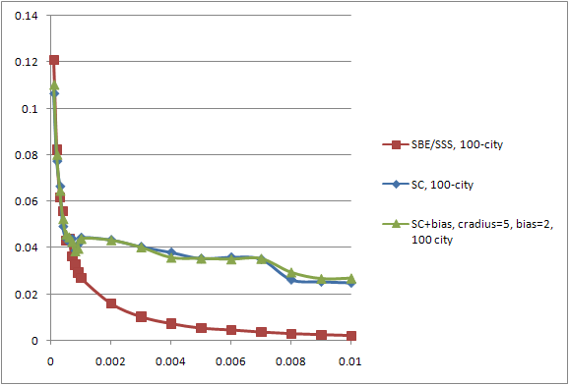
Map generation technique comparison
fraction of utility loss vs optimal
typical loss by online plan repair strategies
sample rate

Slide 26
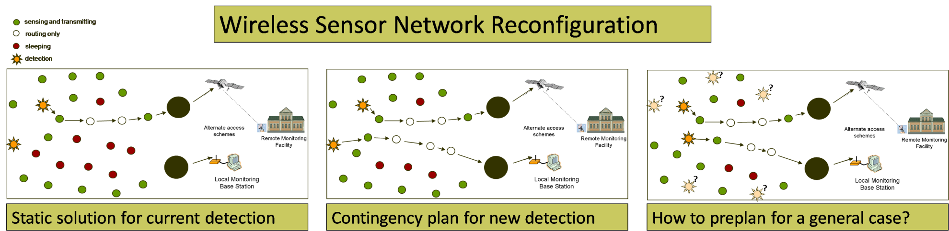
Next steps – Wireless Sensor Network
Plan: {1->2, 2->5, 3->0, 5->3}
Dimensions of problem space: {sensor energy, target location}

Slide 27
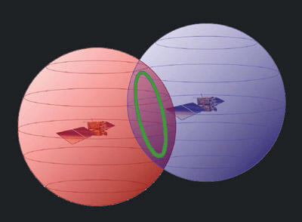
Next steps – Extend to higher dimensions

