Slide 1
Actively Classifying Traveling Salesmen with Knapsacks
MAPLE Lab meeting
Robert Holder
20 Sept 2011

Slide 2
Overview
Motivation
Reduce reaction time of real-time planners to changes in the environment
Approach
Preplanned libraries as alternative to traditional online plan repair
Leverage larger amount of offline time to save small amount of online time.

Slide 3
Overview (2)
Examples
Computing Resource Allocation
Mobile Sensor Scheduling
Vehicle Routing
Wireless Sensor Network Reconfiguration

Slide 4
Dynamic Vehicle Routing Problem
Three vehicles to visit twelve destinations

Slide 5
Dynamic Vehicle Routing Problem
Static solution for known destinations

Slide 6
Dynamic Vehicle Routing Problem
Consideration for potential additional destination
Notes:
Anything could happen. A vehicle could break down, a customer could cancel, or, as in this example, a new destination could become necessary

Slide 7
Dynamic Vehicle Routing Problem
X
X
X
Contingency solution for additional destination

Slide 8
Dynamic Vehicle Routing Problem
Implementation of contingency solution

Slide 9
Dynamic Vehicle Routing Problem
How to plan contingencies for arbitrary possibilities?

Slide 10
Traveling Salesperson Problem
4
2
1
3
Four fixed cities
Central starting point
Unknown fifth city

Slide 11
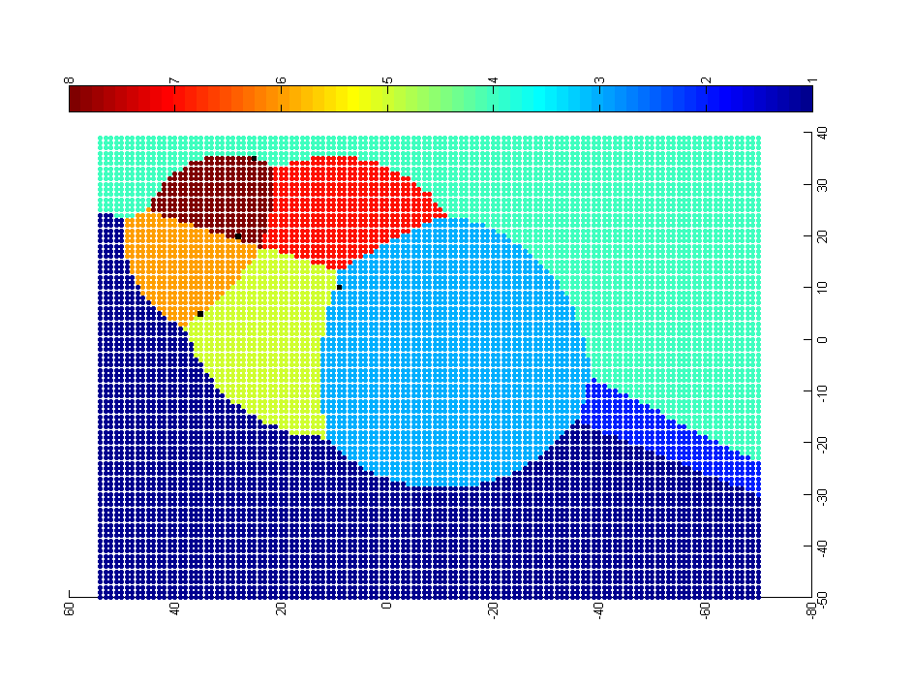
Approach: Problem-Solution Map
4
0-1-3-2-5-4
0-1-5-4-2-3
0-1-3-2-4-5
2
1
0-1-3-5-2-4
3
0-1-5-3-2-4
0-5-1-3-2-4
0-3-2-4-1-5
0-1-4-2-3-5
Each point represents a potential location of the fifth city. The color of the point represents the optimal solution for the resulting 5-city TSP.

Slide 12
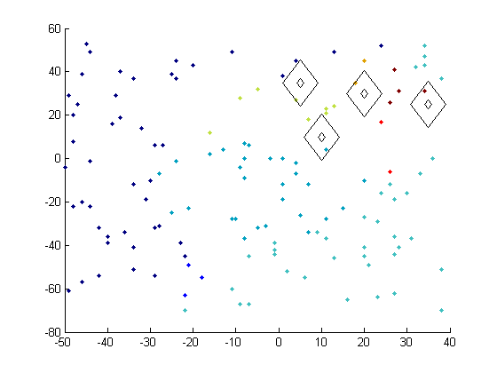
Map Generation – Sampling & Classification
Preliminary experiment with random sampling and nearest neighbor classification

Slide 13
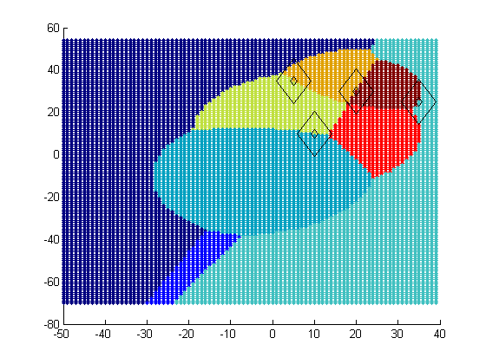
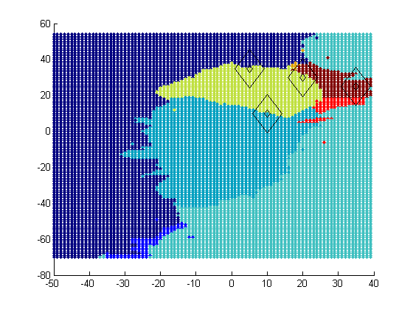
Map Generation – Sampling & Classification
Ideal PS Map
Approximated PS Map
Preliminary experiment with random sampling and nearest neighbor classification

Slide 14
Sampling & Classification + Active Learning
Determine eventual number of samples
n = sample_rate * total_instances
Create initial sample of solutions of size
n_{i} = alpha * n
For each unknown sample
if polling results in unambiguous result, keep approximate result
else if total samples < n, generate exact solution

Slide 15
Sampling & Classification + Active Learning
ambiguous
landslide
unanimous

Slide 16
Map generation technique comparison
fraction of utility loss from optimal
typical utility loss by online plan repair strategies
sample rate

Slide 17
Knapsack problem
Given a set of objects, maximize the value of the objects chosen while staying within the weight limit
Total available weight: 400 dekagrams (dag) = 4 kg
Base solution occupies 396 dag
New item varies in weight and value from 1 to 100

Slide 18

Ideal PS Map – Knapsack problem initial slack = 4 dag, new item’s weight and value vary from 1 to 100
1,1
weight
value

Slide 19
typical utility loss by online plan repair strategies = .006

Slide 20
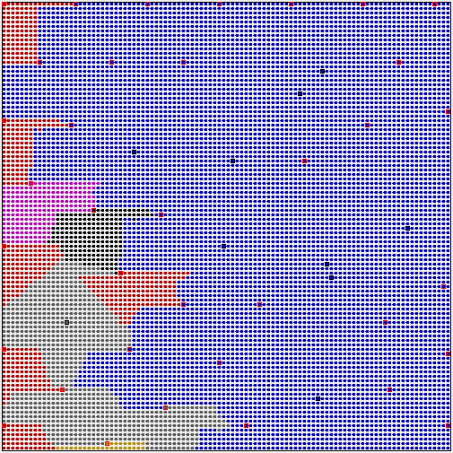
Knapsack problem: initial slack = 4 dag, new item’s weight and value vary from 1 to 100
Ideal
Approximation, sample rate = .005, SC+AL, alpha = 0.2
1,1
weight
1,1
weight
value
value

Slide 21
typical utility loss by online plan repair strategies = .006

Slide 22
Current Directions
Modification of SC+AL algorithm
Scalability to higher dimension problem instances
Application of Solution Border Estimation to >2 dimensions (detail if time permits)
Application of PS Map approximation to UAV allocation

Slide 23
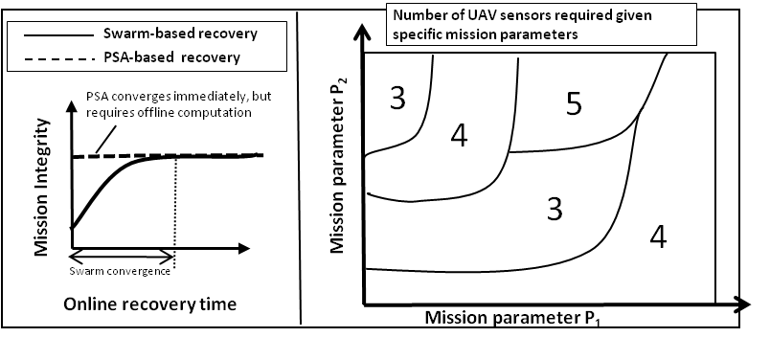
UAV Allocation

Slide 24
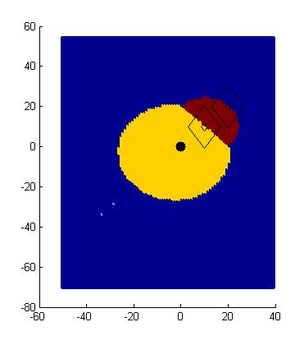
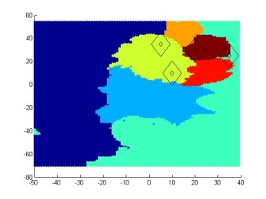
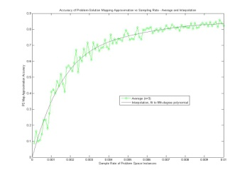
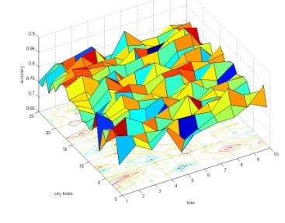
That’s it! Unless we want to discuss Solution Border Estimation
Basic
Sampling
Smart
Sampling
Border
Estimation
Motivation
Approach

Slide 25
Map Generation- Solution Border Estimation
P0 – P1 – P2 – Px
P0 – P1 – Px – P2
P0 – P2 – P1 – Px
P0 – P2 – Px – P1
P0 – Px – P1 – P2
P0 – Px – P2 – P1
P2
P1
P0
Px
dist(P0,P1) + dist(P1,Px) + dist(Px,P2) = dist(P0,Px) + dist(Px,P1) + dist(P1,P2)
dist(P0,P1) + dist(Px,P2) = dist(P0,Px) +dist(P1,P2)
dist(Px,P2) = dist(Px,P0) + C

Slide 26
Map Generation- Solution Border Estimation
P0 – P1 – P2 – Px
P0 – P1 – Px – P2
P0 – P2 – P1 – Px
P0 – P2 – Px – P1
P0 – Px – P1 – P2
P0 – Px – P2 – P1
P2
P1
P0
Px
dist(P0,P1) + dist(P1,P2) + dist(P2,Px) = dist(P0,Px) + dist(Px,P1) + dist(P1,P2)
dist(P0,P1) + dist(P2,Px) = dist(P0,Px) + dist(P1,Px)
ugly

Slide 27
Map Generation – Solution Border Estimation
P0 – P1 – P2 – Px
P0 – P1 – Px – P2
P0 – P2 – P1 – Px
P0 – P2 – Px – P1
P0 – Px – P1 – P2
P0 – Px – P2 – P1

Slide 28
SBE Implementation
Unfortunately, solving the equations is not trivial
Developed a ‘border tracing’ approach
sample problem instances to find representatives of solutions in the space
for each pair combination
find a problem instance on the boundary using binary search
trace the solution border from the boundary point
for each border intersection
find region to fill in by sending rays in each direction
fill region using fill algorithm

Slide 29
SBE – two solution representatives

Slide 30
SBE – binary search to find border

Slide 31
SBE – binary search to find border
?
?
?

Slide 32
SBE – binary search to find border
?
?
?

Slide 33
SBE – binary search to find border

Slide 34
SBE – binary search to find border
?
?
?
?

Slide 35
SBE – tracing red/blue solution border

Slide 36
SBE – found red/blue solution border

