Slide 1
Solution Border Estimation in Problem Space Analysis
MAPLE Lab meeting
22 Sept 2010

Slide 2
Dynamic Vehicle Routing Problem
Three vehicles to visit twelve destinations

Slide 3
Dynamic Vehicle Routing Problem
Static solution for known destinations

Slide 4
Dynamic Vehicle Routing Problem
Consideration for potential additional destination
Notes:
Anything could happen. A vehicle could break down, a customer could cancel, or, as in this example, a new destination could become necessary

Slide 5
Dynamic Vehicle Routing Problem
X
X
X
Contingency solution for additional destination

Slide 6
Dynamic Vehicle Routing Problem
Implementation of contingency solution

Slide 7
Dynamic Vehicle Routing Problem
How to plan contingencies for arbitrary possibilities?

Slide 8
Traveling Salesperson Problem
4
2
1
3
Four fixed cities
Central starting point
Unknown fifth city

Slide 9
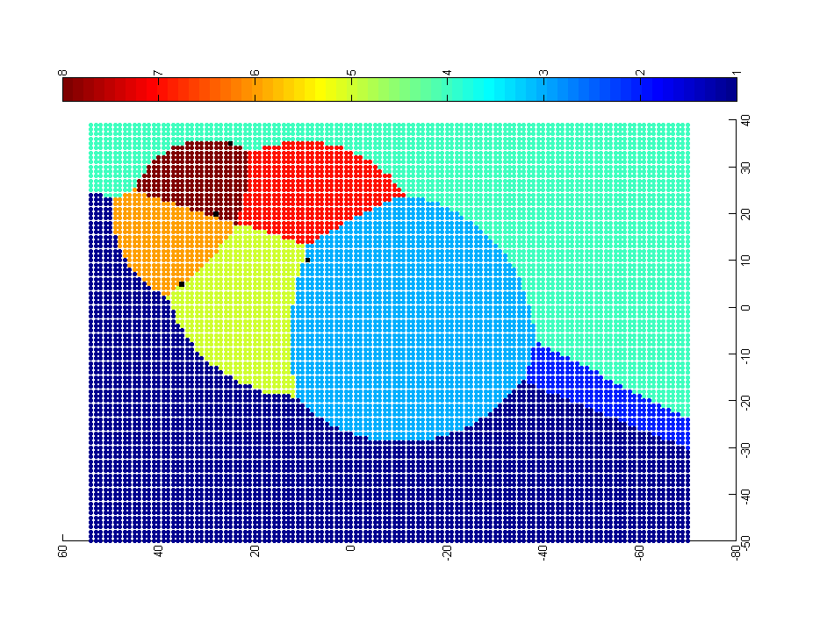
Approach: Problem-Solution Map
4
0-1-3-2-5-4
0-1-5-4-2-3
0-1-3-2-4-5
2
1
0-1-3-5-2-4
3
0-1-5-3-2-4
0-5-1-3-2-4
0-3-2-4-1-5
0-1-4-2-3-5
Each point represents a potential location of the fifth city. The color of the point represents the optimal solution for the resulting 5-city TSP.

Slide 10
PS Map generation
Sampling-Classification (Java + Matlab)
Sampling-Classification + Bias (Java + Matlab)
Sampling-Classification + Active Learning (in progress)
Solution Border Estimation (Java)
Select from Sampled Solutions (Java)
Smoothing (Java)

Slide 11
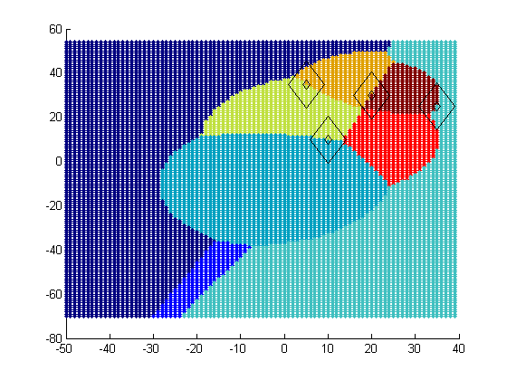
Mathematical Basis
Fixed points must occur on a border between two different solutions
The proof leads us to consider another application

Slide 12
Solution Border Estimation
P1
P0
Px
Px?
dist(P0,P1) + dist(P1,Px) = dist(P0,Px) + dist(Px,P1)
dist(P0,P1) = dist(P0,Px)
dist(Px,P0) = C

Slide 13
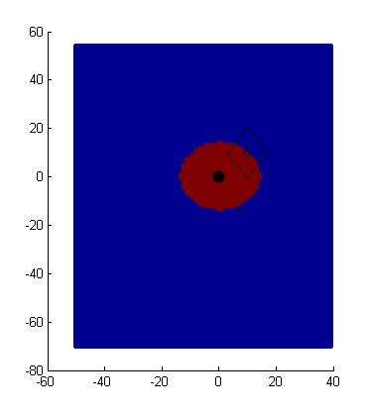
Solution Border Estimation
P1
P0 – P1 – Px
P0 – Px – P1
P0
Px
dist(P0,P1) + dist(P1,Px) = dist(P0,Px) + dist(Px,P1)
dist(P0,P1) = dist(P0,Px)
dist(Px,P0) = C

Slide 14
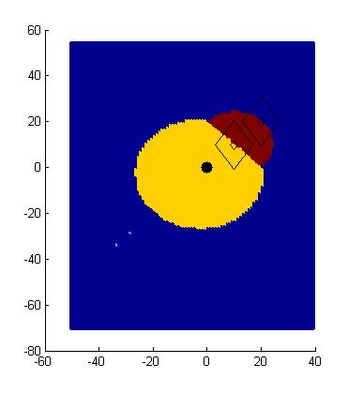
Solution Border Estimation
P0 – P1 – P2 – Px
P0 – P1 – Px – P2
P0 – P2 – P1 – Px
P0 – P2 – Px – P1
P0 – Px – P1 – P2
P0 – Px – P2 – P1
P2
P1
P0
Px?

Slide 15
Solution Border Estimation
P0 – P1 – P2 – Px
P0 – P1 – Px – P2
P0 – P2 – P1 – Px
P0 – P2 – Px – P1
P0 – Px – P1 – P2
P0 – Px – P2 – P1
P2
P1
P0
Px
dist(P0,P1) + dist(P1,P2) + dist(P2,Px) = dist(P0,P1) + dist(P1,Px) + dist(Px,P2)
dist(P1,P2) = dist(P1,Px)
dist(Px,P1) = C

Slide 16
Solution Border Estimation
P0 – P1 – P2 – Px
P0 – P1 – Px – P2
P0 – P2 – P1 – Px
P0 – P2 – Px – P1
P0 – Px – P1 – P2
P0 – Px – P2 – P1
P2
P1
P0
Px
dist(P0,P1) + dist(P1,Px) + dist(Px,P2) = dist(P0,Px) + dist(Px,P1) + dist(P1,P2)
dist(P0,P1) + dist(Px,P2) = dist(P0,Px) +dist(P1,P2)
dist(Px,P2) = dist(Px,P0) + C

Slide 17
Solution Border Estimation
P0 – P1 – P2 – Px
P0 – P1 – Px – P2
P0 – P2 – P1 – Px
P0 – P2 – Px – P1
P0 – Px – P1 – P2
P0 – Px – P2 – P1
P2
P1
P0
Px
dist(P0,P1) + dist(P1,P2) + dist(P2,Px) = dist(P0,Px) + dist(Px,P1) + dist(P1,P2)
dist(P0,P1) + dist(P2,Px) = dist(P0,Px) + dist(P1,Px)
ugly

Slide 18
Solution Border Estimation
P0 – P1 – P2 – Px
P0 – P1 – Px – P2
P0 – P2 – P1 – Px
P0 – P2 – Px – P1
P0 – Px – P1 – P2
P0 – Px – P2 – P1

Slide 19
SBE Implementation
Unfortunately, solving the equations is not trivial
Developed a ‘border tracing’ approach
sample problem instances to find representatives of solutions in the space
for each pair combination
find a problem instance on the boundary using binary search
trace the solution border from the boundary point
for each border intersection
find region to fill in by sending rays in each direction
fill region using fill algorithm

Slide 20
SBE – two solution representatives

Slide 21
SBE – binary search to find border

Slide 22
SBE – tracing red/blue solution border

Slide 23
SBE – found red/blue solution border

Slide 24
SBE – intersection with green border

Slide 25
SBE – intersection representative

Slide 26
SBE – finding region representatives

Slide 27
Experiment
DTSPs of 5, 10, 20, 50, and 100 cities
90 x 90 grid
3 instances of each
Brute force generation of ideal PS Maps
SBE generation
Sample rates ranging from 10 to 1000 samples per 100K
10 runs per instance and sample rate pair

Slide 28
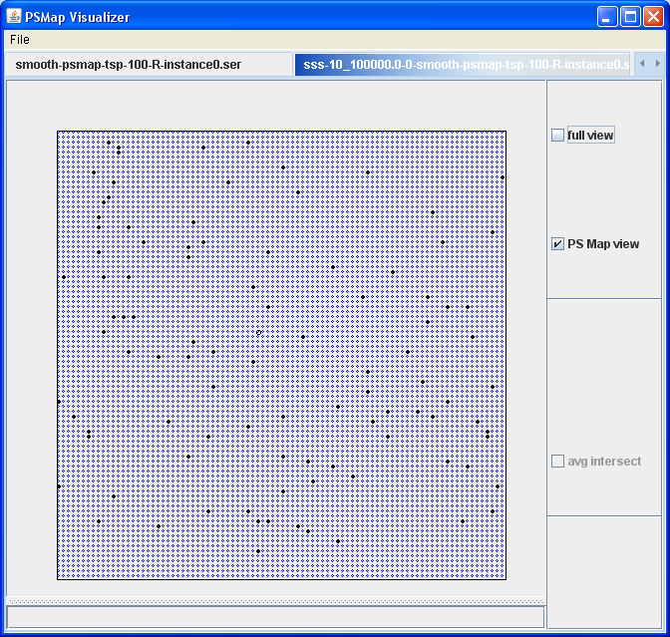
Sample rate 10/100K

Slide 29
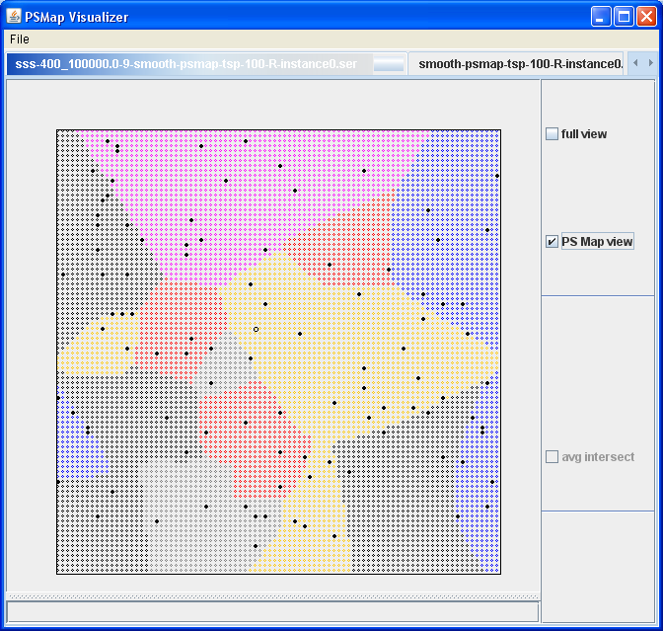
Sample rate 400/100K (.004)

Slide 30
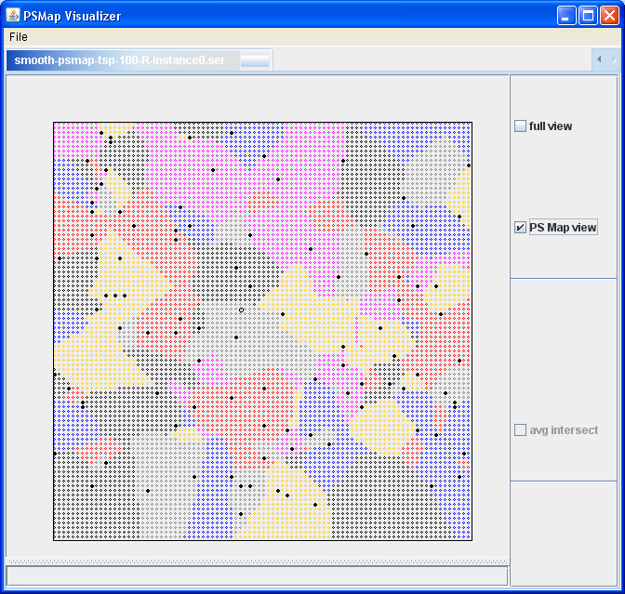
Ideal Map

Slide 31
Fraction of utility loss for SSS/SBE for TSPs of size 100 10 runs x 3 instances for each sample rate
Average fraction of utility loss
Sample rate

Slide 32
Results
Accurate with low sample rate
Relies on ability to find representatives for each solution
Unexpected benefits
because we can mathematically show that certain problem instances MUST have the same solution, we can find noise in the solver (led to smoothing technique)

Slide 33
Open questions
Is there a better way to do this?
Can this be applied to domains with higher dimensionality?
How to sample most efficiently such that
a sample has a high chance of discovering a new solution
is there utility in addl samples? where do we sample?
the solution that is discovered has a high chance in increasing the accuracy of the approximation
the solution has a large region

Slide 35
Fraction of solutions discovered for TSPs of size 100

Slide 36
Next steps – try on something real!
Application relevance
dynamic, real time systems
event reaction time is less than planning time
time available to strategize between event
Examples
Distributed systems with little or no communication
Uncertainty in results of action
Decide when to decide
Concrete
WSN
Flow tubes
Galcon? :-D

Slide 37
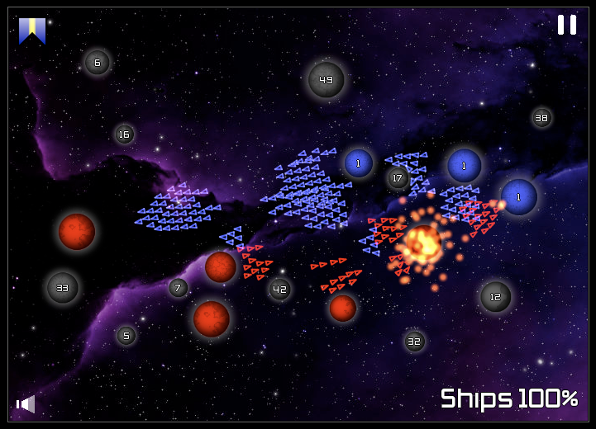

Slide 38
Backup

Slide 39
Map Generation
Ideal view of solution space topology

Slide 40
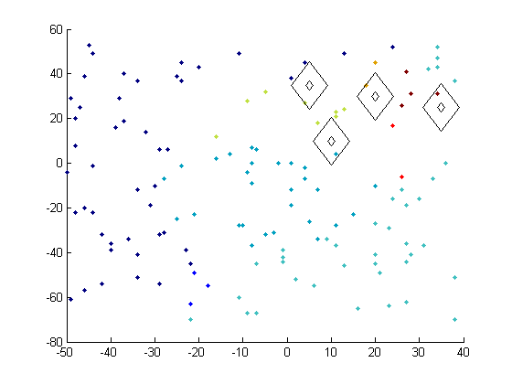
Map Generation
Preliminary experiment with random sampling and nearest neighbor classification

Slide 41
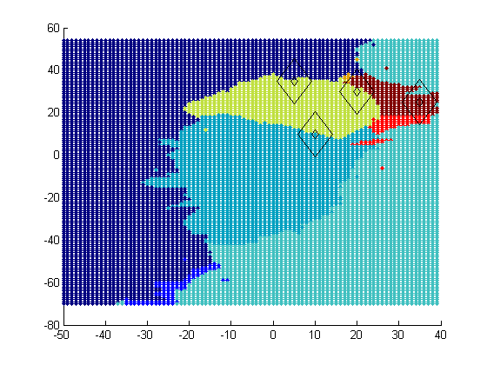
Map Generation
Ideal PS Map
Approximated PS Map
Preliminary experiment with random sampling and nearest neighbor classification

Slide 42
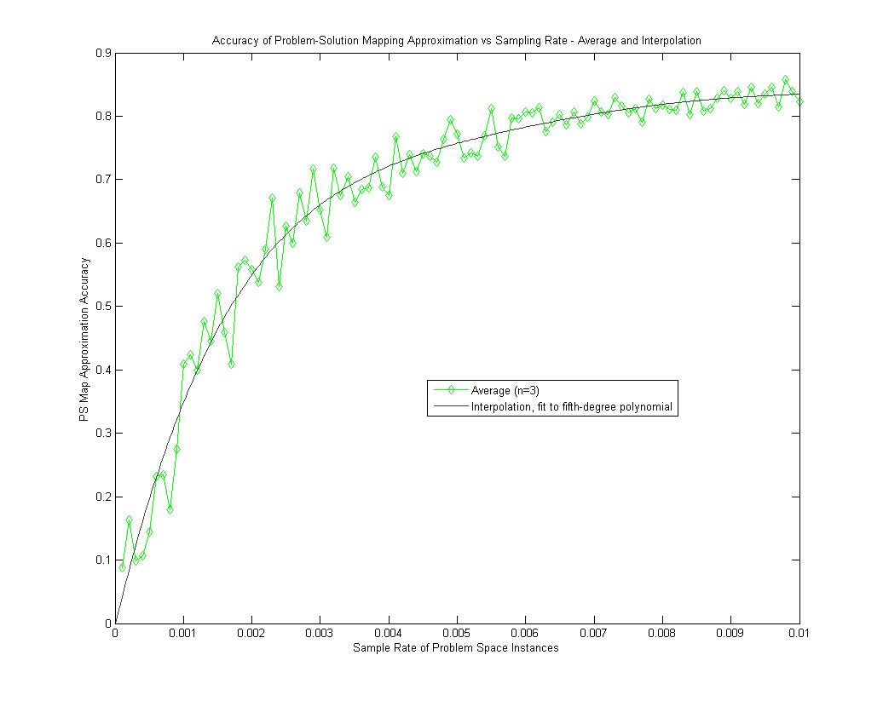
Map Generation
Preliminary experiment with random sampling and nearest neighbor classification demonstrates
75% accuracy from a 0.5% sample rate.

Slide 43
Domain-Based Hints
All the fixed points lie on regional boundaries

