Slide 1
Approaches for rapid replanning in dynamic environments
Robert Holder

Slide 2
Overview
Motivation
Reduce reaction time of real-time planners to changes in the environment
Approach
Preplanned libraries as alternative to traditional online plan repair
Leverage larger amount of offline time to save small amount of online time
Techniques
Sampling & Classification
Solution Border Estimation
Sampling & Classification + Active Learning (“Smart sampling”)

Slide 3
Overview (2)
Examples of applicable domains
Computing Resource Allocation
Mobile Sensor Scheduling
Vehicle Routing
Wireless Sensor Network Reconfiguration

Slide 4
Dynamic Vehicle Routing Problem
Three vehicles to visit twelve destinations

Slide 5
Dynamic Vehicle Routing Problem
Static solution for known destinations

Slide 6
Dynamic Vehicle Routing Problem
Consideration for potential additional destination
Notes:
Anything could happen. A vehicle could break down, a customer could cancel, or, as in this example, a new destination could become necessary

Slide 7
Dynamic Vehicle Routing Problem
X
X
X
Contingency solution for additional destination

Slide 8
Dynamic Vehicle Routing Problem
Implementation of contingency solution

Slide 9
Dynamic Vehicle Routing Problem
How to plan contingencies for arbitrary possibilities?

Slide 10
Traveling Salesperson Problem
4
2
1
3
Four fixed cities
Central starting point
Unknown fifth city

Slide 11
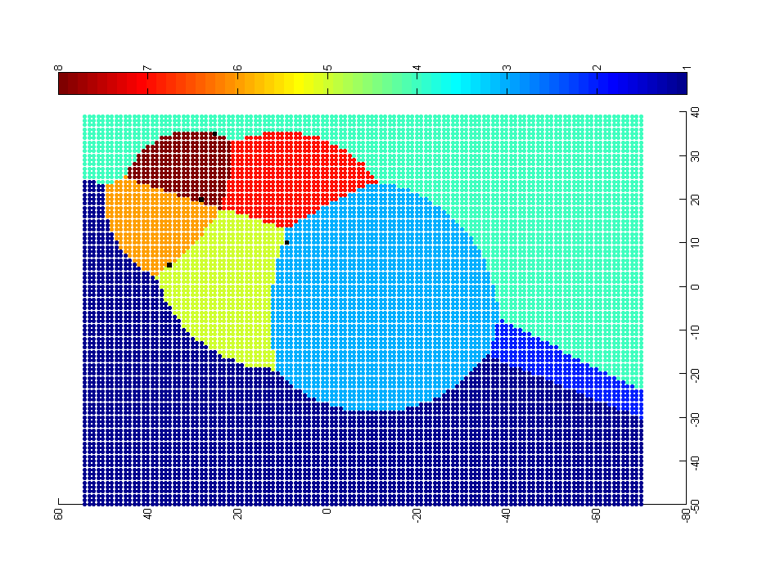
Approach: Problem-Solution Map
4
0-1-3-2-5-4
0-1-5-4-2-3
0-1-3-2-4-5
2
1
0-1-3-5-2-4
3
0-1-5-3-2-4
0-5-1-3-2-4
0-3-2-4-1-5
0-1-4-2-3-5
Each point represents a potential location of the fifth city. The color of the point represents the optimal solution for the resulting 5-city TSP.

Slide 12
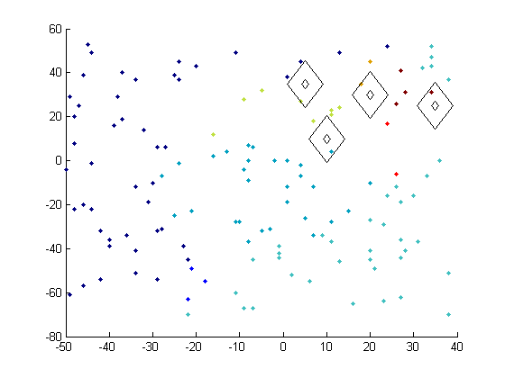
Map Generation – Sampling & Classification
Preliminary experiment with random sampling and nearest neighbor classification

Slide 13
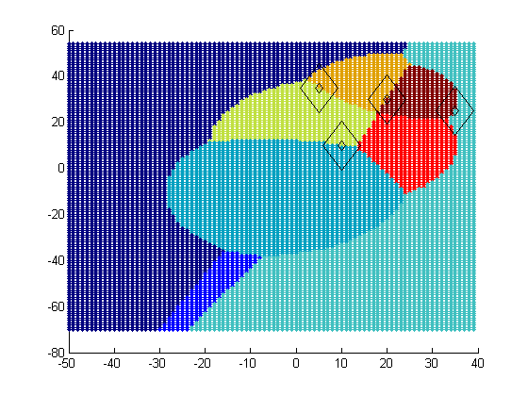
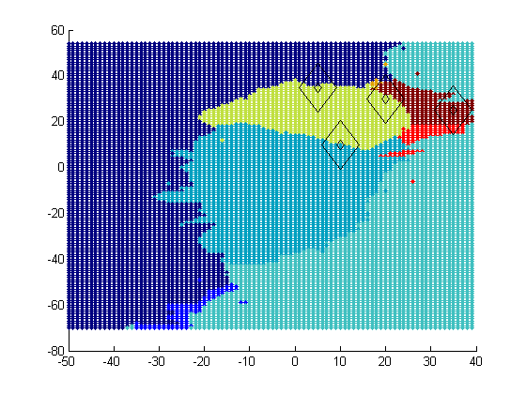
Map Generation – Sampling & Classification
Ideal PS Map
Approximated PS Map
Preliminary experiment with random sampling and nearest neighbor classification

Slide 14
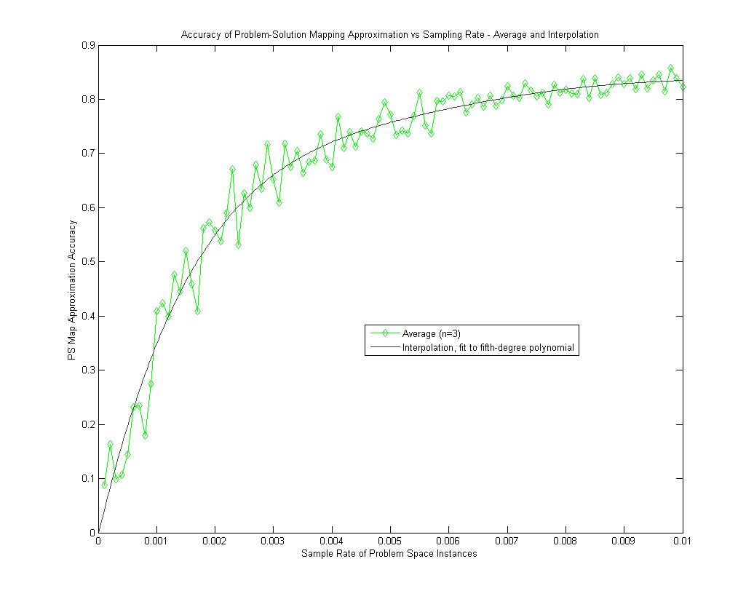
Map Generation
Preliminary experiment with random sampling and nearest neighbor classification demonstrates
75% accuracy from a 0.5% sample rate.

Slide 15
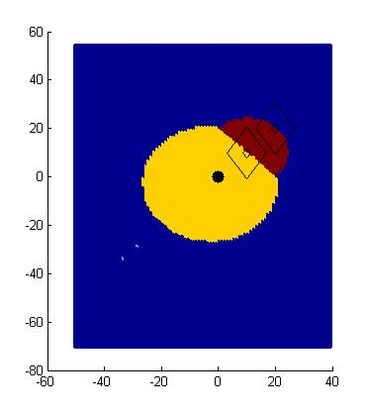
Solution Border Estimation
P0 – P1 – P2 – Px
P0 – P1 – Px – P2
P0 – P2 – P1 – Px
P0 – P2 – Px – P1
P0 – Px – P1 – P2
P0 – Px – P2 – P1
P2
P1
P0
Px?

Slide 16
Solution Border Estimation
P0 – P1 – P2 – Px
P0 – P1 – Px – P2
P0 – P2 – P1 – Px
P0 – P2 – Px – P1
P0 – Px – P1 – P2
P0 – Px – P2 – P1
P2
P1
P0
Px
dist(P0,P1) + dist(P1,P2) + dist(P2,Px) = dist(P0,P1) + dist(P1,Px) + dist(Px,P2)
dist(P1,P2) = dist(P1,Px)
dist(Px,P1) = C

Slide 17
Map Generation- Solution Border Estimation
P0 – P1 – P2 – Px
P0 – P1 – Px – P2
P0 – P2 – P1 – Px
P0 – P2 – Px – P1
P0 – Px – P1 – P2
P0 – Px – P2 – P1
P2
P1
P0
Px
dist(P0,P1) + dist(P1,Px) + dist(Px,P2) = dist(P0,Px) + dist(Px,P1) + dist(P1,P2)
dist(P0,P1) + dist(Px,P2) = dist(P0,Px) +dist(P1,P2)
dist(Px,P2) = dist(Px,P0) + C

Slide 18
Map Generation- Solution Border Estimation
P0 – P1 – P2 – Px
P0 – P1 – Px – P2
P0 – P2 – P1 – Px
P0 – P2 – Px – P1
P0 – Px – P1 – P2
P0 – Px – P2 – P1
P2
P1
P0
Px
dist(P0,P1) + dist(P1,P2) + dist(P2,Px) = dist(P0,Px) + dist(Px,P1) + dist(P1,P2)
dist(P0,P1) + dist(P2,Px) = dist(P0,Px) + dist(P1,Px)
ugly

Slide 19
Map Generation – Solution Border Estimation
P0 – P1 – P2 – Px
P0 – P1 – Px – P2
P0 – P2 – P1 – Px
P0 – P2 – Px – P1
P0 – Px – P1 – P2
P0 – Px – P2 – P1

Slide 20
SBE Implementation
Unfortunately, solving the equations is not trivial
Developed a ‘border tracing’ approach
sample problem instances to find representatives of solutions in the space
for each pair combination
find a problem instance on the boundary using binary search
trace the solution border from the boundary point
for each border intersection
find region to fill in by sending rays in each direction
fill region using fill algorithm

Slide 21
SBE – two solution representatives

Slide 22
SBE – binary search to find border

Slide 23
SBE – binary search to find border
?
?
?

Slide 24
SBE – binary search to find border
?
?
?

Slide 25
SBE – binary search to find border

Slide 26
SBE – binary search to find border
?
?
?
?

Slide 27
SBE – tracing red/blue solution border

Slide 28
SBE – found red/blue solution border

Slide 29
Sampling & Classification + Active Learning
Determine eventual number of samples
n = sample_rate * total_instances
Create initial sample of solutions of size
n_{i} = alpha * n
For each unknown sample
if polling results in unambiguous result, keep approximate result
else if total samples < n, generate exact solution

Slide 30
Sampling & Classification + Active Learning
ambiguous
landslide
unanimous

Slide 31
fraction of utility loss from optimal
typical utility loss by online plan repair strategies
loss by insertion repair
sample rate

Slide 32
Knapsack problem
Given a set of objects, maximize the value of the objects chosen while staying within the weight limit
Total available weight: 400 dekagrams (dag) = 4 kg
Base solution occupies 396 dag
New item varies in weight and value from 1 to 100

Slide 33

Ideal PS Map – Knapsack problem initial slack = 4 dag, new item’s weight and value vary from 1 to 100
1,1
weight
Solutions that do not include the new item
value

Slide 34
typical utility loss by online plan repair strategies = .006

Slide 35
Current Directions
Enhancement of SC+AL algorithm
Scalability to higher dimension problem instances
Application of Solution Border Estimation to >2 dimensions
Application of PS Map approximation to UAV allocation

Slide 36
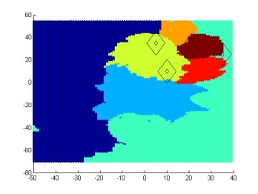

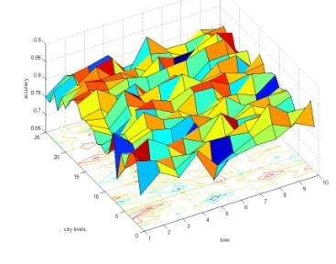
Summary
Basic
Sampling
Smart
Sampling
Border
Estimation
Motivation
Approach

