Slide 1
Rapid Replanning in Dynamic Environments
Robert Holder
R1D

Slide 2
Motivation
Computing Resource Allocation (ARMS)
Mobile Sensor Scheduling (FAME)
Vehicle Routing (AEC)
Wireless Sensor Network Reconfiguration
Smart Grid
WMD Fallout Modeling
SVM Reclassification

Slide 3
Overview
Problem
Reduce reaction time of real-time planners to changes in the environment
Approach
Preplanned libraries as alternative to traditional online plan repair
Leverage larger amount of offline time to save small amount of online time.

Slide 4
Dynamic Vehicle Routing Problem
Three vehicles to visit twelve destinations

Slide 5
Dynamic Vehicle Routing Problem
Static solution for known destinations

Slide 6
Dynamic Vehicle Routing Problem
Consideration for potential additional destination
Notes:
Anything could happen. A vehicle could break down, a customer could cancel, or, as in this example, a new destination could become necessary

Slide 7
Dynamic Vehicle Routing Problem
X
X
X
Contingency solution for additional destination

Slide 8
Dynamic Vehicle Routing Problem
Implementation of contingency solution

Slide 9
Dynamic Vehicle Routing Problem
How to plan contingencies for arbitrary possibilities?

Slide 10
Traveling Salesperson Problem
4
2
1
3
Four fixed cities
Central starting point
Unknown fifth city

Slide 11
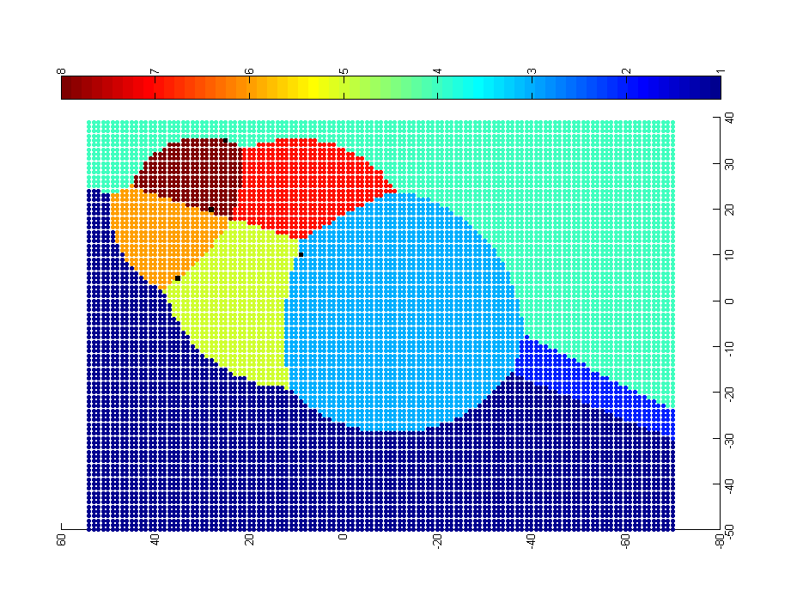
Approach: Problem-Solution Map
4
0-1-3-2-5-4
0-1-5-4-2-3
0-1-3-2-4-5
2
1
0-1-3-5-2-4
3
0-1-5-3-2-4
0-5-1-3-2-4
0-3-2-4-1-5
0-1-4-2-3-5
Each point represents a potential location of the fifth city. The color of the point represents the optimal solution for the resulting 5-city TSP.

Slide 12
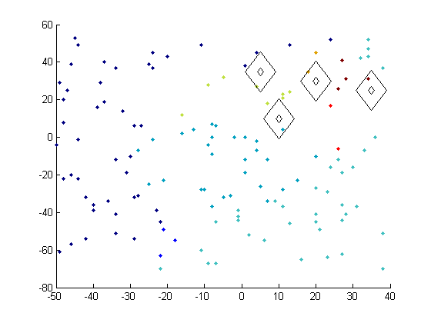
Map Generation
Preliminary experiment with random sampling and nearest neighbor classification

Slide 13
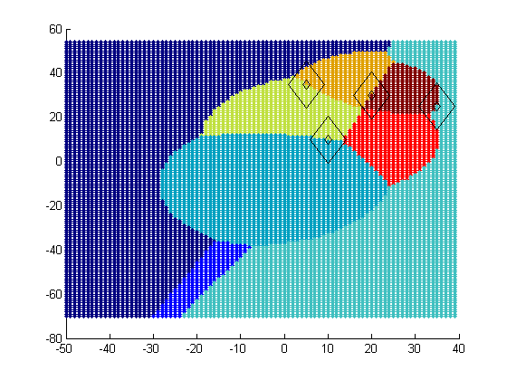
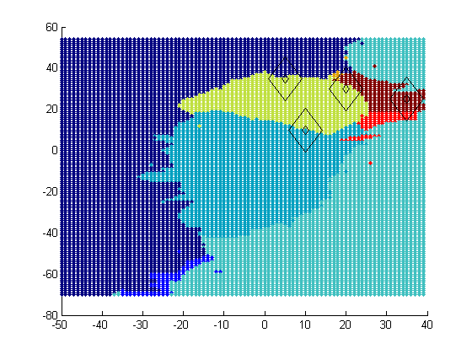
Map Generation
Ideal PS Map
Approximated PS Map
Preliminary experiment with random sampling and nearest neighbor classification

Slide 14
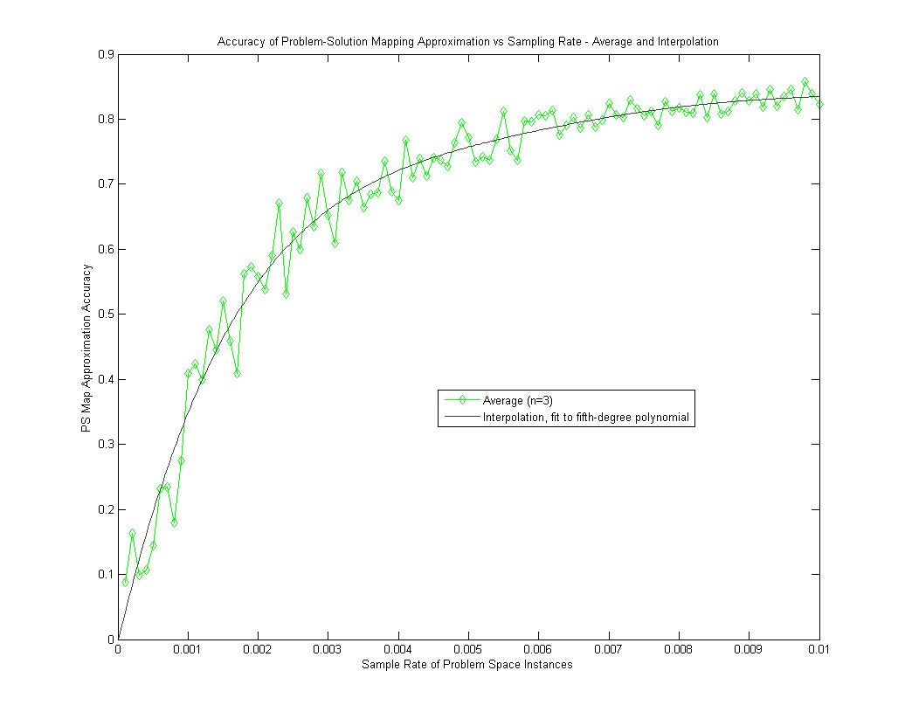
Map Generation
Preliminary experiment with random sampling and nearest neighbor classification demonstrates
75% accuracy from a 0.5% sample rate.

Slide 15

Homogeneous Solution Regions

Slide 16
PS Map Generation
Sampling-Classification
Sampling-Classification + Bias
Sampling-Classification + Active Learning
Solution Border Estimation
Solution Border Estimation - trace
Select from Sampled Solutions
Support Vector Machine (SVM) Classification
SVM + Solution Border Estimation

Slide 17
Solution Border Estimation
P1
P0
Px
Px?
dist(P0,P1) + dist(P1,Px) = dist(P0,Px) + dist(Px,P1)
dist(P0,P1) = dist(P0,Px)
dist(Px,P0) = C

Slide 18
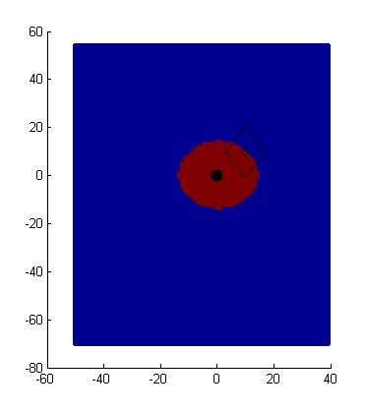
Solution Border Estimation
P1
P0 – P1 – Px
P0 – Px – P1
P0
Px
dist(P0,P1) + dist(P1,Px) = dist(P0,Px) + dist(Px,P1)
dist(P0,P1) = dist(P0,Px)
dist(Px,P0) = C

Slide 19
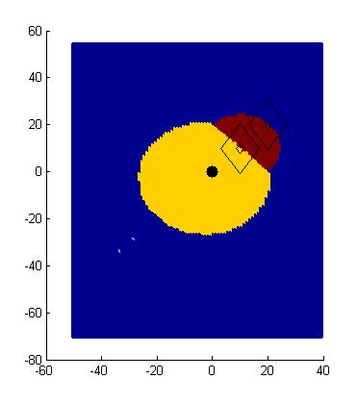
Solution Border Estimation
P0 – P1 – P2 – Px
P0 – P1 – Px – P2
P0 – P2 – P1 – Px
P0 – P2 – Px – P1
P0 – Px – P1 – P2
P0 – Px – P2 – P1
P2
P1
P0
Px?

Slide 20
Solution Border Estimation
P0 – P1 – P2 – Px
P0 – P1 – Px – P2
P0 – P2 – P1 – Px
P0 – P2 – Px – P1
P0 – Px – P1 – P2
P0 – Px – P2 – P1
P2
P1
P0
Px
dist(P0,P1) + dist(P1,P2) + dist(P2,Px) = dist(P0,P1) + dist(P1,Px) + dist(Px,P2)
dist(P1,P2) = dist(P1,Px)
dist(Px,P1) = C

Slide 21
Solution Border Estimation
P0 – P1 – P2 – Px
P0 – P1 – Px – P2
P0 – P2 – P1 – Px
P0 – P2 – Px – P1
P0 – Px – P1 – P2
P0 – Px – P2 – P1
P2
P1
P0
Px
dist(P0,P1) + dist(P1,Px) + dist(Px,P2) = dist(P0,Px) + dist(Px,P1) + dist(P1,P2)
dist(P0,P1) + dist(Px,P2) = dist(P0,Px) +dist(P1,P2)
dist(Px,P2) = dist(Px,P0) + C

Slide 22
Solution Border Estimation
P0 – P1 – P2 – Px
P0 – P1 – Px – P2
P0 – P2 – P1 – Px
P0 – P2 – Px – P1
P0 – Px – P1 – P2
P0 – Px – P2 – P1
P2
P1
P0
Px
dist(P0,P1) + dist(P1,P2) + dist(P2,Px) = dist(P0,Px) + dist(Px,P1) + dist(P1,P2)
dist(P0,P1) + dist(P2,Px) = dist(P0,Px) + dist(P1,Px)
ugly

Slide 23
Solution Border Estimation
P0 – P1 – P2 – Px
P0 – P1 – Px – P2
P0 – P2 – P1 – Px
P0 – P2 – Px – P1
P0 – Px – P1 – P2
P0 – Px – P2 – P1

Slide 24
Solution Border Estimation
P0 – P1 – P2 – Px
P0 – P1 – Px – P2
P0 – P2 – P1 – Px
P0 – P2 – Px – P1
P0 – Px – P1 – P2
P0 – Px – P2 – P1
P2
P1
P0
Px?

Slide 25
Key Insights
Homogeneous solution regions
Continuous objective functions
Robustness in specific problem instance characteristics
These features can be exploited
Equating objective functions
Sampling and classification
If absent, these features can be generated
Plan solution reindexing
Plan abstraction

Slide 26
Map Approximation
fraction of utility loss from optimal
typical utility loss by online plan repair strategies
sample rate

Slide 27
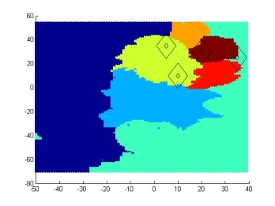

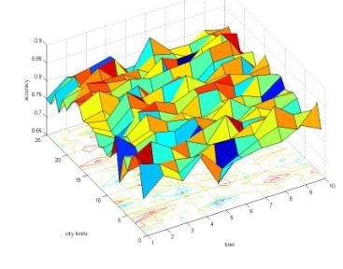
Questions
Basic
Sampling
Smart
Sampling
Border
Estimation
Motivation
Approach

Slide 28
Backup

Slide 29
Ideal PS Map – Knapsack problem initial slack = 4 dag, new item’s weight and value vary from 1 to 100
1,1
weight
Solutions that do not include the new item
value

