Slide 1
Efficient Plan Space Analysis
Robert Holder

Slide 2
Overview
Motivation
Reduce reaction time of real-time planners to changes in the environment
Approach
Preplanned libraries as alternative to traditional online plan repair
Leverage larger amount of offline time to save small amount of online time.

Slide 3
Overview (2)
Examples
Computing Resource Allocation
Mobile Sensor Scheduling
Vehicle Routing
Wireless Sensor Network Reconfiguration

Slide 4
Dynamic Vehicle Routing Problem
Three vehicles to visit twelve destinations

Slide 5
Dynamic Vehicle Routing Problem
Static solution for known destinations

Slide 6
Dynamic Vehicle Routing Problem
Consideration for potential additional destination
Notes:
Anything could happen. A vehicle could break down, a customer could cancel, or, as in this example, a new destination could become necessary

Slide 7
Dynamic Vehicle Routing Problem
X
X
X
Contingency solution for additional destination

Slide 8
Dynamic Vehicle Routing Problem
Implementation of contingency solution

Slide 9
Dynamic Vehicle Routing Problem
How to plan contingencies for arbitrary possibilities?

Slide 10
Traveling Salesperson Problem
4
2
1
3
Four fixed cities
Central starting point
Unknown fifth city

Slide 11
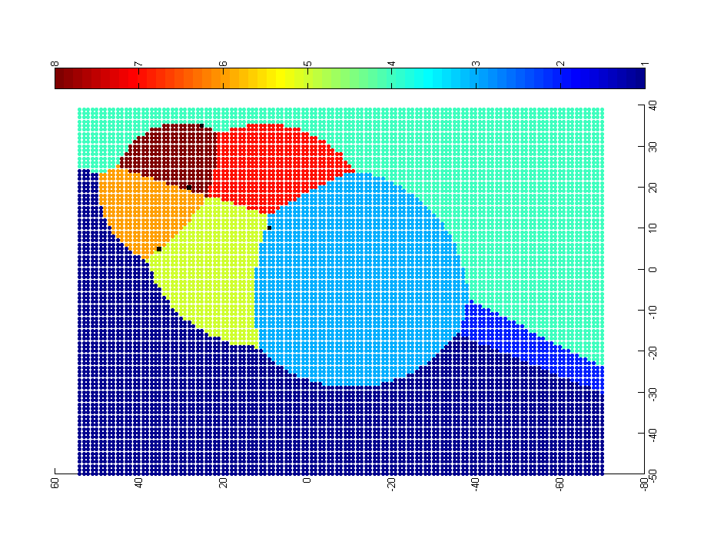
Approach: Problem-Solution Map
4
0-1-3-2-5-4
0-1-5-4-2-3
0-1-3-2-4-5
2
1
0-1-3-5-2-4
3
0-1-5-3-2-4
0-5-1-3-2-4
0-3-2-4-1-5
0-1-4-2-3-5
Each point represents a potential location of the fifth city. The color of the point represents the optimal solution for the resulting 5-city TSP.

Slide 12
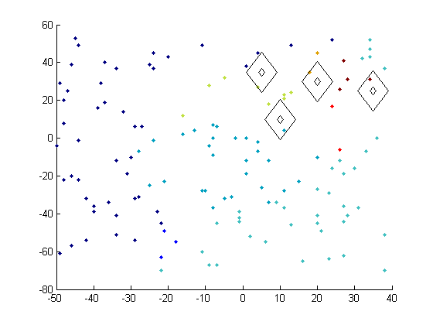
Map Generation – Sampling & Classification
Preliminary experiment with random sampling and nearest neighbor classification

Slide 13
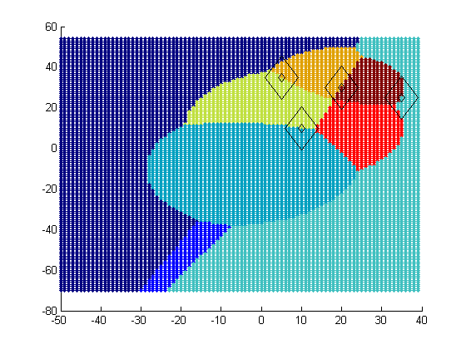
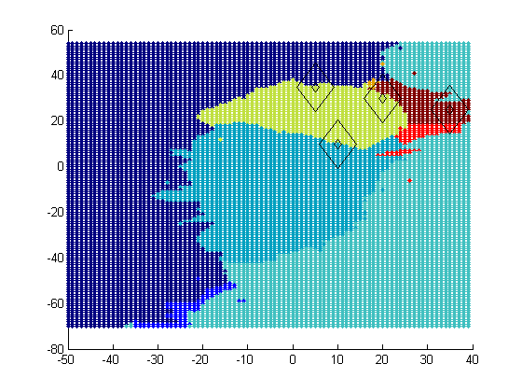
Map Generation – Sampling & Classification
Ideal PS Map
Approximated PS Map
Preliminary experiment with random sampling and nearest neighbor classification

Slide 14
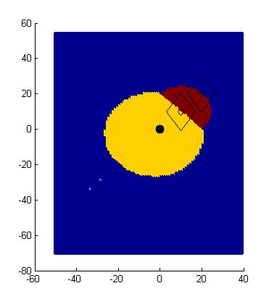
Map Generation- Solution Border Estimation
P0 – P1 – P2 – Px
P0 – P1 – Px – P2
P0 – P2 – P1 – Px
P0 – P2 – Px – P1
P0 – Px – P1 – P2
P0 – Px – P2 – P1
P2
P1
P0
Px
dist(P0,P1) + dist(P1,Px) + dist(Px,P2) = dist(P0,Px) + dist(Px,P1) + dist(P1,P2)
dist(P0,P1) + dist(Px,P2) = dist(P0,Px) +dist(P1,P2)
dist(Px,P2) = dist(Px,P0) + C

Slide 15
Map Generation- Solution Border Estimation
P0 – P1 – P2 – Px
P0 – P1 – Px – P2
P0 – P2 – P1 – Px
P0 – P2 – Px – P1
P0 – Px – P1 – P2
P0 – Px – P2 – P1
P2
P1
P0
Px
dist(P0,P1) + dist(P1,P2) + dist(P2,Px) = dist(P0,Px) + dist(Px,P1) + dist(P1,P2)
dist(P0,P1) + dist(P2,Px) = dist(P0,Px) + dist(P1,Px)
ugly

Slide 16
Map Generation – Solution Border Estimation
P0 – P1 – P2 – Px
P0 – P1 – Px – P2
P0 – P2 – P1 – Px
P0 – P2 – Px – P1
P0 – Px – P1 – P2
P0 – Px – P2 – P1

Slide 17
SBE Implementation
Unfortunately, solving the equations is not trivial
Developed a ‘border tracing’ approach
sample problem instances to find representatives of solutions in the space
for each pair combination
find a problem instance on the boundary using binary search
trace the solution border from the boundary point
for each border intersection
find region to fill in by sending rays in each direction
fill region using fill algorithm

Slide 18
SBE – two solution representatives

Slide 19
SBE – binary search to find border

Slide 20
SBE – binary search to find border
?
?
?

Slide 21
SBE – binary search to find border
?
?
?

Slide 22
SBE – binary search to find border

Slide 23
SBE – binary search to find border
?
?
?
?

Slide 24
SBE – tracing red/blue solution border

Slide 25
SBE – found red/blue solution border

Slide 26
Sampling & Classification + Active Learning
Determine eventual number of samples
n = sample_rate * total_instances
Create initial sample of solutions of size
n_{i} = alpha * n
For each unknown sample
if polling results in unambiguous result, keep approximate result
else if total samples < n, generate exact solution

Slide 27
Sampling & Classification + Active Learning
ambiguous
landslide
unanimous

Slide 28
Map generation technique comparison
fraction of utility loss from optimal
typical utility loss by online plan repair strategies
sample rate

Slide 30
Notes:
Makes sense that there is no discernable difference between the alpha levels, as the initial sample density is not high enough to take advantage of SC+AL active sampling

Slide 31

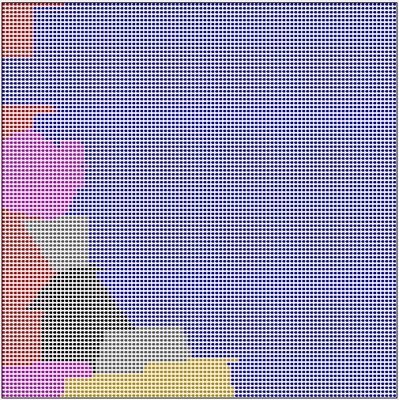
Knapsack problem: initial slack = 4, new item’s weight and value vary from 1 to 100
Ideal
Approximation, sample rate = .005, SC+AL, alpha = 0.2
1,1
weight
1,1
weight
value
value

Slide 32
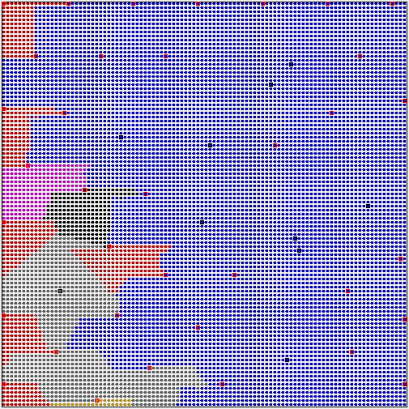
Knapsack problem: initial slack = 4, new item’s weight and value vary from 1 to 100
Ideal
Approximation, sample rate = .005, SC+AL, alpha = 0.2
1,1
weight
1,1
weight
value
value

Slide 33
fraction of utility loss from optimal
sample rate

Slide 34
Notes:
If solution is feasible, then no effect with a feasibility check. If solution is NOT feasible, then the utility is zero. Biggest deal here is that the utility going to zero creates more of an error.

Slide 38
typical utility loss by online plan repair strategies = .006

Slide 39
SVM approach

Slide 40
SVM approach

Slide 41
SVM approach

Slide 42
SVM Approach

Slide 47
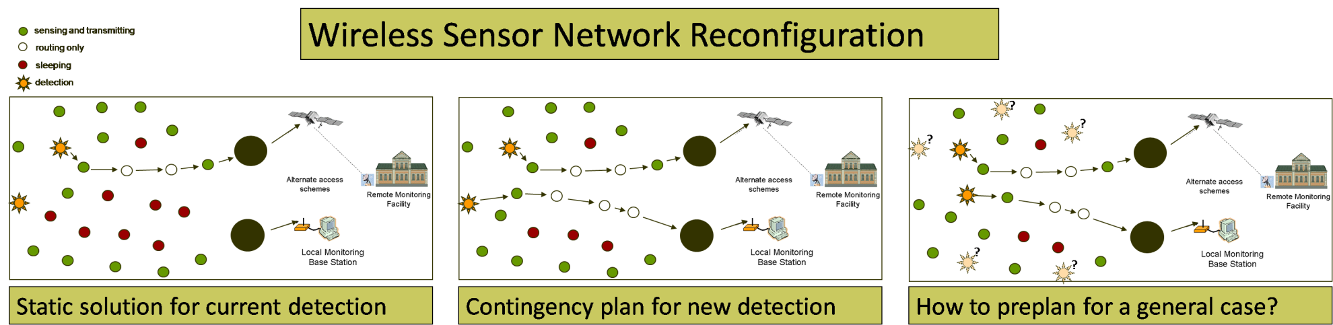
Next steps – Wireless Sensor Network
Plan: {1->2, 2->5, 3->0, 5->3}
Dimensions of problem space: {sensor energy, target location}

Slide 48
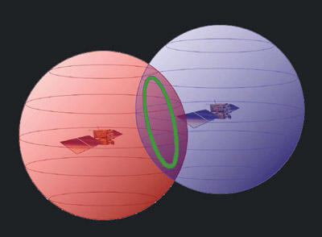
Next steps – Extend to higher dimensions

