Slide 1
Rapid Plan Adaptation Through Offline Analysis of Potential Plan Disruptors
Robert H. Holder, III
Dissertation Defense
December 9, 2015
Committee:
Dr. Marie desJardins, Chair
Dr. Tim Finin, Chair
Dr. Tim Oates
Dr. R. Scott Cost
Dr. Don Miner

Slide 2
Outline
Motivation
Related Work
Approach
Algorithms
Map Generation
Experiments
TSP
Knapsack
Elevator
Practical Application
Sample rate
Indexing and Abstraction
Summary

Slide 3
Motivation
Real-time Planning Problems
Shipboard Computing Resource Allocation
Mobile Sensor Scheduling
Unmanned Vehicle Routing
Wireless Sensor Network (WSN) Reconfiguration

Slide 4
Overview
Problem
Reduce reaction time of real-time planners to changes in the environment
Approach
Preplanned libraries as alternative to traditional online plan repair
Leverage larger amount of offline time to save small amount of online time.

Slide 5
Motivation
For planning problems in a real-time environment,
A plan library is a means of rapidly adapting to a new environment.
Hypothesis:
Plan Library: Problem space analysis can inform the efficient creation of a plan library.
Problem Space Analysis: A sampling of problem instances and their solutions can lend insight into the underlying structure of the domain.

Slide 6
Contributions
Framework to model and reason about the topological structure of the solutions of related plans
Novel algorithms that exploit solution space structure to generate plan libraries
Techniques to manipulate the structure of the solution space to be favorable for approximation algorithms
Evaluation of these algorithms by comparison to competing techniques for a set of sample problems

Slide 7
Dynamic Vehicle Routing Problem
Three vehicles to visit twelve destinations

Slide 8
Dynamic Vehicle Routing Problem
Static solution for known destinations

Slide 9
Dynamic Vehicle Routing Problem
Consideration for potential additional destination
Notes:
Anything could happen. A vehicle could break down, a customer could cancel, or, as in this example, a new destination could become necessary

Slide 10
Dynamic Vehicle Routing Problem
X
X
X
Contingency solution for additional destination

Slide 11
Dynamic Vehicle Routing Problem
Implementation of contingency solution

Slide 12
Dynamic Vehicle Routing Problem
How to plan contingencies for arbitrary possibilities?

Slide 13
Outline
Motivation
Related Work
Approach
Problem-Solution (PS) Map
Solution-Problem-Utility (SPU) Map
Solution Similarity (SS) Map
Map Utilization
Plan Library Generation
Algorithm Selection and Configuration
Informed Problem Decomposition
Map Generation
Domain-Based Hints
Sampling
Interpolation
Research Directions
Summary

Slide 14
Related Work – Technique Comparison
Plan Library generation
case-based reasoning (created after runtime)
reactive planning (subset of input, localized)
conditional & contingency planning (localized)
decision-theoretic (relies on probabilities)
Real-time Planning
plan repair (runtime, works for small changes)
anytime & contract algorithms (runtime)

Slide 15
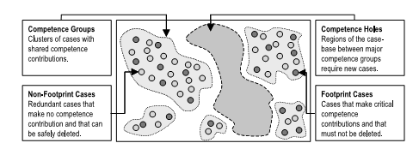
Related Work – Case-Based Reasoning
Smyth & McKenna (2001)

Slide 16
Related Work – Domain Space Analysis
State Space Analysis
Bulka (2009) – Backbone planning
Kondaris (2008) – Automated skill learning
Hoffman (2001) – State space “benches” and “exits”
Solution Space Analysis
Danshla (2010) – Mapping problem to best heuristic
Miner (2009) – Solution gradient lines
Rosen, et. al. (2005) – Medical plan comparison
Gopal & Starkschall (2002) – Medical plan topology
Boyan & Moore (2000) – Estimate best initial search state
Plan-Space Planning
Trinquart (2003) – Plan space reachability
Hoffman & Nebel (2001) – Uses plan space structure to estimate distance to goal state

Slide 17
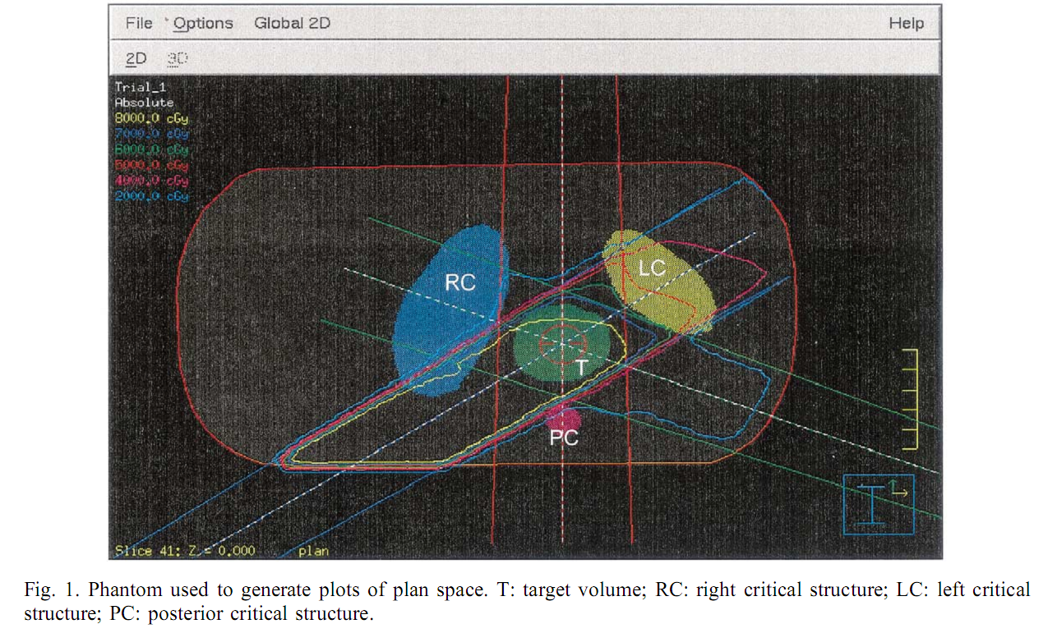
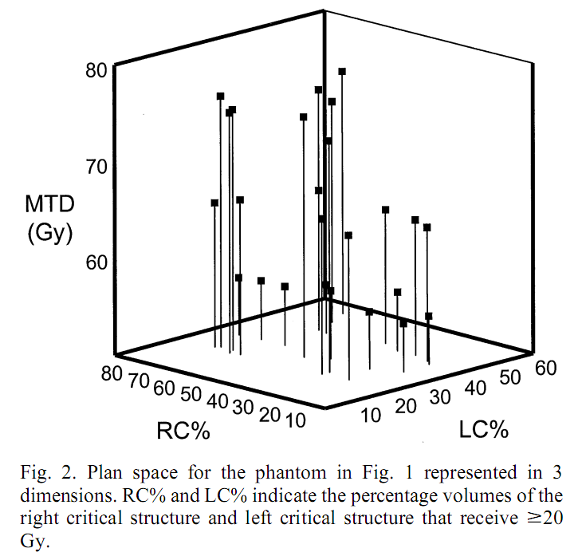
Related Work – Gopal & Starkschall (2002)

Slide 18
Traveling Salesperson Problem
4
2
1
3
Four fixed cities
Central starting point
Unknown fifth city

Slide 19
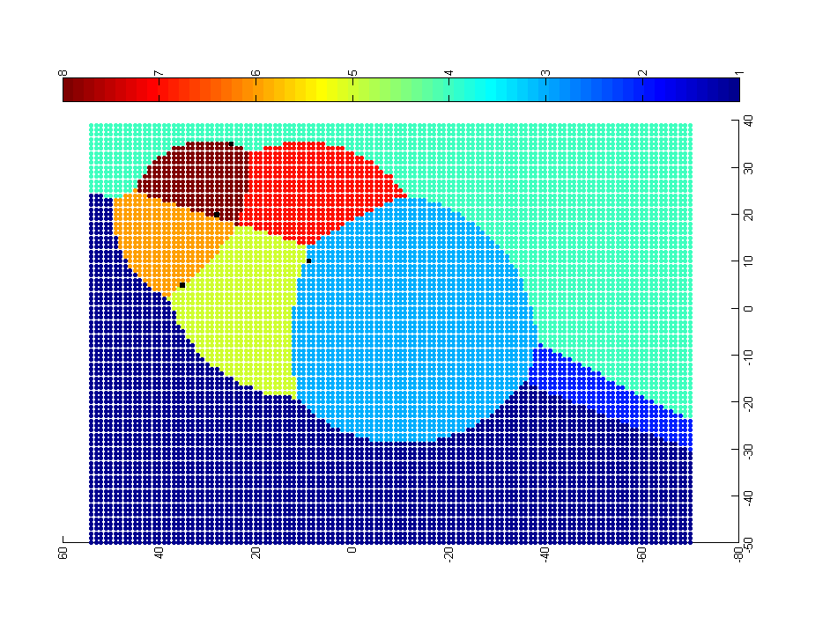
Approach: Problem-Solution Map
4
2
1
3
Each point represents a potential location of the fifth city. The color of the point represents the optimal solution for the resulting 5-city TSP.

Slide 20
Approach: Problem-Solution Map
4
0-1-3-2-5-4
0-1-5-4-2-3
0-1-3-2-4-5
2
1
0-1-3-5-2-4
3
0-1-5-3-2-4
0-5-1-3-2-4
0-3-2-4-1-5
0-1-4-2-3-5
Each point represents a potential location of the fifth city. The color of the point represents the optimal solution for the resulting 5-city TSP.

Slide 21

Approach
Problem-Solution Map (PS Map)
contiguous regions – only need to store one solution per region
complexity – higher interaction of regions indicates a more complex space

Slide 22
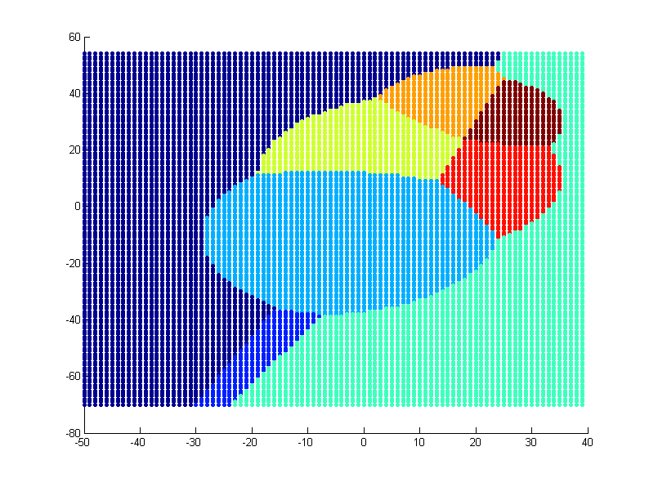
Map Generation
5-city TSP (1 unknown city)
small problem with two degrees of freedom
12k problem instances
naive solver
fast runtime
5-city TSP (2 unknown cities)
larger problem with four degrees of freedom
311k problem instances
naive solver
~20 minutes runtime

Slide 23
Map Generation
Complete map generation is not feasible
(would make algorithm selection irrelevant)
how can we approximate the map efficiently?
Map approximation
sampling
interpolation
domain-based hints
example: fixed city locations lie on regional borders

Slide 24
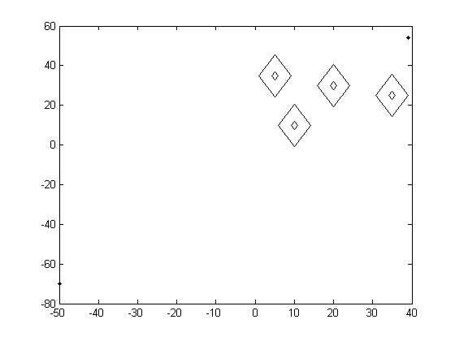
Map Generation
Initial view of solution space topology

Slide 25
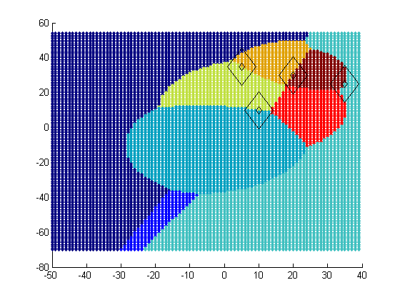
Map Generation
Ideal view of solution space topology

Slide 26
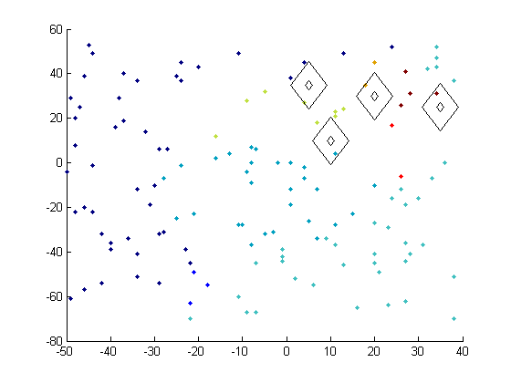
Map Generation
Preliminary experiment with random sampling and nearest neighbor classification

Slide 27
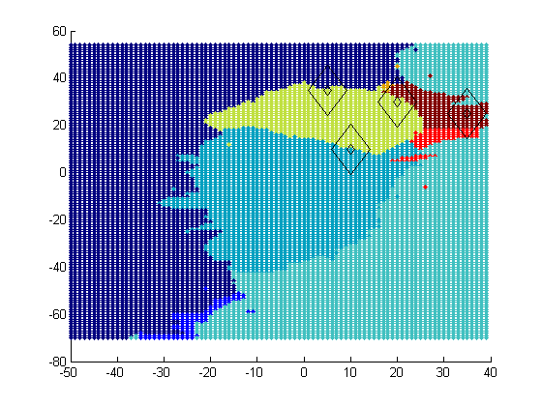
Map Generation
Ideal PS Map
Approximated PS Map
Preliminary experiment with random sampling and nearest neighbor classification

Slide 28
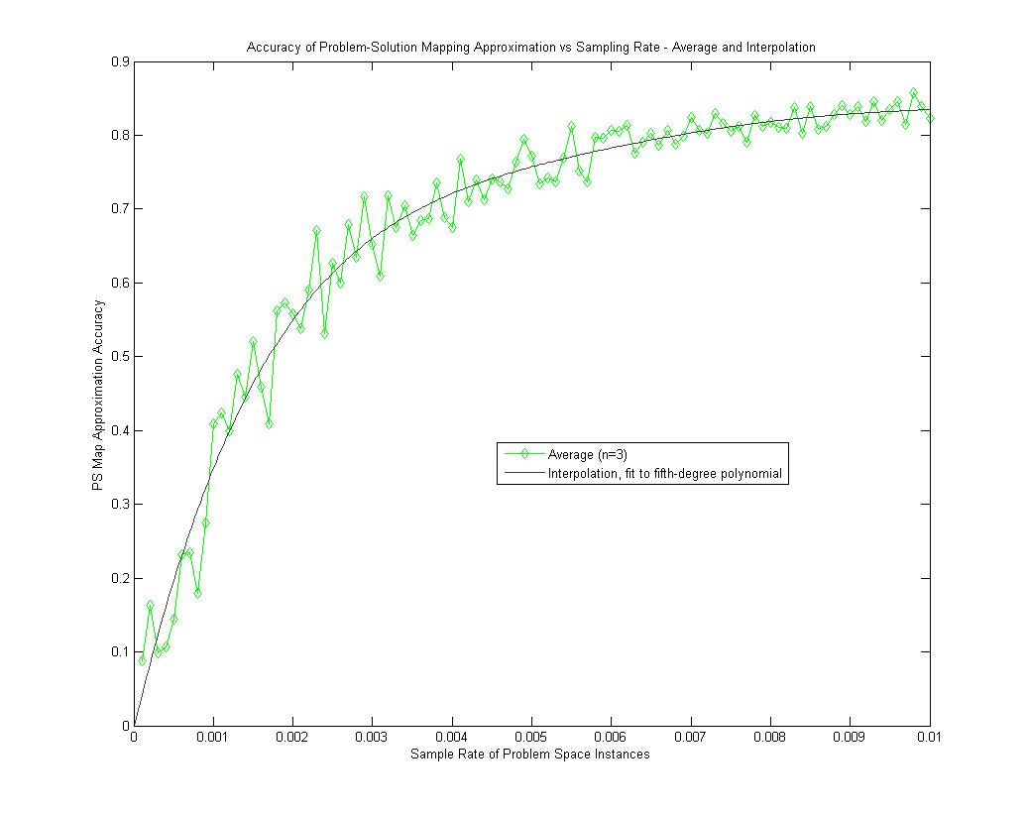
Map Generation
Preliminary experiment with random sampling and nearest neighbor classification demonstrates
75% accuracy from a 0.5% sample rate.

Slide 29
Sampling & Classification
Sampling
uniform/random/NOLHS/Rapidly expanding Random Trees (RRT)
strategic sampling (active learning)
schemes biased by domain hints
Classification
Nearest neighbor
k nearest neighbors vs. radius of nearest neighbors
weighting neighbors by distance
Support Vector Machine (linear, non-linear)
Bayesian Network
Neural Network

Slide 30
Domain-Based Hints
All the fixed points lie on regional boundaries

Slide 31
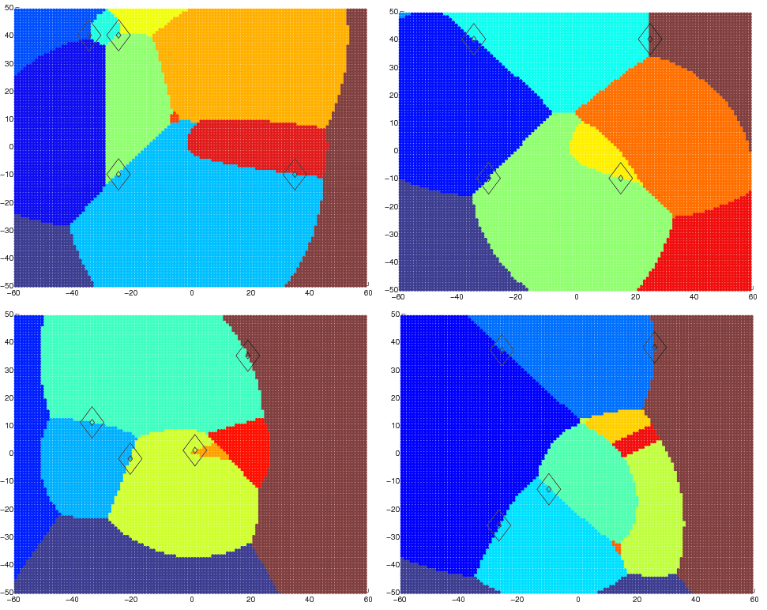
Domain-Based Hints
All the fixed points lie on regional boundaries

Slide 32
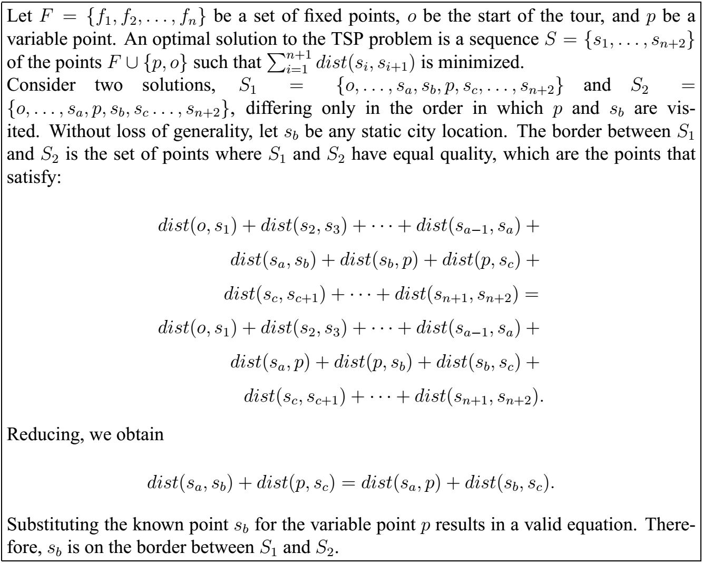
Domain-Based Hints

Slide 33
SC+bias
Bias samples toward fixed city locations
City radius
Bias factor

Slide 34
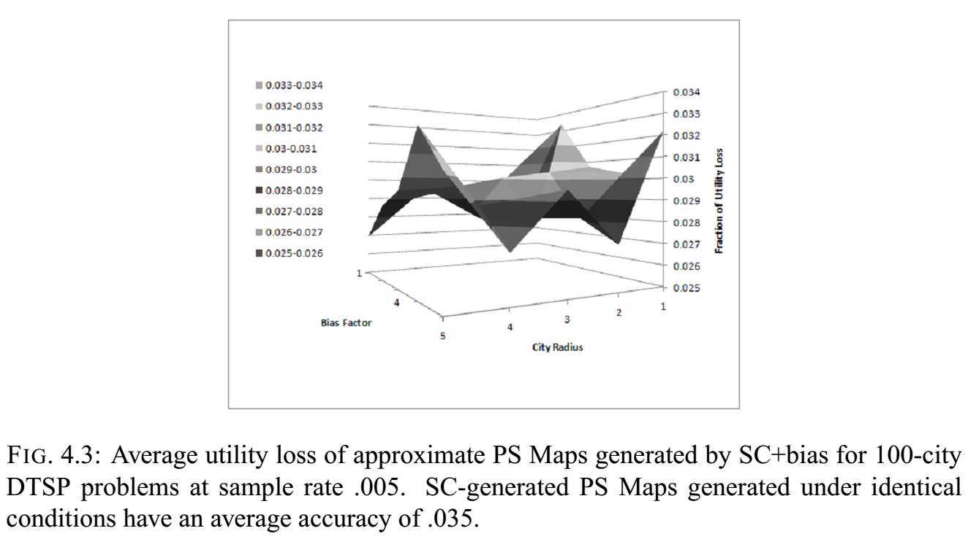
SC+bias

Slide 35
Sampling & Classification + Active Learning
Determine eventual number of samples
n = sample_rate * total_instances
Create initial sample of solutions of size
n_{i} = alpha * n
For each unknown sample
if polling results in unambiguous result, keep approximate result
else if total samples < n, generate exact solution

Slide 36
Sampling & Classification + Active Learning
ambiguous
landslide
unanimous

Slide 37
Solution Border Estimation
Using techniques similar to those used to justify SBE, can solution borders be calculated?
For each combination of two solutions, equate objective functions to determine shape of border

Slide 38
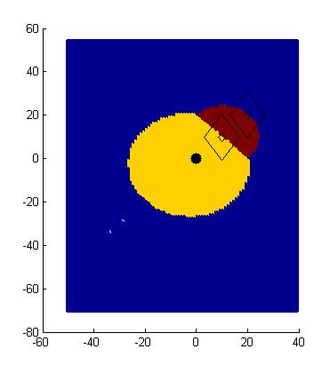
Solution Border Estimation
P0 – P1 – P2 – Px
P0 – P1 – Px – P2
P0 – P2 – P1 – Px
P0 – P2 – Px – P1
P0 – Px – P1 – P2
P0 – Px – P2 – P1
P2
P1
P0
Px?

Slide 39
Solution Border Estimation
P0 – P1 – P2 – Px
P0 – P1 – Px – P2
P0 – P2 – P1 – Px
P0 – P2 – Px – P1
P0 – Px – P1 – P2
P0 – Px – P2 – P1
P2
P1
P0
Px
dist(P0,P1) + dist(P1,P2) + dist(P2,Px) = dist(P0,P1) + dist(P1,Px) + dist(Px,P2)
dist(P1,P2) = dist(P1,Px)
dist(Px,P1) = C

Slide 40
Map Generation- Solution Border Estimation
P0 – P1 – P2 – Px
P0 – P1 – Px – P2
P0 – P2 – P1 – Px
P0 – P2 – Px – P1
P0 – Px – P1 – P2
P0 – Px – P2 – P1
P2
P1
P0
Px
dist(P0,P1) + dist(P1,Px) + dist(Px,P2) = dist(P0,Px) + dist(Px,P1) + dist(P1,P2)
dist(P0,P1) + dist(Px,P2) = dist(P0,Px) +dist(P1,P2)
dist(Px,P2) = dist(Px,P0) + C

Slide 41
Map Generation- Solution Border Estimation
P0 – P1 – P2 – Px
P0 – P1 – Px – P2
P0 – P2 – P1 – Px
P0 – P2 – Px – P1
P0 – Px – P1 – P2
P0 – Px – P2 – P1
P2
P1
P0
Px
dist(P0,P1) + dist(P1,P2) + dist(P2,Px) = dist(P0,Px) + dist(Px,P1) + dist(P1,P2)
dist(P0,P1) + dist(P2,Px) = dist(P0,Px) + dist(P1,Px)
ugly

Slide 42
Map Generation – Solution Border Estimation
P0 – P1 – P2 – Px
P0 – P1 – Px – P2
P0 – P2 – P1 – Px
P0 – P2 – Px – P1
P0 – Px – P1 – P2
P0 – Px – P2 – P1

Slide 43
Solution Border Estimation
P0 – P1 – P2 – Px
P0 – P1 – Px – P2
P0 – P2 – P1 – Px
P0 – P2 – Px – P1
P0 – Px – P1 – P2
P0 – Px – P2 – P1
P2
P1
P0
Px?

Slide 44
SBE Implementation
Unfortunately, solving the equations is not trivial
Developed a ‘border tracing’ approach
sample problem instances to find representatives of solutions in the space
for each pair combination
find a problem instance on the boundary using binary search
trace the solution border from the boundary point
for each border intersection
find region to fill in by sending rays in each direction
fill region using fill algorithm

Slide 45
SBE – two solution representatives

Slide 46
SBE – binary search to find border

Slide 47
SBE – binary search to find border
?
?
?

Slide 48
SBE – binary search to find border
?
?
?

Slide 49
SBE – binary search to find border

Slide 50
SBE – binary search to find border
?
?
?
?

Slide 51
SBE – tracing red/blue solution border

Slide 52
SBE – found red/blue solution border

Slide 53
SVM
SBE-trace only available in two dimensions. Use SVM-based approach to mimic SBE’s border-finding approach
Train SVM with problem instances as observations and solution as label

Slide 54
SVM

Slide 55
SVM+SBE
Use SBE-trace to find borders between solutions
Augment training instances in an attempt to constrain the placement of maximum margin plane

Slide 56
SSS
Initial sample creates a set of known solutions
For each unsolved problem instance, test each known solution and assign the best one
Assumes cost of solution evaluation is not prohibitive

Slide 57
Evaluation
Three domains
Traveling Salesman Problem
0-1 Knapsack Problem
Elevator Problem
Map approximation
Average fraction of utility loss from optimal
System performance
Comparison to online repair algorithms
Offline computation time vs. online performance

Slide 58
Evaluation: TSP

Slide 59
Evaluation: Knapsack Problem

Slide 60
Evaluation: Elevator Problem
Solution Space Manipulation
Smoothing
Plan Abstraction
Plan Normalization
Online Repair Framework
van der Krogt & de Weerdt (2005)
Unrefinement – remove conflicting steps
Refinement – add steps that contribute to goal

Slide 61
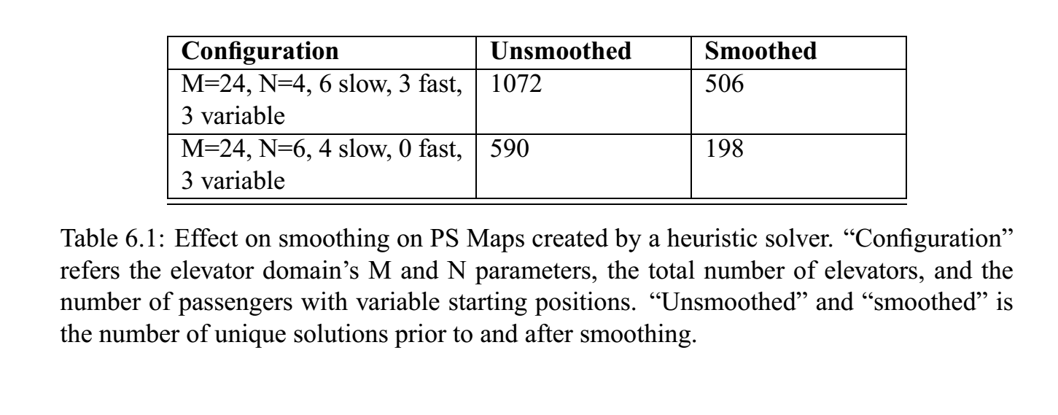
Smoothing
Correction of heuristic solver inaccuracies
Reduction of unique solutions

Slide 62
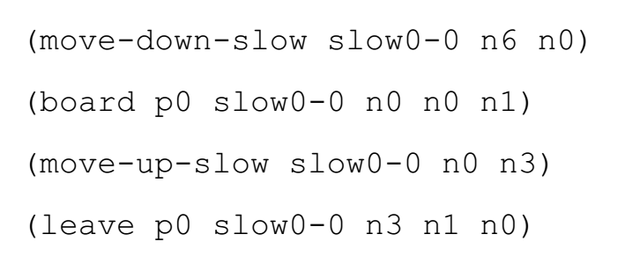
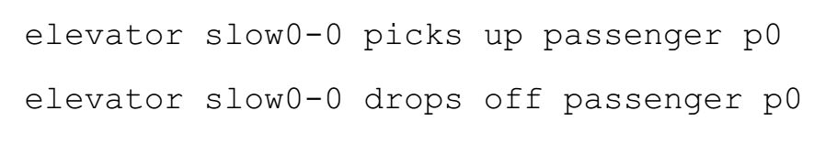
Plan Abstraction

Slide 63
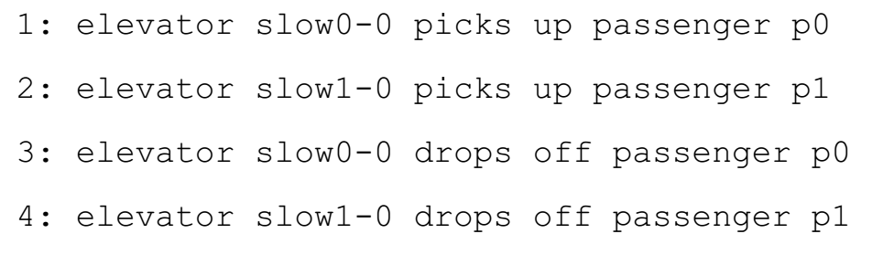
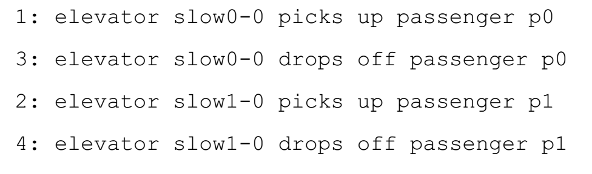
Plan Normalization

Slide 64
Results

Slide 65
Offline vs online

Slide 66
Future Work

Slide 67
Summary

Slide 68
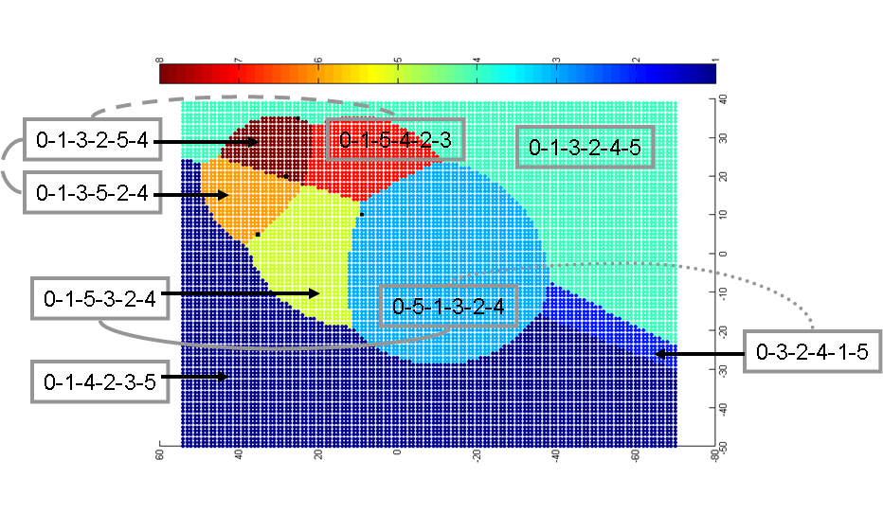
Thank you

Slide 69
Backup

Slide 70
Research Plan Goals
Investigate inferring a problem space analysis and solution topology from a sample set of problem instance and solution pairs
Apply problem space analysis and other domain characteristics to the creation of an efficient plan library
Apply problem space analysis to the selection of algorithms suited for a particular region of the problem space
Apply problem space analysis to strategic decomposition of large planning problems

Slide 71
Contributions
Framework to model and reason about the topological structure of the solutions of related plans
Techniques to predict and leverage the effect of problem instance characteristics and attributes on the topological structure of the solution space
Novel algorithms that exploit solution space structure to generate plan libraries, select & configure algorithms, and decompose large problems
Evaluation of these algorithms on a sample problems by comparison to competing techniques

Slide 72
Summary
Use of problem space analysis to facilitate real-time planning
plan library creation
algorithm selection
problem decomposition
Use of sampling and interpolation techniques to create problem space maps
traditional techniques
domain-based hints
informed kernel selection

Slide 73
References
Bulka (2009) “Efficient Planning Using Plan Libraries to Capture the Structure of the State Space”
Gopal & Starkschall (2002) “Plan space: representation of treatment plans in multidimensional space”
Hoffman (2001) “Local Search Topology in Planning Benchmarks: An Empirical Analysis”
Hoffman & Nebel (2001) “The FF Planning System: Fast Plan Generation Through Heuristic Search”
Onder & Pollack (1996) “Contingency Selection in Plan Generation”
Kondaris (2008) “Autonomous Robot Skill Acquisition”
Miner (2009) “Rule Abstraction: Understanding Emergent Behavior in Swarm Systems”
Smyth & McKenny (2001) “Competence Models and the Maintenance Problem”
Rosen, et. al. (2005) “Interactively exploring optimized treatment plans”
Trinquart (2003) “Analyzing Reachability within Plan Space”

Slide 74
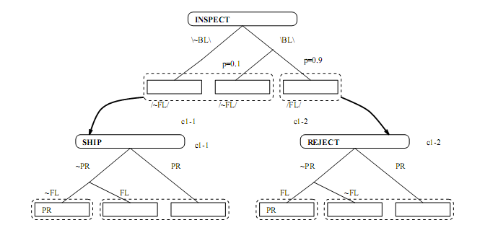
Related Work – Contingency Planning
Onder & Pollock (1996)

Slide 75

Ideal PS Map – Knapsack problem initial slack = 4 dag, new item’s weight and value vary from 1 to 100
1,1
weight
Solutions that do not include the new item
value

Slide 76
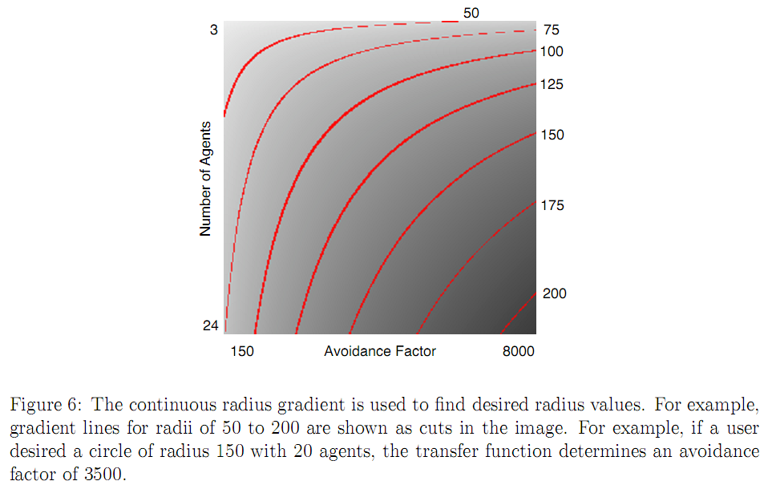

Related Work – Miner (2009)

