Slide 1
Project 3 Tutorial
Repository-level Program Slicing
Chengpeng Wang
wang6590@purdue.edu

Slide 2
Overview
Program Slicing
LLM-driven Program Slicing
Project 3: RepoSlice
Grading Criteria

Slide 3
Overview
Program Slicing
LLM-driven Program Slicing
Project 3: RepoSlice
Grading Criteria

Slide 4
Recap on Program Slicing
1
2
3
4
5
6
7
8
9
void main ( ) {
int I=0;
int sum=0;
while (I<N) {
sum=add(sum,I);
I=add(I,1);
}
printf (“sum=%d\n”,sum);
printf(“I=%d\n”,I);
S: …. = f (v)
Slice of v at S is the set of statements involved in computing v’s value at S.
[Mark Weiser, 1982]

Slide 5
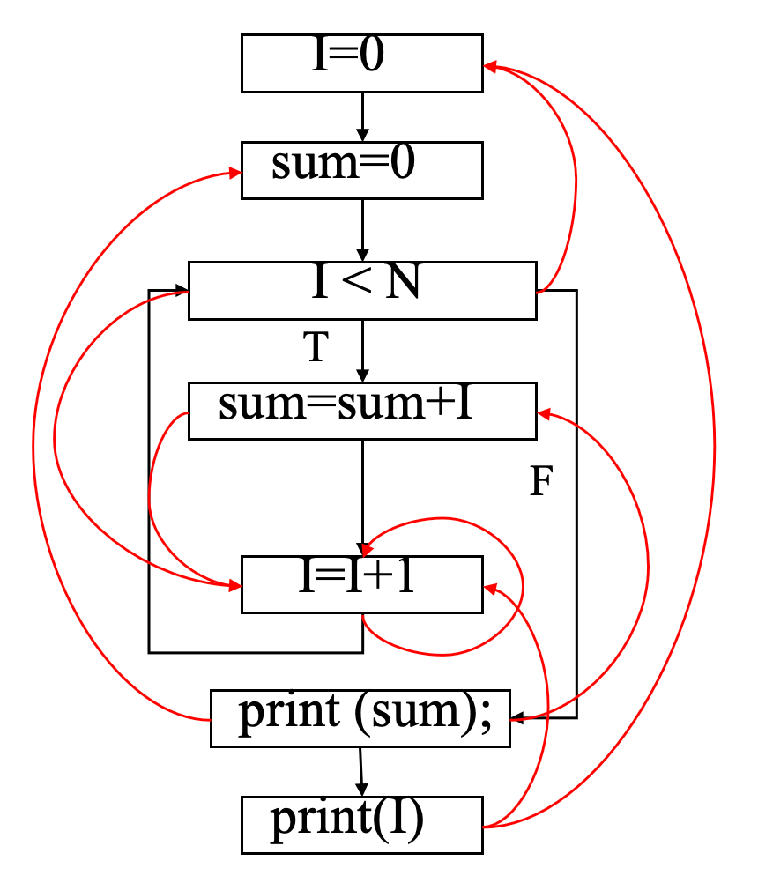
Data/Control Dependence in Dependence Graph
Dependence Graph
  Data dep.
  Control dep.
X is data dependent on Y if (1) there is a variable v that is defined at Y and used at X and (2) there exists a path of nonzero length from Y to X along which v is not re-defined.

Slide 6
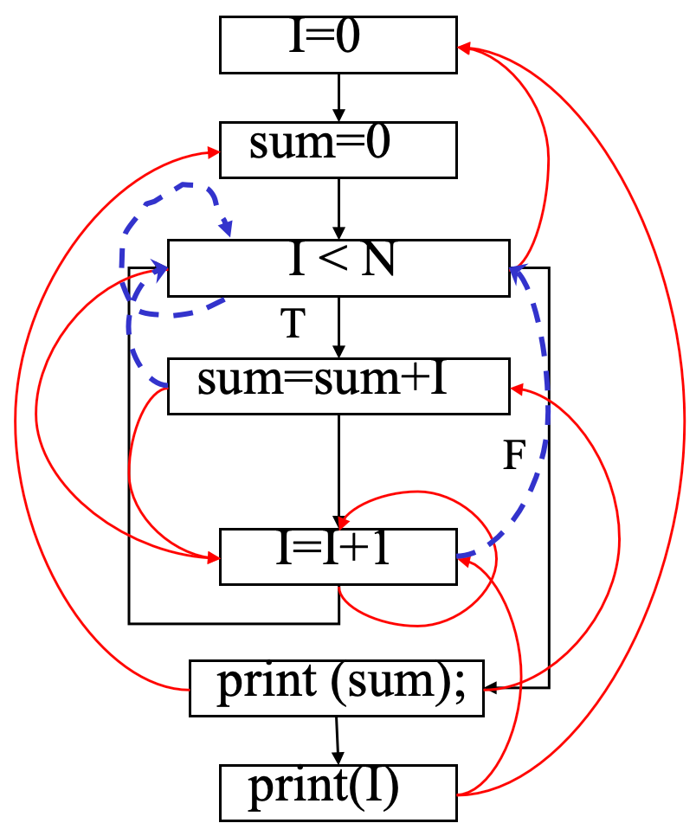
Data/Control Dependence in Dependence Graph
Dependence Graph
  Data dep.
  Control dep.
Y is control-dependent on X iff X directly determines whether Y executes
  X is not strictly post-dominated by Y
  there exists a path from X to Y s.t. every node in the path other than X and Y is post-dominated by Y

Slide 7
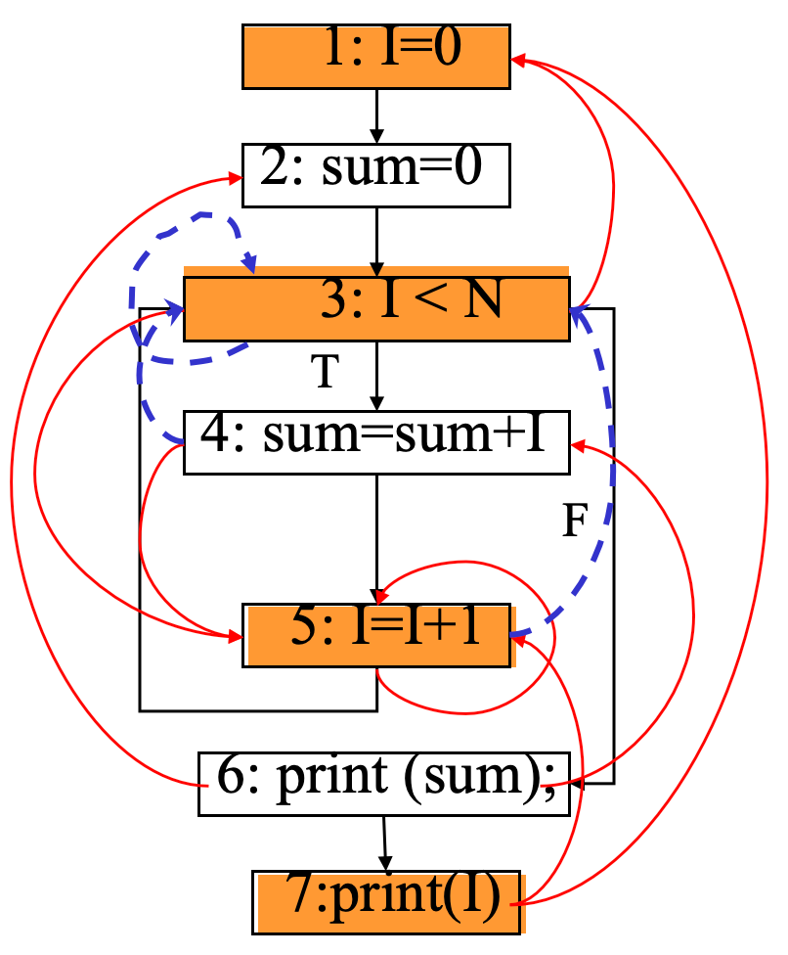
How to Compute Slices
Given a slicing criterion, i.e., the starting point, a slice is computed as the set of reachable nodes in the dependence graph
Slice(I@7)=?
Slice(I@7)={1,3,5,7}

Slide 8
Overview
Program Slicing
LLM-driven Program Slicing
Project 3: RepoSlice
Grading Criteria

Slide 9


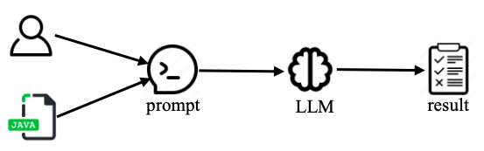





Why We Need LLMs for Program Slicing
Get rid of compilation
Easy to migrate to different programming languages
uncompilable
Compiler
c
Frontend
ompilable
IR
Slicer
result
Existing Static
Program Slicer
LLM-driven Program Slicer

Slide 10
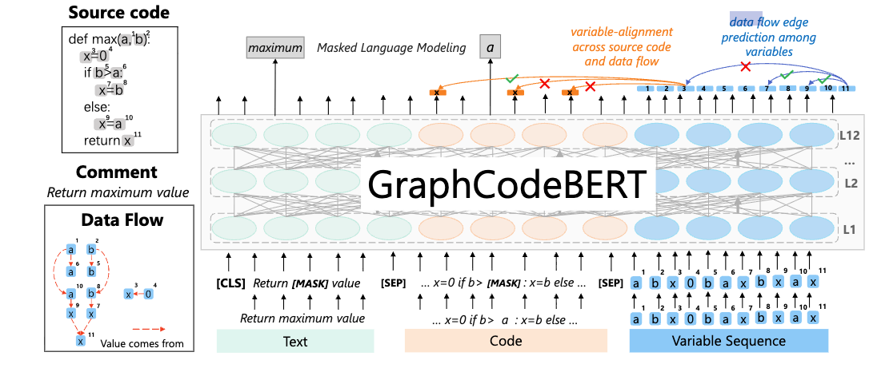
Why LLMs Can Support Slicing
Pretraining Task of GraphCodeBert: Edge Predication
Daya Guo, et al. Pre-training Code Representations with Data Flow, ICLR 2021

Slide 11
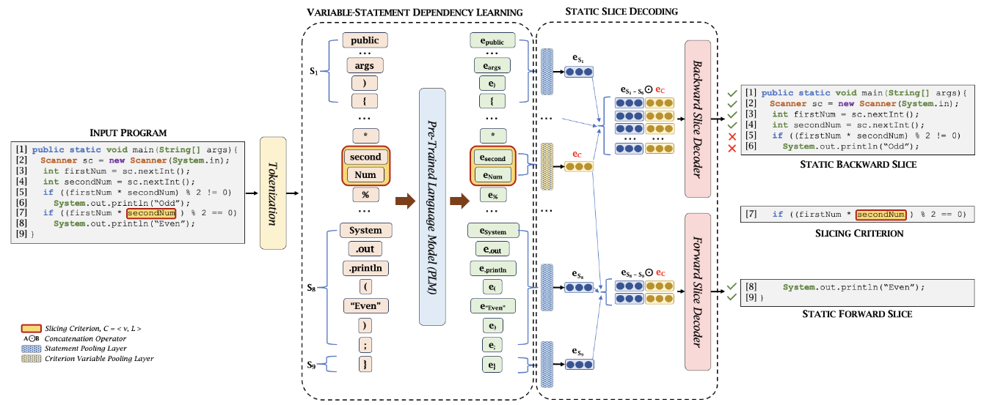
Why LLMs Can Support Slicing
Embedding + Classifier
Aashish Yadavally, et al. A Learning-Based Approach to Static Program Slicing, OOPSLA 2024

Slide 12



Why LLMs Can Support Slicing
Prompt engineering with Decoder-only Models
Please generate the slices containing statement that depend
on the variable repeated at line 3?
src/sofa/pbrpc/pbjson.cc
1. Value* field2json(FieldDescriptor *field, Value* default){
2. ...
3. bool repeated = field->is_repeated;
4. Value* json = NULL;
5. if (repeated) {
6. json = new Value(kArrayType);
7. }
8. switch (field->cpp_type()){
9. case CPPTYPE_DOUBLE:
10. ...
default: break;
}
if (!repeated || field->value.GetType() != kArrayType)
14. Return json;
15. return default;
16. }
Line 3: Definition of repeated - starting point
Line 5: Condition directly uses repeated - data dependent
Line 6: Executes only when repeated is true - control dependent on line 5
Line 7: Closing brace of if block - part of control structure
Line 13: Condition uses repeated in boolean expression - data dependent
Line 14: Executes only when line 13 condition is true - control dependent on line 13
Therefore, we have the slices as follows:
3. bool repeated = field->is_repeated;
5. if (repeated) {
6. json = new Value(kArrayType);
7. }
13. if (repeated && field->value.GetType() != kArrayType)
14. return json;

Slide 13

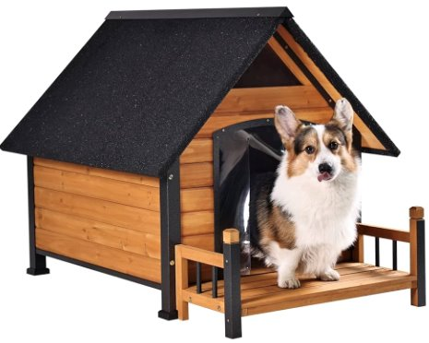
LLM-driven Program Slicing
From intra-procedural slicing to repository-level slicing
  Building block: LLM-driven intra-procedural slicing
  Mission: Extract slices for a whole repository

Slide 14
Demo Time
Demo I: End-to-end program slicing
Demo II: Program slicing using Cursor agent

Slide 15
Overview
Program Slicing
LLM-driven Program Slicing
Project 3: RepoSlice
Grading Criteria

Slide 16
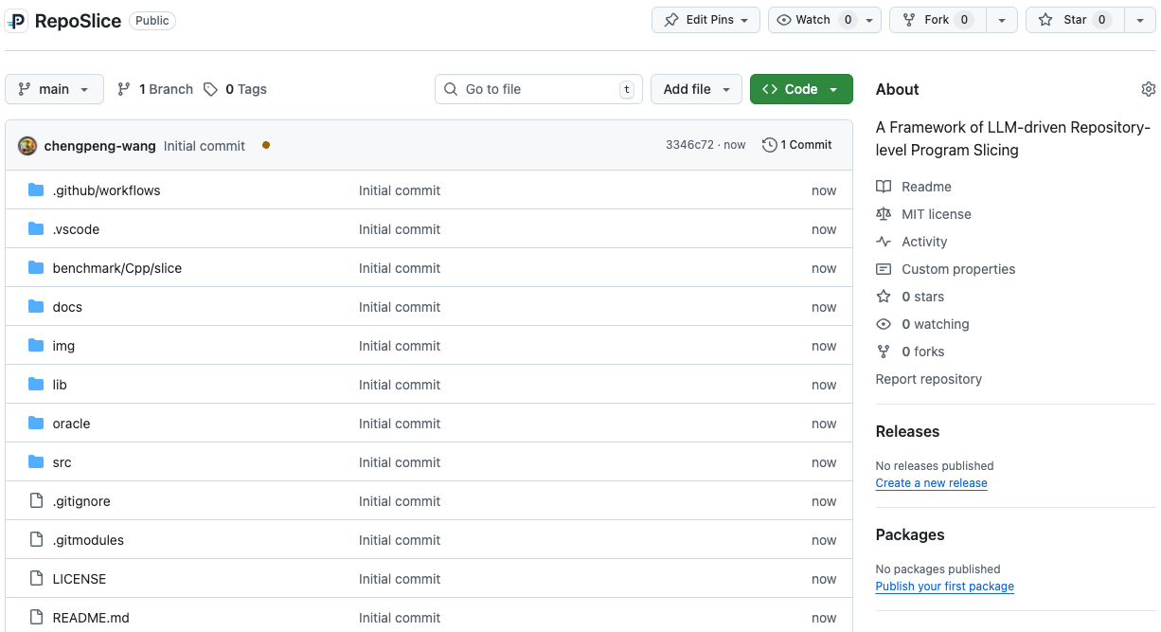
Project 3: RepoSlice
https://github.com/PurCL/RepoSlice

Slide 17
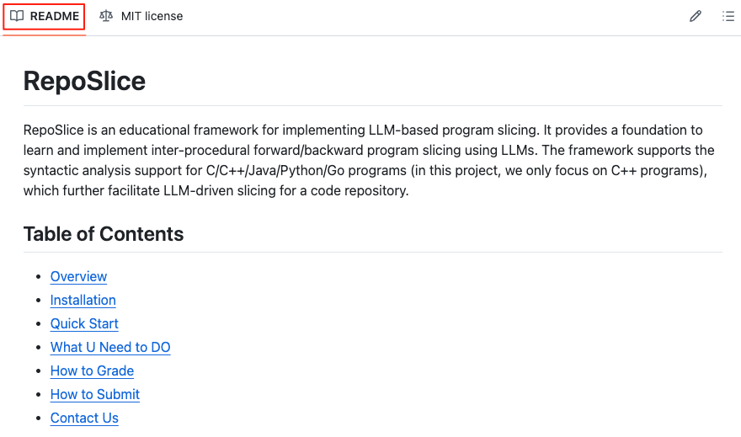
RepoSlice: README

Slide 18
Project 3: RepoSlice
Overview
Installation and Quick Start
What U Need to Do
Demo Time
Utilities
Submission

Slide 19
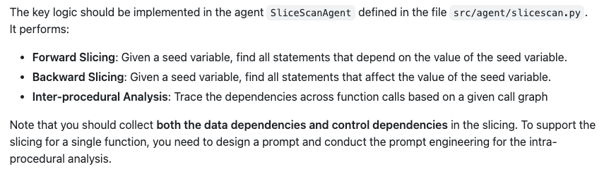
RepoSlice: Overview

Slide 20





RepoSlice: Overview
parsing library: Tree-Sitter
U6IR
Call graph
Function meta-data
TS-Analyzer
SliceScanAgent
Slices
Slicing Request

Slide 21
Project 3: RepoSlice
Overview
Installation and Quick Start
What U Need to Do
Demo Time
Utilities
Submission

Slide 22
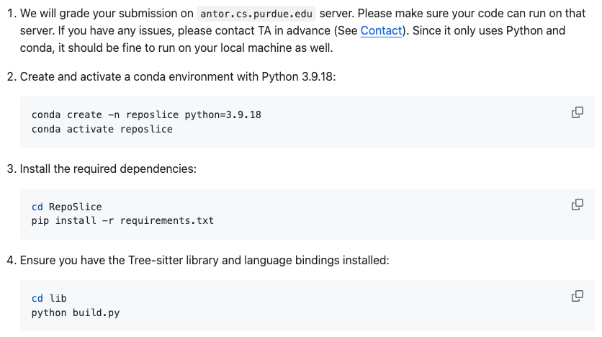
RepoSlice: Installation and Quick Start
Installation

Slide 23
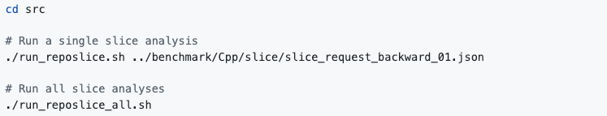
RepoSlice: Installation and Quick Start
Quick Start
  We prepare three example projects in benchmark/Cpp/slice
  Test the framework with the provided example projects:
  After analysis, results will be available in
    Log files: log/SliceScanAgent/
    Result files: result/SliceScanAgent/

Slide 24
Project 3: RepoSlice
Overview
Installation and Quick Start
What U Need to Do
Demo Time
Utilities
Submission

Slide 25
RepoSlice: What U Need to Do
Backward slicing
  Rule I: If the seed depends on a parameter, jump out of the current function and set the corresponding arguments in the caller functions as the seed of slicing the caller functions.
void goo(int w) {
…
y = w + 1;
foo(y, 1);
}
…
parameter
void foo(int a, int b) {
…
x = a + 1;
print(x);
}
argument
void hoo(int u) {
…
z = u - 1;
foo(z, 1);
}
…
callee function
argument
caller functions

Slide 26
RepoSlice: What U Need to Do
Backward slicing
  Rule II: If the seed depends on the value of a call expression (i.e., output value), step into the callee function and set the return value of the callee function as the seed of slicing callee functions
void foo(int a, int b) {
…
x = goo(a) + 1;
print(x);
}
int goo(int w) {
…
z = w + 1;
return z;
}
output value
return value
caller function
callee function

Slide 27
RepoSlice: What U Need to Do
Forward slicing
  Rule I: If the seed value affects an argument of a call expression, step into the callee function of the call expression and set the corresponding parameter as the seed of slicing the callee function.
parameter
void goo(int w) {
…
y = w + 1;
foo(y, 1);
}
void foo(int a, int b) {
…
x = hoo(a) + 1;
print(x);
}
argument
caller function
callee function

Slide 28
RepoSlice: What U Need to Do
Forward slicing
  Rule II: If the seed value affects a return value of the current function, jump out of the current function and set the corresponding call expression (i.e., output value) in the caller function as the seed of slicing the caller function
int goo(int w) {
…
z = w + 1;
return z;
}
void foo(int a, int b) {
…
x = goo(a) + 1;
y = x + 1;
}
output value
return value
callee function
caller function

Slide 29
RepoSlice: What U Need to Do
Several program lines do not really matter
  The function declaration
  The variable declaration
  Big brackets (i.e., { and })
  Space lines
We add them in the whitelist
  Just ignore them
1. void foo (int a) {
2. int I;
3. I = 0;
4. int sum=0;
5. while (I<N) {
6. sum=add(sum,I);
7. I=add(I,1);
8. }
9.
10. return 0;
11. }

Slide 30
RepoSlice: What U Need to DO
parsing library: Tree-Sitter
U6IR
Call graph
Function meta-data
TS-Analyzer
SliceScanAgent
Slices
Maintain a queue as a worklist
Process each intra-procedural slicing instance
Collect the slices in relevant functions
Slicing Request

Slide 31
RepoSlice: What U Need to Do
Implement SliceScanAgent in src/agent/slicescan.py
Implement SliceScanState in src/memory/state/slicescan_state.py
Design and polish the Prompts
  src/prompt/Cpp/slicescan/forward_slicer.json
  src/prompt/Cpp/slicescan/backward_slicer.json

Slide 32
Project 3: RepoSlice
Overview
Installation and Quick Start
What U Need to Do
Demo Time
Utilities
Submission

Slide 33
RepoSlice: Demo Time
Demo I: Walk through RepoSlice
Demo II: Run intra-procedural backward slicing

Slide 34
Project 3: RepoSlice
Overview
Installation and Quick Start
What U Need to Do
Demo Time
Utilities
Submission

Slide 35
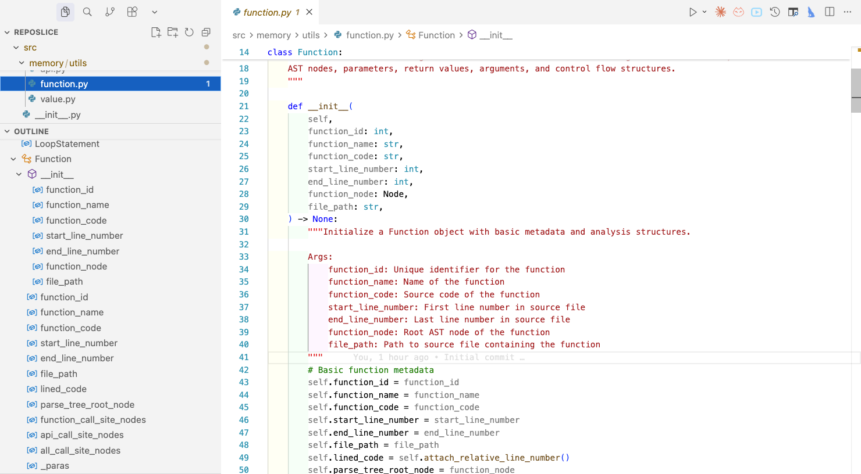
RepoSlice: Utilities
Function (src/memory/utils/function.py)

Slide 36
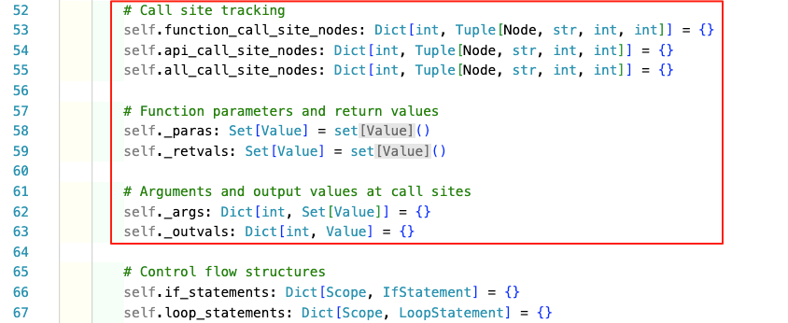
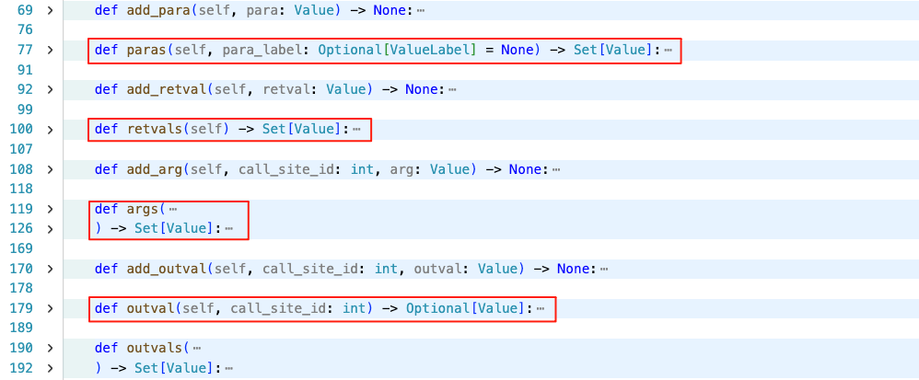
RepoSlice: Utilities
Function (src/memory/utils/function.py)

Slide 37

RepoSlice: Utilities
U6IR (src/memory/memory/IR/U6IR.py)

Slide 38
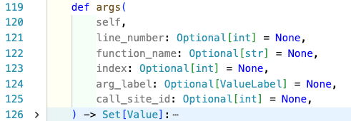
Example Implementation
Find arguments that match with the given parameter
  Input: argument value and its index
  Step I: Retrieve all the caller functions
  Step II: Get all the call sites in the caller functions invoking the current function
  Step III: Select arguments of each call site with the same index

Slide 39
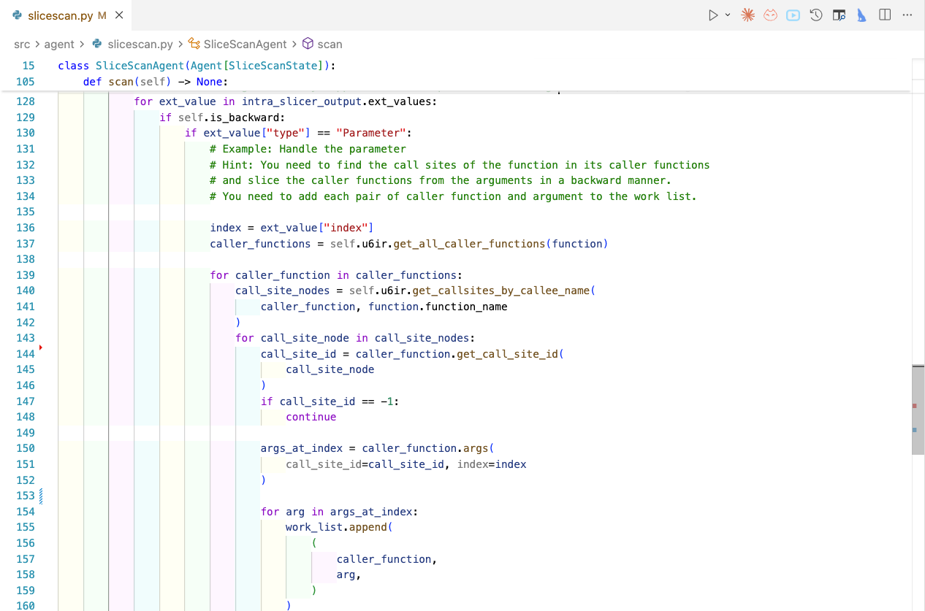

Slide 40
Project 3: RepoSlice
Overview
Installation and Quick Start
What U Need to Do
Demo Time
Utilities
Submission

Slide 41
RepoSlice: Submission
Compress the directory src ONLY into proj3_<FirstName>_<LastName>.tar.gz
Submit it to Brightspace before Dec 12 11:59pm EST
Note that you should not modify other files outside the directory src.
  Don’t load external models.
  If you need other package packages, please email to TA for approval.

Slide 42
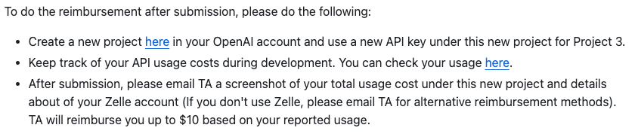
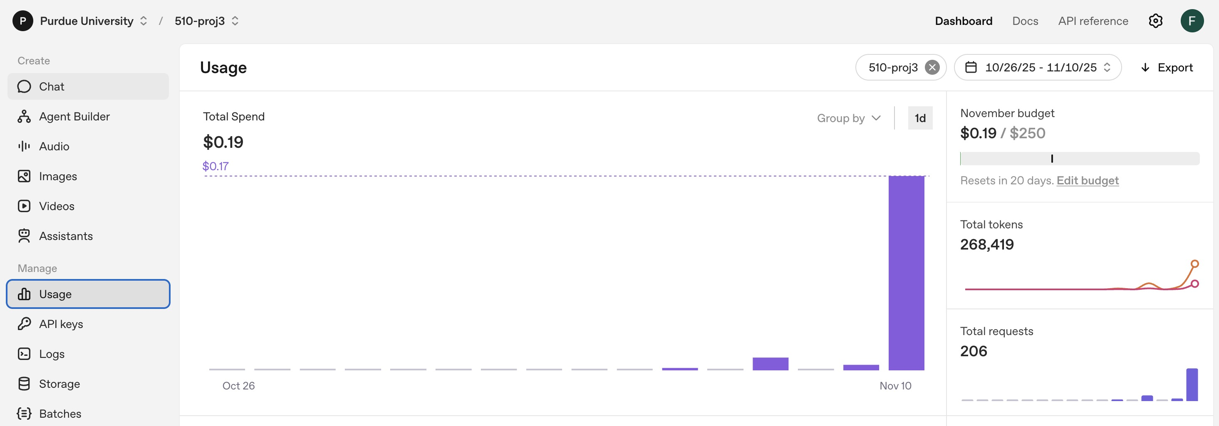
API Token Cost
https://platform.openai.com/settings/organization/projects
https://platform.openai.com/settings/organization/usage

Slide 43
Important Tips
Step-by-step debugging
Read the logs carefully
Make prompts human-interpretable

Slide 44
Overview
Program Slicing
LLM-driven Program Slicing
Project 3: RepoSlice
Grading Criteria

Slide 45
Grading Criteria
Manual check whether all the TODOs are implemented and the two prompt templates are designed
  You should not merge all the file content to invoke LLMs for slicing
  You have to invoke IntraSlicer and implement the worklist algorithm
Testcases: 6 public cases and 4 hidden cases
  C programs with no pointers and recursions
Run RepoSlice using gpt-4o-mini five times and choose the highest scores
  Run run_judger.sh to compute the F1 score
  Obtain the score of each slicing request: min(Your_F1_score × 1.25, 1.0) × 10

Slide 46
Q & A
We will upload the recording of this tutorial to Brightspace
If you have any further questions, please feel free to reach out to us:
  Chengpeng Wang: wang6590@purdue.edu
  Shiwei Feng: feng292@purdue.edu

