Slide 1
Classes in Python

Slide 2
But first, Format Strings!

Slide 3
Why Classes?
Limitations of standard data types and collections
Makes code more manageable, maintainable, and reduces errors
You could define an employee like:
employee1 = [“Mary”, 34, “CTO”, 190_000]
employee2 = [“Mark”, 23, “Janitor”, 90_000]
What are the potential problems of this system?

Slide 4
Classes vs Instances
Classes are the overarching blueprint
An instance is an object created from that blueprint
Let’s try it out, follow along on your console

Slide 5
Defining a Class
class Dog:
pass

Slide 6
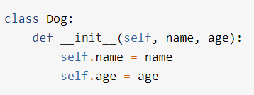
Adding an init method

Slide 7
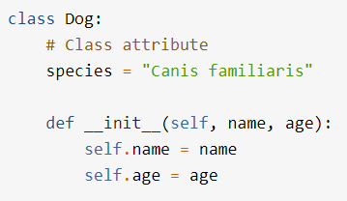
Creating a Class Attribute

Slide 8
Make and Compare Instances
Create two instances of dogs with names and ages
Access their values
Change their values
Compare them using the == operator
== operator vs the ‘is’ keyword: How can this be problematic
Bonus: Dunder methods, after next slide

Slide 9
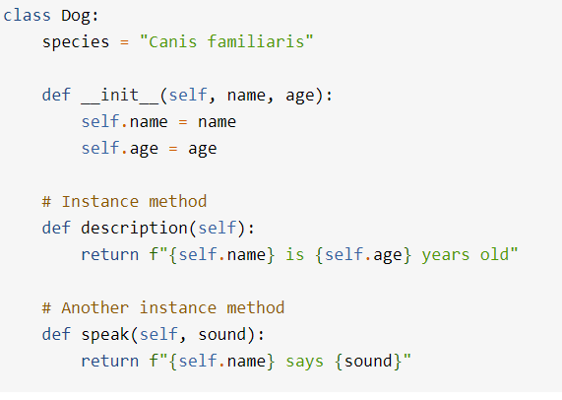
Methods
Try out these methods with some
new dog instances

Slide 10
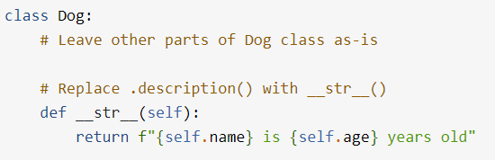
Implement a Dunder Method
Then try out the print method
Bonus: Implement a ‘greater than’ dunder method to allow dogs to be compared by age

Slide 11
Inheritance
Child and Parent Classes
Child classes can override parent methods and attributes
Child classes can add new methods and attributes
A note a typing and classes

Slide 12
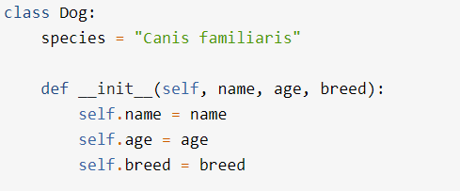
Modify your class

Slide 13
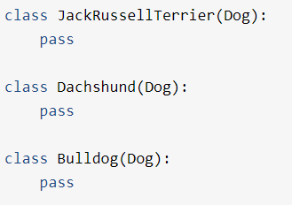
Create Child Classes
Make one instance of each, check to verify
that everything still works.
Then check them using the `type` function
Check both child and parent class using
the `isinstance` function

Slide 14


Extend Functionality

Slide 15
Solve the Problems for Classes

