Slide 1
File Input and Output

Slide 2


Opening and Closing Files
Two main methods, one is better than the other

Slide 3
File Modes
Read Only (‘r’) : Open text file for reading. The handle is positioned at the beginning of the file. If the file does not exist, raises I/O error. This is also the default mode in which file is opened.
Read and Write (‘r+’) : Open the file for reading and writing. The handle is positioned at the beginning of the file. Raises I/O error if the file does not exist.
Write Only (‘w’) : Open the file for writing. For existing file, the data is truncated and over-written. The handle is positioned at the beginning of the file. Creates the file if the file does not exist.
Write and Read (‘w+’) : Open the file for reading and writing. For existing file, data is truncated and over-written. The handle is positioned at the beginning of the file.
Append Only (‘a’) : Open the file for writing. The file is created if it does not exist. The handle is positioned at the end of the file. The data being written will be inserted at the end, after the existing data.
Append and Read (‘a+’) : Open the file for reading and writing. The file is created if it does not exist. The handle is positioned at the end of the file. The data being written will be inserted at the end, after the existing data.

Slide 4



Reading From a File

Slide 5

Writing to a File

Slide 6
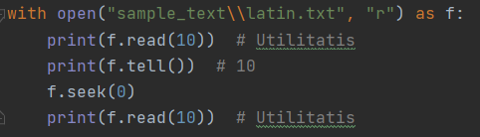
Positioning Within a File
Accomplished with seek and tell
Warning: You probably don’t need them for this lesson

Slide 7
Use Functions from the os module
listdir – Takes as input a directory, lists all files and directories in that directory. Assumes the current directory if not provided.
rename – Takes the path of the original file, and the new name for the file
remove – Takes a file path, then removes the file
mkdir – Makes a dir

Slide 8
A note on file separators
Windows uses “\” to separate files and directories in filepaths
Unix systems use “/” to separate files and directories in filepaths
As a lazy solution for interoperability, python will recognize “/” as working on Windows systems. The reverse is not true.
This is a bit of a hack that only works for small scripts.
A more professional solution would be to use the pathlib module.

Slide 9
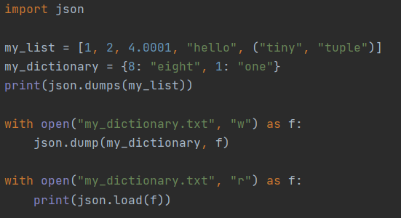
Working with JSON

