Slide 1
Working with Exceptions

Slide 2
What are Exceptions?
Syntax Errors vs Exceptions (Syntax Errors are exceptions, but you won’t work with them)
Exceptions are ‘thrown’ when a program in unable to continue execution normally
Catching exceptions vs letting them bubble up, potentially ending the program
Python recommends you ask for forgiveness rather than permission (i.e. only handle stuff when you have a good reason)

Slide 3
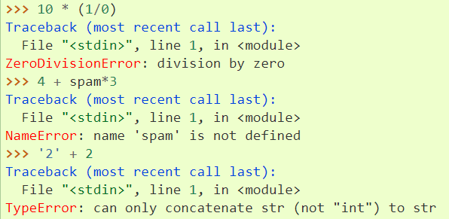
When do Exceptions occur?

Slide 4
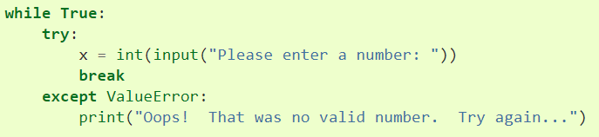
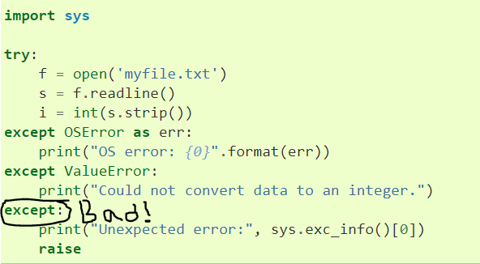
How to Handle Exceptions

Slide 5
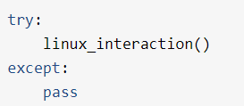
How Not to Handle Exceptions
Avoid having a blank exception
If you really want to do this, indicate it using `except Exception:`
Catching an exception only to pass
Don’t catch exceptions just because they occur, have a reason in code to work with them

Slide 6
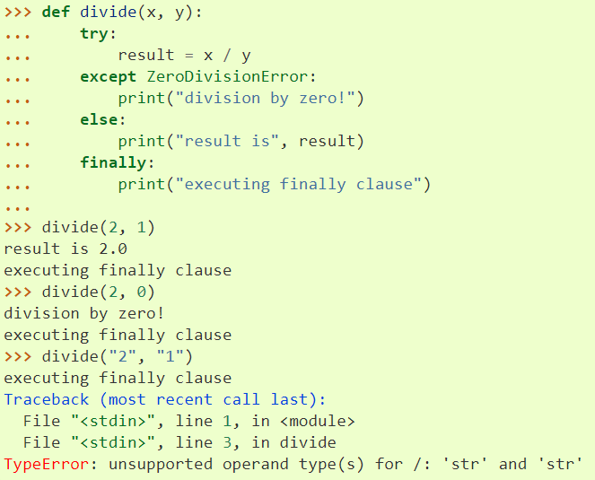
else and finally with Try/Except
else runs if no exception occurs
finally runs regardless of exceptions
finally runs even if new errors are raised, or if break, continue, or return statements occur

Slide 7
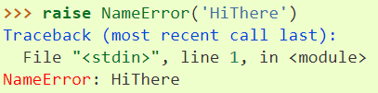
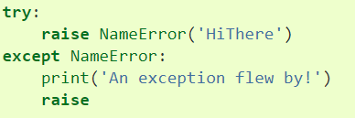
The raise Statement
With an argument, throws an exception
Without, it raises the current exception

Slide 8
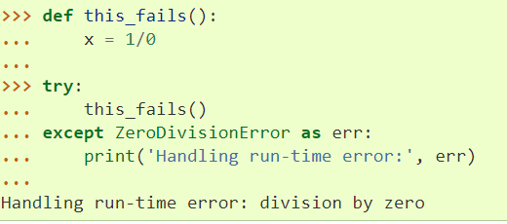
Exceptions Cascade Back Through Functions

Slide 9
Break for the Exceptions Notebook

