Slide 1
Introduction to Functions

Slide 2
What are functions?
Encapsulate functionality
Parameterized
Return values or change variables outside of their scope

Slide 3
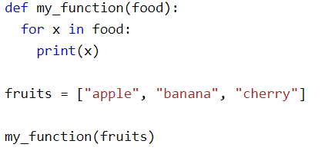
Parameters
Parameters vs Arguments (Mildly pedantic

Slide 4
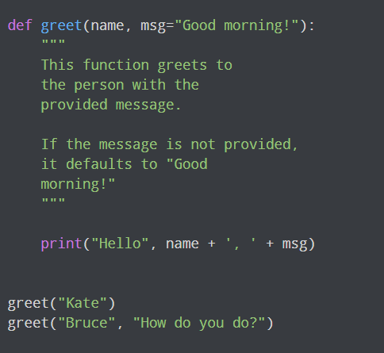
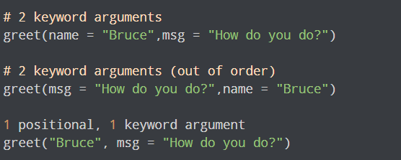
Keyword and Default Arguments

Slide 5
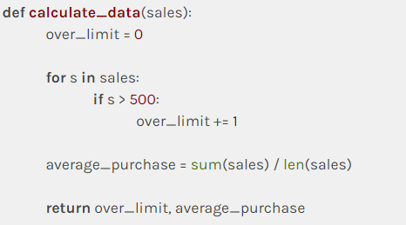
Returning Values
You can return one value or multiple values in a Tuple
You may unpack them when the values are returned

Slide 6
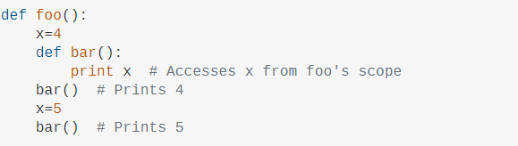
Scoping
LEGB Rule
Local
Enclosing
Global
Built-Ins

Slide 7
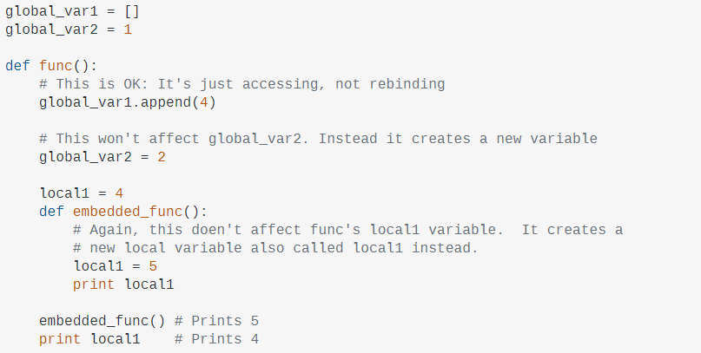
Scoping (cont.)

Slide 8
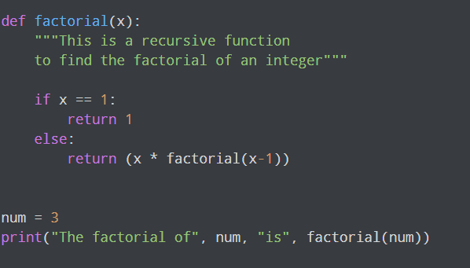
Recursion
Functions can call themselves
Generally, use base cases first followed by the recursion

Slide 9
Typing
A “relatively” new feature in Python. (Since 2014)
Unlike other languages, does NOT change Python’s behavior. Purely for people or entities that read the code.
Practically used by IDE’s to assist in identifying code problems.

Slide 10
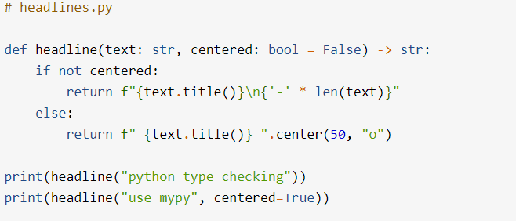
Typing Example
Notes:
Demonstrate type checking by IDE in code editor

Slide 11

Bonus: Anonymous Functions
Use the keyword “lambda”
Use in specialized circumstances, probably not needed in this class

