Slide 1
Networking with Sockets

Slide 2
What are sockets?
Connect individual services between nodes.
Normally require IP addresses and ports for the client and server.
Focus exclusively on TCP for this class
TCP comes with built in reliability mechanisms that are transparent to the socket.
Notes:
Skip if OSI 7-layer model was previously covered.

Slide 3
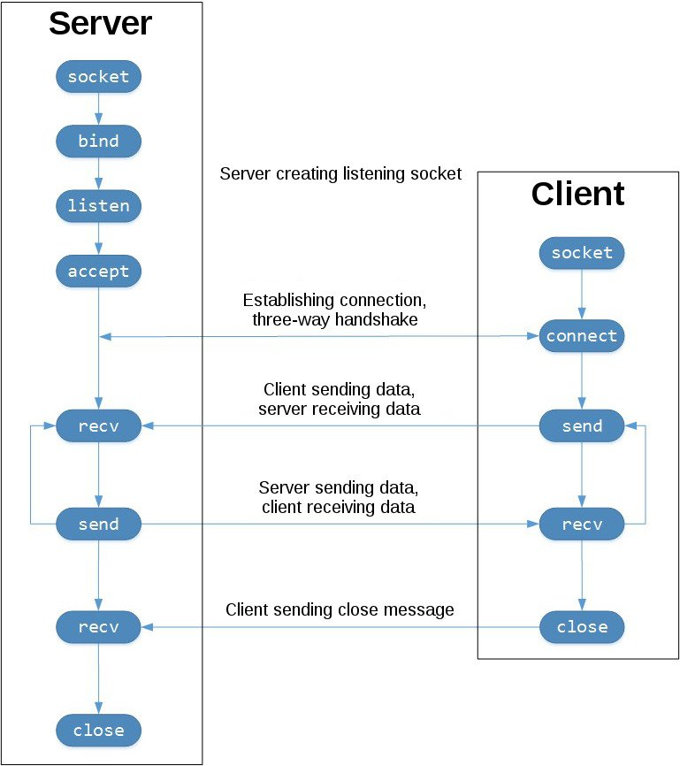

Slide 4
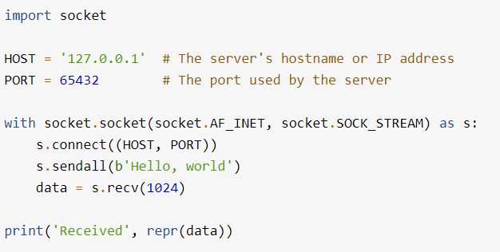
The Echo Client
Chooses an ephemeral port for the client’s connection

Slide 5
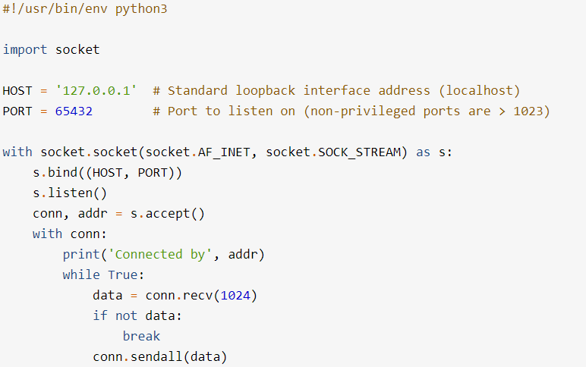
Echo Server Overview
AF_INET indicates IPv4
SOCK_STREAM indicates TCP
IPv6 and UDP beyond the scope of this course, but not too different

Slide 6

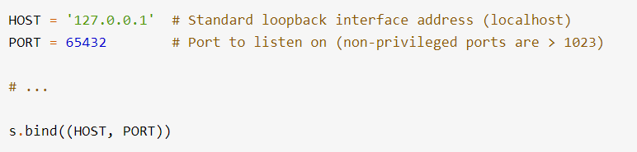
Initial Set Up and Binding to a port
Using the ‘with’ context manager vs the traditional close method
bind takes a tuple of a host string and port integer

Slide 7
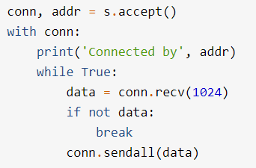
Receiving a Connection and Echoing
An accepted connection returns a socket connection and a tuple of the ip and port of the remote socket connection

Slide 8
Bytes vs Strings
Python’s String and Bytes data structures are similar but have a few critical differences
For Strings each entry is a single character, so each entry could be multiple bytes depending on what type of character it is (e.g. emoji’s take multiple bytes but are a single character)
For Bytes each entry is a single byte, so for a multi byte character such as an emoji it would have multiple sequential entries.

Slide 9
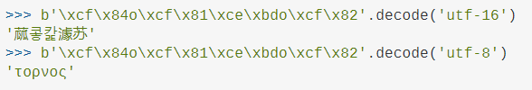

Bytes vs Strings (cont.)
Sockets expect Bytes objects as inputs to send and returns Bytes objects from recv.
You can convert back and forth using encode and decode methods

Slide 10
Troubleshooting (You’ll need it)
You will likely run into ‘zombie’ sockets that hog a port after you want them shutdown, preventing use of that port.
Use `netstat -ano` to check current sockets on your computer.
On linux systems use `lsof -i –n` to identify sockets and their associated process IDs.
Both have a lot of output, so pipe to `grep` or `findstr` for your port on linux and windows, respectively.
Use `kill` on both systems to kill the process associated with the socket. Some trial and error may be required.
On windows you can also use task manager to kill processes.
ctl+shift+escape is an easy way to bring up the task manager

