Slide 1
Threading

Slide 2
What is a thread?
A thread is an entity within a process that can be scheduled for execution. Also, it is the smallest unit of processing that can be performed in an OS (Operating System).
Threads vs Processes
Threads each possess a separate execution stack
Threads share data within their process
Normally in Python, only one Thread is ever running at a time, though the CPU switches between them rapidly enough to often make it seem like they’re running at the same time.

Slide 3
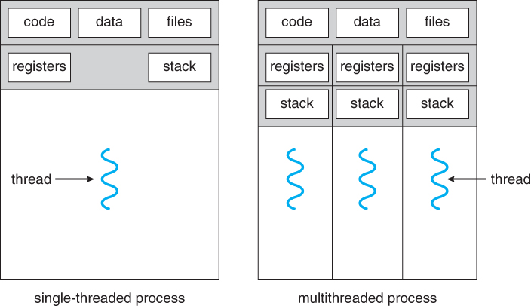

Slide 4
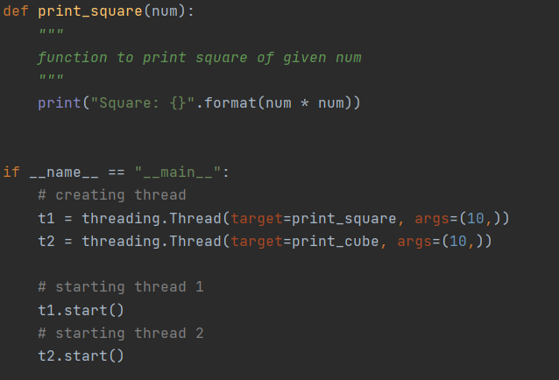
Creating Threads
Use the threading module
threading.Thread to create
The start method to begin running

Slide 5
Thread Creation
class threading.Thread(group=None, target=None, name=None, args=(), kwargs={}, *, daemon=None)
This constructor should be called with keyword arguments:
target is a callable function that will be run
args is the argument tuple for the target function. Defaults to ().
kwargs is a dictionary of keyword arguments for the target function. Defaults to {}.
If not None, daemon explicitly sets whether the thread is daemonic. If None (the default), the daemonic property is inherited from the current thread.

Slide 6
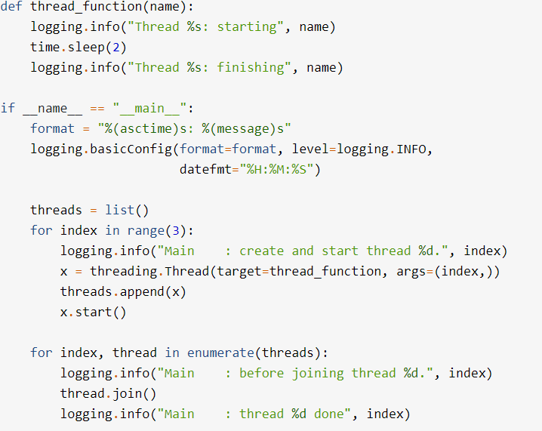
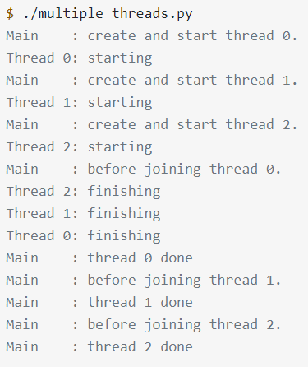
Using the Join Method

Slide 7
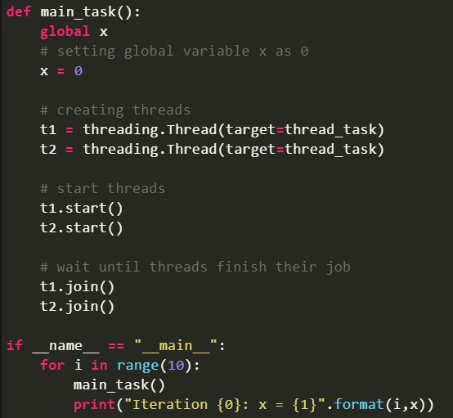
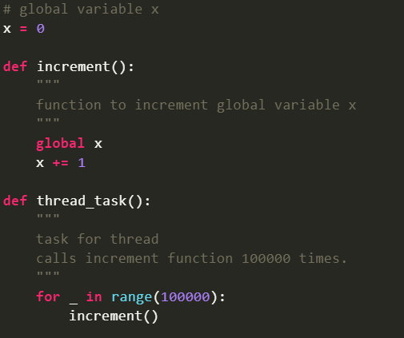
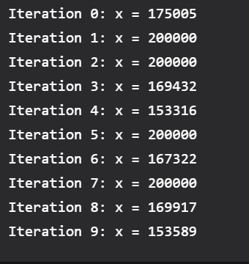
Race Conditions

Slide 8
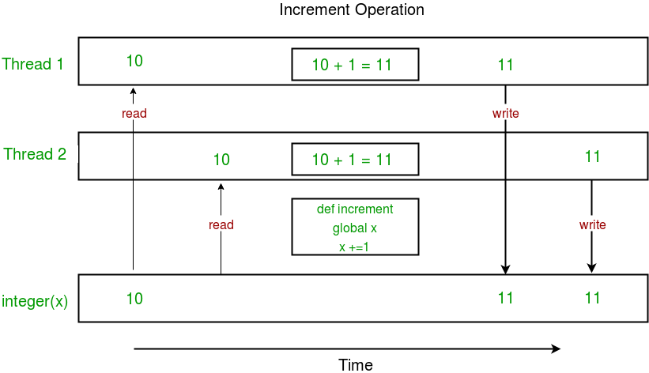
What’s causing the Race Condition?
Multiple threads trying to access the same shared resource

Slide 9
Using Locks to Solve Race Conditions
Solved using a Lock
Lock has two methods relevant to us:
acquire
Release
Using these we can synchronize threads accessing the same resources

Slide 10
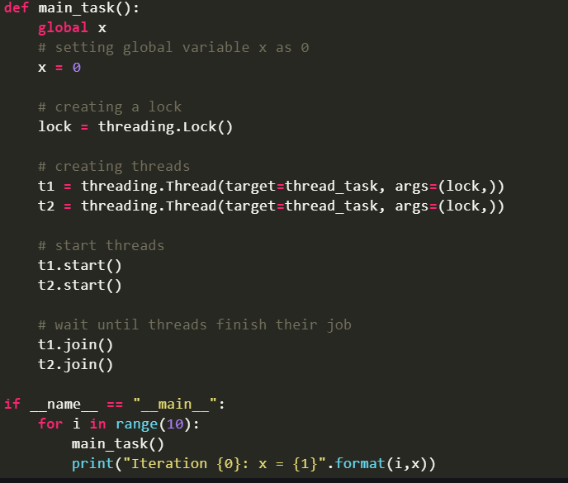
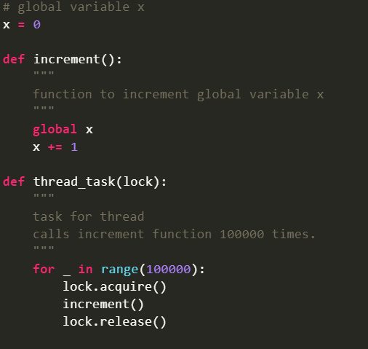
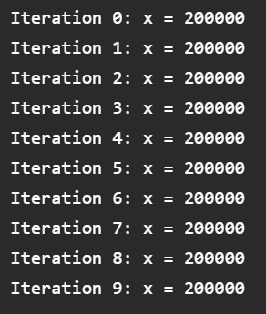
Race Conditions: Revisited

Slide 11
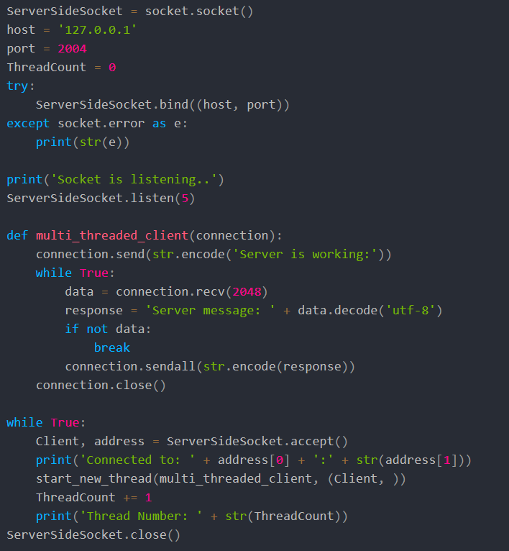
Acting as a Server for Multiple Connections
Accept can be called multiple times for a listening socket
Each time accept is called it waits for the next client to connect.

Slide 12
Break for the Threading Workbook

