Slide 1
Project56 - Presentation by Group 1: 'Cooperatio'
This project was realized by the following merry men:
Steven Schenk, robin bakker, Cees-Jan Nolen, Robert Kraaijeveld

Slide 2
What this presentation is all about:
A quick live overview of the project that we made (starting now)
An overview of the programming languages, paradigms and frameworks that we used.
The coolest part: Each team-member will showcase some of their best work!

Slide 3



Our progamming languages of choice:

Slide 4
Why did we choose these three?
We chose C++ as one of our back-end languages because of its' speed and reliability, and because it is OO.
We chose C as our other back-end language because of its' speed and reliability (again) and because it works well with the Linux Os.
We chose for Laravel to be our front-end framework because it does a lot of small programming tasks for you.
(more on Laravel later)

Slide 5
Cees-Jan Nolen The CSV-reader, the Database-entities and the listener...

Slide 6
The making of the listener and CSV-reader
In the beginning of the project, we made our own CSV-reader which parsed CSV files!
It became redundant over time, but it is still pretty interesting.
Our listener (which listens for changes in a certain directory) is still in use!
listener(string fullpath) //Listen for any changes in this directory ->
csvreader(string path) //-> Parse the CSV file at this path

Slide 7
Why make our own ORM?
3rd party libraries where very hard to find
When we did find them, they were impossible to install
Also, they often contained functionality we did not need.
So, we made our own:
void MonitoringEntity::insert_in_database() {
ostringstream insert_query;
insert_query << "INSERT INTO monitoring ";
insert_query << "VALUES ('";

Slide 8
Steven Schenk The great FDB and PostgreSQL

Slide 9
Why create File-database? (FDB)
ORM / database-drivers wouldn't work
FDB split large CSV files up into smaller ones and stored them.
This was all done by hand!

Slide 10
FBD's problems:
Problem: Searching for an exact value took too long.
Solution: The creation of an indexation file! This file would store the values of the DateTime and UnitId rows, to make searching faster.

Slide 11
FBD's problems:
Problem: Range-searching takes way too long.

Slide 12
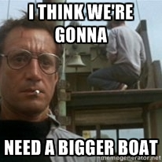

Slide 13
FBD's problems:
Solution: Removing FBD and starting over again,
using PostgreSQL and the PostgreSQL driver for C++:
Libpqxx.
The CSVReader mentioned earlier also made things slower, so it was removed too.

Slide 14
Robert Kraaijeveld The great tale of the PDFCreator and the database-pusher

Slide 15
Why create PDF's?
More data and measurements of data than can be contained in a web page
Easily sharable with co-workers
Easily archivable for later use or for legal reasons
PDF creation enables our user to access their report-history later.
The creation and aggregation of our PDFs can be done 'off-camera' in our C++ code.

Slide 16
How it worked out
Not too good at first.
Our PDF library had no documentation. Literally.
We had few usable aggregations.
We werent sure if creating PDFs was a good choice.
But it got better!
We created usefull aggregation methods.
We cleaned the code, making it into good and propah' Object Oriented C++.

Slide 17
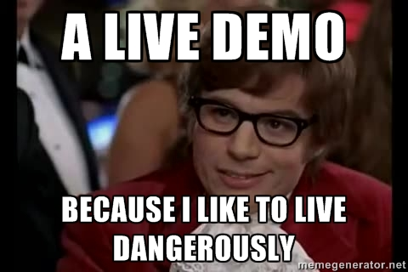
And now...

Slide 18
Robin Bakker The story of Laravel

Slide 19

So whats this Laravel thing, anyway?
Large PHP5 Framework
MVC (Model-View-Controller)

Slide 20
What did we do with it?
Basically, give the user a smooth way to interact with our back-end!
We used routes to configure the accesible URL's on our webpage,
Models to define databases,
And views to create our elegant webpages.
Route::get('uploaded', ['middleware' => 'auth', 'uses' => 'PagesController@uploadFinished']);
Route::get('auth/login', 'Auth\AuthController@getLogin');
Route::post('auth/login', 'Auth\AuthController@postLogin');

Slide 21
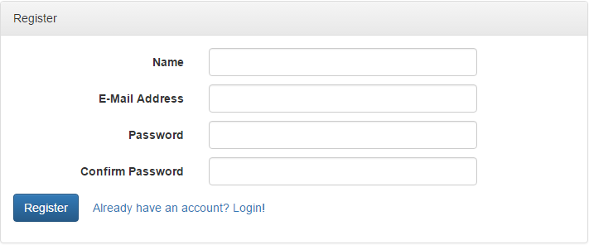
But, there's more!
We created an upload-system,
A user-database including login- and registration-handling,
Not to mention very clean error-handling!

Slide 22

Interested?
Laracon
Amsterdam
23th & 24th August

Slide 23
Do you have any questions that need answering?

Slide 24



