Slide 1
Categorical Cluster Analysis
Xiaoyi Ma
Robert Long

Slide 2

Previously...
Clusters clearly defined (subject $i$)
Explanatory vs outcome also clearly defined
Euclidean distances make sense

Slide 3
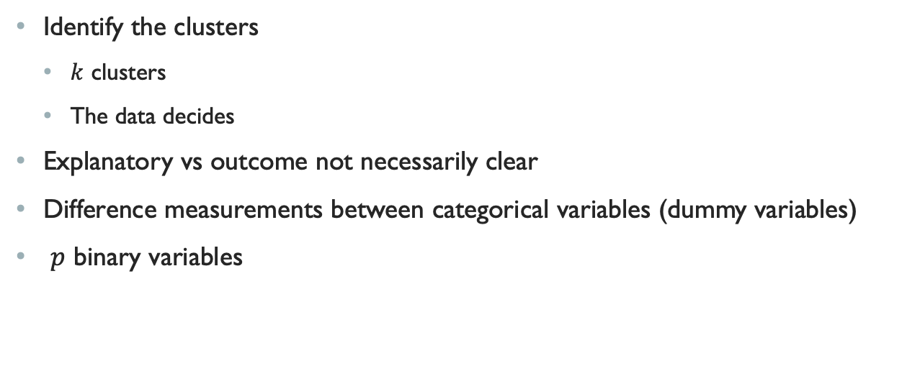
Now…
Identify the clusters
$k$ clusters
The data decides
Explanatory vs outcome not necessarily clear
Difference measurements between categorical variables (dummy variables)
$p$ binary variables

Slide 4
Data
Categorical variables
Vector of binaries (dummy variables)

Slide 5
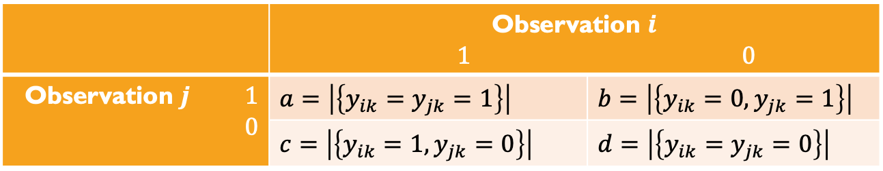
Similarity
 | Observation $i$ $1$ $0$
Observation $j$ $1$ $0$ | $$a=\left|\left\{y_{ik}=y_{jk}=1\right\}\right|$$ | $$b=\left|\left\{y_{ik}=0, y_{jk}=1\right\}\right|$$
 | $$c=\left|\left\{y_{ik}=1, y_{jk}=0\right\}\right|$$ | $$d=\left|\left\{y_{ik}=y_{jk}=0\right\}\right|$$

Slide 6
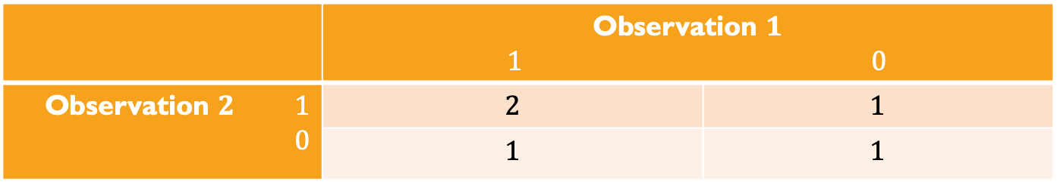

Similarity Example
$$Y_{1}=(0, 1, 1, 0, 1)$$
$$Y_{2}=(1, 1, 0, 0, 1)$$
 | Observation $1$ $1$ $0$
Observation $2$ $1$ $0$ | $$2$$ | $$1$$
 | $$1$$ | $$1$$

Slide 7
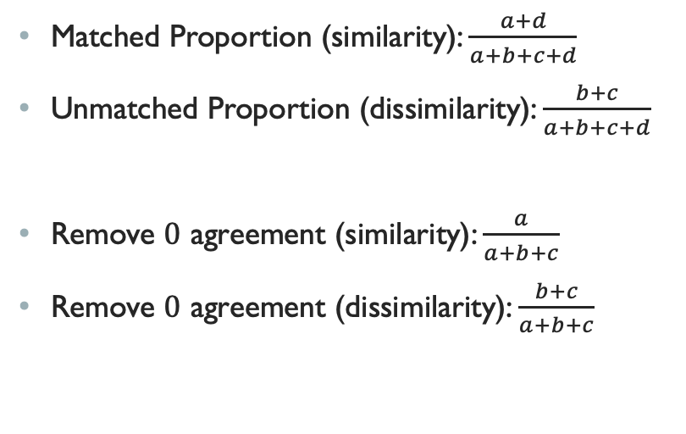
Similarity Metrics
Matched Proportion (similarity): $\frac{a+d}{a+b+c+d}$
Unmatched Proportion (dissimilarity): $\frac{b+c}{a+b+c+d}$
Remove $0$ agreement (similarity): $\frac{a}{a+b+c}$
Remove $0$ agreement (dissimilarity): $\frac{b+c}{a+b+c}$

Slide 8
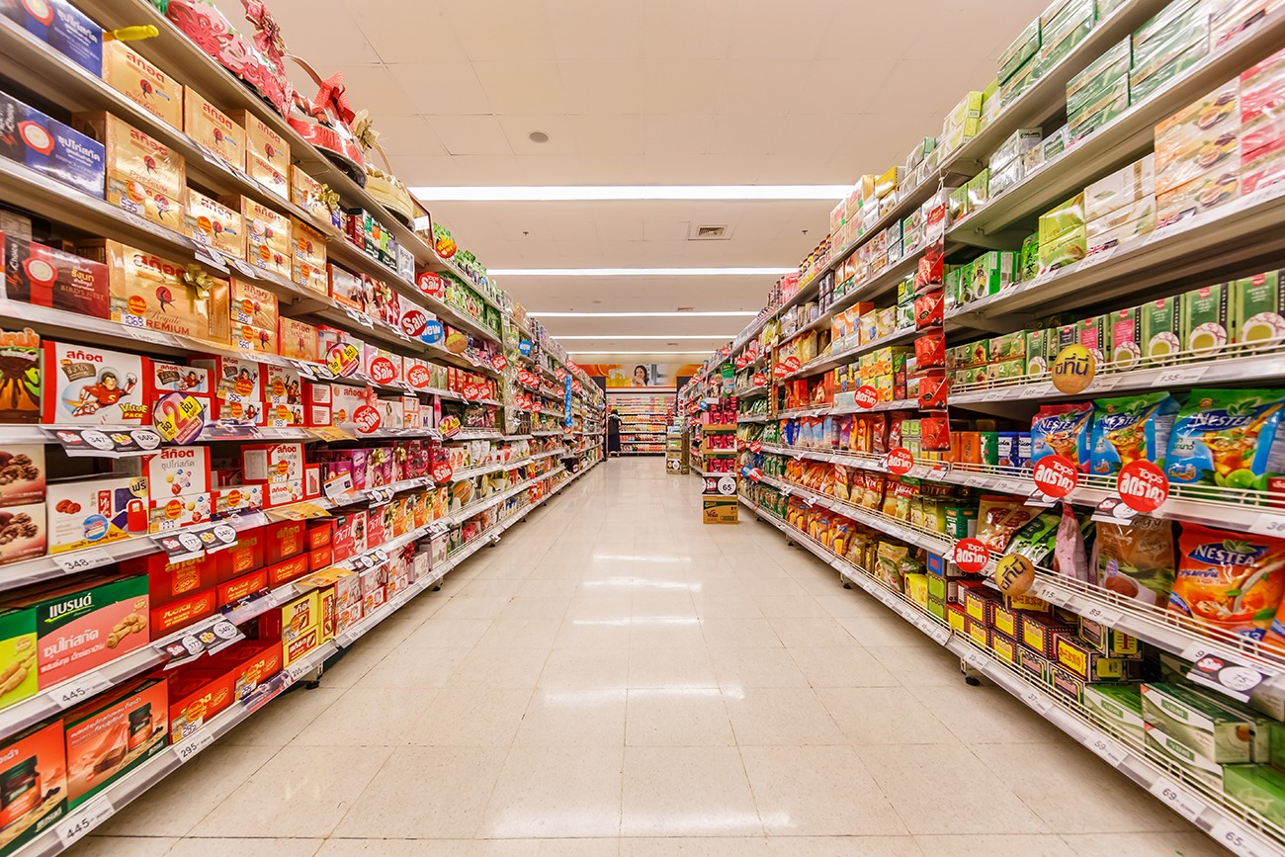
Why Alternate Similarity Metrics?

