Slide 1
Harrod-Neutral Technical Progress and Capital-Theoretic Paradoxes
Robert L. Vienneau
5 April 2025

Slide 2
Approach
Two examples
Two-commodity, circulating capital model
Three-commodity, circulating capital model
Harrod-neutral technical change simplifies the depiction of the evolution of prices of production through secular time
Partitions parameter space with parallel affine functions
No double fluke cases
No fluke switch points on the axis for the rate of profits
Assumes prices of production provide insight
Considers secular evolution, that is, the very long run
Does not address how the dynamics of market prices relate to prices of production and to the variation in the cost-minimizing technique with distribution

Slide 3
Definition of Harrod-Neutrality
“If all the techniques in a technology undergo the same degree of labor-saving technical change, the result is a labor-augmenting technical change, which is called Harrod-neutral… Another way to think of … Harrod-neutral technical change is as a rescaling of the measure of labor input…” -- Foley, Duncan K., Thomas R. Michl, and Daniele Tavani. 2019. Growth and Distribution, 2nd edition. Cambridge: Harvard University Press, p. 66.
Neutrality “implies, to put it roughly, that the productivity of labour embodied in machines is raised in equal measure with that of those engaged on minding machines; it implies an equal rise of productivity on the part of all labour however far back or forward it may be between the inception and the final stage in production...” -- Harrod, Roy. 1948. Towards a Dynamic Economics. London: Macmilan, p. 23.
“A stream of inventions, which are neutral as defined, will, provided that the rate of interest is unchanged, leave the distribution of the total national product as between labour (in the broadest sense) and capital unchanged.” – ibid., p.23.
Some other definitions of neutrality: Hicks-neutral, Solow-neutral

Slide 4
Definitions of Selected Capital-Theory ‘Paradoxes’
Setting:
Comparisons of long run positions, in which production is adapted to effective demand and in which prices of production prevail
The model is open
Either the rate of profits or the wage is taken as given from outside the model
A switch point, in a model of circulating capital, is a wage or rate of profits at which two wage curves intersect
The reswitching of techniques occurs when a technique is cost-minimizing at two discrete ranges of the rate of profits or the wage, with other techniques cost-minimizing in intermediate ranges
Capital-reversing occurs when the technique that is cost-minimizing at a lower wage or higher rate of profits, around a switch point, requires less labor or a higher ratio of the value of capital to output to produce the same net output
The reverse substitution of labor occurs when, around a switch point, a lower wage or a higher rate of profits is associated, in one industry, with a smaller amount of labor per unit of gross output.
Other examples: Process recurrence, phenomena related to the economic life of a machine, the order of fertility, and the order of rentability

Slide 5
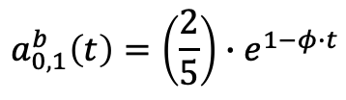
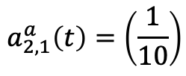
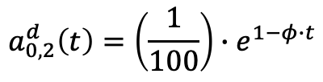
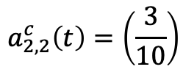

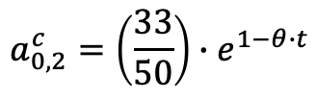
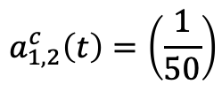
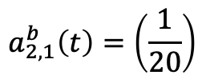

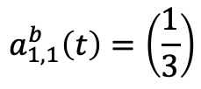


Example Technology for Harrod-Neutral Technical Progress
Iron Industry
Corn Industry
INPUTS
Process a
Process b
Process c
Process d
Labor
(Person-Yrs)
$$a_{0,1}^{b}\left(t\right)=\left(\frac{2}{5}\right)∙e^{1−φ∙t}$$
$$a_{0,2}^{c}=\left(\frac{33}{50}\right)∙e^{1−θ∙t}$$
$$a_{0,2}^{d}\left(t\right)=\left(\frac{1}{100}\right)∙e^{1−φ∙t}$$
$$a_{0,1}^{a}=e^{1−θ∙t}$$
Iron (Ton)
$$a_{1,1}^{b}\left(t\right)=\left(\frac{1}{3}\right)$$
$$a_{1,2}^{c}\left(t\right)=\left(\frac{1}{50}\right)$$
$$a_{1,2}^{d}\left(t\right)=\left(\frac{71}{100}\right)$$
$$a_{1,1}^{a}\left(t\right)=0$$
Corn
(Bushels)
$$a_{2,1}^{a}\left(t\right)=\left(\frac{1}{10}\right)$$
$$a_{2,1}^{b}\left(t\right)=\left(\frac{1}{20}\right)$$
$$a_{2,2}^{c}\left(t\right)=\left(\frac{3}{10}\right)$$
$$a_{2,2}^{d}\left(t\right)=0$$
OUTPUTS
1 Ton Iron
1 Ton Iron
1 Bushel Corn
1 Bushel Corn

Slide 6
Techniques
Technique
Iron Industry
Corn Industry
Alpha
Process a
Process c
Beta
Process a
Process d
Gamma
Process b
Process c
Delta
Process b
Process d

Slide 7
Notes On Technology
Alpha and Delta experience Harrod-neutral technical change, possibly at different rates
Beta and Gamma combine processes from the two techniques with Harrod-neutral technical change
Iron and corn are Sraffa-basics in all techniques. Corn is numeraire.
Extends reswitching example from Bruno, Burmeister, Sheshinski (1966). Their example lacks the second iron-producing process and technical change
Problem: How does the analysis of the choice of technique, with prices of production, vary as technical change occurs in secular time?

Slide 8
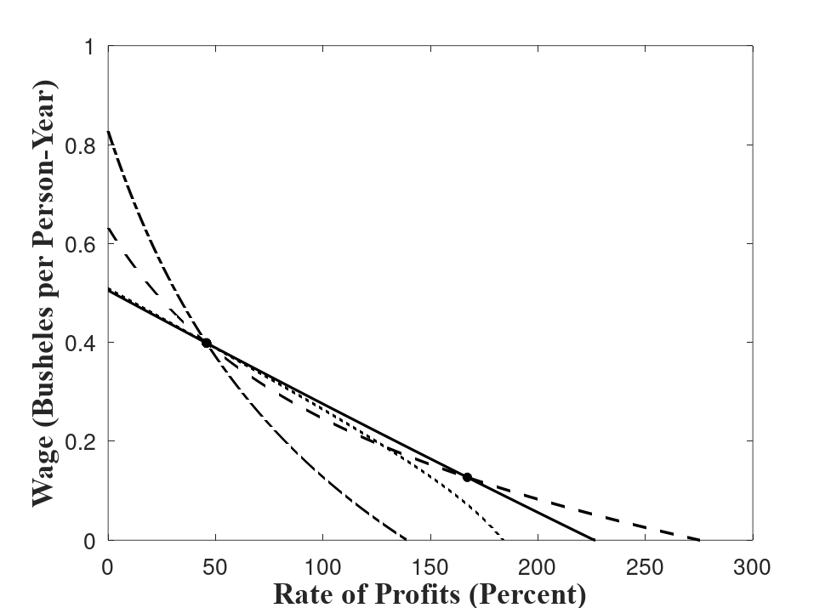



An Example for the Choice of Technique
$$θ=0.8$$
Delta
$$φ=0.096$$
$$t≈0.36344039$$
Switch point at which four wage curves intersect
Alpha
Switch point with capital-reversing
Beta
Gamma

Slide 9
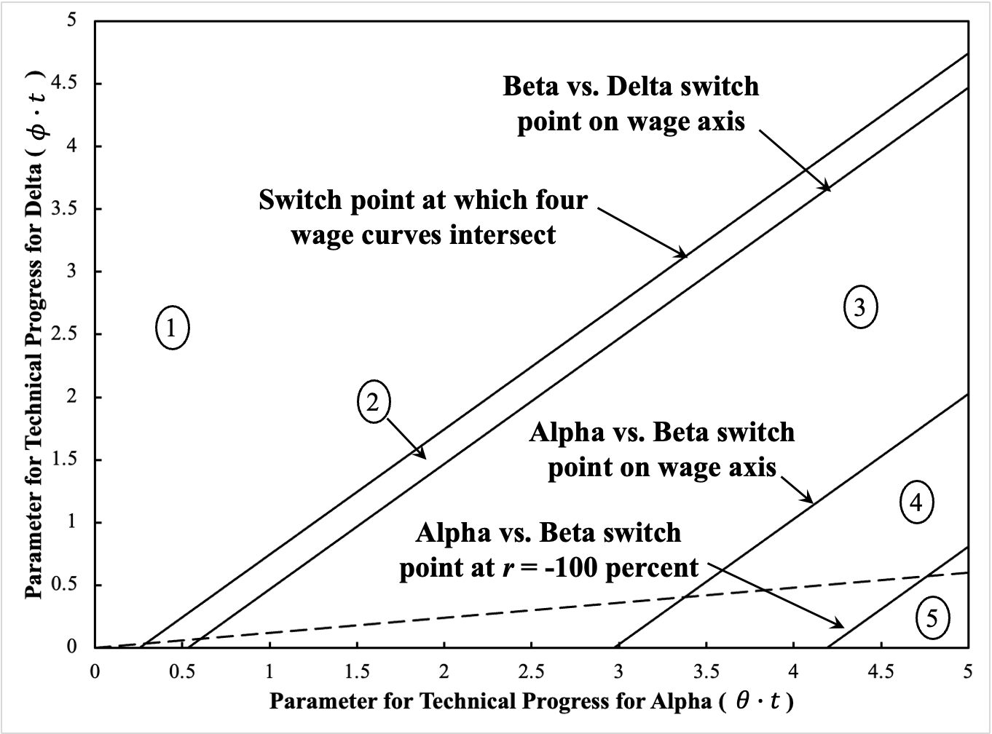
Parameter Space Partitioned by Fluke Switch Points

Slide 10
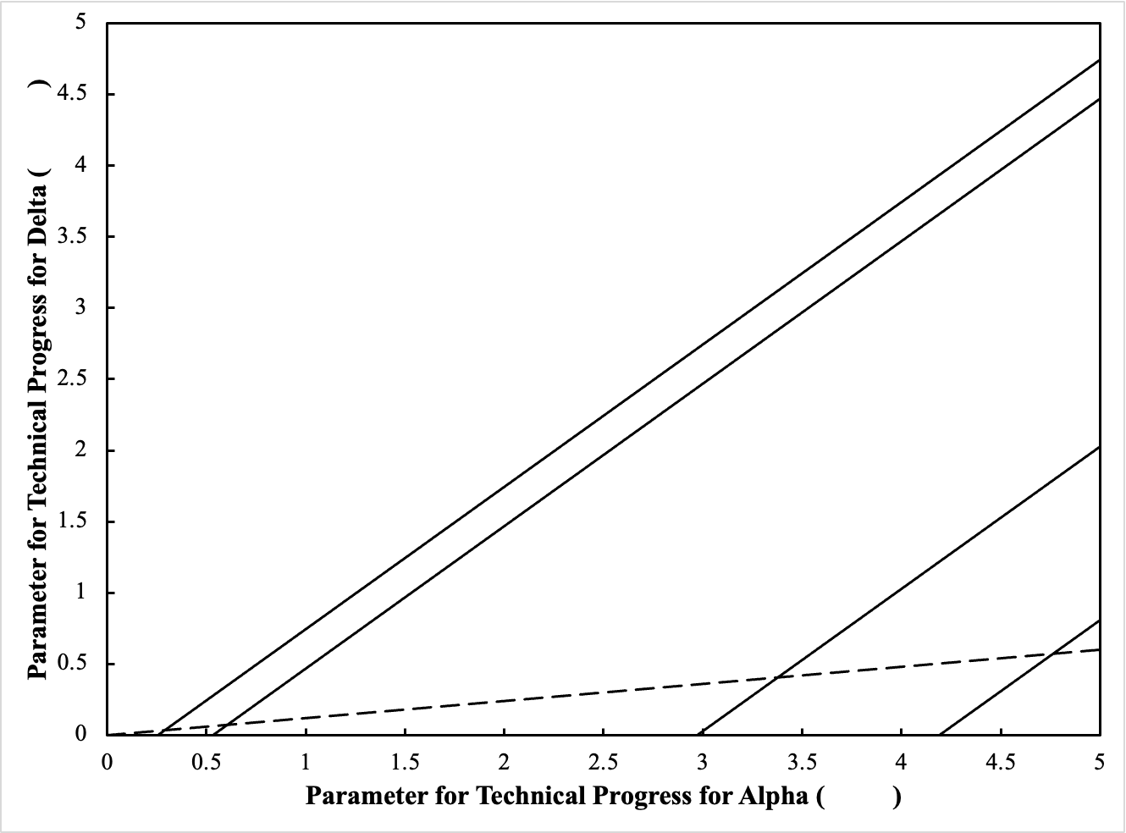


Beta vs. Delta switch point on wage axis
$$φ∙t$$
Switch point at which four wage curves intersect
3
1
2
Alpha vs. Beta switch point on wage axis
4
Alpha vs. Beta switch point at r = -100 percent
5
$$θ∙t$$

Slide 11
Choice of Technique (in order of increasing rate of profits)
Region
Cost-Minimizing Techniques
Properties
1
Delta, Gamma, Alpha, Beta
Capital-reversing, reverse substitution of labor for Alpha vs. Beta switch point
2
Delta, Beta, Alpha, Beta
Reswitching, and capital-reversing and the reverse substitution of labor.
3
Beta, Alpha, Beta
Reswitching, capital-reversing, and the reverse substitution of labor.
4
Alpha, Beta
The reverse substitution of labor
5
Alpha, Beta
‘Non-perverse’ switch point

Slide 12
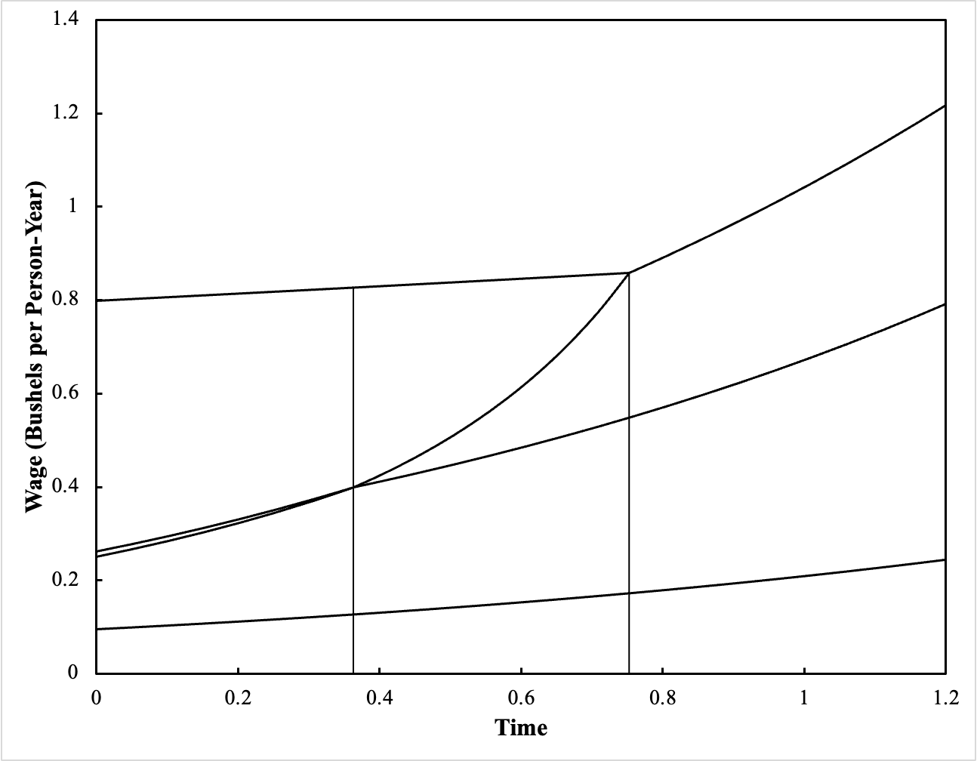


$$θ=0.8$$
Maximum wage for Beta
$$φ=0.096$$
Maximum wage for Delta
3
Beta
1
2
Beta vs. Delta switch point on wage axis
Delta
Gamma
Switch point at which four wage curves intersect
Alpha
Beta

Slide 13
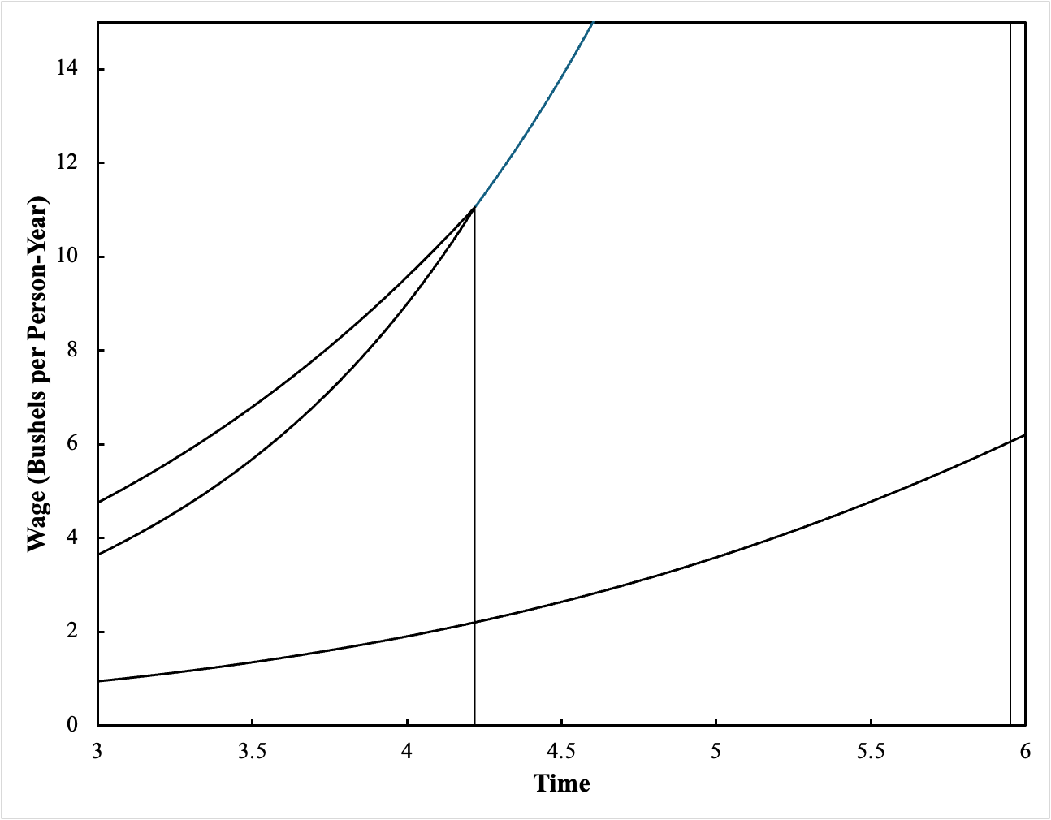

$$θ=0.8$$
$$φ=0.096$$
Maximum rate of profits for Alpha
Maximum rate of profits for Beta
Alpha vs. Beta switch point on wage axis
4
Alpha vs. Beta switch point at r = -100 percent
Beta
3
Alpha
5
Beta

Slide 14
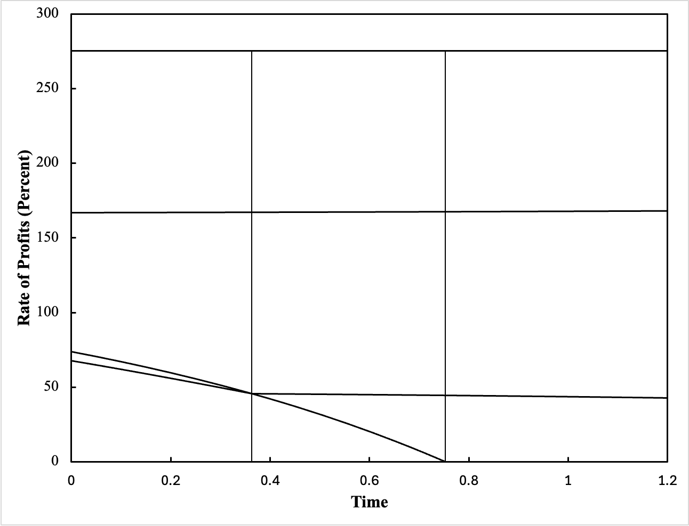

$$θ=0.8$$
$$φ=0.096$$
Beta
Maximum rate of profits for Beta
Alpha
2
3
Switch point at which four wage curves intersect
Gamma
Beta vs. Delta switch point on wage axis
Beta
Delta
1

Slide 15
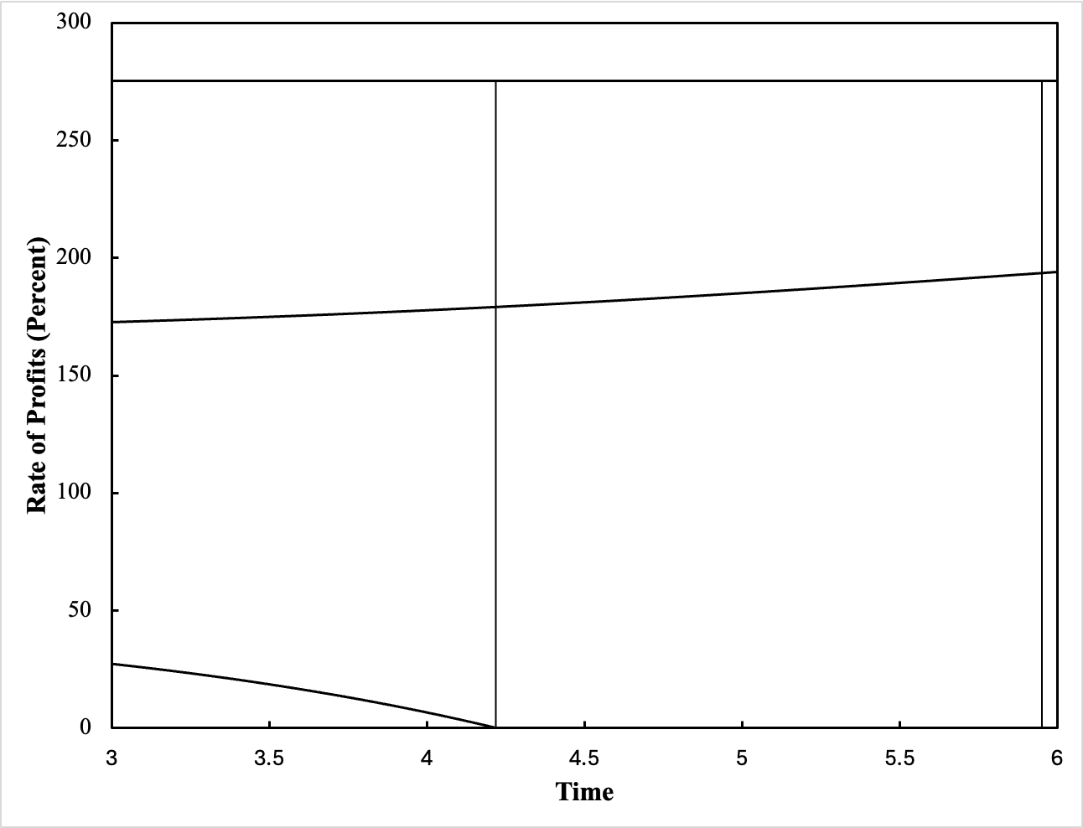


$$θ=0.8$$
$$φ=0.096$$
Maximum rate of profits for Beta
Beta
4
3
5
Alpha vs. Beta switch point at r = -100 percent
Alpha
Alpha vs. Beta switch point on wage axis
Beta

Slide 16
Summary of Example
Beta, a mixed technique, is cost-minimizing at the maximum rate of profits
At the start
Delta is cost-minimizing at a rate of profits of zero
Example exhibits capital-theoretic ‘paradoxes’
Along illustrated trajectory, the rate of neutral technical progress in Alpha exceeds the rate of neutral technical progress in Delta
Alpha must eventually be cost-minimizing at a rate of profits of zero.
Trajectory illustrates how capital-theoretical ‘paradoxes’ can disappear

Slide 17

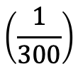


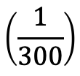

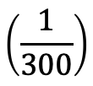
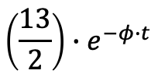

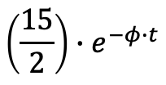

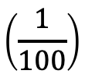
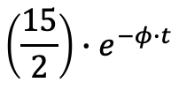




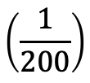
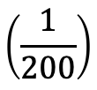


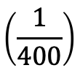


Example for Three-Commodity Technology
Iron Industry
Steel Industry
Corn Industry
INPUTS
Process a
Process b
Process c
Process d
Process e
Process f
Labor
(Person-Yrs)
$$\left(\frac{15}{2}\right)∙e^{−φ∙t}$$
$$\left(\frac{13}{2}\right)∙e^{−φ∙t}$$
$$\left(\frac{15}{2}\right)∙e^{−φ∙t}$$
32${∙e}^{−σ∙t}$
60${∙e}^{−σ∙t}$
55${∙e}^{−σ∙t}$
$$\left(\frac{1}{6}\right)$$
$$\left(\frac{2}{5}\right)$$
$$\left(\frac{1}{200}\right)$$
$$\left(\frac{1}{100}\right)$$
Iron (Ton)
$$1$$
$$0$$
Steel (Ton)
$$\left(\frac{1}{200}\right)$$
$$\left(\frac{1}{400}\right)$$
$$\left(\frac{1}{4}\right)$$
$$\left(\frac{3}{10}\right)$$
$$\left(\frac{1}{4}\right)$$
$$0$$
Corn
(Bushels)
$$\left(\frac{1}{300}\right)$$
$$\left(\frac{1}{300}\right)$$
$$\left(\frac{1}{300}\right)$$
$$0$$
$$0$$
$$0$$
1 Ton Iron
1 Ton
1 Ton Steel
1 Ton
1 Bushel Corn
OUTPUTS
1 Bushel

Slide 18
Techniques
Technique
Iron Industry
Steel Industry
Corn Industry
Alpha
Process a
Process c
Process e
Beta
Process a
Process c
Process f
Gamma
Process a
Process d
Process e
Delta
Process a
Process d
Process f
Epsilon
Process b
Process c
Process e
Zeta
Process b
Process c
Process f
Eta
Process b
Process d
Process e
Theta
Process b
Process d
Process f

Slide 19
Notes On Technology
Alpha and Theta experience Harrod-neutral technical change, possibly at different rates
Iron, steel, and corn are Sraffa-basics in all techniques. Corn is numeraire.
Variation on example from Vienneau (2024). That example lacks technical change, and the vector of labor coefficients differs
Problem: How does the analysis of the choice of technique, with prices of production, vary as technical change occurs in secular time?

Slide 20
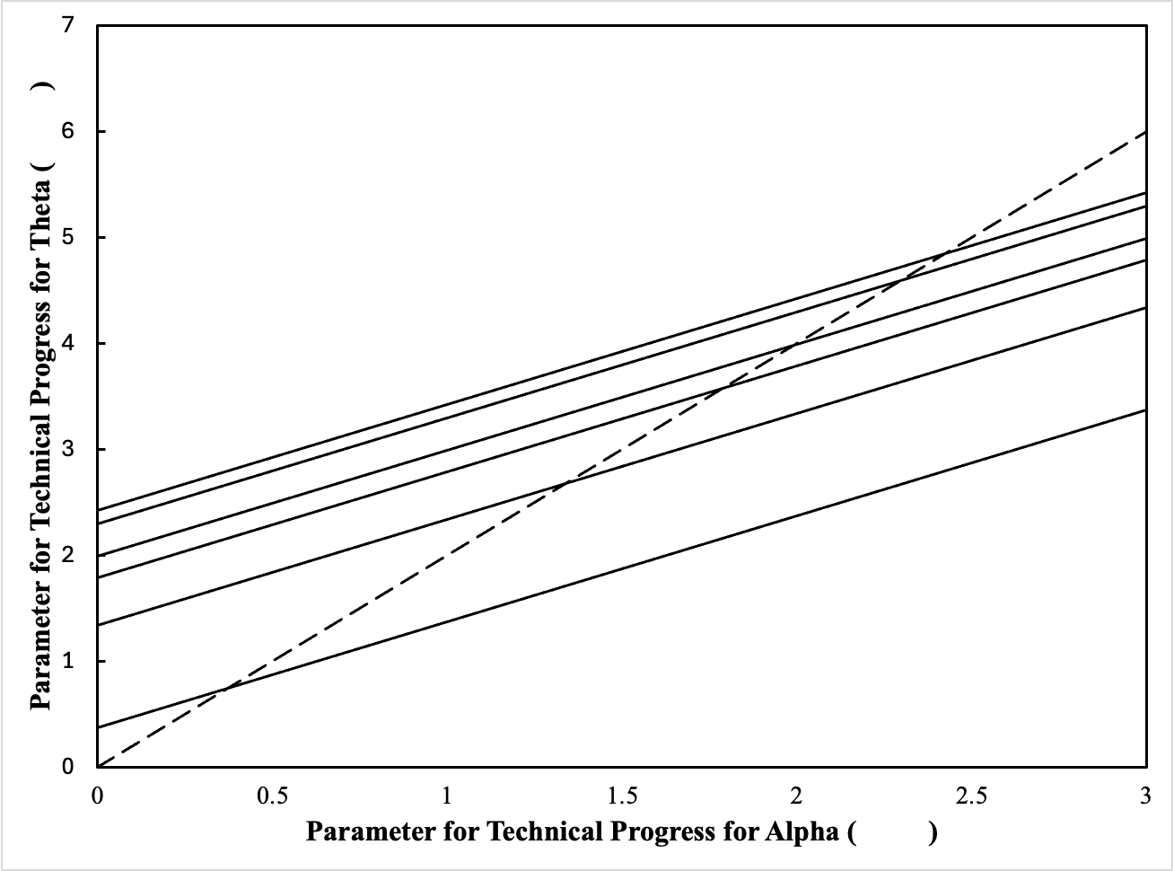

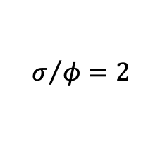

Switch point at intersection of Beta, Delta, Zeta, and Theta wage curves
7
$$σ∙t$$
$$σ/φ=2$$
Zeta vs. Theta switch point on wage axis
Alpha vs. Beta switch point at r = -100 percent
6
5
Beta vs. Zeta switch point on wage axis
3
4
Alpha vs. Beta switch point on wage axis
2
Alpha vs. Beta wage curves tangent at switch point
1
$$φ∙t$$

Slide 21
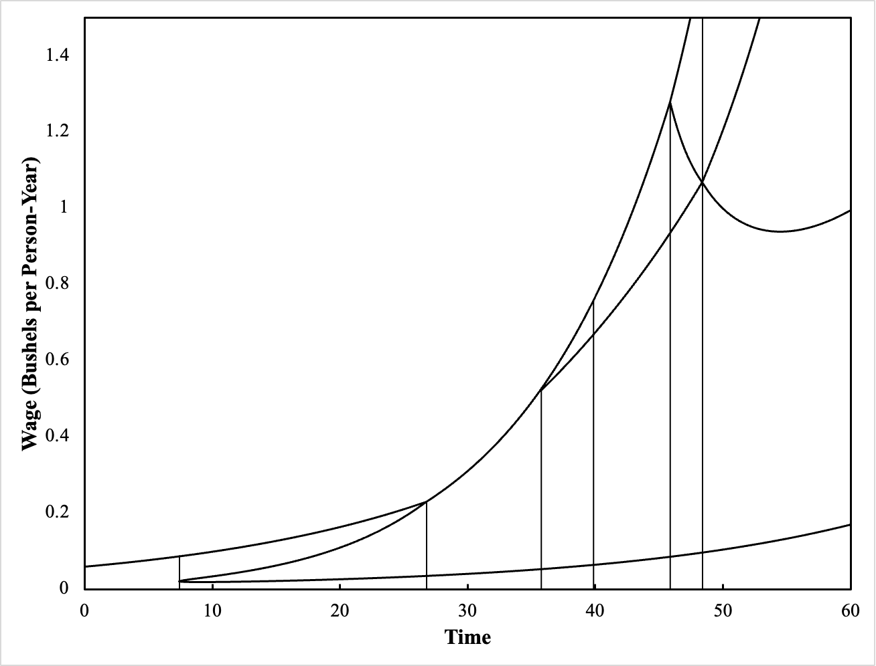
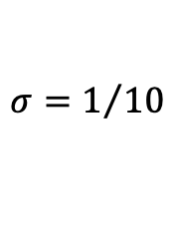
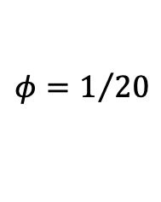
$$φ=1/{20}$$
Infeasible Region
$$σ=1/{10}$$
Theta
Delta
Four wage curves intersect at switch point
7
Switch points on wage axis
Zeta
Beta
6
5
Alpha vs. Beta switch point at r = -100 percent
Alpha vs. Beta wage curves tangent at switch point
4
1
3
2
Alpha

Slide 22
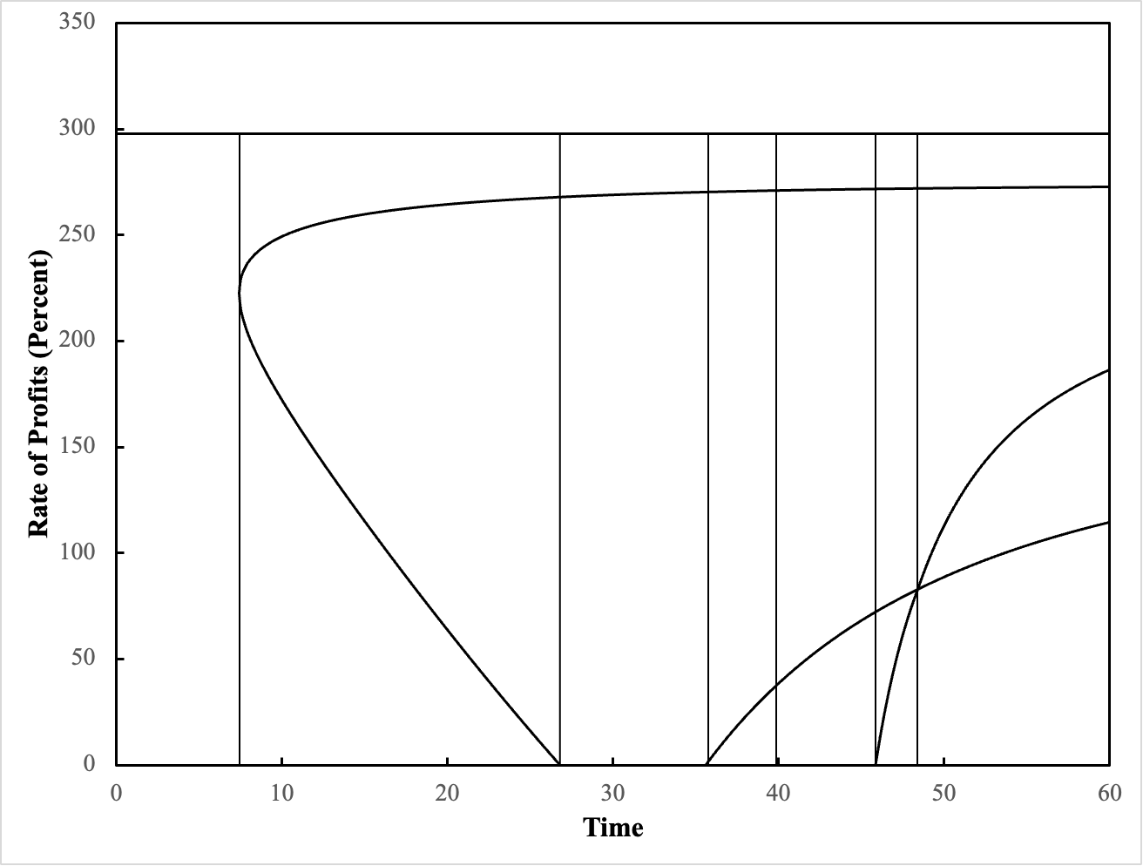
$$φ=1/{20}$$
Infeasible Region
$$σ=1/{10}$$
1
2
Beta
3
4
5
6
7
Alpha vs. Beta wage curves tangent at switch point
Alpha vs. Beta switch point at r = -100 percent
Four wage curves intersect at switch point
Delta
Switch points on wage axis
Alpha
Theta
Zeta

Slide 23
Choice of Technique (in order of increasing rate of profits)
Region
Cost-Minimizing Techniques
Properties
1
Alpha
No switch points
2
Alpha, Beta, Alpha
Reswitching , capital-reversing, and the reverse substitution of labor for the second switch point
3
Beta, Alpha
Reverse substitution of labor
4
Zeta, Beta, Alpha
Reverse substitution of labor
5
Zeta, Beta, Alpha
No ‘perverse’ phenomena
6
Theta, Zeta, Beta, Alpha
No ‘perverse’ phenomena
7
Theta, Delta, Beta, Alpha
No ‘perverse’ phenomena

Slide 24
Summary of Three-Commodity Example
At the start
Alpha is cost-minimizing whatever the distribution of income
Labor inputs are too large in the processes comprising Theta, in all industries, to be ever adopted
However labor inputs decrease with technical progress, Alpha is cost-minimizing at a zero wage.
Harrod-neutral technical progress for Theta exceeds that for Alpha
Theta is eventually cost-minimizing at a rate of profits of zero
At the end, the processes in each industry must change at each one of the three non-fluke switch points
Reswitching , capital-reversing, and the reverse substitution of labor can only be transient phenomena

Slide 25
Conclusions
Illustrates how, if reswitching, capital-reversing, and the reverse substitution of labor are transient phenomena, Harrod-neutral technical change eliminates them
Harrod-neutral technical change cannot change rank of techniques by maximum rates of profits.
Partitions corresponding to fluke switch points in parameter space are affine functions with slopes of unity. Proofs can be provided.
Rates of profits at which fluke switch points occur do not vary with neutral technical progress (four wage curves intersect, two wage curves tangent)
In practice, technical change will vary, have biases (Marx-biased?), involve processes from more than two techniques, involve commodities produced only with selected techniques.

Slide 26
References
Bruno, Michael, Edwin Burmeister, and Eytan Sheshinski. 1966. The nature and implications of the reswitching of techniques. Quarterly Journal of Economics 80(4): 526-553.
Vienneau, Robert L. 2024. Characteristics of labor markets varying with perturbations of relative markups. Review of Political Economy 36(2): 827-843.
Vienneau, Robert L. 2025. Technical change and triple-switching in the corn-tractor model. DRAFT, SUBMITTED TO CENTRO SRAFFA WORKING PAPERS

