Slide 1
Extended Schefold Example

Slide 2
Triple-Switching in Competitive Case
Bertram Schefold. Fixed capital as a joint product and the analysis of accumulation with different forms of technical progress: pp. 17—171.
In: Luigi L. Pasinetti (ed.) 1980. Essays on the Theory of Joint Production. New York: Columbia University Press.

Slide 3
Choice of Technique
Alpha technique: corn produced directly
Beta technique
Roundabout
Machine produced from corn and labor
Machine disposed of after operating one year
Never cost-minimizing
Gamma technique
Roundabout
Machine produced from corn and labor
Machine operated two years
A bushel corn is numeraire

Slide 4
Conclusions
Cambridge capital critique is applicable to non-competitive markets
Technology can support triple-switching
Can be disguised by persistent barriers to entry, non-competitive market power
Persistent market power can also lead ‘non-perverse’ technology to exhibit double-switching, etc. (Vienneau 2024)
Austrian identification of capital-intensity with roundaboutness untenable, unsustainable
Triple-switching, capital-reversing, etc. transient phenomena in technical change as one technique replaces another as dominant
Can be shown with Steedman’s corn-tractor model (Vienneau 2025)

Slide 5






Variables
$$w$$
Wage (bushels corn per person year)
$$r$$
Scale factor for the rate of profits
$$p_{1}$$
Price of a new machine (bushels corn per machine)
$$p_{2}$$
Price of an old machine (bushels corn per machine)
$$s_{1}$$
Relative markup in machine industry
$$s_{2}$$
Relative markup in corn industry

Slide 6

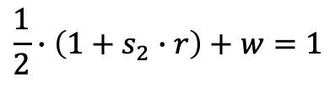
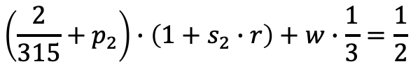
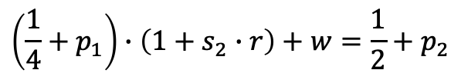
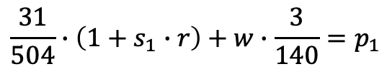
Alpha price equation
$$\frac{1}{2}∙\left(1+s_{2}∙r\right)+w=1$$
Gamma price equations
$$\frac{31}{504}∙\left(1+s_{1}∙r\right)+w∙\frac{3}{140}=p_{1}$$
$$\left(\frac{1}{4}+p_{1}\right)∙\left(1+s_{2}∙r\right)+w=\frac{1}{2}+p_{2}$$
$$\left(\frac{2}{315}+p_{2}\right)∙\left(1+s_{2}∙r\right)+w∙\frac{1}{3}=\frac{1}{2}$$
$$s_{1}+s_{2}=1$$

Slide 7
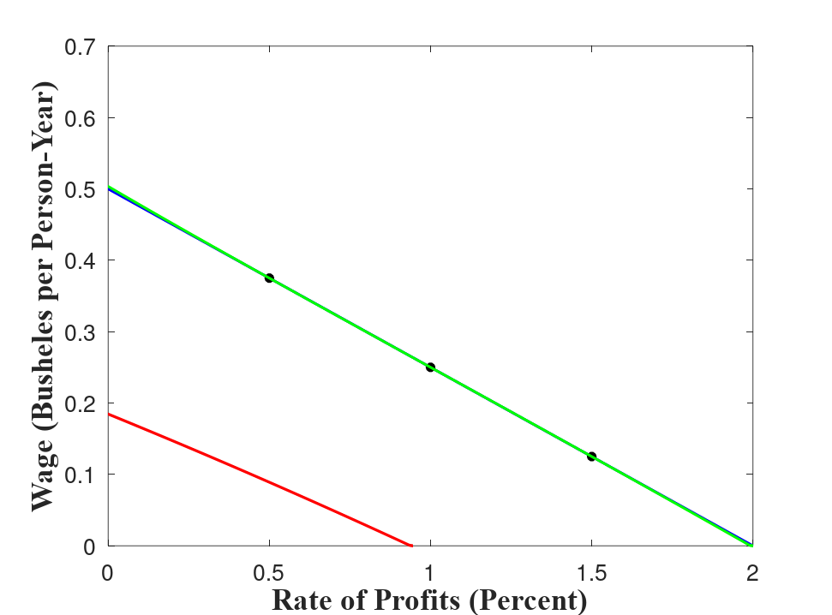
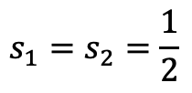
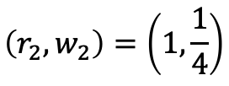
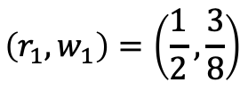
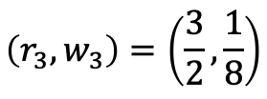
Competitive Case
$$s_{1}=s_{2}=\frac{1}{2}$$
Gamma cost-minimizing
Alpha cost-minimizing
$$\left(r_{1},w_{1}\right)=\left(\frac{1}{2},\frac{3}{8}\right)$$
$$\left(r_{2},w_{2}\right)=\left(1,\frac{1}{4}\right)$$
Beta wage curve
$$\left(r_{3},w_{3}\right)=\left(\frac{3}{2},\frac{1}{8}\right)$$

Slide 8
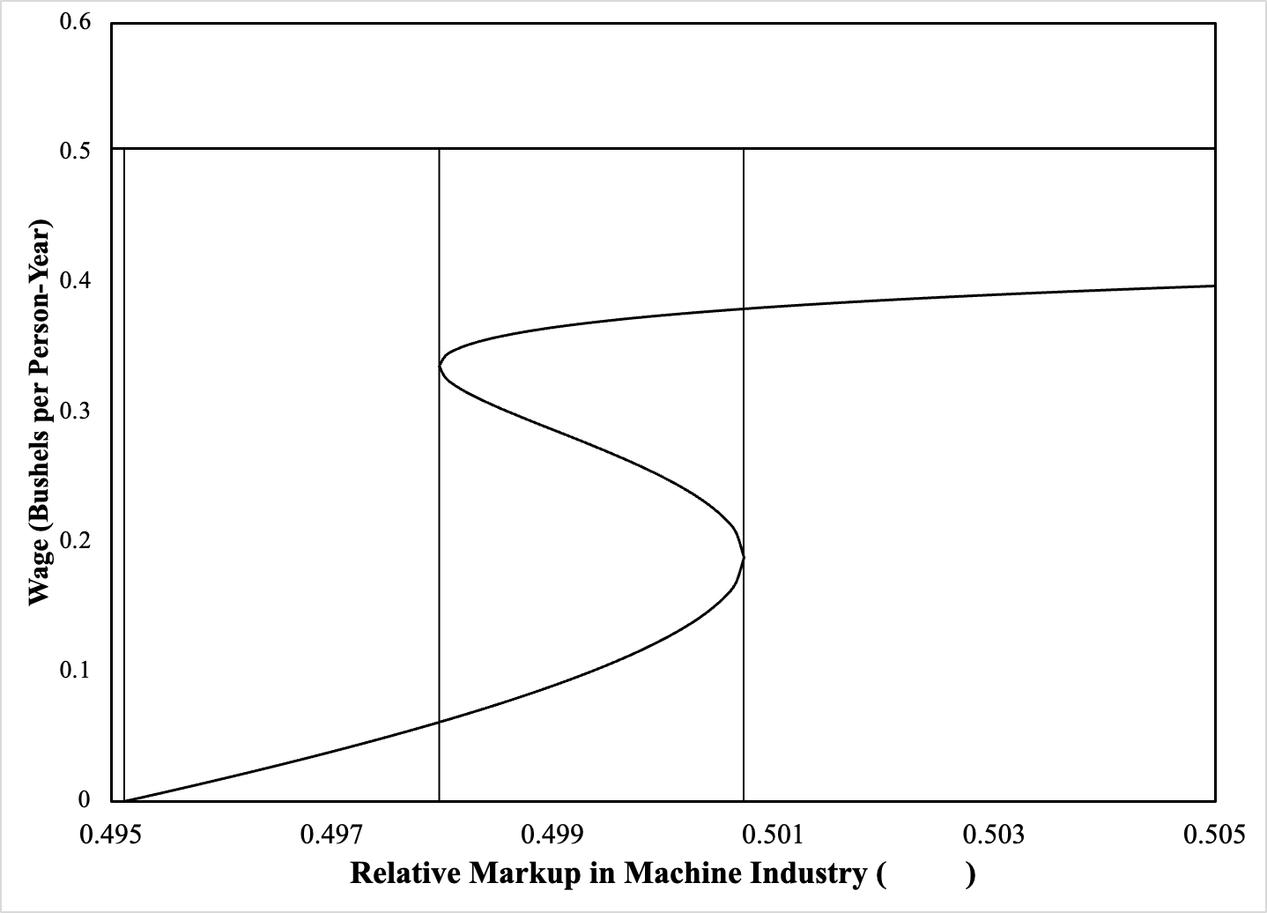


Infeasible region
$$s_{1}+s_{2}=1$$
Gamma Cost-Minimizing
Wage curves tangent at switch point
Switch point on axis for scale factor for rate of profits
Alpha Cost-Minimizing
$$s_{1}$$

