Slide 1

Presentation Link
www.youtube.com/watch?v=uFBCkqPnDiE
DDS Analytics

Slide 2

MSDS-6306 Case Study 02
Employee Attrition
Robert Price
DDS Analytics

Slide 3
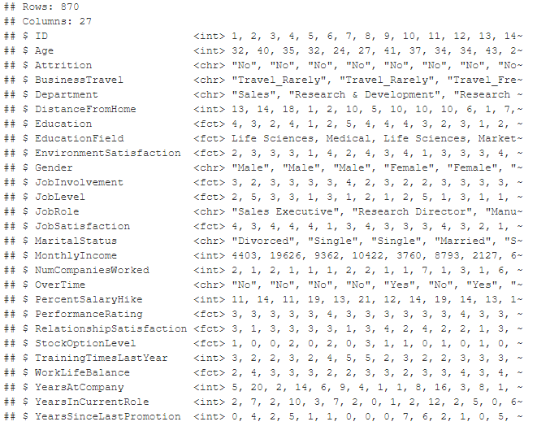

Data Preparation and Cleaning
Data Preparation Process
Import Data
Clean Columns
Transform Data
DDS Analytics

Slide 4
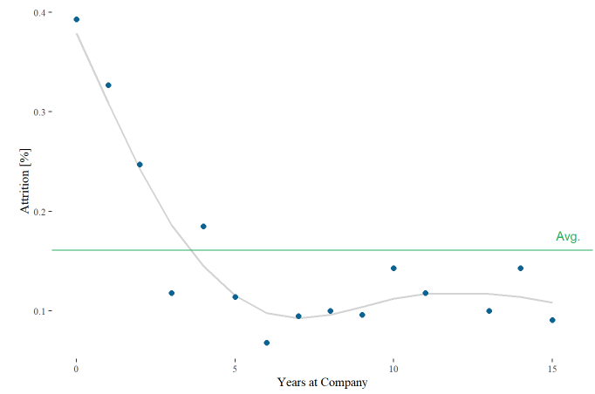
Employees are more likely to leave within the first 3-4 years of joining the company
Employee Attrition Over Time
Average Attrition Rate: 16%
New Employee Attrition: 24%
new employees < 5 years of service
DDS Analytics

Slide 5
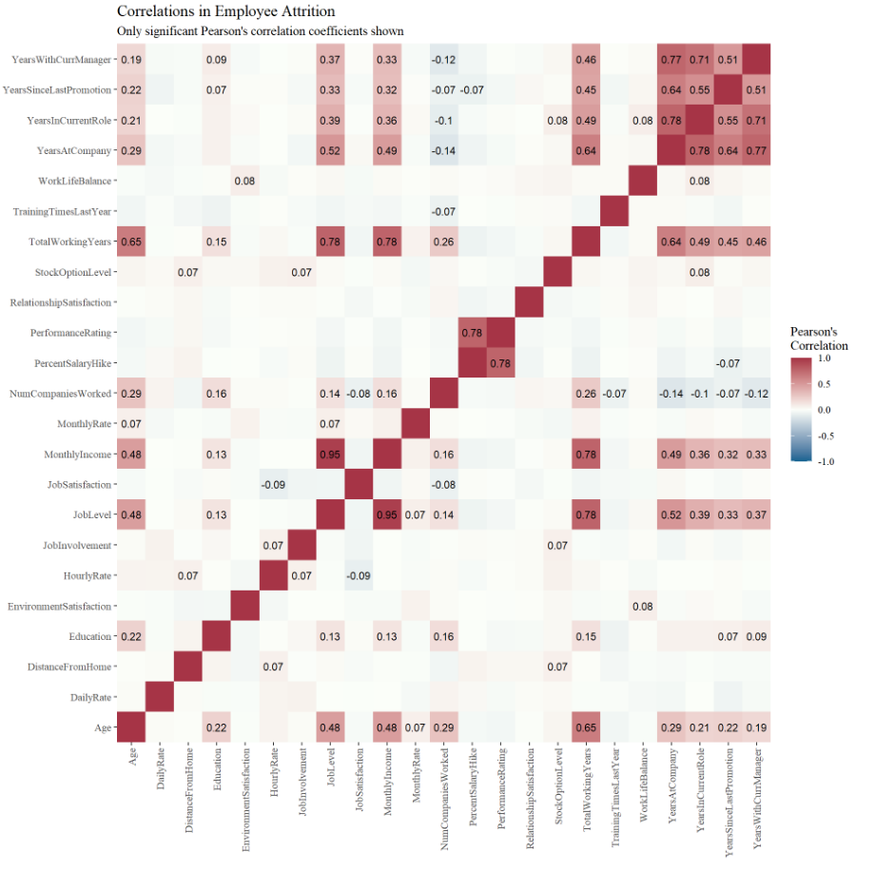
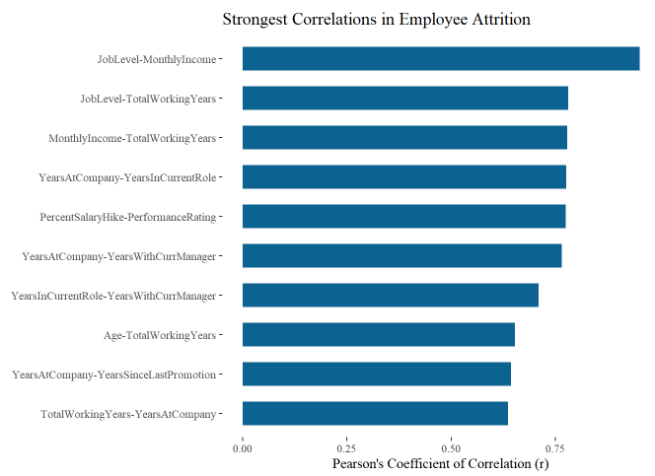
Analysis of feature correlations revealed that some highly correlated variables could be removed from the dataset without negatively impacting predictability
Correlations in Employee Attrition
Strongest Correlation Pairs
only significant (p-value < 0.05) correlation coefficients shown
DDS Analytics

Slide 6
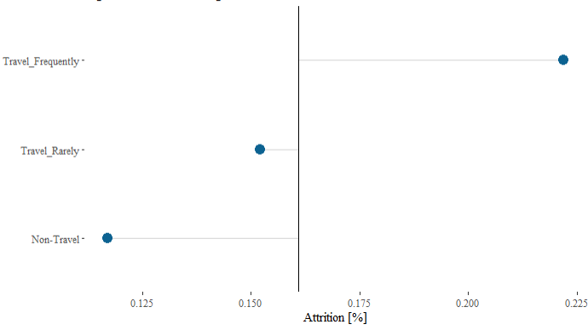
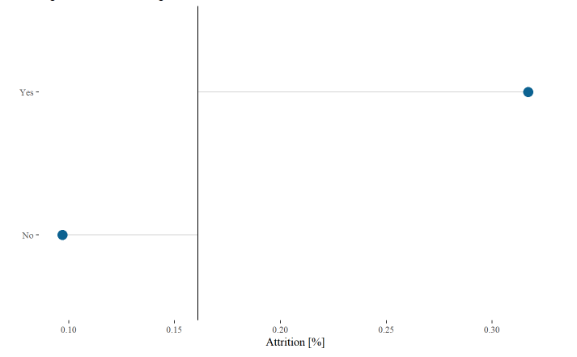
Discrete variables can be analyzed by visualizing the deviation from the mean attrition for each category
Relationship between Business Travel and Attrition
Relationship between Overtime and Attrition
higher values indicate higher attrition
DDS Analytics

Slide 7
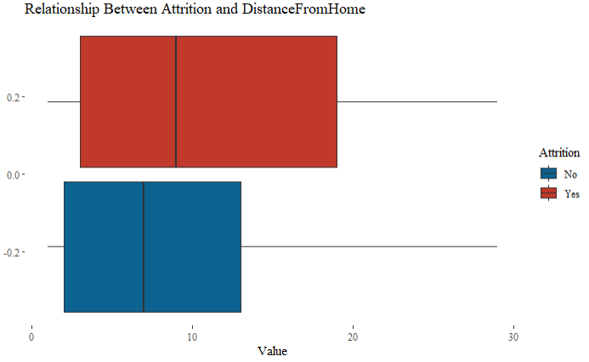
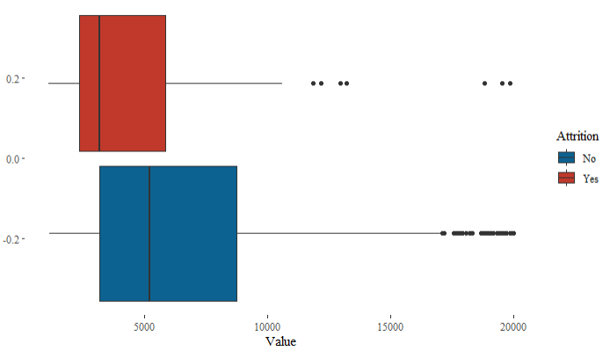
Continuous variables can be analyzed by comparing boxplots by attrition
Relationship between Distance From Home and Attrition
Relationship between Monthly Income and Attrition
Individuals that live close tend to have lower attrition
Higher earning individuals tend to have lower attrition
DDS Analytics

Slide 8
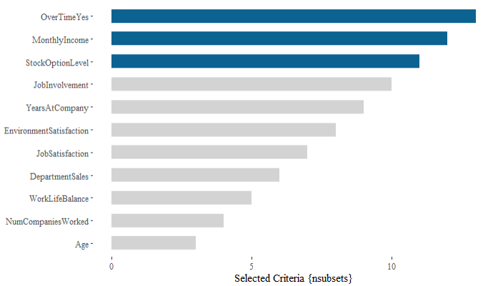
The top three factors that contribute to turnover were calculated using the Multivariate Adaptive Regression Splines (MARS) algorithm with estimated variable importance
Estimated Feature Importance
What is Feature Importance?
Feature importance is a measure of the strength of the relationship between observed values and the response.
DDS Analytics

Slide 9
Two classification models were assessed to predict employee attrition, with logistic regression being selected due to higher metric scores
Classification: Naïve Bayes
Classification: Logistic Regression
probability based model
regression based model
 | Naïve Bayes | Logistic Regression
Accuracy | 87.0% | 87.4%
Sensitivity | 94.5% | 92.3%
Specificity | 47.6% | 61.0%
Pos. Prediction Value | 90.4% | 92.7%
DDS Analytics

Slide 10
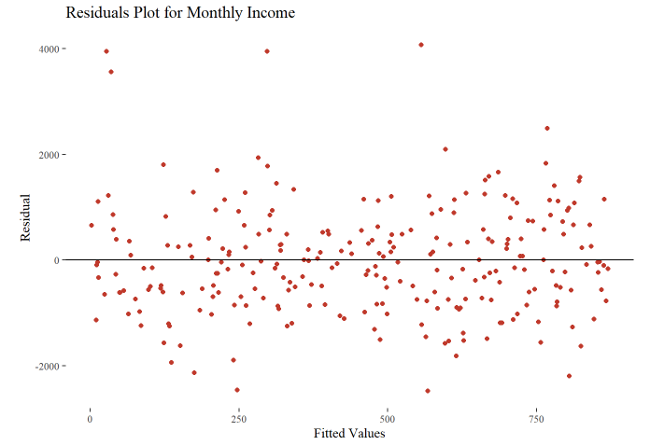
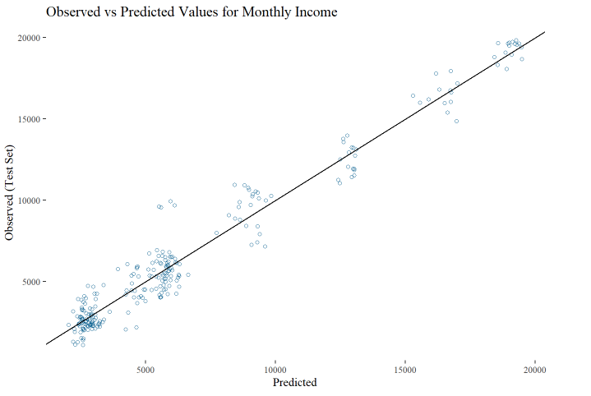
A multiple linear regression model was used to predict employee monthly incomes, resulting in a RMSE of $1,017
Residuals Plot for Monthly Income
Observed vs Predicted Values for Monthly Income
RMSE: $1,017
DDS Analytics

