Slide 1

Ramirez Quispe, Robert Marlindo
Maestría en Ingeniería Hidráulica
Universidad Nacional de Ingeniería
Lima, Perú.
March 24, 2021
https://ramirezquispe1.blogspot.com/
ramirezquispe1@gmail.com
Modelling Water Resources
with programming languages

Slide 2
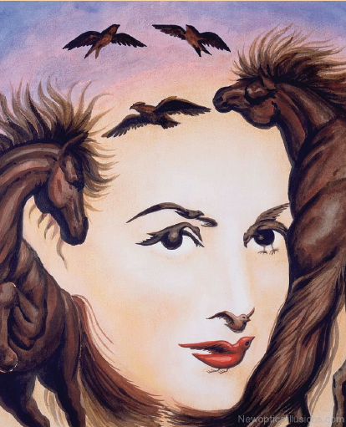
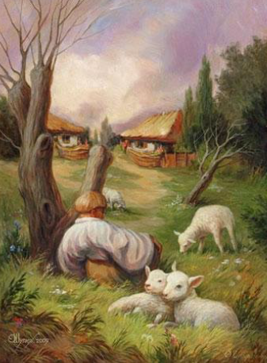
Artificial neural networks
Introduction
Languages
My programs
Free programs
¿What is observed in these images? ¿The computer will be able to recognize?
https://ramirezquispe1.blogspot.com/2020/09/neuronales-artificiales-redes.html

Slide 3


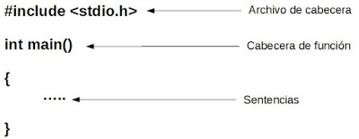




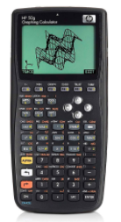
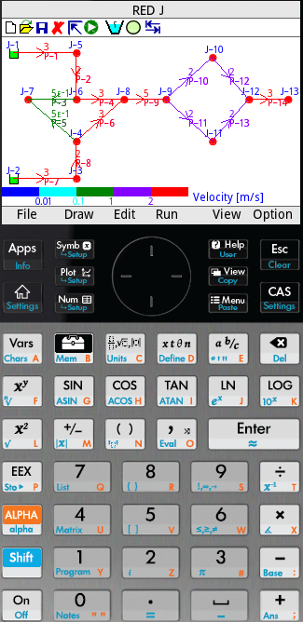





Programming Languages
Introduction
Languages
My programs
Free programs

Slide 4
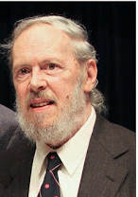
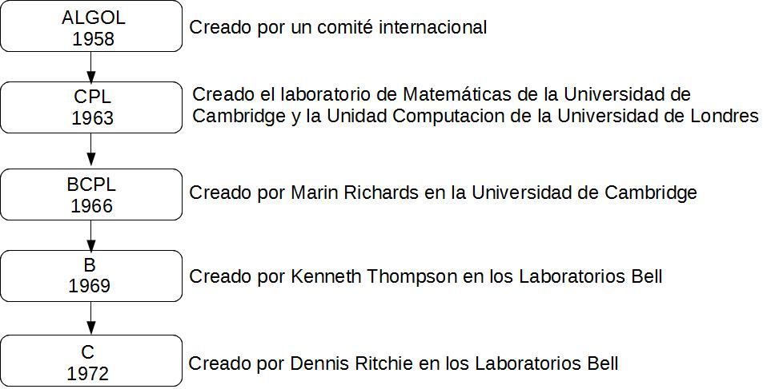

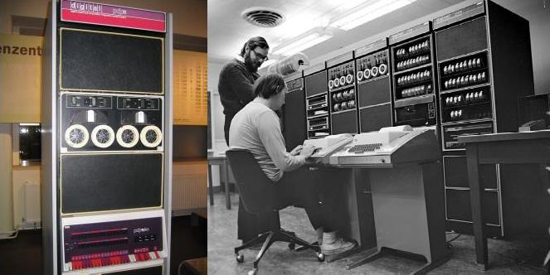



Language C
Introduction
Languages
My programs
Free programs
Dennis Ritchie
Aplicaciones escrito en C
http://cajasdepastillas.blogspot.com/2018/10/lenguaje-c.html
Software de GIS escrito en C++

Slide 5
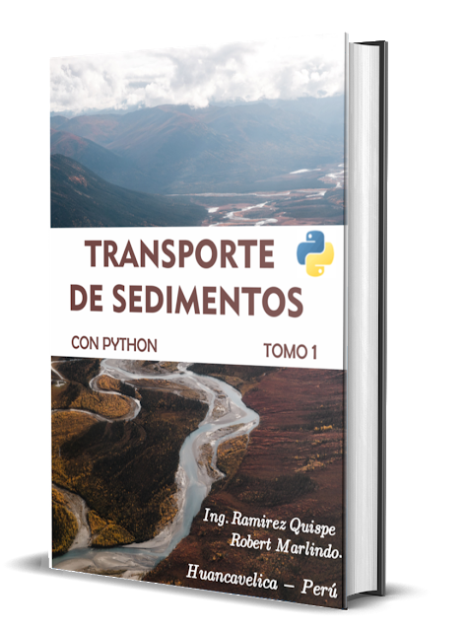
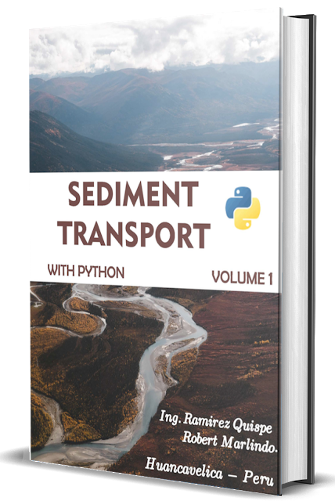
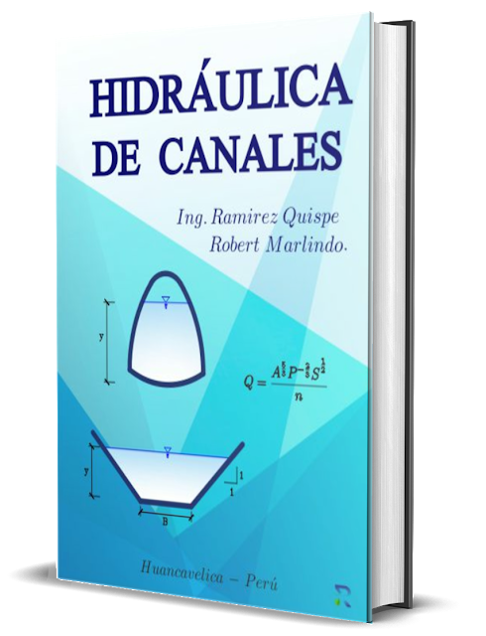
My books about Hydraulic
Introduction
Languages
My programs
Free programs
https://ramirezquispe1.blogspot.com/2020/09/hidraulica-de-canales-ramirez-quispe.html
https://ramirezquispe1.blogspot.com/2021/03/transporte-de-sedimentos-con-python.html
https://ramirezquispe1.blogspot.com/2021/03/sediment-transport-with-python-english.html

Slide 6
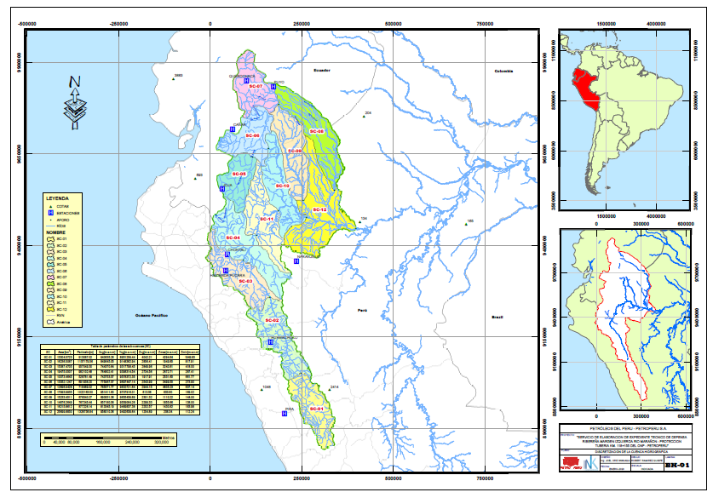
Python and Arcgis
Introduction
Languages
My programs
Free programs
Data: curvas, ríos y punto de aforo.
https://www.youtube.com/watch?v=bVw2TW6ErD8

Slide 7
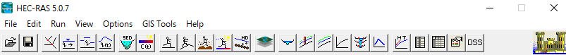
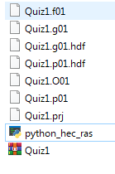
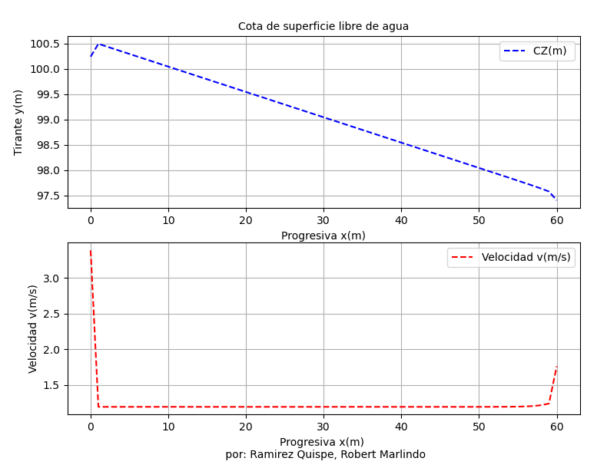
Python and Hec Ras
Introduction
Languages
My programs
Free programs
https://www.youtube.com/watch?v=nkpGGQ0YGJU

Slide 8
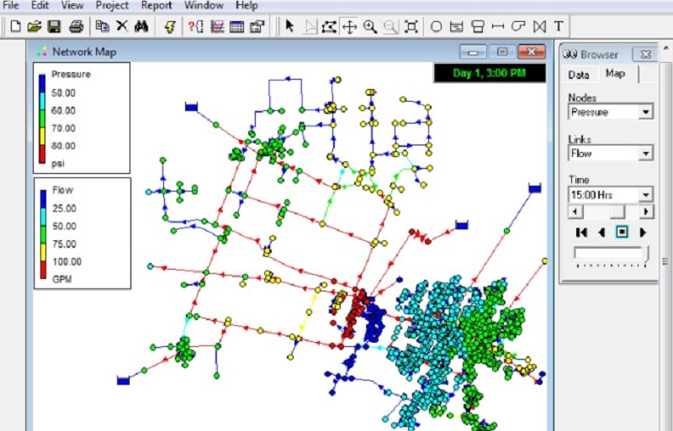
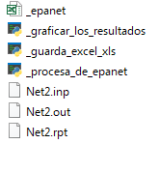
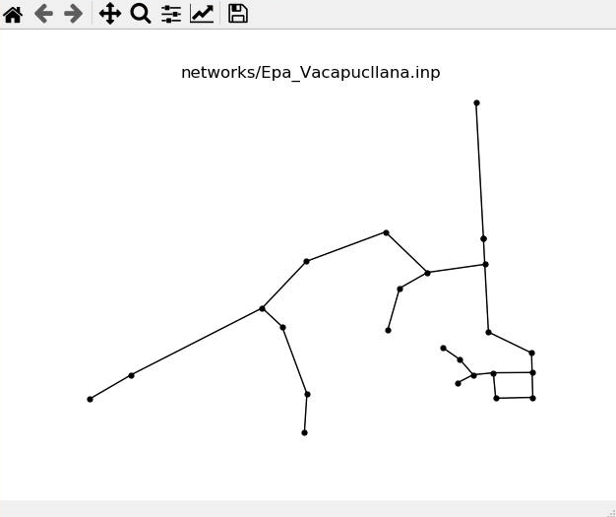
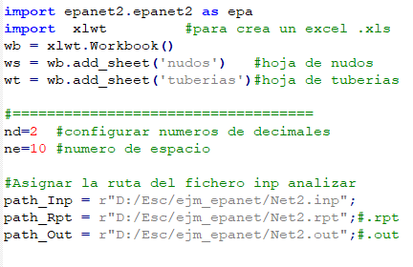
Python and Epanet
https://www.youtube.com/watch?v=T3WcnDsTiP0

Slide 9
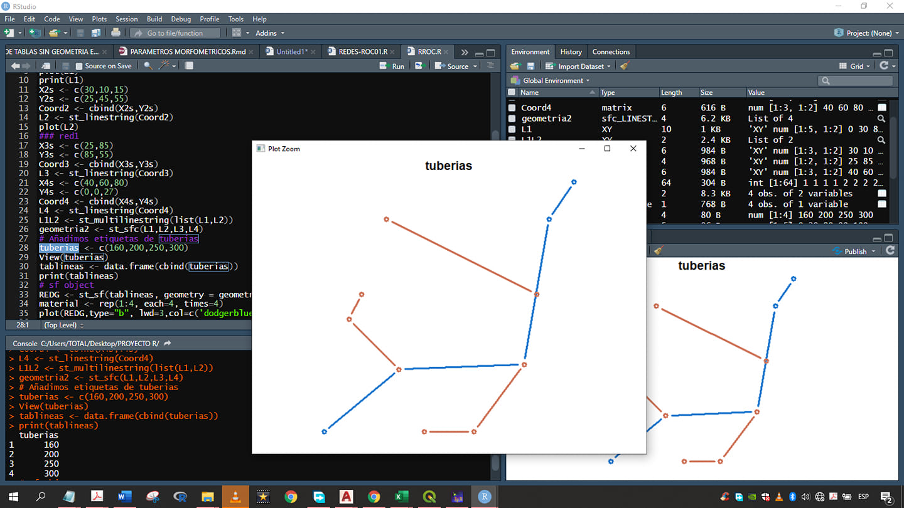
Epanet - R (R-studio)
Introduction
Languages
My programs
Free programs

Slide 10
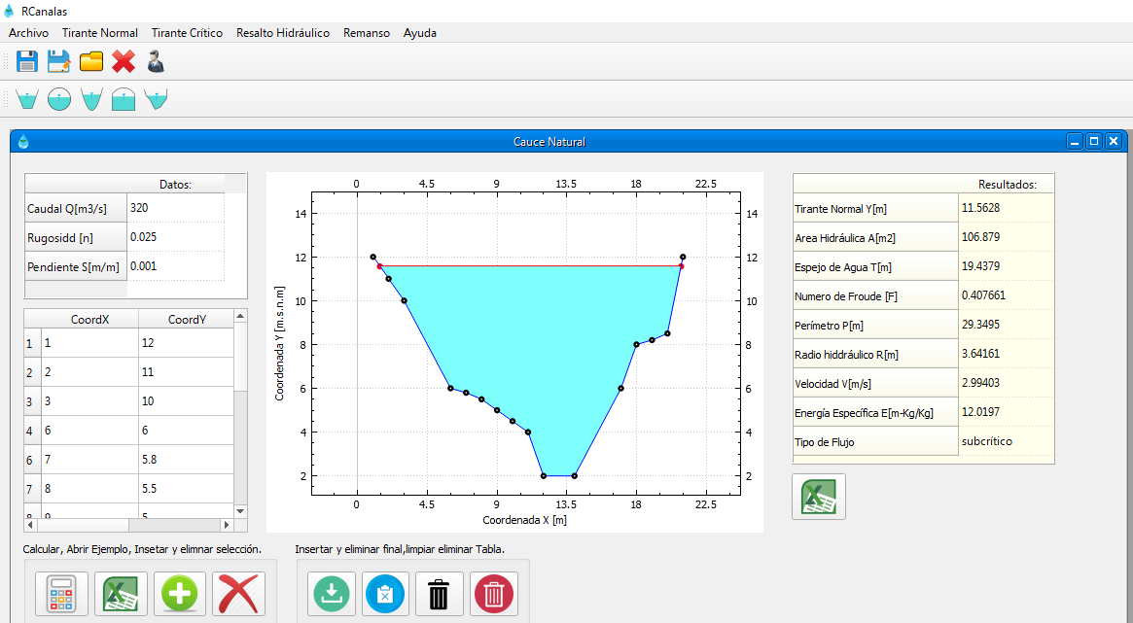
Software (RCanales) in C++
Download free: https://www.youtube.com/watch?v=7b8DFpX300k

Slide 11
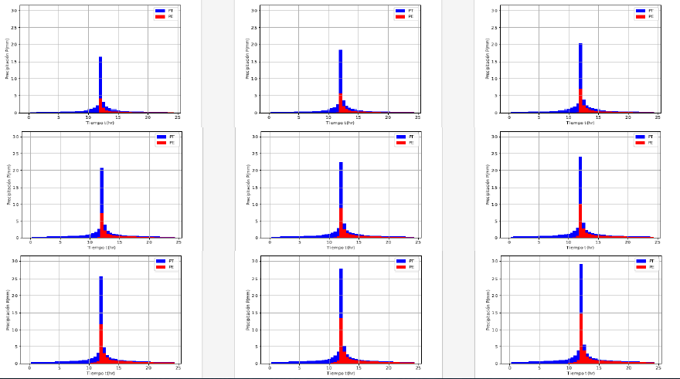
Extreme event analysis – with Python
Introduction
Languages
My programs
Free programs
https://ramirezquispe1.blogspot.com/2020/09/analisis-de-eventos-extremos.html

Slide 12
Extreme event analysis – with Python
Introduction
Languages
My programs
Free programs
https://ramirezquispe1.blogspot.com/2020/09/analisis-de-eventos-extremos.html

Slide 13
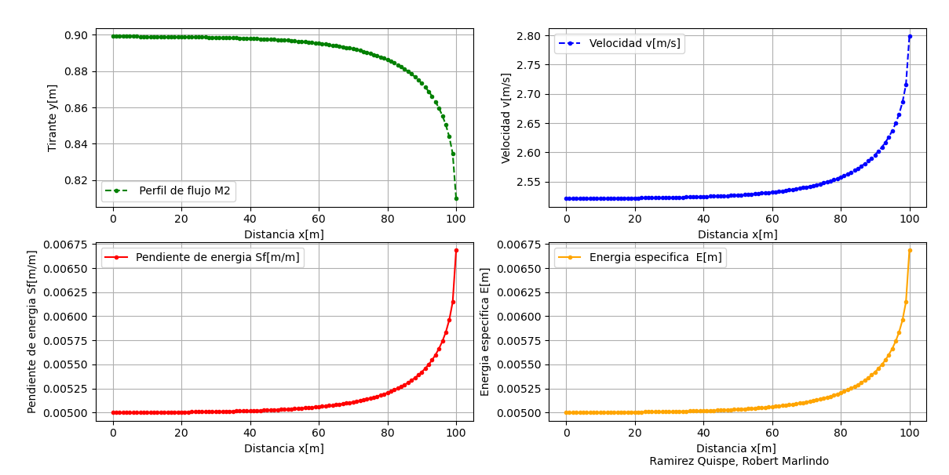
Languages C++, R and Python
Introduction
Languages
My programs
Free programs
https://ramirezquispe1.blogspot.com/2021/03/lenguajes-c-r-entorno-r-studio-y-python.html

Slide 14
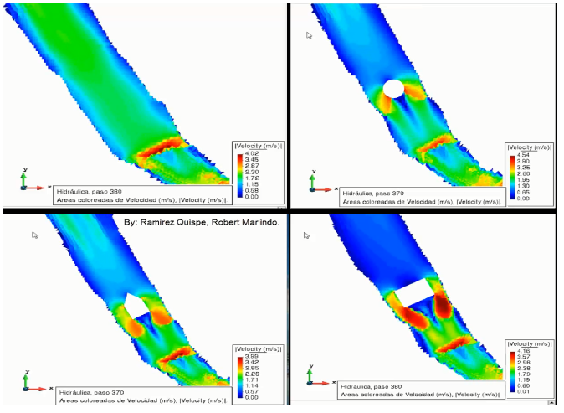
Free software on water resources
Introduction
Languages
My programs
Free programs
Hec-Ras 1D/2D.
Iber 2D.
iRiC.
OpenFoam.
Telemac 2D/3D.
Delft3D.
Qgis
Saga-Gis By. Robert
PRMS (Precipitation-Runoff Modeling System)
Swat (soil and water at basin level)
Modflow
MT3DMS (simulates advection, scattering / diffusion and adsorption/absorption chemical reactions of contaminants in groundwater)

Slide 15
Programming languages
Introduction
Languages
My programs
Languages online
Python
https://www.python.org/
https://drive.google.com/drive/folders/16aL9mkKNmxTBXlrw-EndpdJ0DkllwEqd?usp=sharing
C++, Fortran. Python, Ruby and others
https://www.mycompiler.io/
R Online – You can work from GitHub
https://rstudio.cloud/
Anconda - Online
https://cocalc.com/projects/d1e3a5b9-ecf3-498d-80bd-26e884f9d7bf/files/?session=default

Slide 16
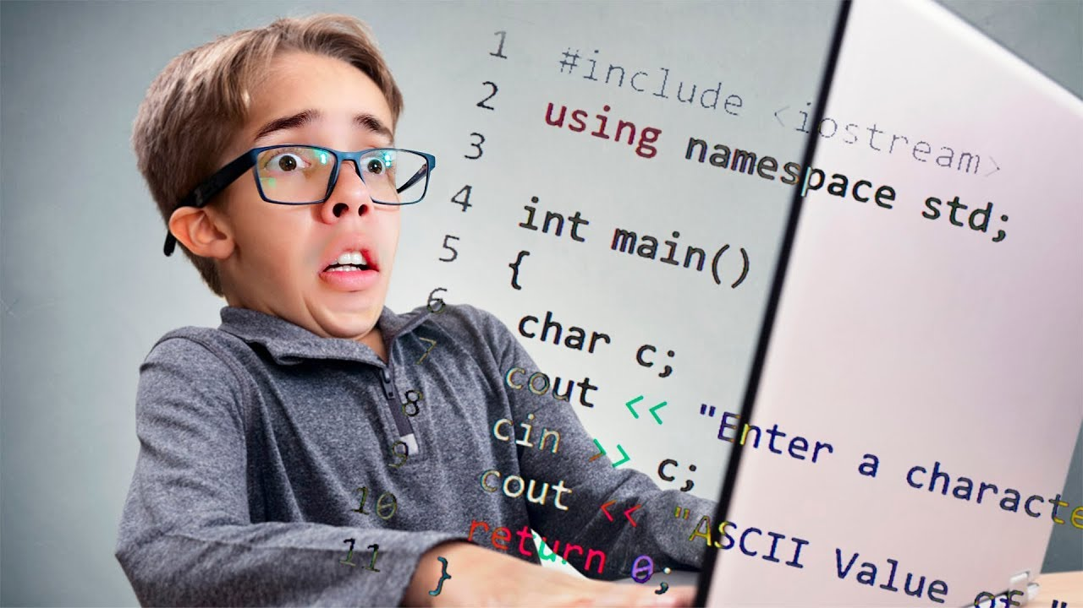
How to start programming?
Introduction
Languages
My programs
stars

Slide 17
Reflections.
Introduction
Languages
My programs
Reflections
Los ordenadores son increíblemente rápidos, precisos, y estúpidos; los humanos son increíblemente lentos, imprecisos, y brillantes. Juntos, su potencia está más allá de lo imaginable. (Albert Einstein)
No importa cuán bueno sea, un modelo no es la realidad, una simulación no es
un experimento, un modelo no brinda evidencia, a lo mucho brinda
argumentos, ¡siendo ya demasiado!
(Ambroise, B)
Más vale una silvestre medición, antes que una computarizada adivinación (Reyes, L)
Una rana no se bebe la charca en la que vive (Proverbio Inca)

Slide 18
Bibliography
https://www.youtube.com/watch?v=G2FCfQj-9ig&list=PLU8oAlHdN5BlvPxziopYZRd55pdqFwkeS
Course about programing in Python
https://ramirezquispe1.blogspot.com/

Slide 19
Thanks so much.
https://ramirezquispe1.blogspot.com/

