Slide 1

Data Structures and Algorithms I.
University of Szeged – Robert Nagy
2025/26. Autumn Semester

Slide 2
Minimum spanning tree
Weighted, undirected graph

Slide 3
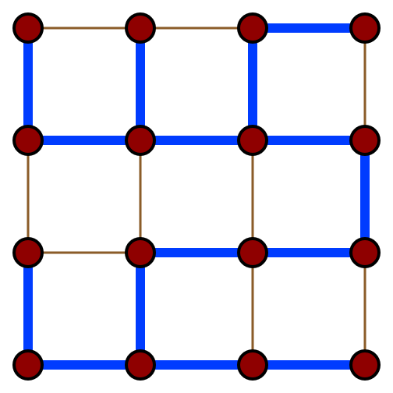
Spanning tree
https://en.wikipedia.org/wiki/Spanning_tree#/media/File:4x4_grid_spanning_tree.svg

Slide 4
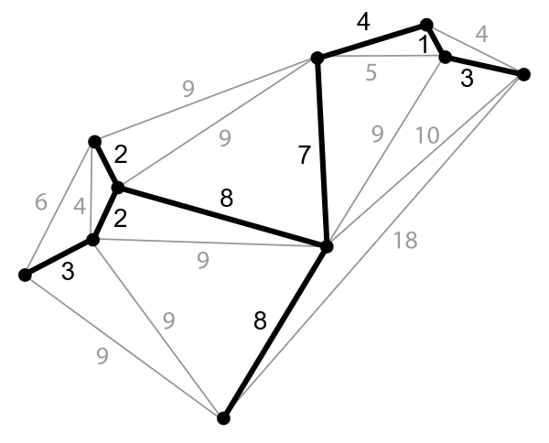
https://en.wikipedia.org/wiki/Minimum_spanning_tree#/media/File:Minimum_spanning_tree.svg

Slide 5
Real world usage
Telecommunication networks
Transportation networks
Water supply networks
Electrical grids

Slide 6
Kruskal’s algorithm
Sort the edges

Slide 7
Kruskal’s algorithm
Sort the edges
Start with the cheapest

Slide 8
Kruskal’s algorithm
Sort the edges
Start with the cheapest
Keep building disjoint sets until they become one single set

Slide 9
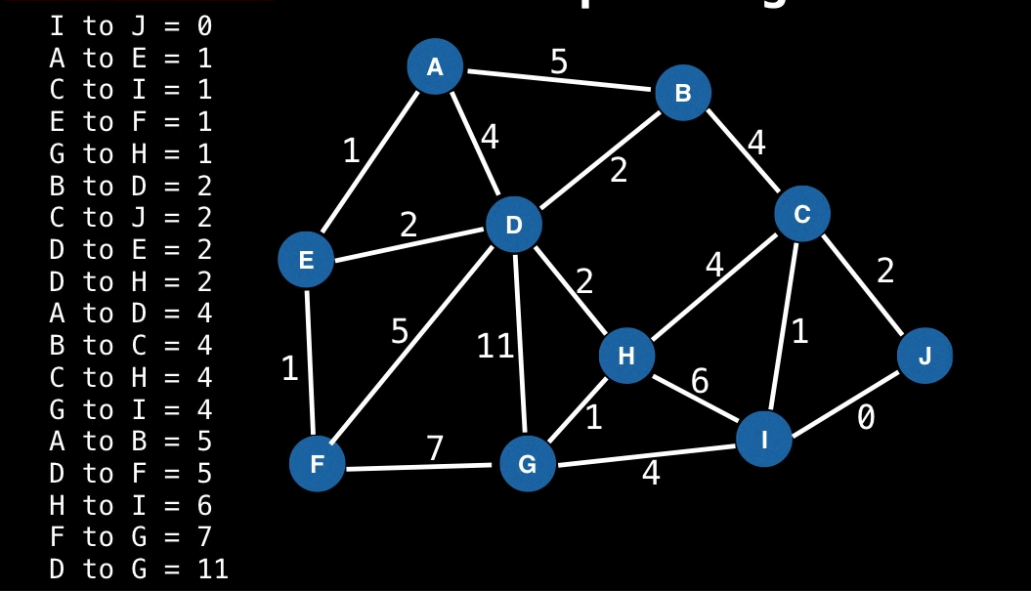
https://www.youtube.com/watch?v=JZBQLXgSGfs

Slide 10
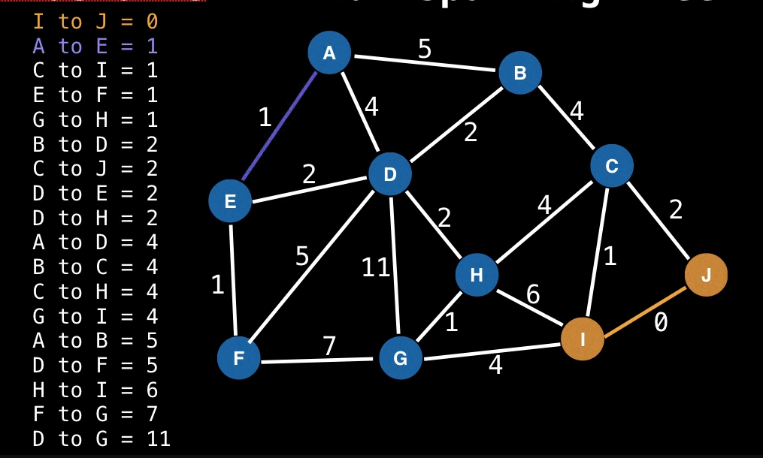
https://www.youtube.com/watch?v=JZBQLXgSGfs

Slide 11
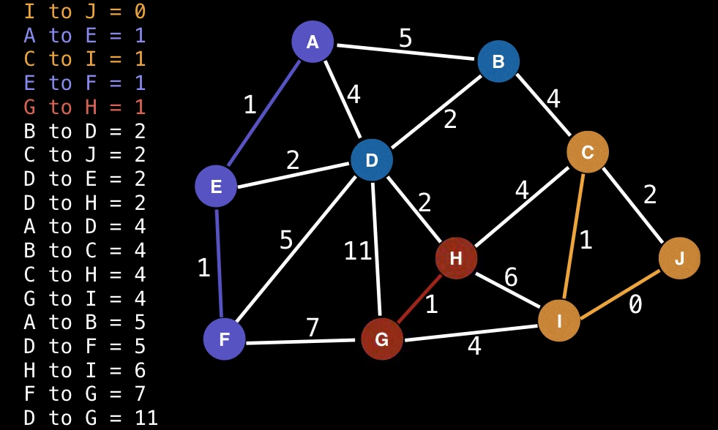
https://www.youtube.com/watch?v=JZBQLXgSGfs

Slide 12
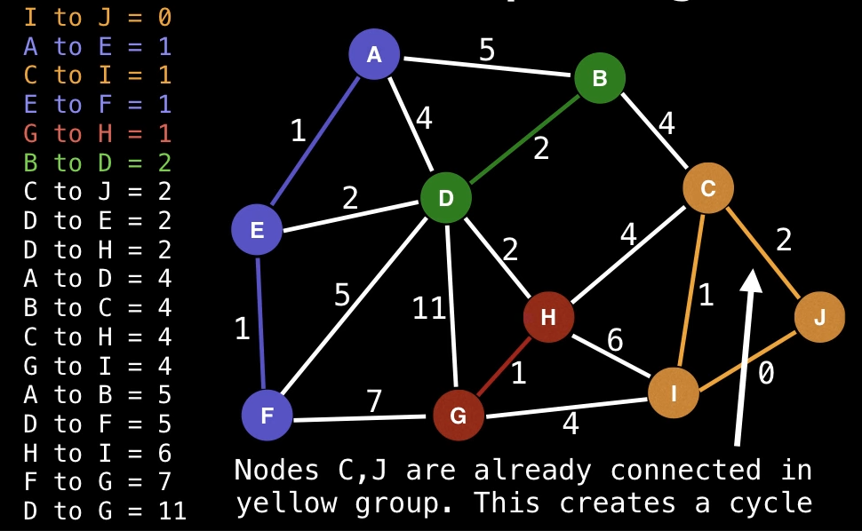
https://www.youtube.com/watch?v=JZBQLXgSGfs

Slide 13
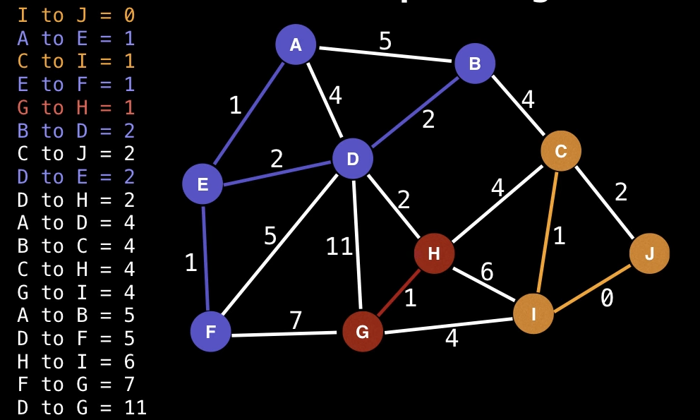
https://www.youtube.com/watch?v=JZBQLXgSGfs

Slide 14
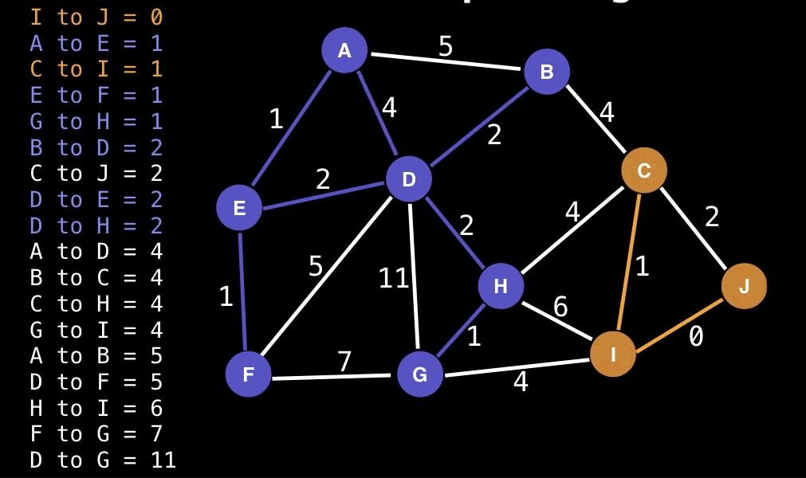
https://www.youtube.com/watch?v=JZBQLXgSGfs

Slide 15
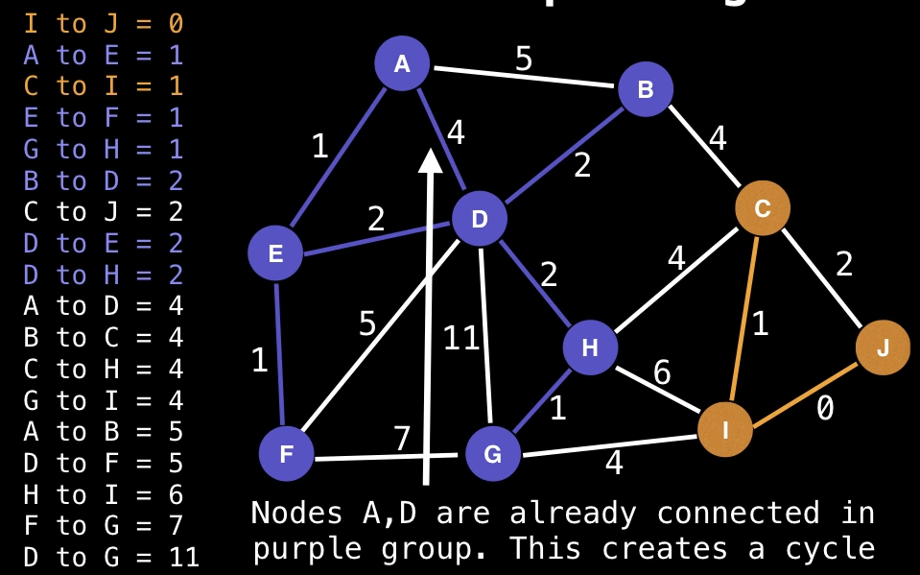
https://www.youtube.com/watch?v=JZBQLXgSGfs

Slide 16
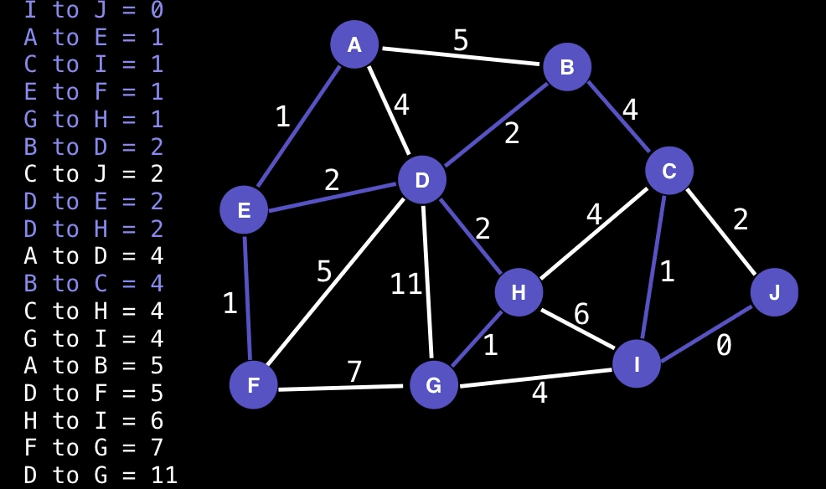
https://www.youtube.com/watch?v=JZBQLXgSGfs

Slide 17
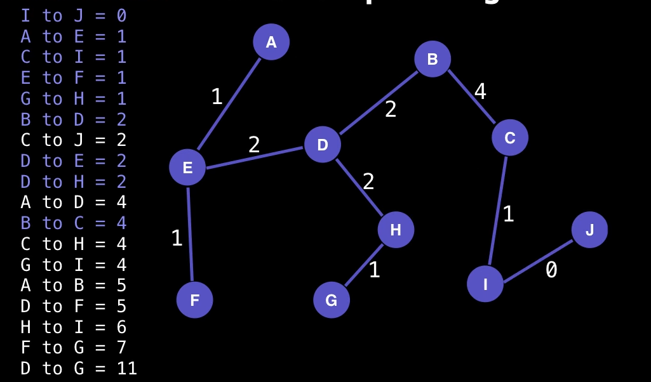
https://www.youtube.com/watch?v=JZBQLXgSGfs

Slide 18
Prim’s algorithm
https://www.geeksforgeeks.org/dsa/prims-minimum-spanning-tree-mst-greedy-algo-5/

