Slide 1

Data Structures and Algorithms I.
University of Szeged
Robert Nagy
2025/26. Spring Semester

Slide 2

Imagine that you’re building a house

Slide 3
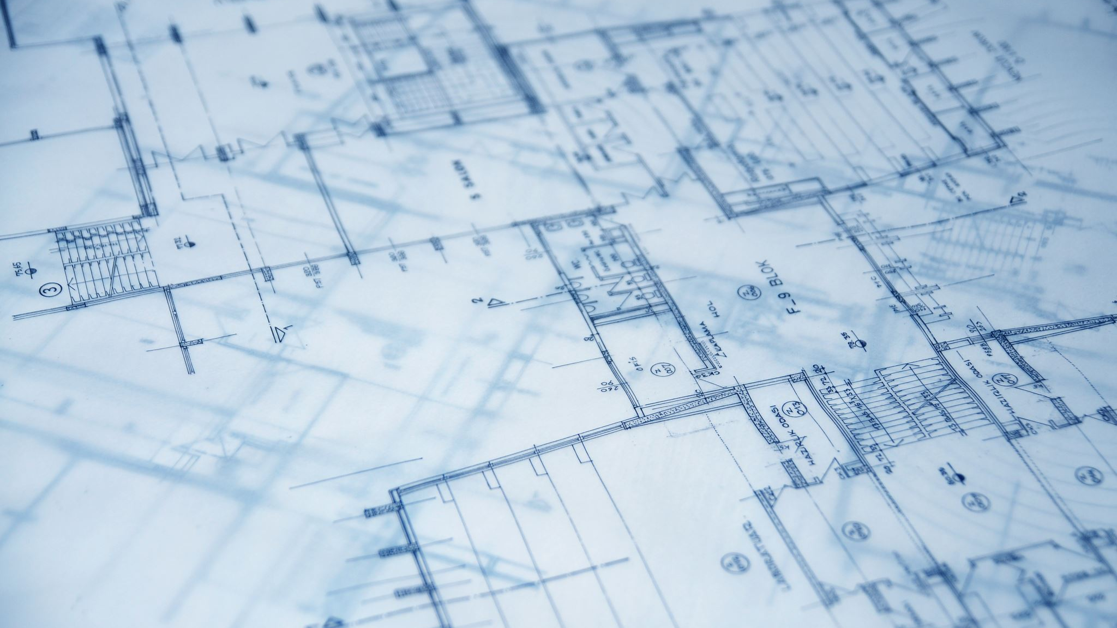
The blueprint – an algorithm

Slide 4

The materials – provide the structure

Slide 5
Even if the blueprint is flawless, low-quality materials can make the house collapse early.

Slide 6

Data - the building blocks for software

Slide 7
Simple Building blocks
Primitive data types
Composite data types
Material type
Fixed / rigid
Flexible / Dynamic
Composite Building blocks
Data structures

Slide 8
Primitive data types – fixed size in memory
Int
Float, Double
Char
Boolean
Pointer
https://www.geeksforgeeks.org/dsa/data-types-in-programming/

Slide 9
Composite data types – fixed size in memory
Objects (Class instances)
ANSI C specific:
  Struct
  Union

Slide 10
Material types
Rigid
Fixed, contiguous place in memory
Flexible
Usually a chain of Nodes
Nodes have a fixed size
The node-chain can grow indefinitely

Slide 11
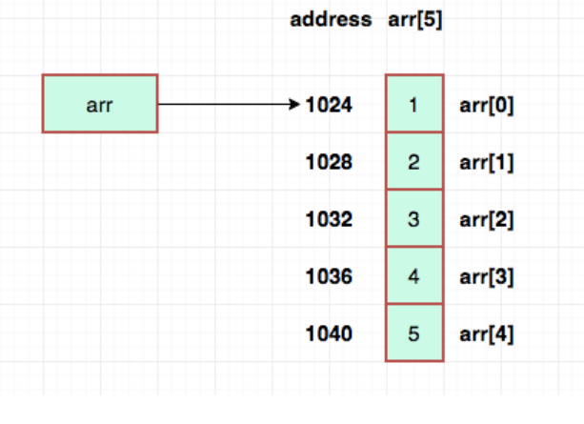
Array – contiguous memory addresses
Array that stores 32-bit integers
https://sites.duke.edu/writing270_02_ss12021_ecyoung/2021/06/28/data-structures-in-our-everyday-lives-arrays/

Slide 12

Pointer
A variable that stores a memory address
A memory address is just a number

Slide 13
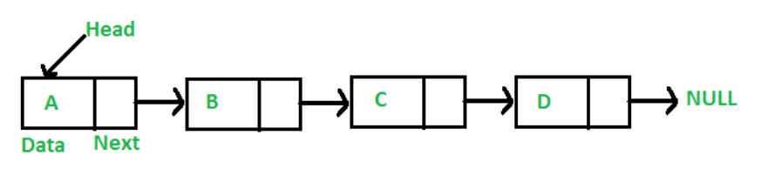
Nodes with pointers to other nodes

Slide 14
Data Structures

Slide 15
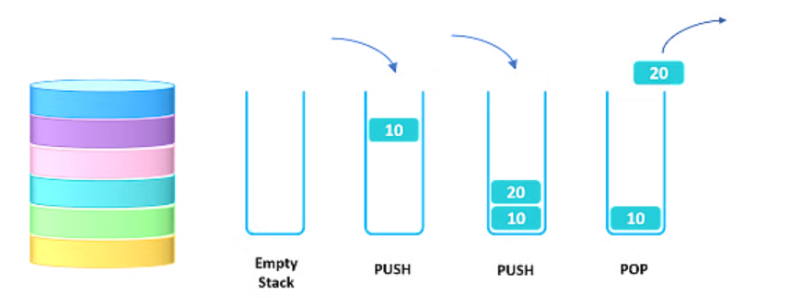
The Stack - LIFO

Slide 16
Usage - Examples
Recursion –
  Transforming recursive code into iterative code
  Call stack

Slide 17
Usage - Examples
Recursion –
  Transforming recursive code into iterative code
  Call stack
Backtracking algorithms
  Maze solvers

Slide 18
Usage - Examples
Recursion –
  Transforming recursive code into iterative code
  Call stack
Backtracking algorithms
  Maze solvers
Undo/Redo operation

Slide 19
Usage - Examples
Recursion –
  Transforming recursive code into iterative code
  Call stack
Backtracking algorithms
  Maze solvers
Undo/Redo operation
Navigation in web browsers and web apps

Slide 20
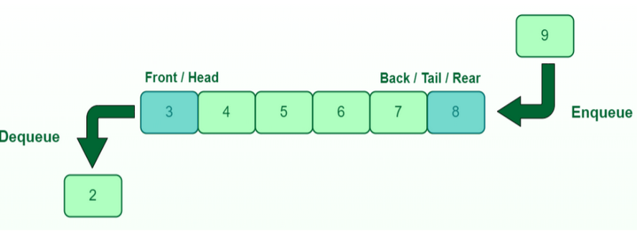
The Queue - FIFO

Slide 21
Usage - Examples
Operating systems
  Task scheduling

Slide 22
Usage - Examples
Operating systems
  Task scheduling
Network routers and switches
  Data packet management

Slide 23
Usage - Examples
Operating systems
  Task scheduling
Network routers and switches
  Data packet management
Printers
Customer service systems

Slide 24

Exercises

Slide 25
The following data stream arrives: 1, 6, 8, 13, 42, 7, 4
  Build a queue, starting with the first element, moving left to right
  Dequeue all the elements one by one, and push them onto a stack
  Pop all elements from the stack

Slide 26
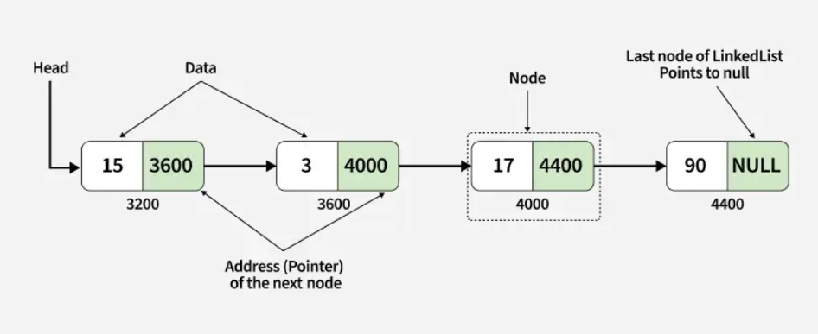
Linked List

Slide 27
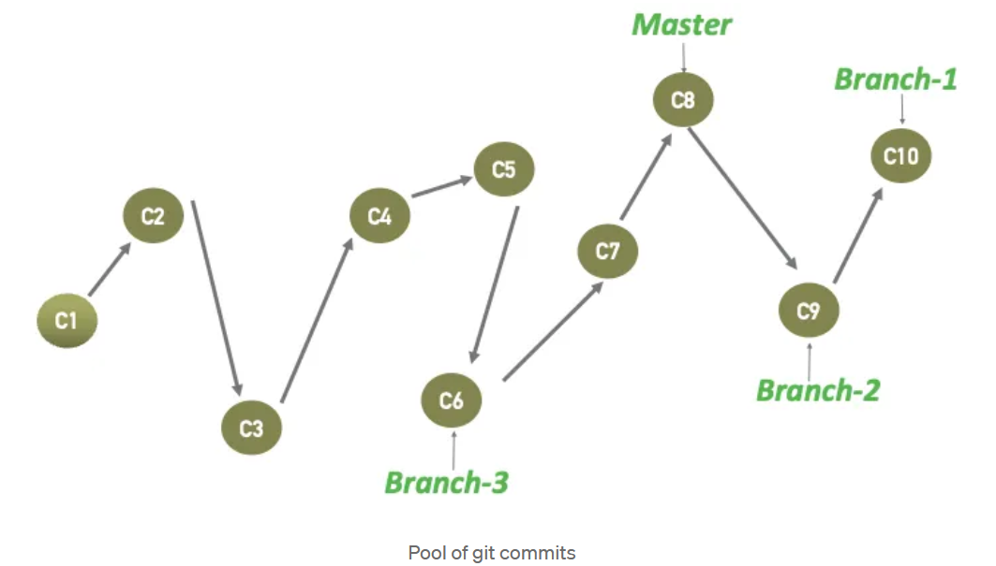
Git
https://medium.com/@vivektikar/demystifying-git-what-is-a-git-branch-exactly-under-the-hood-b0a607ba1129

Slide 28

Binary heap
Read more: https://www.programiz.com/dsa/heap-data-structure

Slide 29
2 Types
Min heap
Max heap

Slide 30
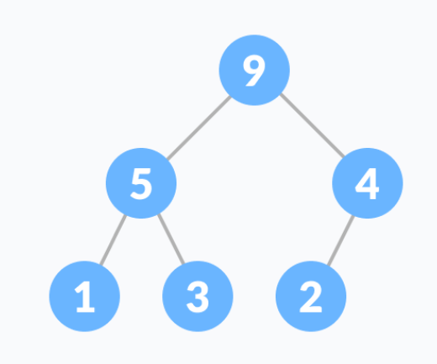
Max heap

Slide 31
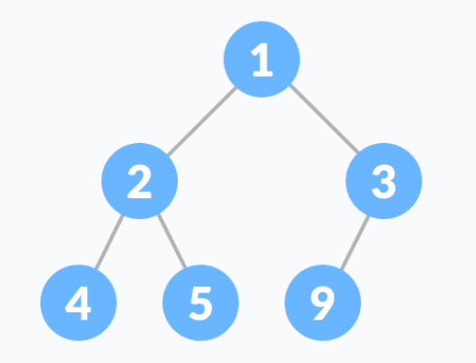
Min heap

Slide 32

Heap properties & functions
A heap is a complete binary tree
“Heapify” procedure

Slide 33
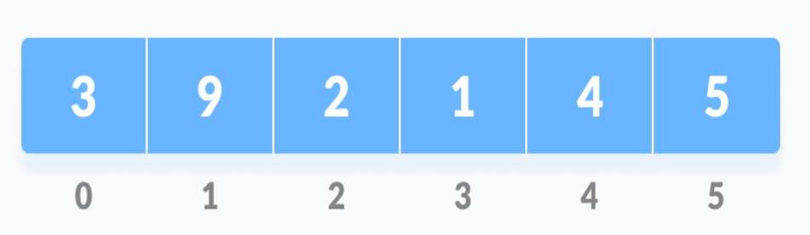
Heapify
Step 1: Input array

Slide 34
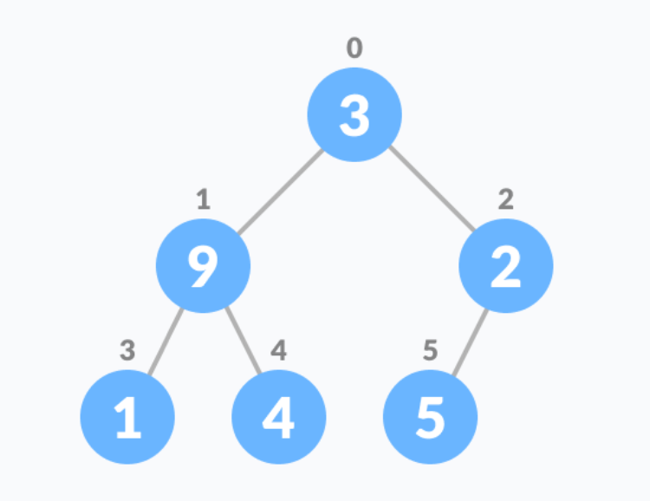
Complete Binary Tree
Step 2 – Construct the CBT From the input array

Slide 35
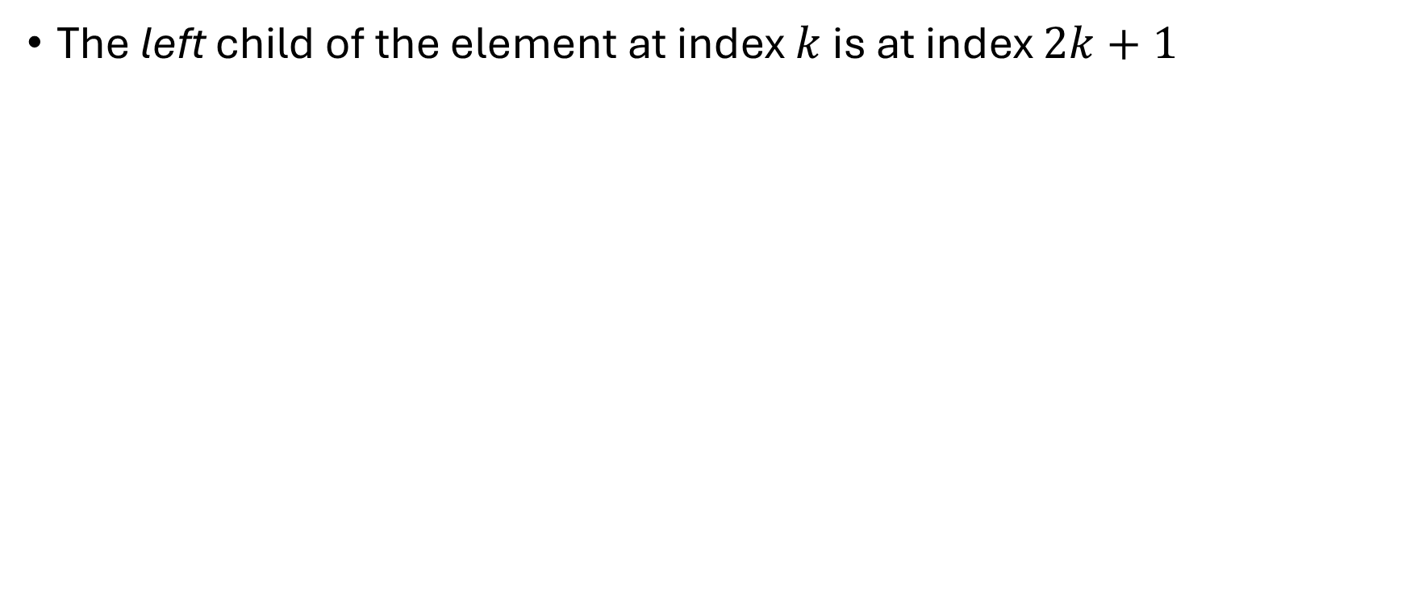
How?
The left child of the element at index $k$ is at index $2k+1$

Slide 36
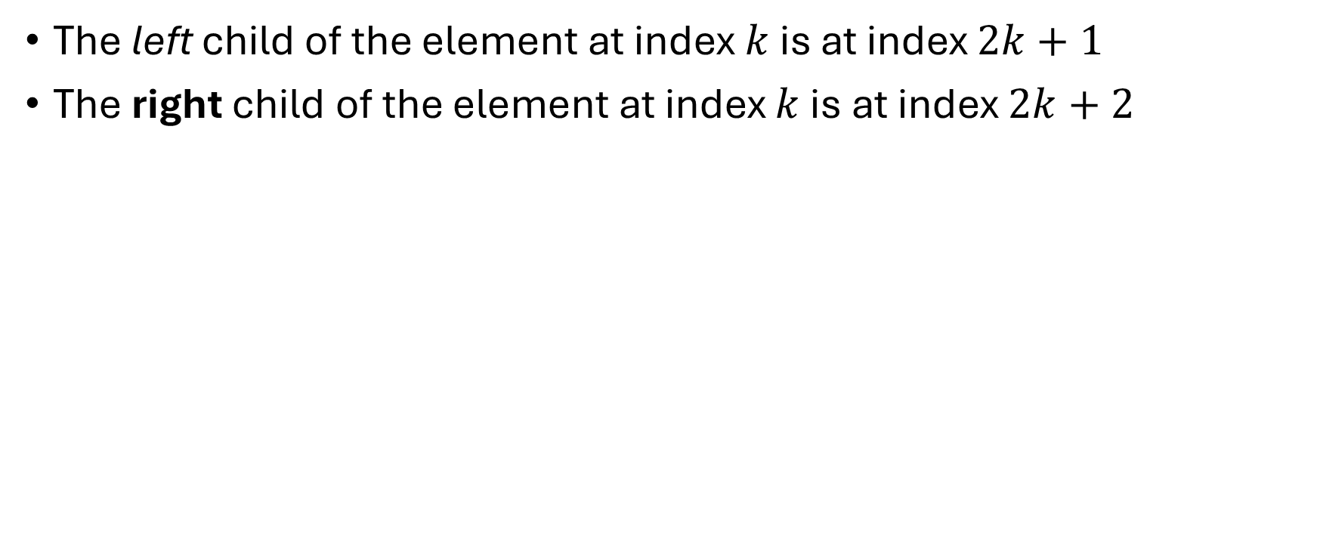
How?
The left child of the element at index $k$ is at index $2k+1$
The right child of the element at index $k$ is at index $2k+2$

Slide 37
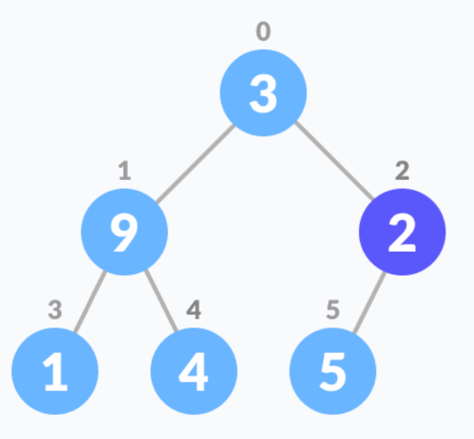
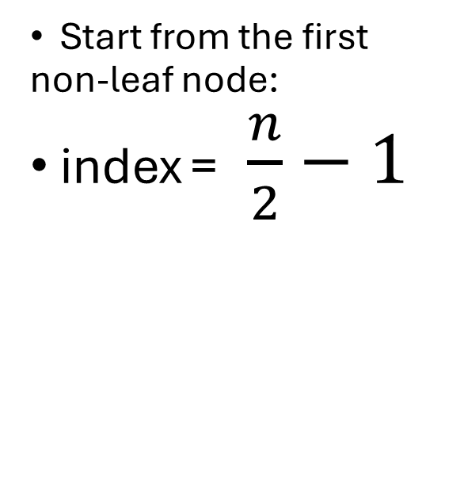
Step 3: “Heapify” – “Bubble up”
Start from the first non-leaf node:
index = $\frac{n}{2}−1$

Slide 38
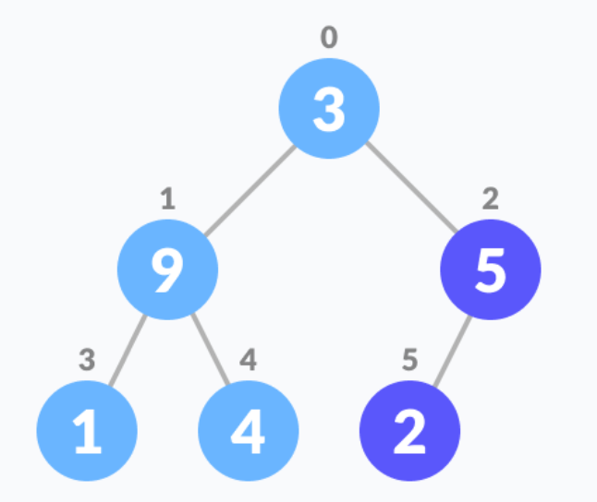
Swap the element with its biggest child
Repeat until done

Slide 39

Example

Slide 40
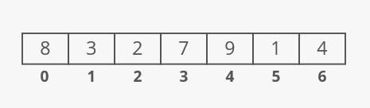

Slide 41
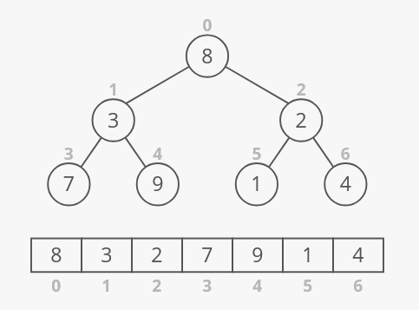

Slide 42
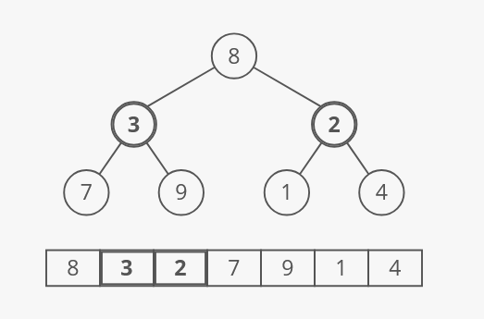

Slide 43
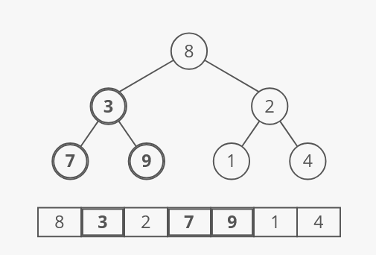

Slide 44
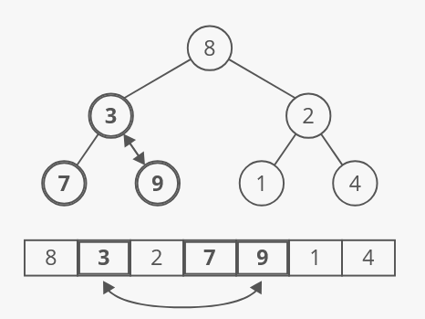

Slide 45
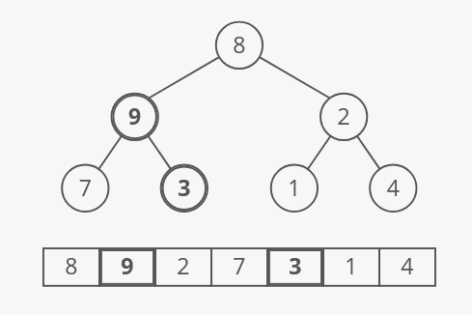

Slide 46
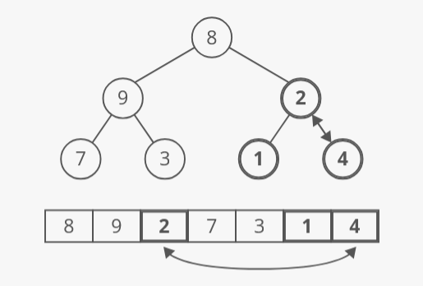

Slide 47
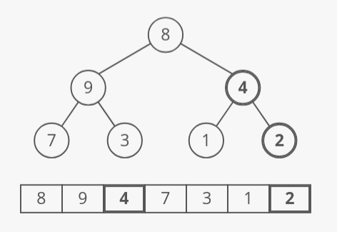

Slide 48
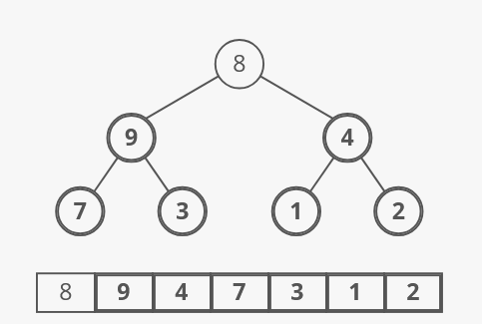

Slide 49
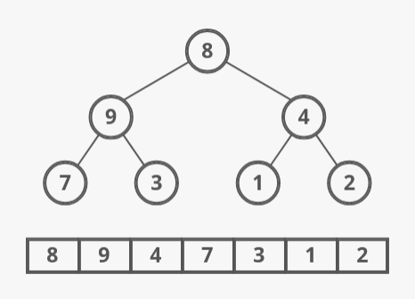

Slide 50
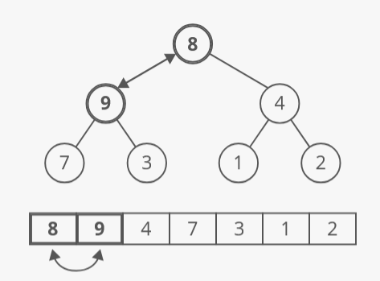

Slide 51
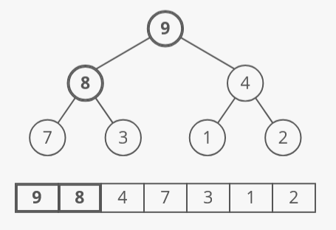

Slide 52

Priority queue

Slide 53
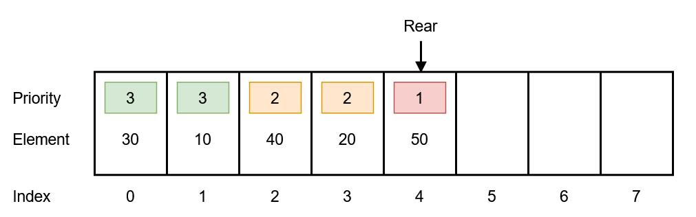

Slide 54
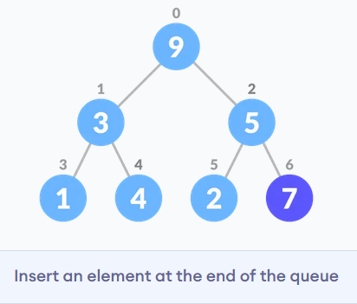

Slide 55
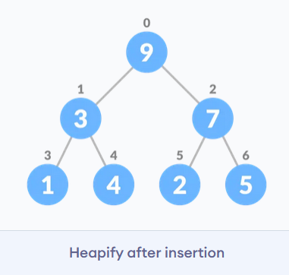

Slide 56
Removing the largest element

Slide 57
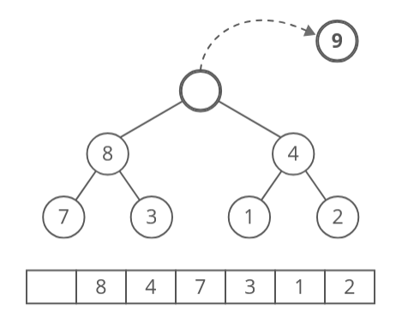

Slide 58
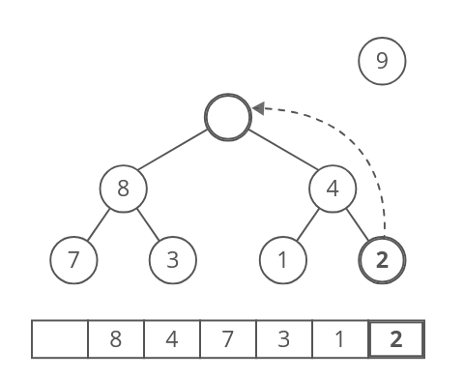

Slide 59
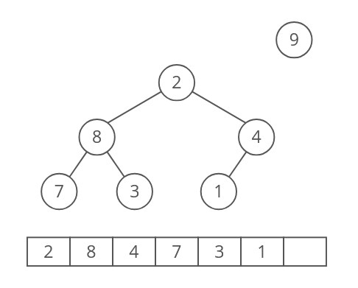

Slide 60
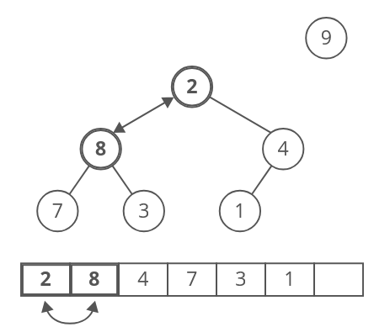

Slide 61
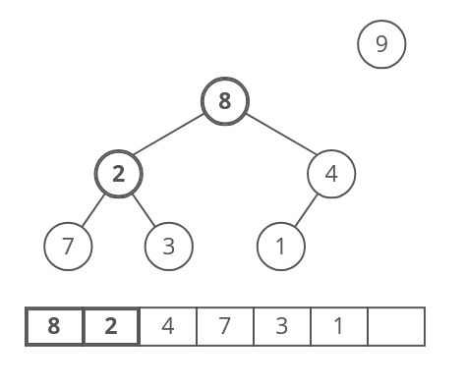

Slide 62
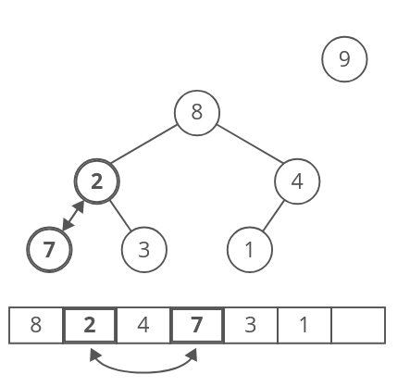

Slide 63
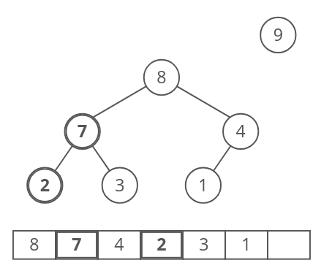

Slide 64
Time complexity of heap operations
Inserting an element – O(lg(n))
Removing an element – O(lg(n))

Slide 65
What about building the Initial heap?
With the right implementation – O(n)
  Homework for extra points: find the proof!

