Slide 1

Data Structures and Algorithms I.
University of Szeged
Robert Nagy
2025/26. Spring Semester

Slide 2

Tree-like structures
We have already seen
  Recursion tree
  Heap

Slide 3
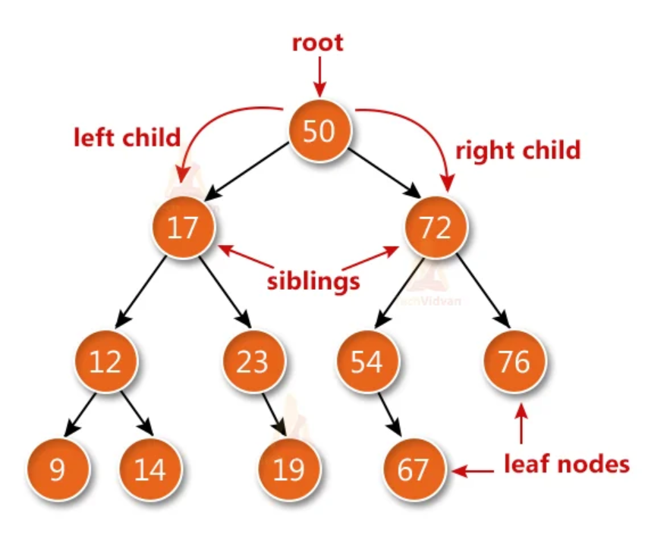
Binary Search Tree

Slide 4

Different types of binary trees

Slide 5
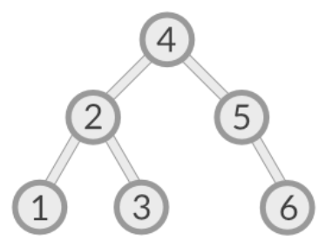
Balanced

Slide 6
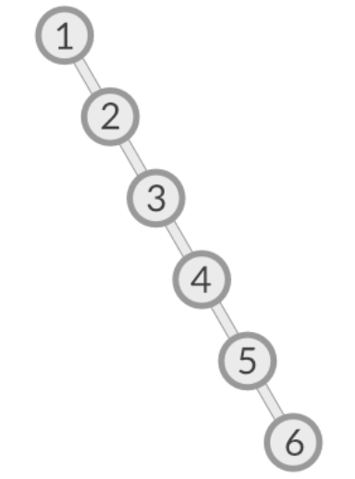
Skewed

Slide 7
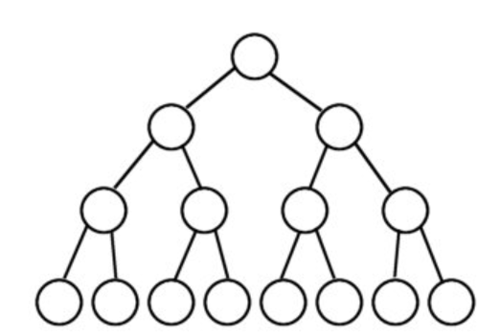
Full binary tree

Slide 8
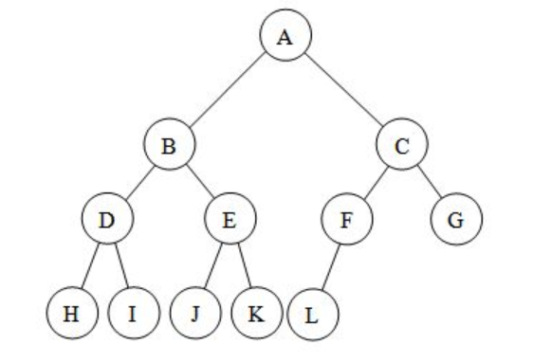
Complete binary tree

Slide 9
Exercise
The following data stream arrives: 32, 15, 77, 65, 43, 6, 9
  Construct a binary search tree, starting with the first element from left to right.

Slide 10
Ways to traverse a binary tree

Slide 11
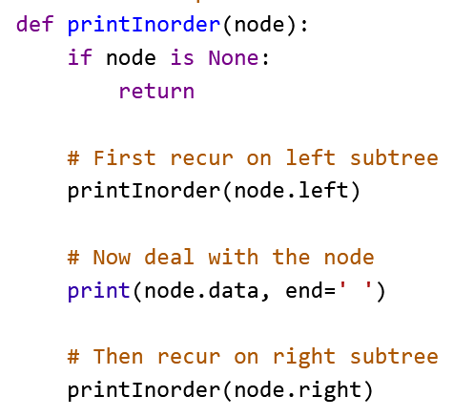
In-order

Slide 12
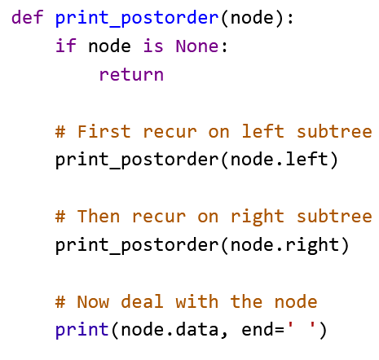
Post-order

Slide 13
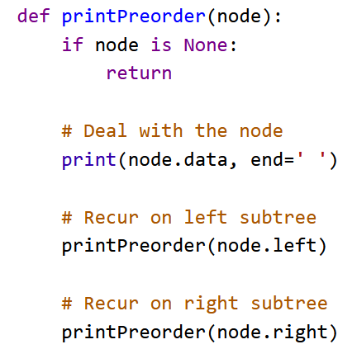
Pre-order

Slide 14
Set
Abstract data type

Slide 15
Unique elements
Ordered
Unordered

Slide 16
Map (Dictionary)
Key – value pairs

Slide 17
Map (Dictionary)
Ordered
Unordered

Slide 18

Deleting a node from a BST

Slide 19
2 distinct cases
Leaf nodes
Internal nodes

Slide 20
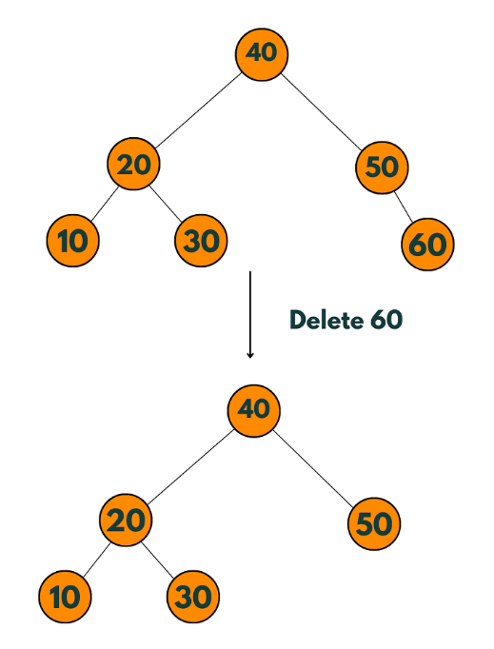
Leaf nodes

Slide 21

Internal nodes – 2 strategies
Replace with the previous
Replace with the next

Slide 22
Time complexity analysis
Each operation depends on the height of the tree
  Worst case – skewed → O(n)
  Best case – balanced → O(lg(n))

