Slide 1

Data Structures and Algorithms I.
University of Szeged
Robert Nagy
2025/26. Spring Semester

Slide 2
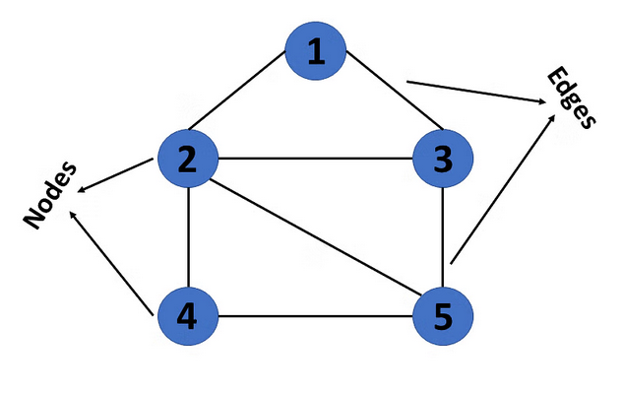
Graph

Slide 3
Some graph properties
Nodes (Vertices) – V
Degree of a vertex
Edges – E
Paths
https://medium.com/@sarinyaswift/intro-to-the-graph-data-structure-a8277c6a2ad9

Slide 4
Graphs in real life
Social networks
Navigation systems
The internet
Search Engines

Slide 5
Different types of graphs

Slide 6
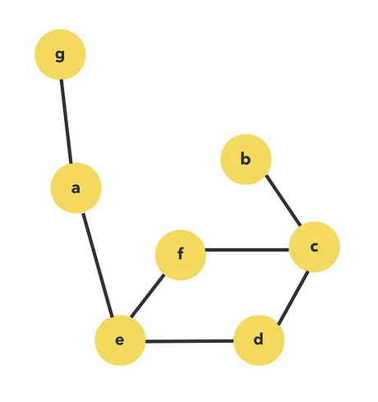
Undirected

Slide 7
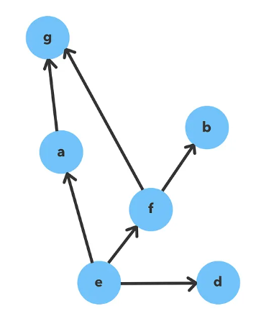
Directed

Slide 8
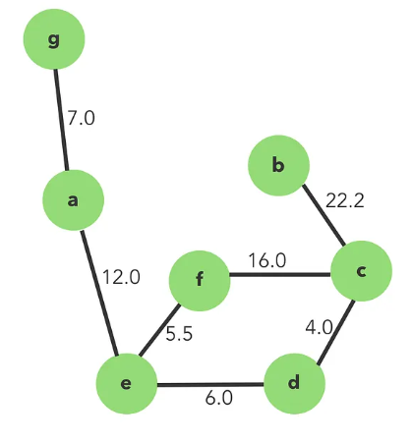
Weighted

Slide 9
Graph representation
Adjacency matrix
Adjacency list

Slide 10
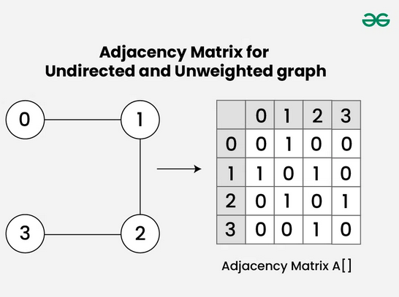

Slide 11
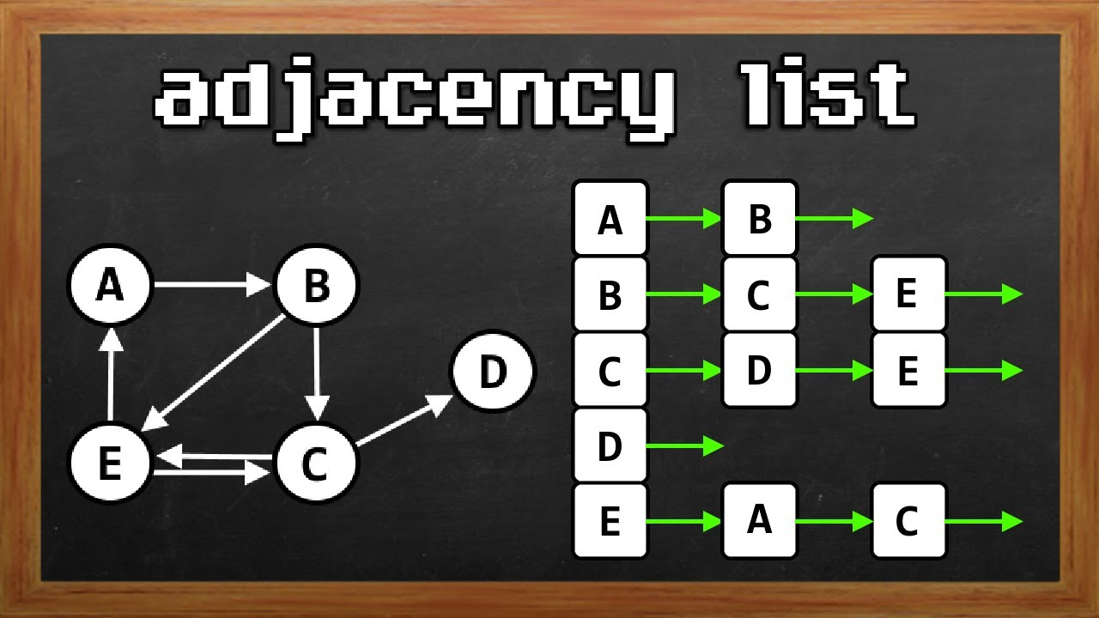
https://www.youtube.com/watch?v=ee6zIj4J3-Y

Slide 12
Adjacency Matrix
Good for dense graphs
Space inefficient – $O(V^{2})$
Space inefficient – 𝑂(𝑉^2)
Adjacency List
Space efficient – $O(V + E)$
Space efficient – 𝑂(𝑉 + 𝐸)
Checking neighbors is fast
Better for sparse graphs
Edge checks take $O\left(1\right)$ time
Edge checks take 𝑂(1) time

Slide 13
Graph Algorithms

Slide 14
BFS – Breadth First Search
https://www.youtube.com/watch?v=xlVX7dXLS64

Slide 15
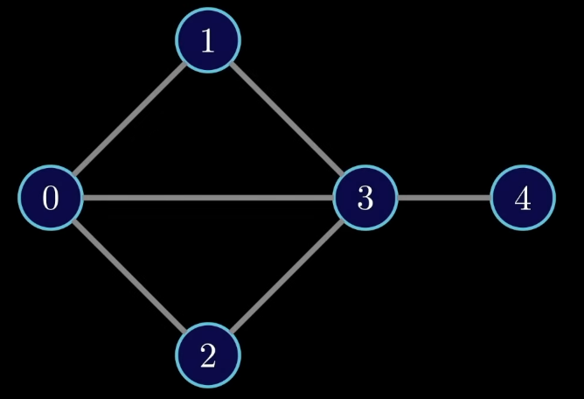

Slide 16
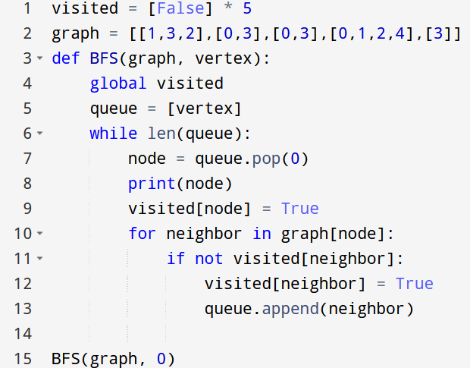

Slide 21
DFS – Depth First Search
https://www.youtube.com/watch?v=PMMc4VsIacU

Slide 22
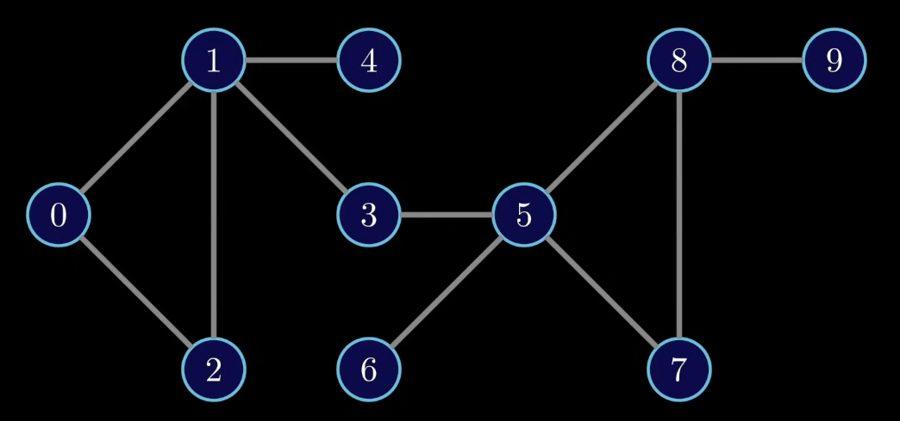

Slide 23
2 DFS Variations
Preorder
Postorder

Slide 24
Preorder

Slide 25
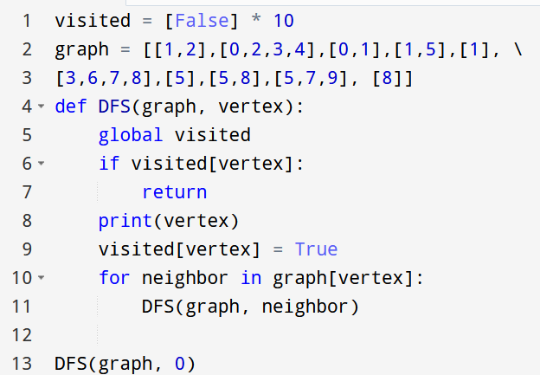

Slide 28
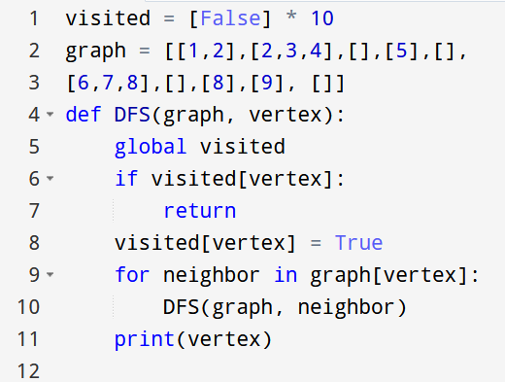
Post-order

Slide 29
Topological sort
Directed, acyclic graphs

Slide 30
Meaning
Think of nodes as tasks
0 → 1 means task 0 must be done before task 1

Slide 31
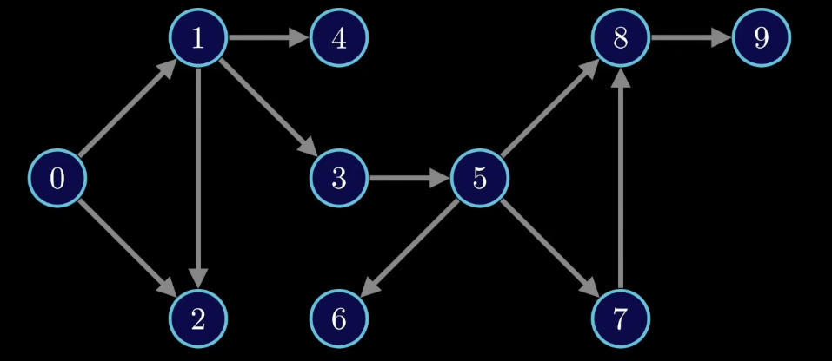

Slide 32
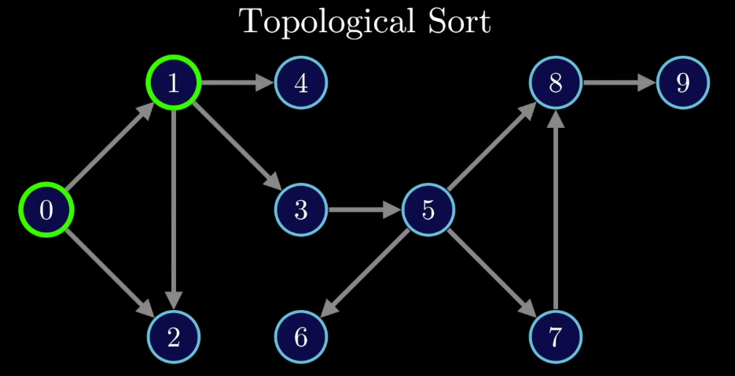

Slide 33
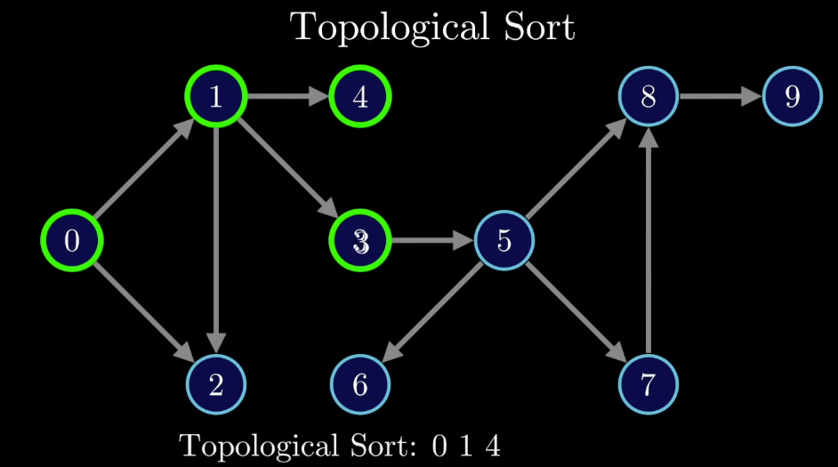

Slide 34
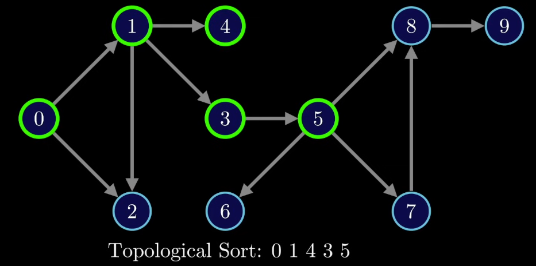

Slide 35
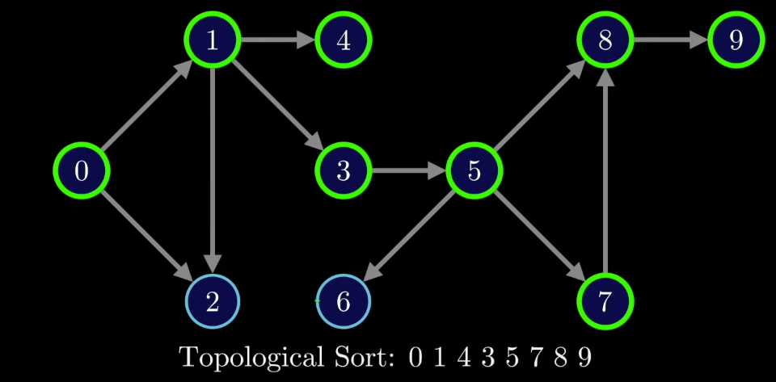

Slide 36
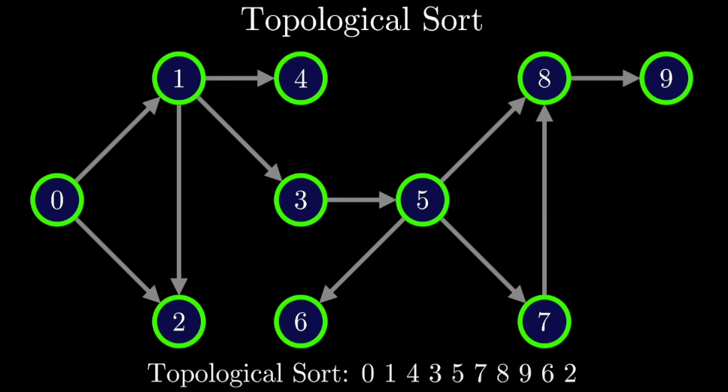

Slide 37
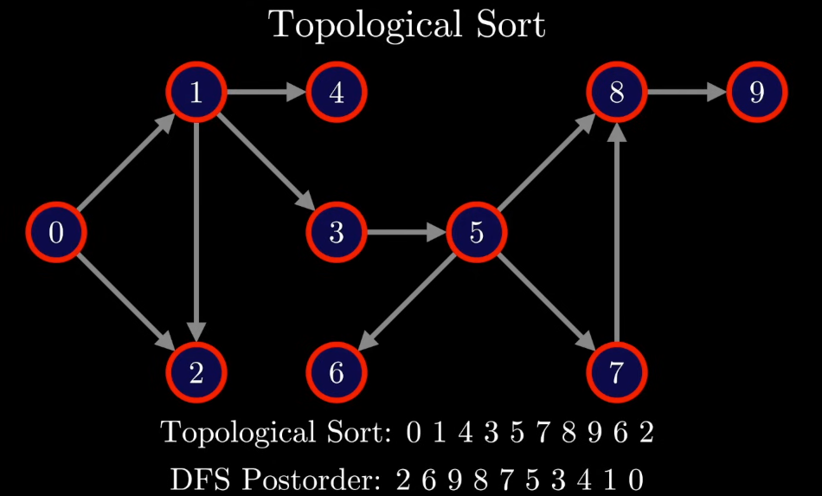

Slide 38
Reversing a post-order DFS always gives a valid topological sort.

Slide 39
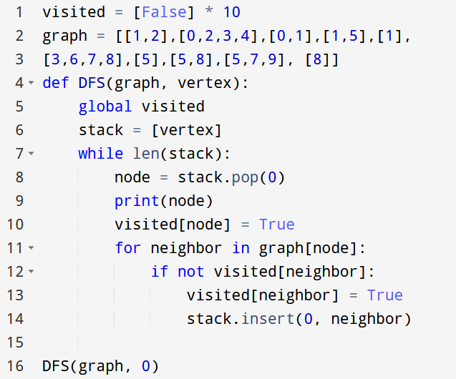
F.Y.I.

