Slide 1

Data Structures and Algorithms I.
University of Szeged
Robert Nagy
2025/26. Spring Semester

Slide 2
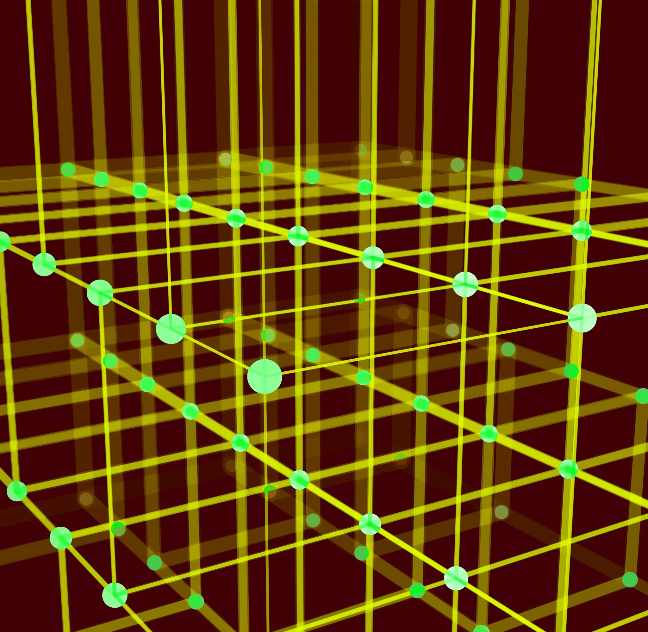
Greedy Algorithms

Slide 3
Optimization problems
Global optimum
Local optimum

Slide 4
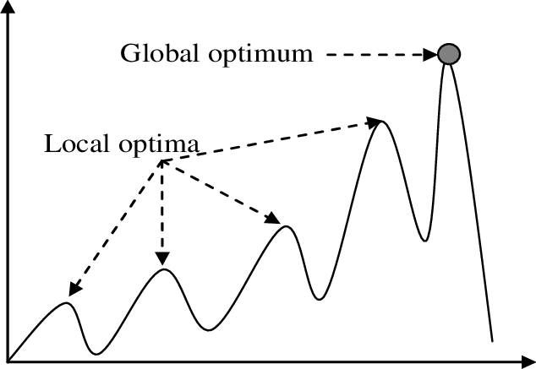

Slide 5
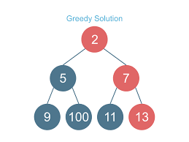

Slide 9

Top-down approach
We assume the best choice at the moment will lead to the best outcome overall

Slide 10
The Fractional Knapsack Problem

Slide 11
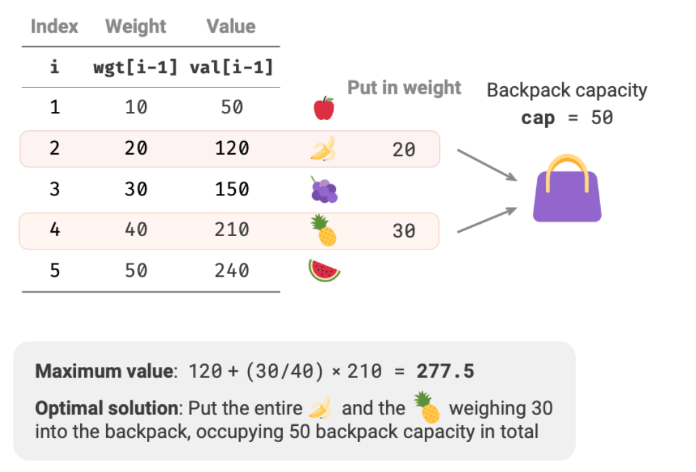
https://www.hello-algo.com/en/chapter_greedy/fractional_knapsack_problem/

Slide 12
https://www.hello-algo.com/en/chapter_greedy/fractional_knapsack_problem/

Slide 13
https://www.hello-algo.com/en/chapter_greedy/fractional_knapsack_problem/

Slide 14
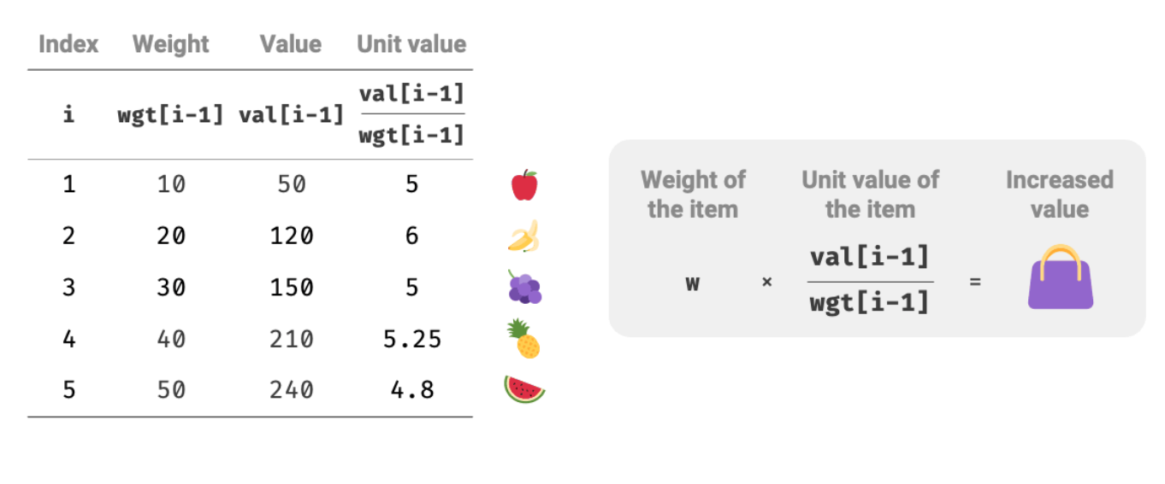
https://www.hello-algo.com/en/chapter_greedy/fractional_knapsack_problem/

Slide 15
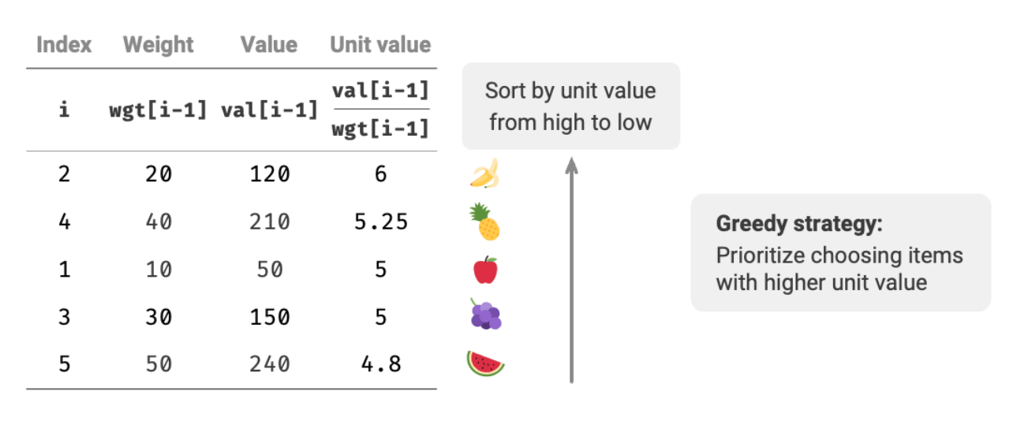
https://www.hello-algo.com/en/chapter_greedy/fractional_knapsack_problem/

Slide 16
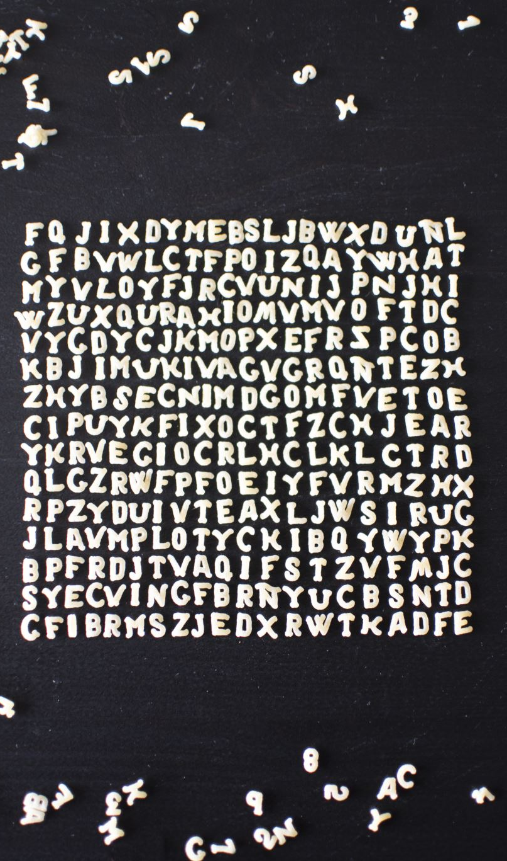
Huffman codes

Slide 17

Text compression

Slide 18
Suppose the following:
You have a 100,000-character long message

Slide 19
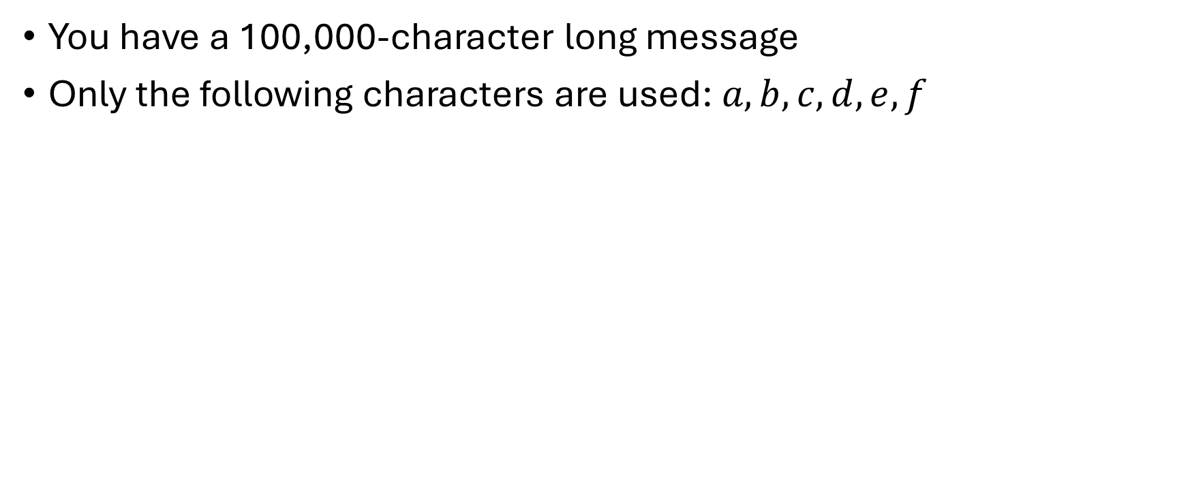
Suppose the following:
You have a 100,000-character long message
Only the following characters are used: $a,b,c,d,e,f$

Slide 20
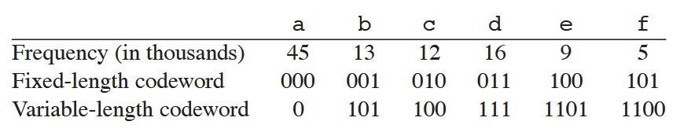
Character encoding

Slide 21
Character encoding

Slide 22
Character encoding

Slide 23

Comparison
Fixed-length codes – 300,000 bits
Variable-length codes – 224,000 bits
That is an approx. 25% improvement

Slide 24
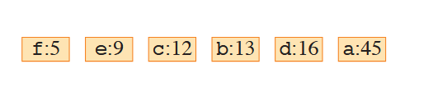

Slide 25
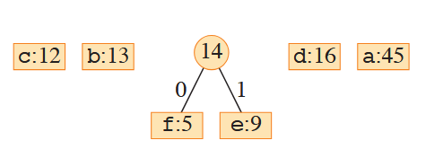

Slide 26
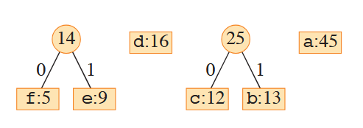

Slide 27
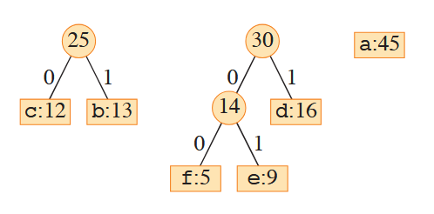

Slide 28
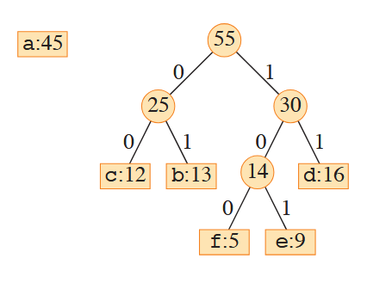

Slide 29
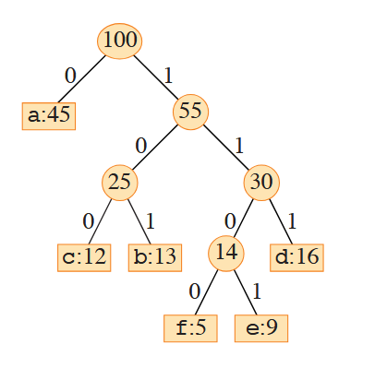

Slide 30
DP VS Greedy
Dynamic Programming
Bottom-up approach
Global Optimum
More complex
Greedy Algorithms
Top-down approach
Local optimum
Easier, but not always correct

