Slide 1

Data Structures and Algorithms I.
University of Szeged
Robert Nagy
2025/26. Spring Semester

Slide 2
Hash tables

Slide 3
Hash function
Transform the input

Slide 4
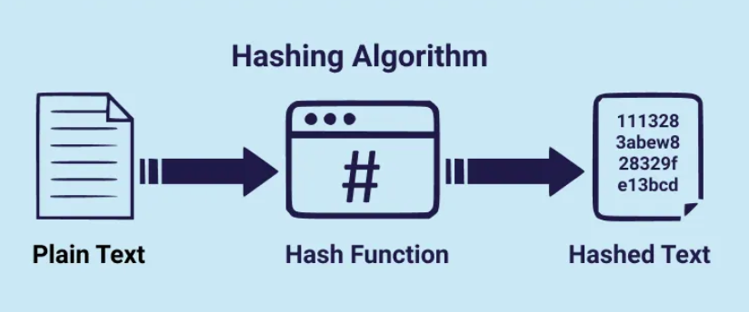
https://medium.com/nybles/hashing-algorithms-d10171ca2e89

Slide 5
Popular hashing algorithms
SHA-256
SHA-3
CRC32
MD5

Slide 6
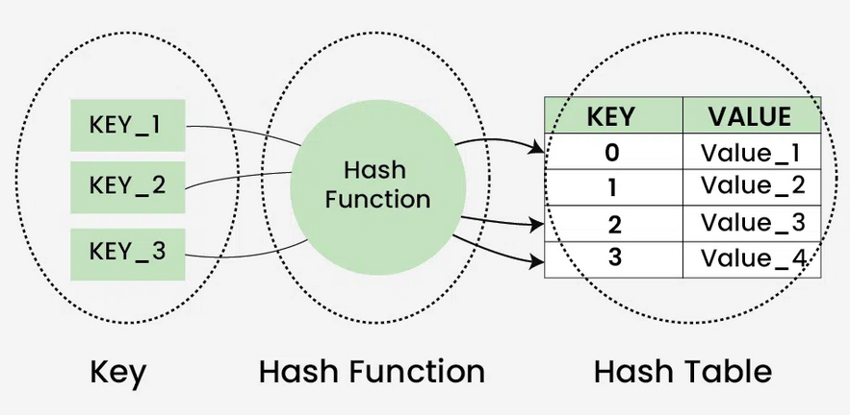
https://www.geeksforgeeks.org/dsa/hash-table-data-structure/

Slide 7
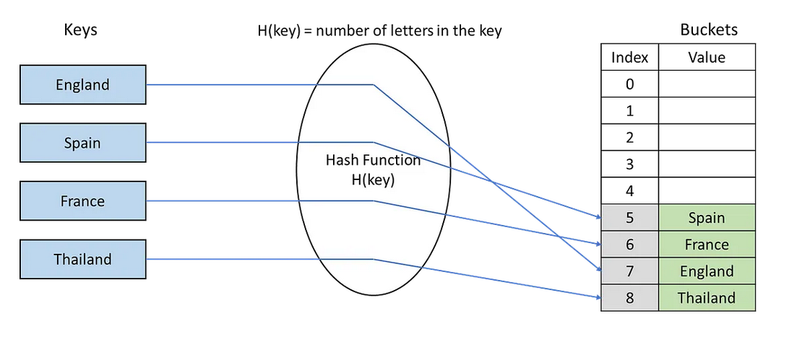

Slide 8
Motivation
Storage for unique elements, with O(1) search time.
  Unordered set
  Unordered map

Slide 9
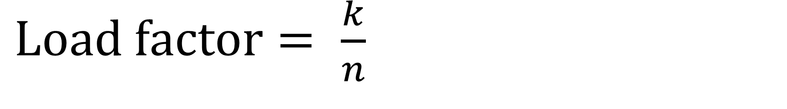
$Load factor= \frac{k}{n}$
The size of the table → n
The number of occupied slots → k

Slide 10
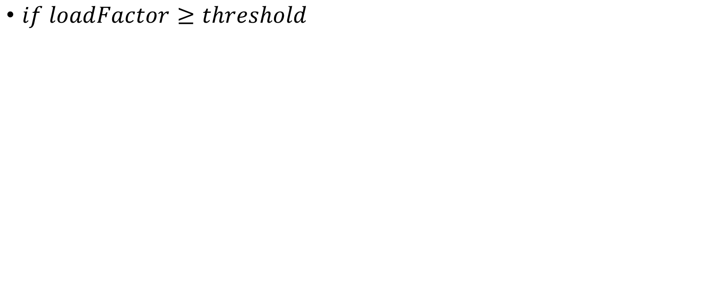
Rehashing
$if loadFactor≥threshold$

Slide 11
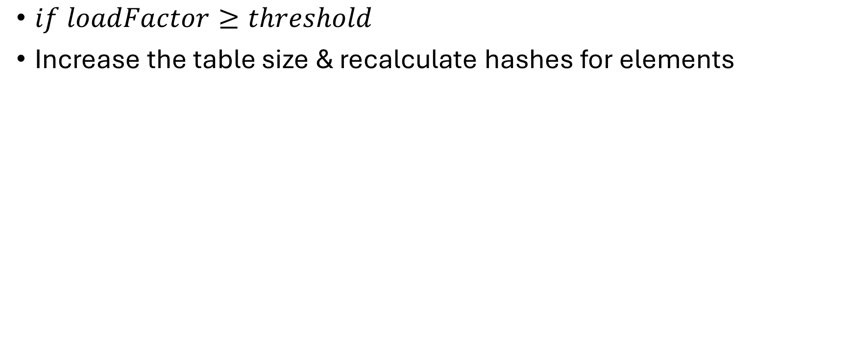
Rehashing
$if loadFactor≥threshold$
Increase the table size & recalculate hashes for elements

Slide 12
Collisions

Slide 13
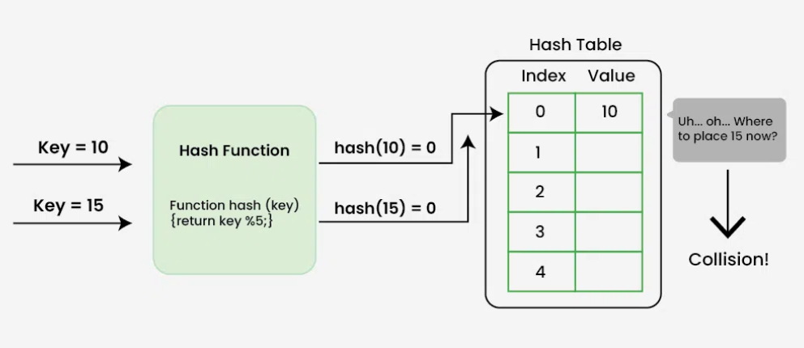

Slide 14

Collision resolution techniques

Slide 15
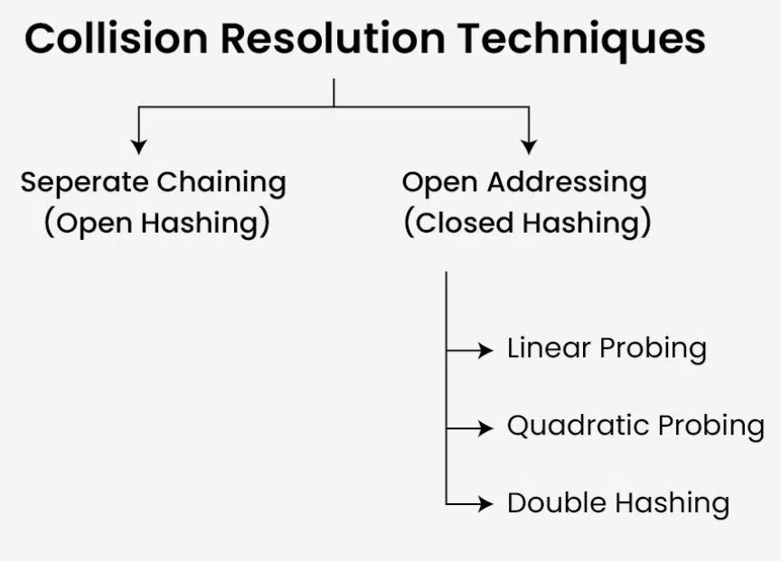
https://www.geeksforgeeks.org/dsa/collision-resolution-techniques/

Slide 16

Separate chaining

Slide 17
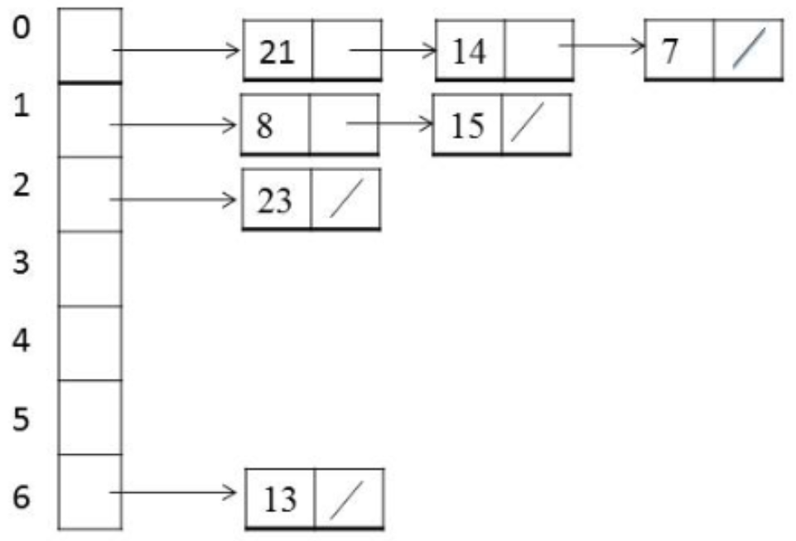
https://www.researchgate.net/figure/Hash-table-representation-for-separate-chaining_fig2_284454241

Slide 18
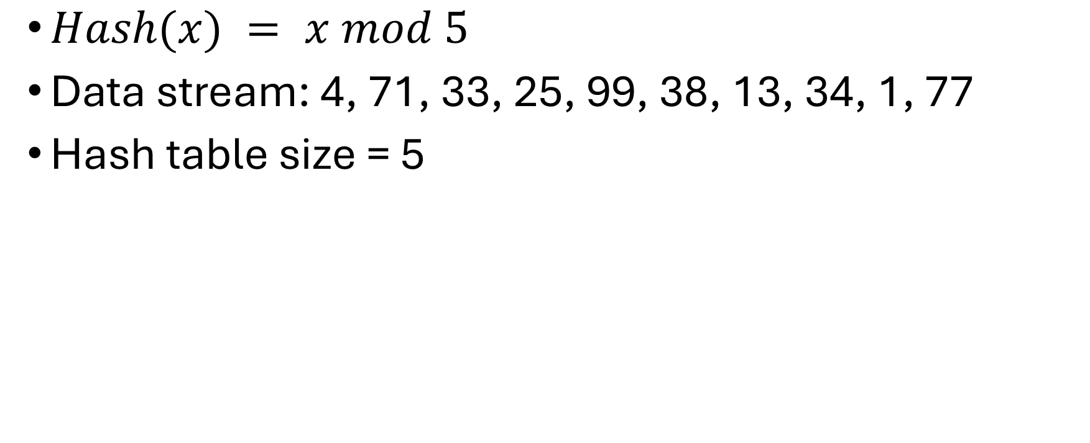
Exercise – separate chaining
$Hash(x) = x mod 5$
Data stream: 4, 71, 33, 25, 99, 38, 13, 34, 1, 77
Hash table size = 5

Slide 19
Linear probing
$$Hash\left(key\right)=\left(key+i\right) mod n$$

Slide 20
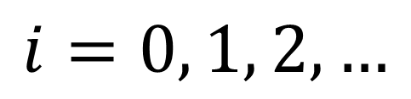
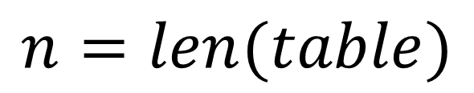
Linear probing
$$Hash\left(key\right)=\left(key+i\right) mod n$$
$$i=0, 1, 2, …$$
$$n=len(table)$$

Slide 21
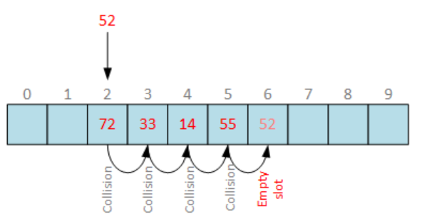
https://www.sysadmins.lv/blog-en/array-search-hash-tables-behind-the-scenes.aspx

Slide 22
Problem – Primary Clustering

Slide 23

Quadratic probing

Slide 24
Example

Slide 25
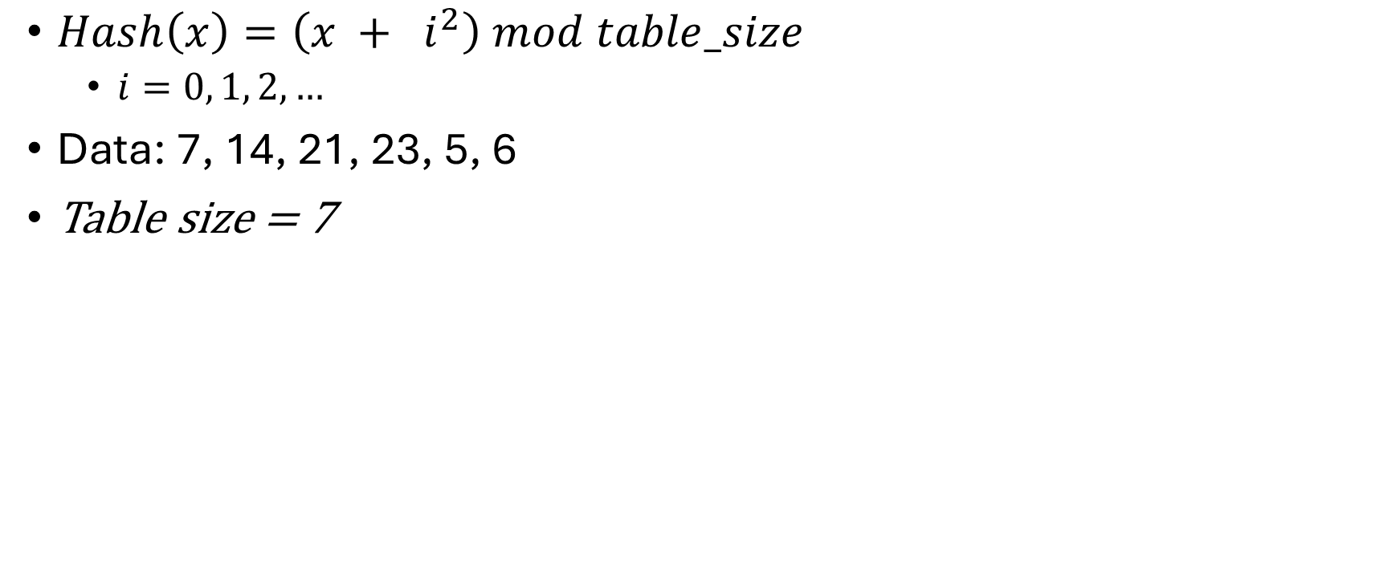
Exercise
$Hash\left(x\right)=\left(x + i^{2}\right) mod table_size$
  $i=0, 1, 2, …$
Data: 7, 14, 21, 23, 5, 6
Table size = 7

Slide 26
F.Y.I.
Abseil – Google’s C++ util lib – Hash uses Quadratic probing
  https://github.com/abseil/abseil-cpp
Open problem:

Slide 27

Double hashing

Slide 28
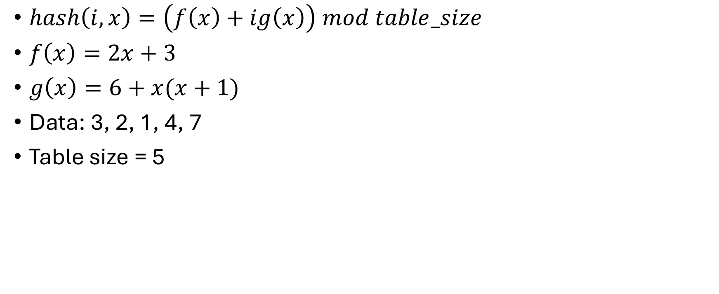
Example
$hash\left(i,x\right)=\left(f\left(x\right)+ig\left(x\right)\right) mod table_size$
$f\left(x\right)=2x+3$
$g\left(x\right)=6+x(x+1)$
Data: 3, 2, 1, 4, 7
Table size = 5

