Slide 1

Data Structures and Algorithms I.
University of Szeged
Robert Nagy
2025/26. Spring Semester

Slide 2

Sorting Algorithms

Slide 3

Why is sorting important?

Slide 4

Database systems

Slide 5
Searching
Naive approach $O(n)$
Naive approach 𝑂(𝑛)
Binary search $O\left(\log_{2}{(n)}\right)$
Binary search 𝑂(log_2⁡〖(𝑛)〗 )

Slide 6
Naive search (Brute force)
Task: Find 3
7, 4, 5, 9, 2, 3, 0, 1, 8

Slide 7
Naive search (Brute force)
Task: Find 3
7, 4, 5, 9, 2, 3, 0, 1, 8

Slide 8
Worst case scenario?

Slide 9
Binary search
Task: Find 3
7, 4, 5, 9, 2, 3, 0, 1, 8

Slide 10
Binary search
Step 1: Sort the input
0, 1, 2, 3, 4, 5, 7, 8, 9

Slide 11
Binary search
Step 2: Find the midpoint
0, 1, 2, 3, 4, 5, 7, 8, 9

Slide 12
Binary search
Step 3: Cut the search space in half
0, 1, 2, 3, 4, 5, 7, 8, 9

Slide 13
Binary search
Step 4: Repeat steps 1-3 until the key is found
0, 1, 2, 3, 4, 5, 7, 8, 9

Slide 14
Binary search
0, 1, 2, 3

Slide 15
Binary search
3

Slide 16

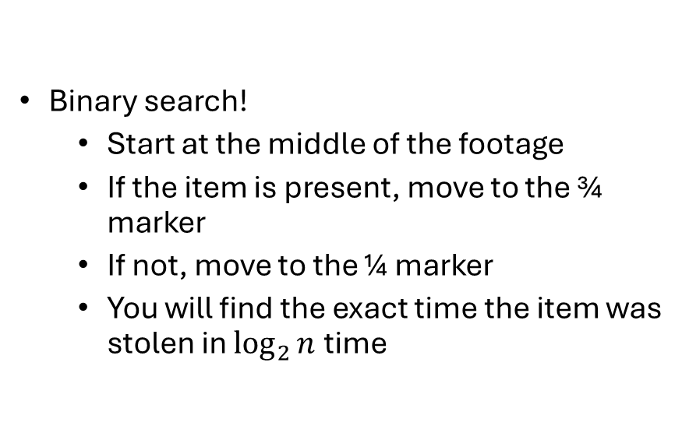
F.Y.I - Watching security footage for stolen items
Binary search!
  Start at the middle of the footage
  If the item is present, move to the ¾ marker
  If not, move to the ¼ marker
  You will find the exact time the item was stolen in $\log_{2}{n}$ time

Slide 17

But how quickly can we sort?

Slide 18
Different approaches to sorting
Comparison based
Non comparison based
Hybrid
Read more: https://www.geeksforgeeks.org/dsa/sorting-algorithms/

Slide 19
Stability
Stable sorting
Unstable sorting

Slide 20
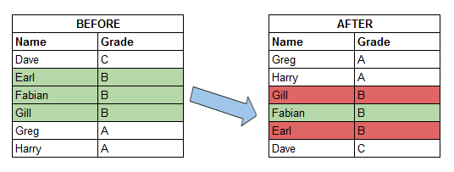

Slide 21

Comparison based sorting

Slide 22
We have already seen
Insertion sort - O($n^{2}$)
Insertion sort - O(𝑛^2)
Merge sort – O($n∗log⁡(n)$)
Merge sort – O(𝑛∗log⁡(𝑛))

Slide 23
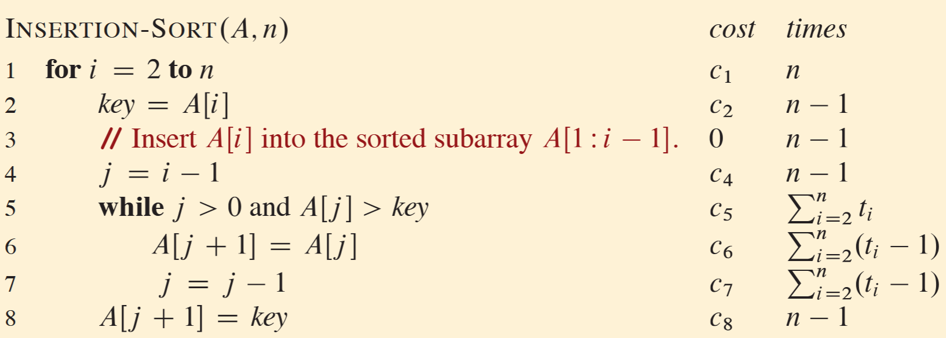
Insertion sort – F.Y.I

Slide 24
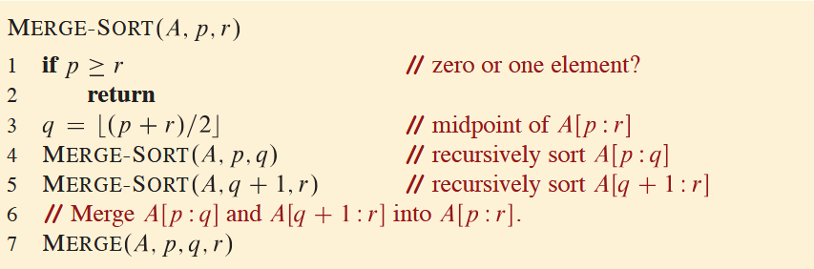
Merge sort – F.Y.I

Slide 25
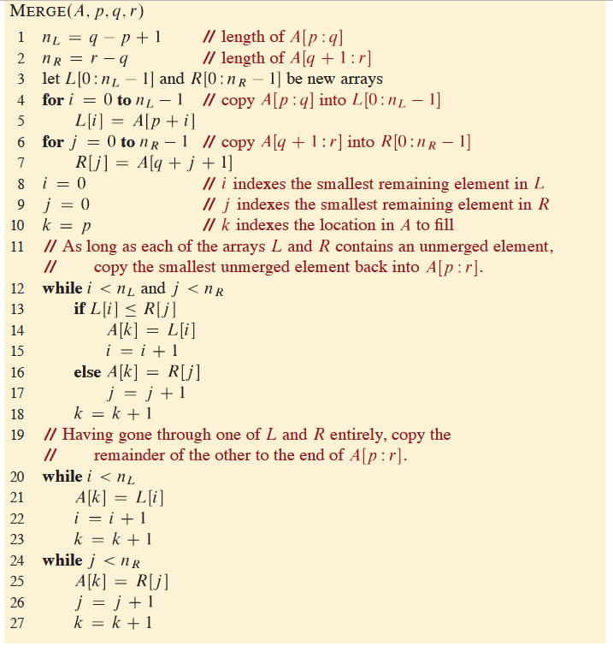

Slide 26
Characteristics
Insertion sort
Efficient for small datasets
Low memory usage
Stable
Merge sort
Efficient for large datasets
Uses extra memory
Stable

Slide 27
Heapsort

Slide 28
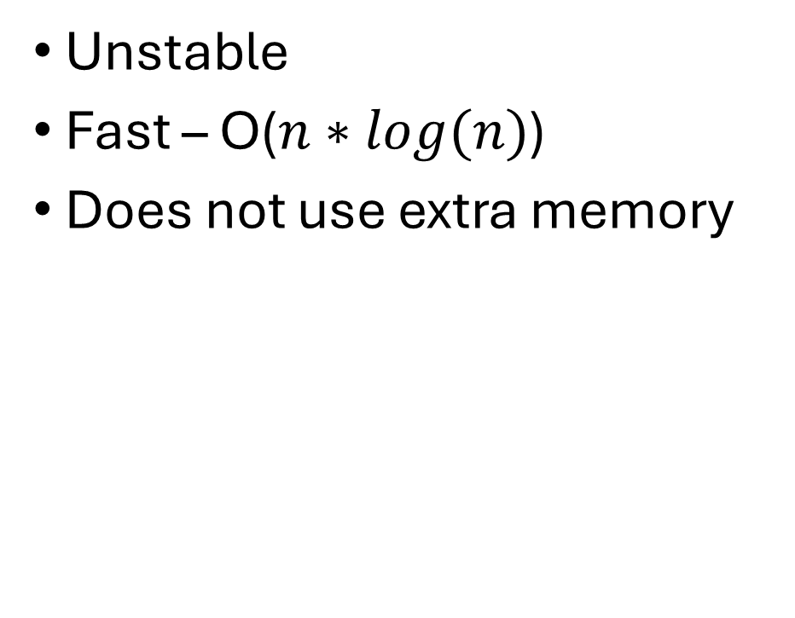
Heapsort
Unstable
Fast – O($n∗log(n)$)
Does not use extra memory

Slide 29
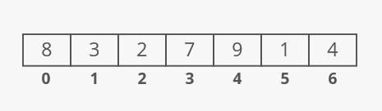
https://www.interviewcake.com/concept/java/heapsort

Slide 30
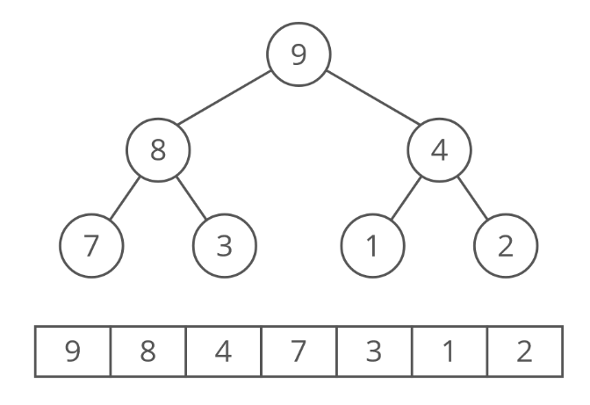

Slide 31
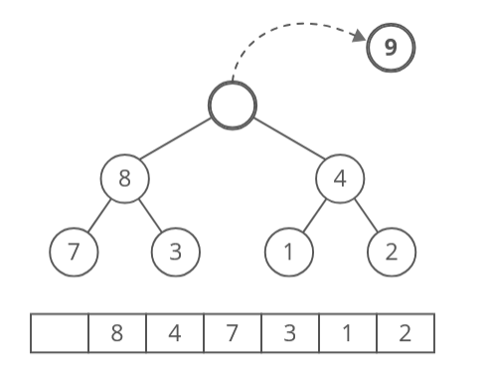

Slide 32
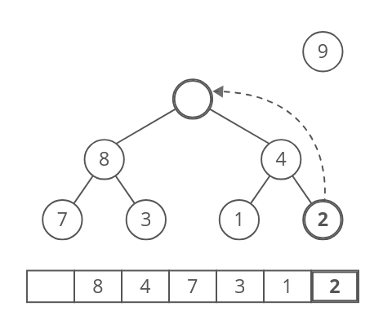

Slide 33
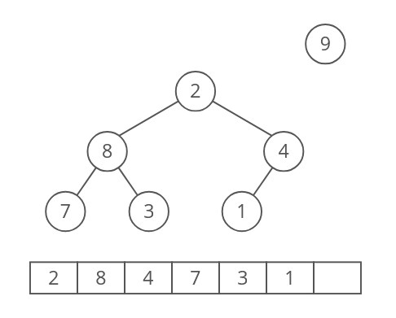

Slide 34
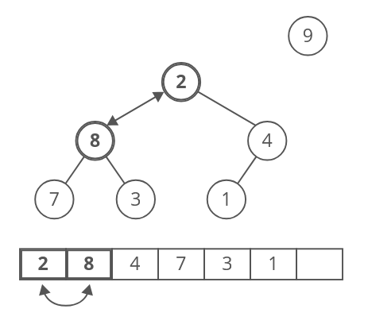

Slide 35
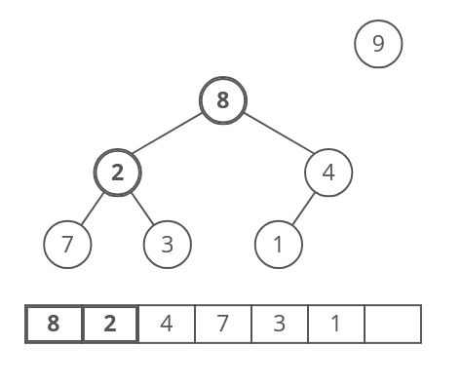

Slide 36
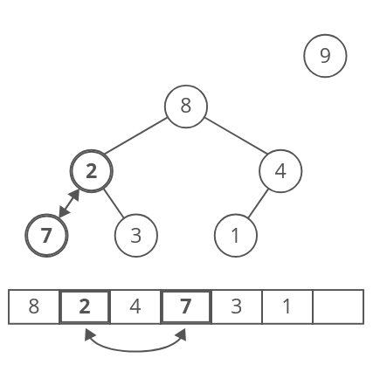

Slide 37
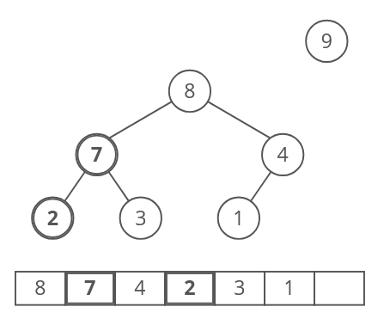

Slide 38
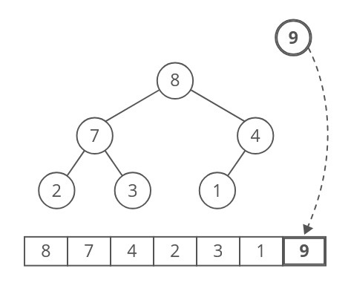

Slide 39
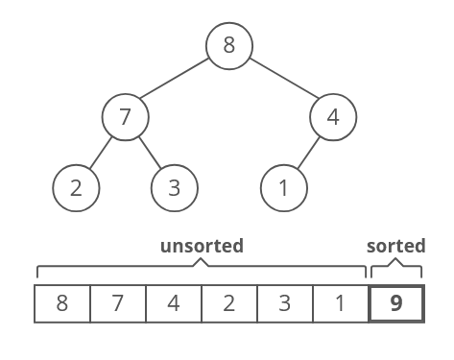

Slide 40
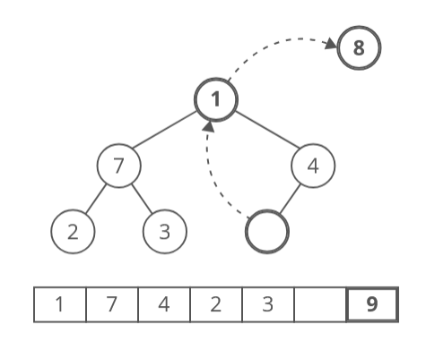

Slide 41
You can guess the rest…
https://www.interviewcake.com/concept/java/heapsort

Slide 42
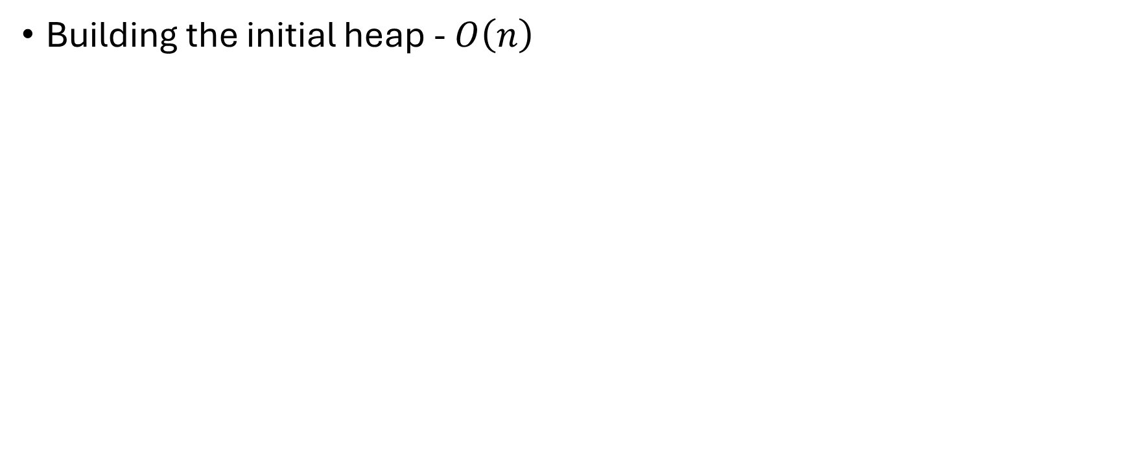
Complexity
Building the initial heap - $O\left(n\right)$

Slide 43
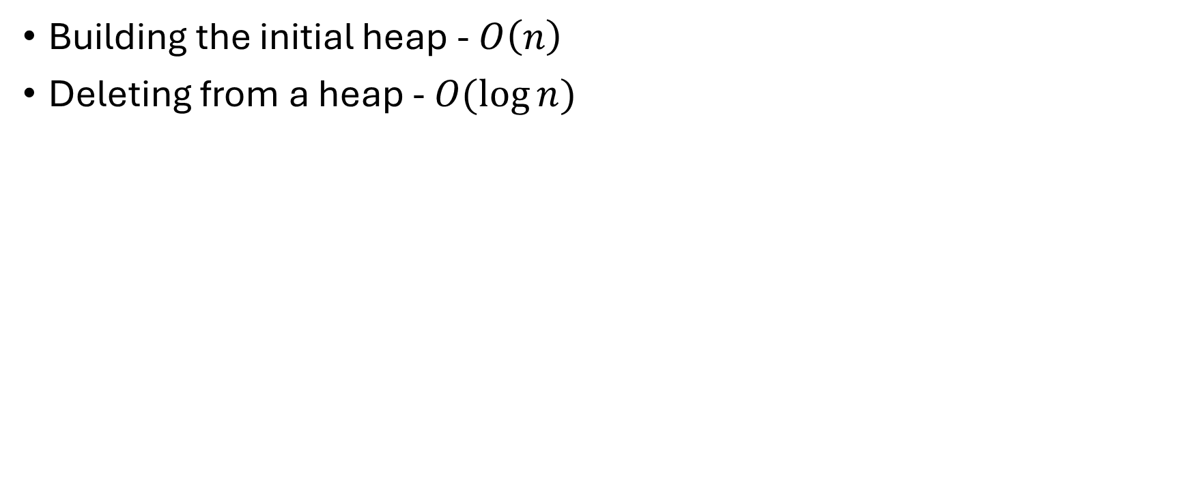
Complexity
Building the initial heap - $O\left(n\right)$
Deleting from a heap - $O(\log{n})$

Slide 44
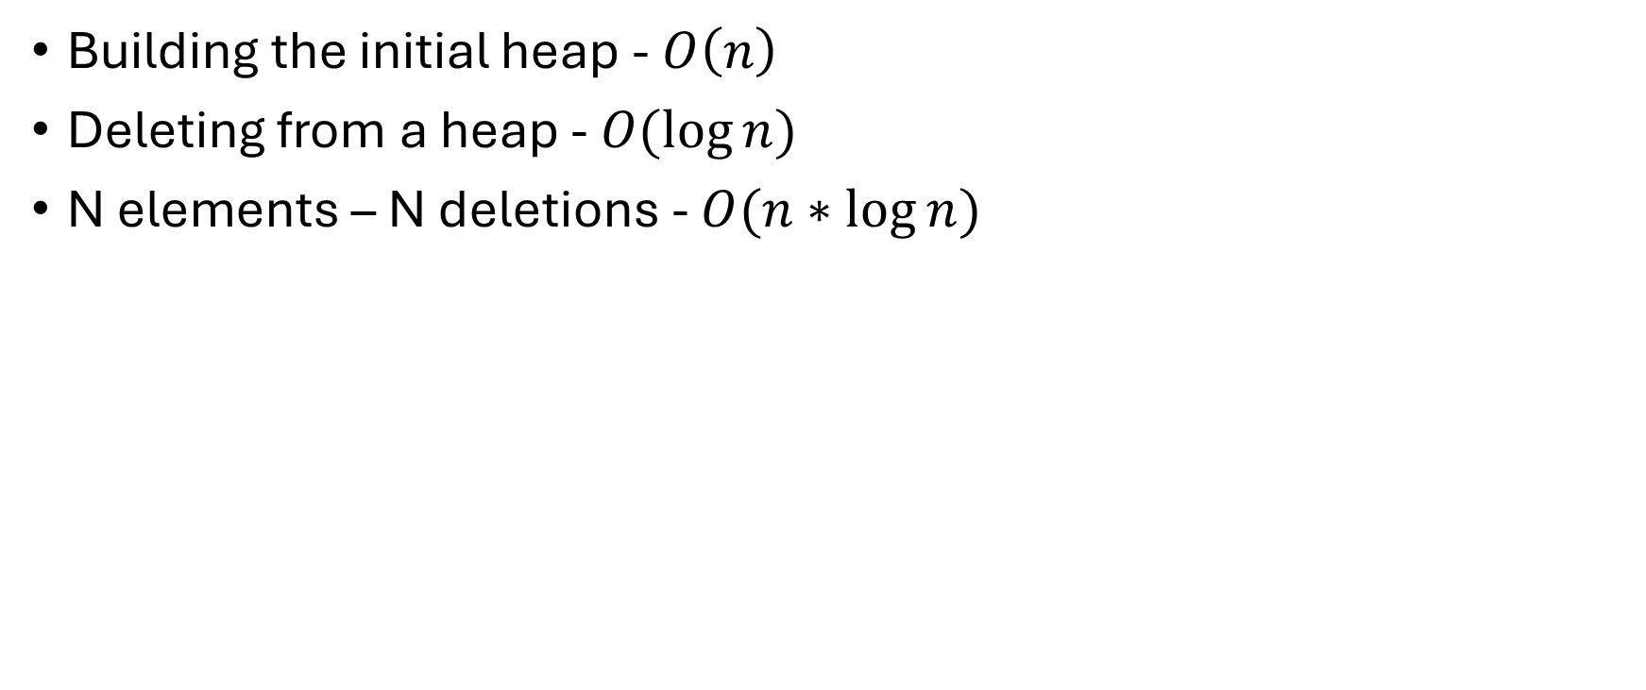
Complexity
Building the initial heap - $O\left(n\right)$
Deleting from a heap - $O(\log{n})$
N elements – N deletions - $O(n∗\log{n})$

Slide 45


The fastest sorting algorithm in the west?
Heapsort
$$O(n\log{n})$$

Slide 46

A new foe appeared!
Quicksort

Slide 47
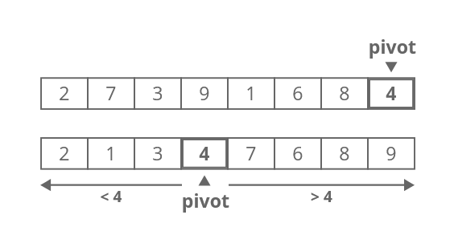
Quicksort
https://www.interviewcake.com/concept/java/quicksort

Slide 48
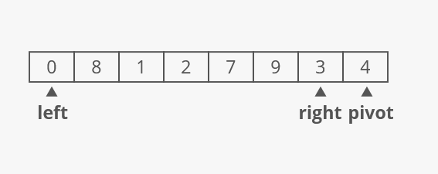
Quicksort

Slide 49
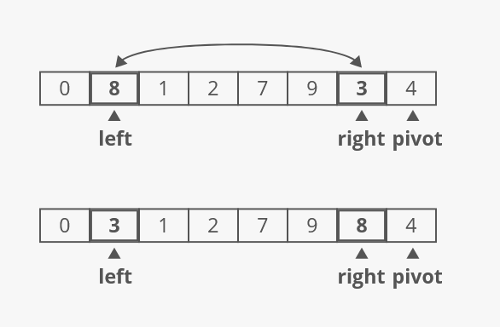

Slide 50
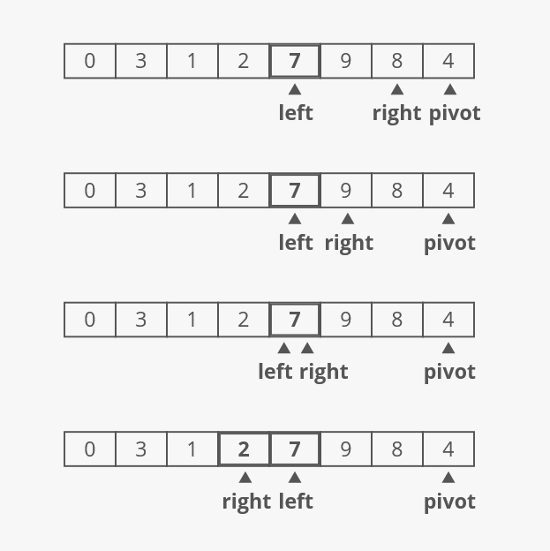

Slide 51
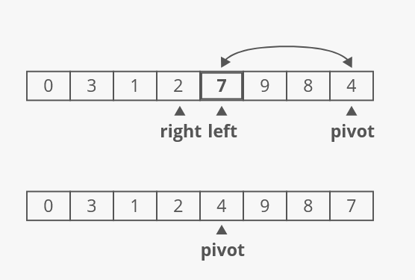

Slide 52
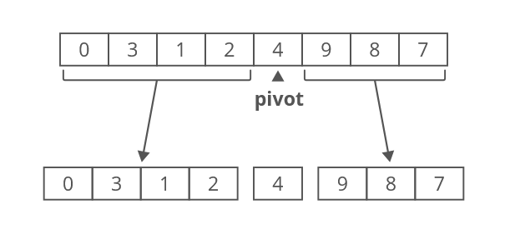
Recursively sort the two halves

Slide 53
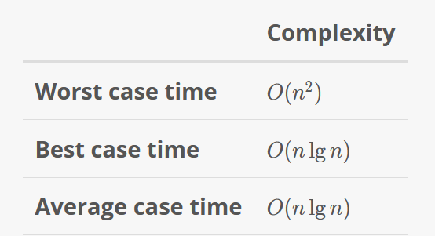
Time complexity

Slide 54
Space Complexity
Recursion allocates a stack frame for each recursive call

Slide 55
Space Complexity
Recursion allocates a stack frame for each recursive call
How tall will the recursion tree be?

Slide 56
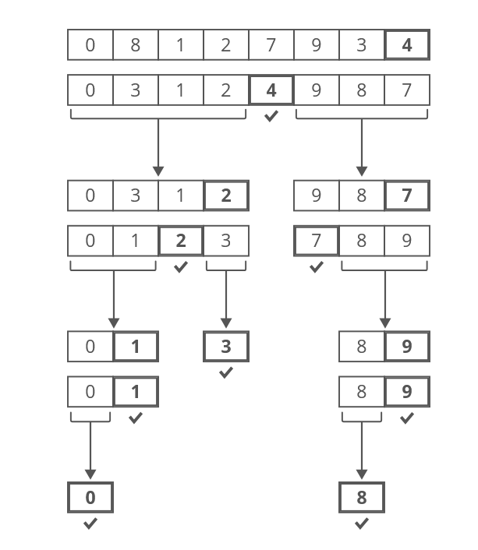
Space Complexity – best case
The pivot is the median
Space complexity is O(lg(n))

Slide 57
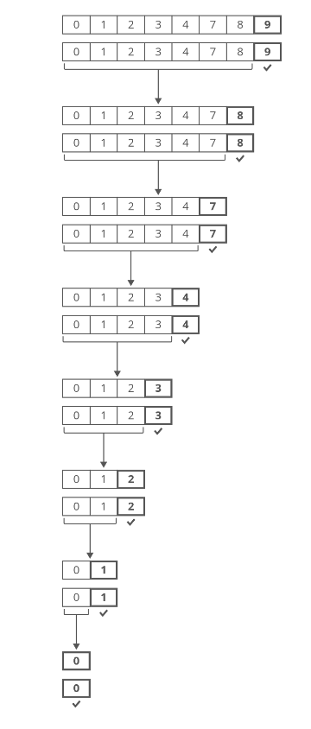
Space Complexity – worst case
The input array is sorted & the pivot is the last elem.
Space complexity is O(n)

Slide 58
Who wins?
Heapsort
Faster in the worst-case scenario
Slower on average
Uses no extra space
Quicksort
Much faster on average
Much slower in the worst-case scenario
Uses extra space

Slide 59
Linux uses Heapsort! – F.Y.I
https://github.com/torvalds/linux/blob/master/lib/sort.c#L53

Slide 60
