Slide 1

Data Structures and Algorithms I.
University of Szeged
Robert Nagy
2025/26. Autumn Semester

Slide 2
Hash tables

Slide 3
Hash function
Transform the input

Slide 4
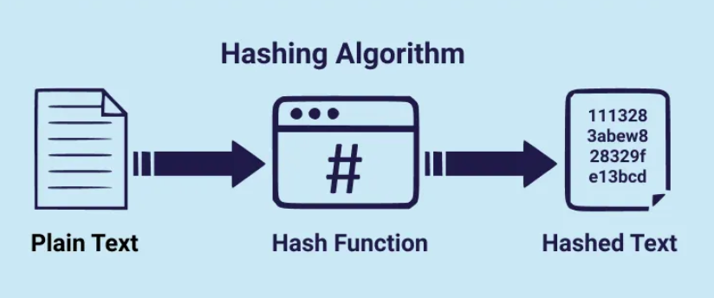
https://medium.com/nybles/hashing-algorithms-d10171ca2e89

Slide 5
Popular hashing functions
SHA-256
SHA-3
CRC32
MD5

Slide 6
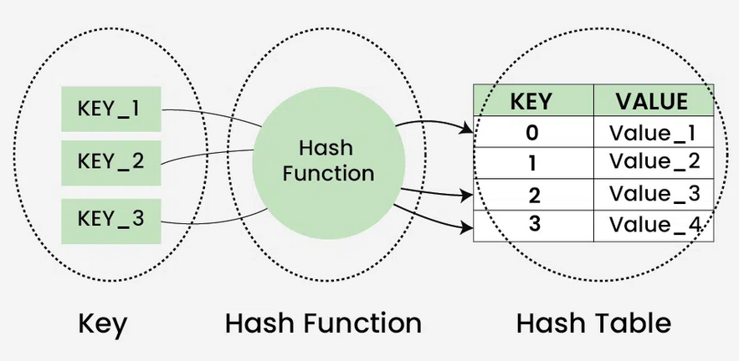
https://www.geeksforgeeks.org/dsa/hash-table-data-structure/

Slide 7
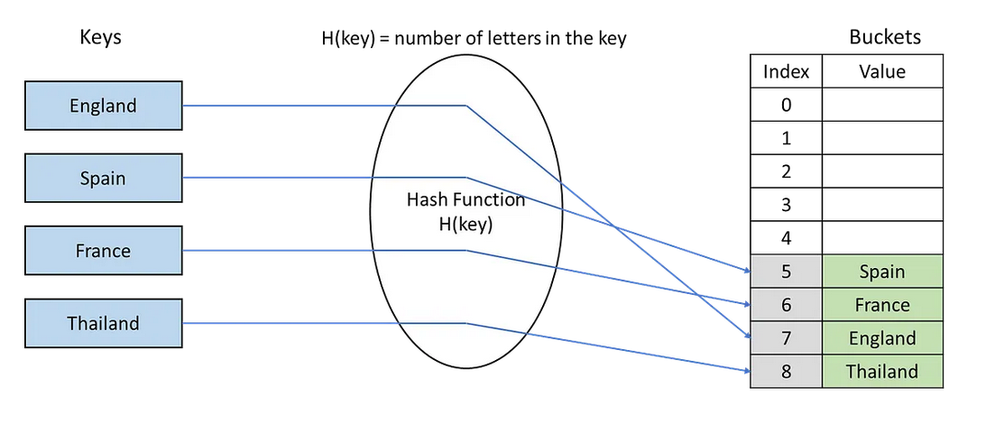

Slide 8
Motivation
Storage for unique elements, with O(1) search time.
  Unordered set
  Unordered map

Slide 9

$Load factor= \frac{k}{n}$
The size of the table – n
The number of occupied slots - k

Slide 10
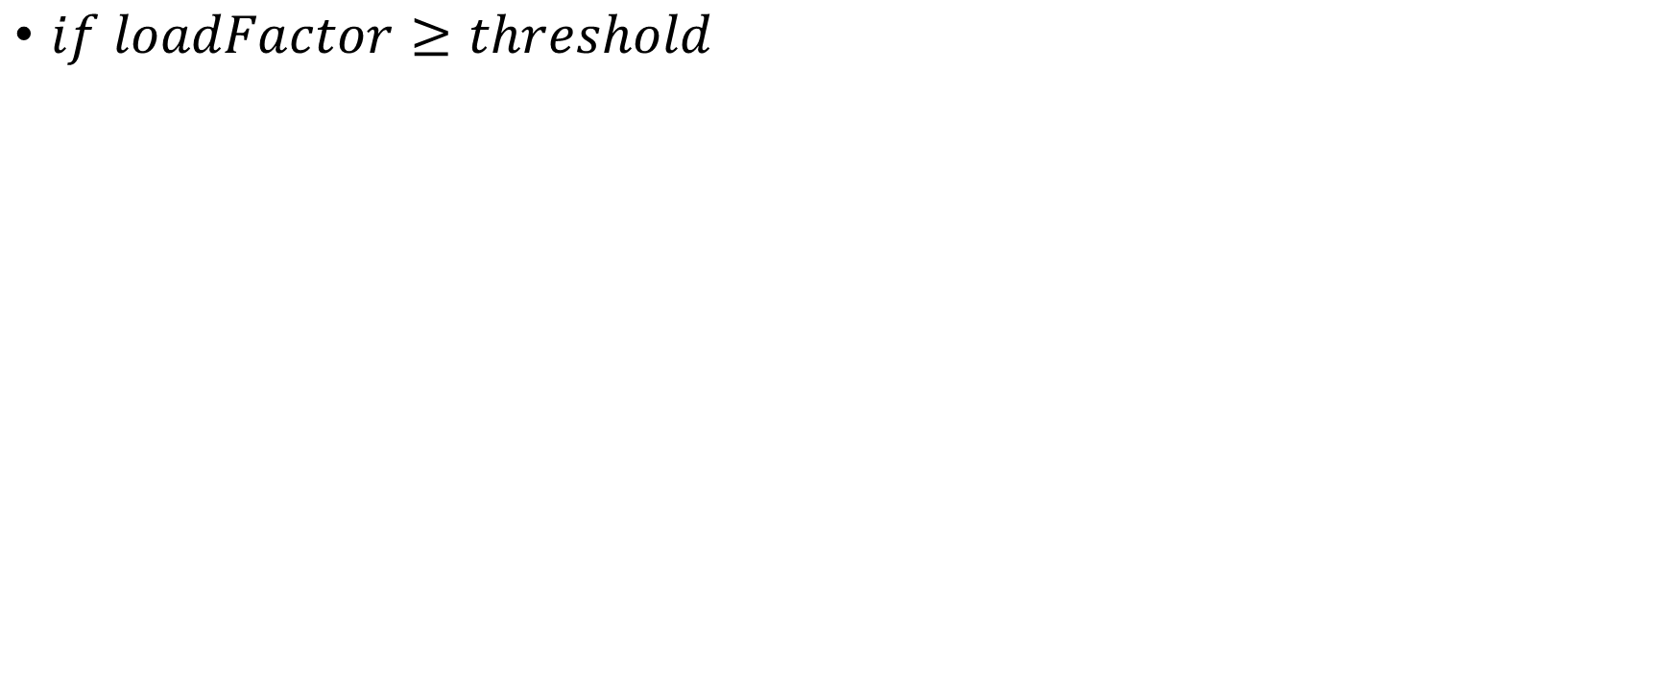
Rehashing
$if loadFactor≥threshold$

Slide 11
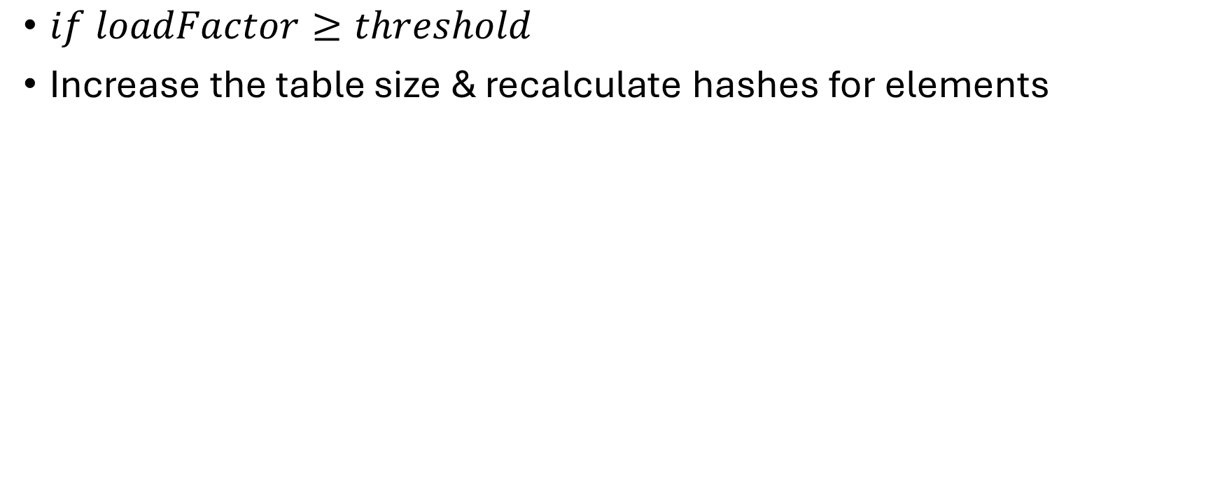
Rehashing
$if loadFactor≥threshold$
Increase the table size & recalculate hashes for elements

Slide 12
Collisions

Slide 13
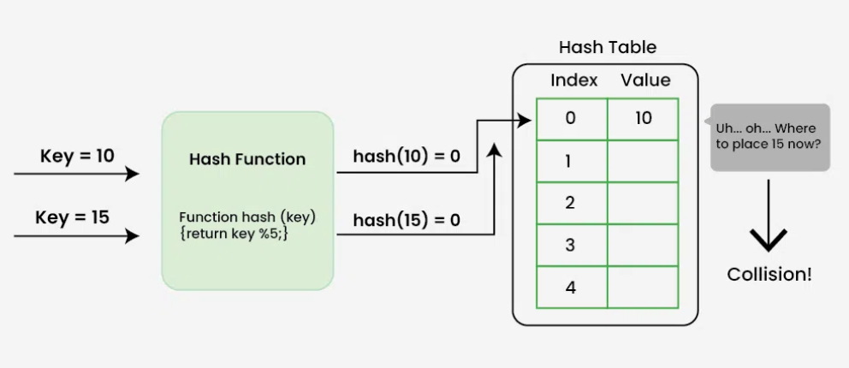

Slide 14

Collision resolution techniques

Slide 15

Linear probing

