Slide 1

Data Structures and Algorithms I.
University of Szeged – Robert Nagy
2025/26. Autumn Semester

Slide 2
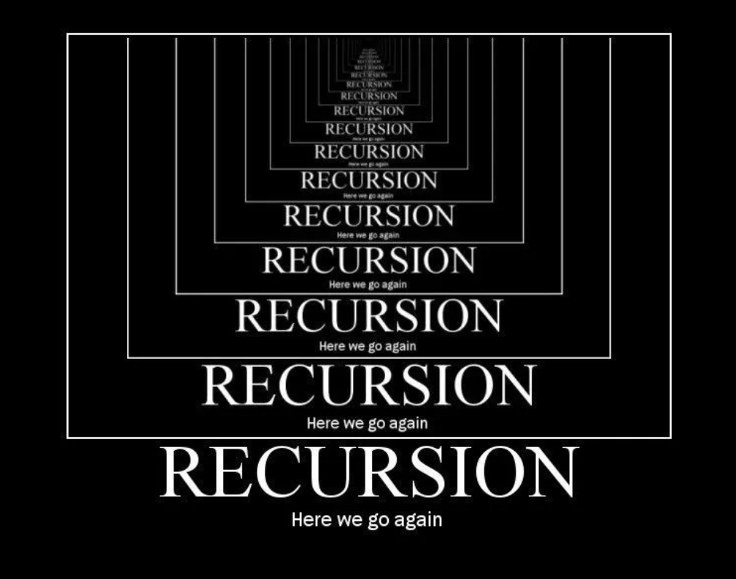

Slide 3
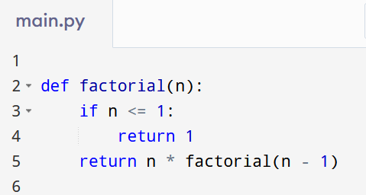

Slide 4
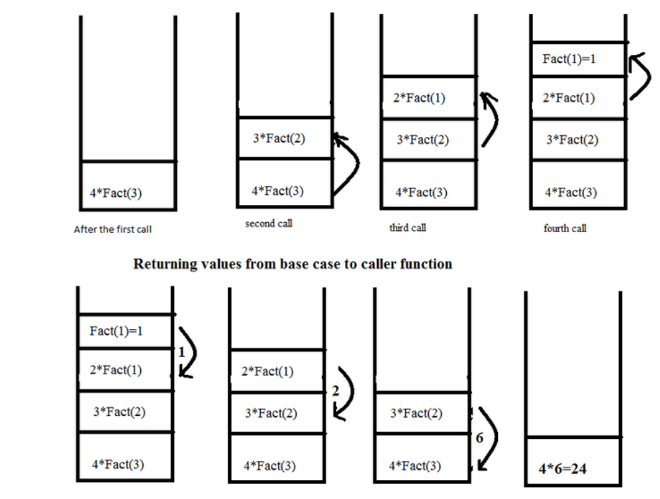
https://stackoverflow.com/questions/19865503/can-recursion-be-named-as-a-simple-function-call

Slide 12
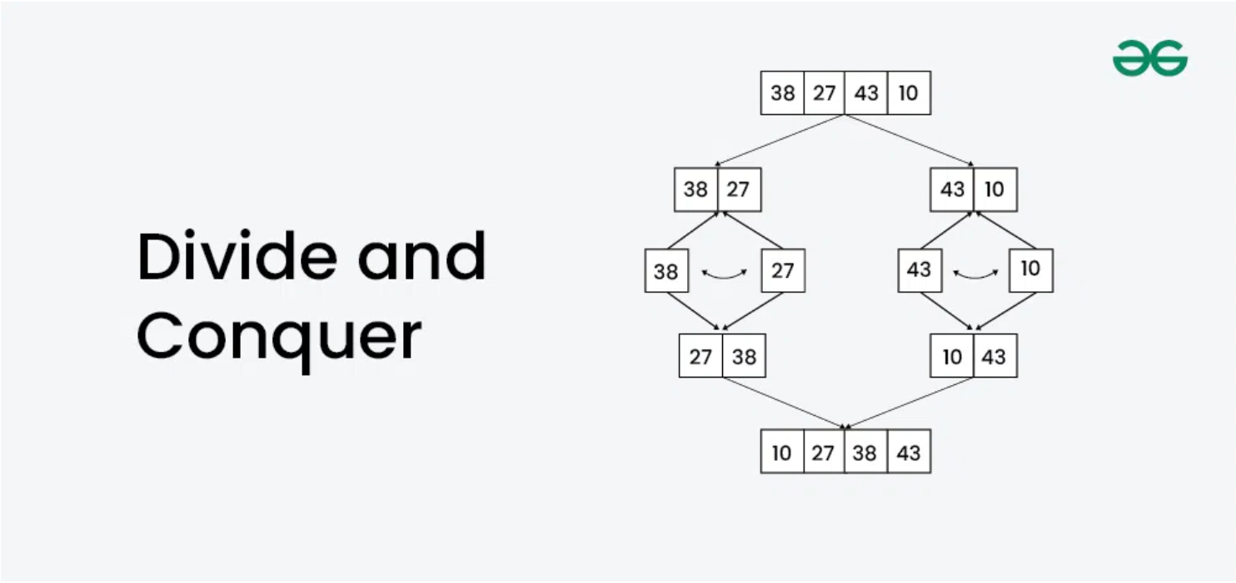

Slide 13
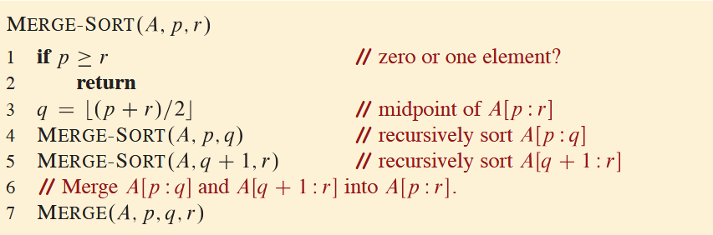

Slide 14
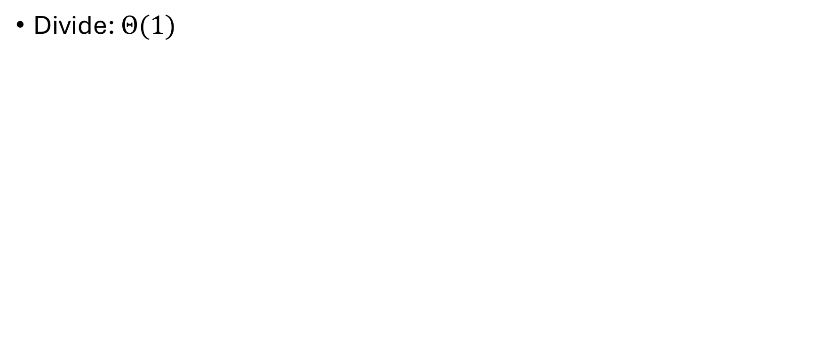
Merge sort – time complexity analysis
Divide: $Θ(1)$

Slide 15
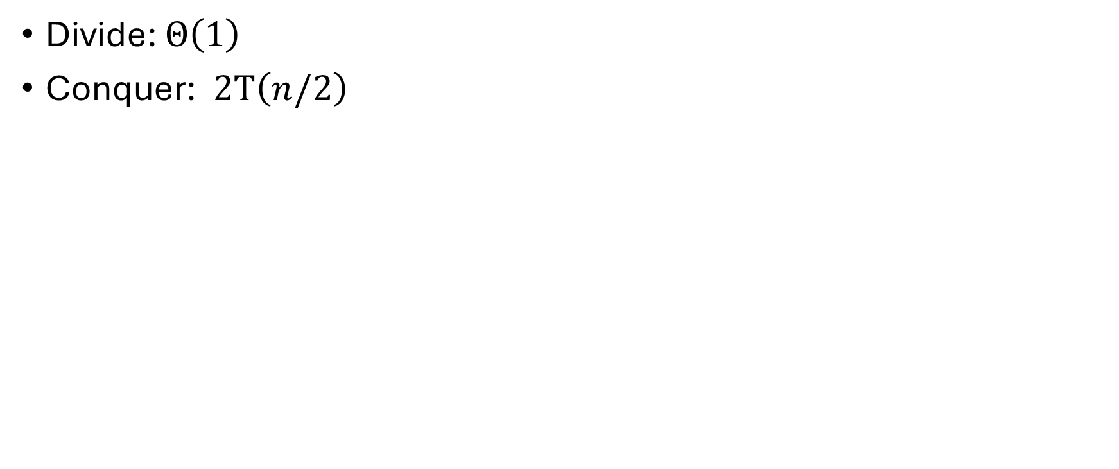
Merge sort – time complexity analysis
Divide: $Θ\left(1\right)$
Conquer: $2T\left(n/2\right)$

Slide 16
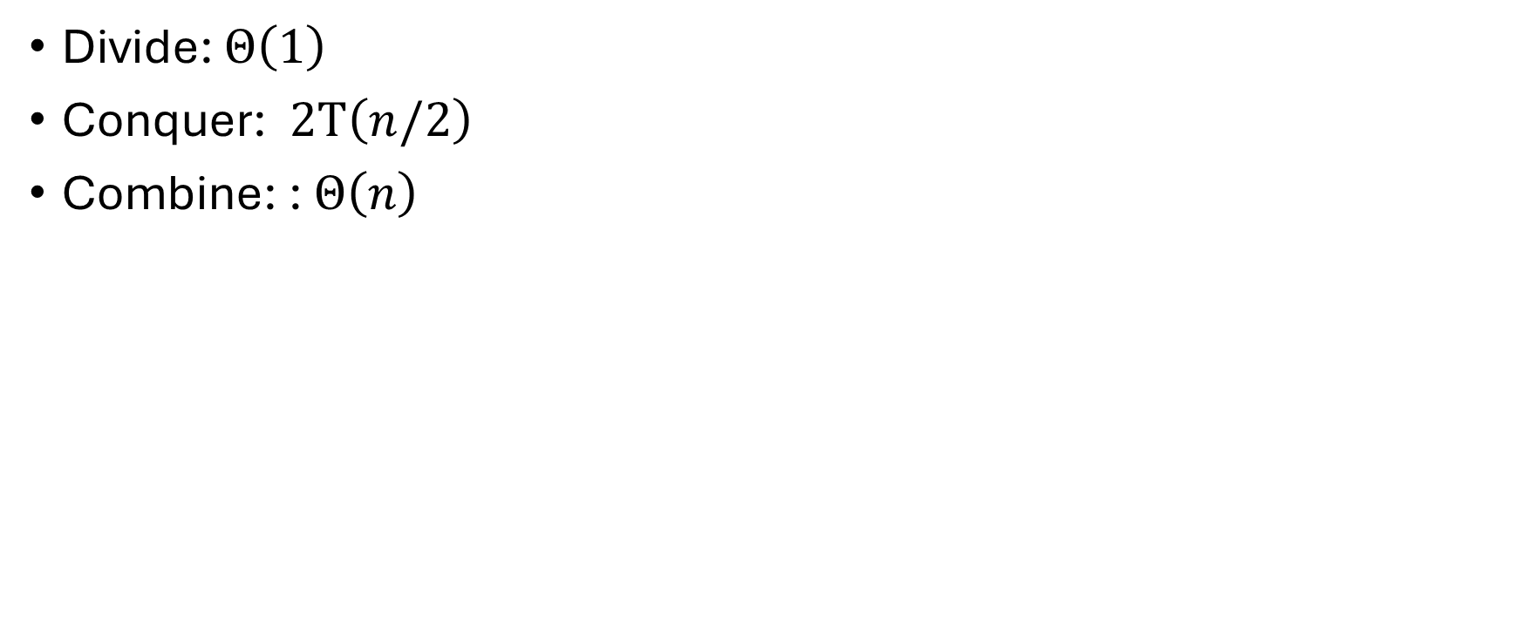
Merge sort – time complexity analysis
Divide: $Θ\left(1\right)$
Conquer: $2T\left(n/2\right)$
Combine: : $Θ\left(n\right)$

Slide 17
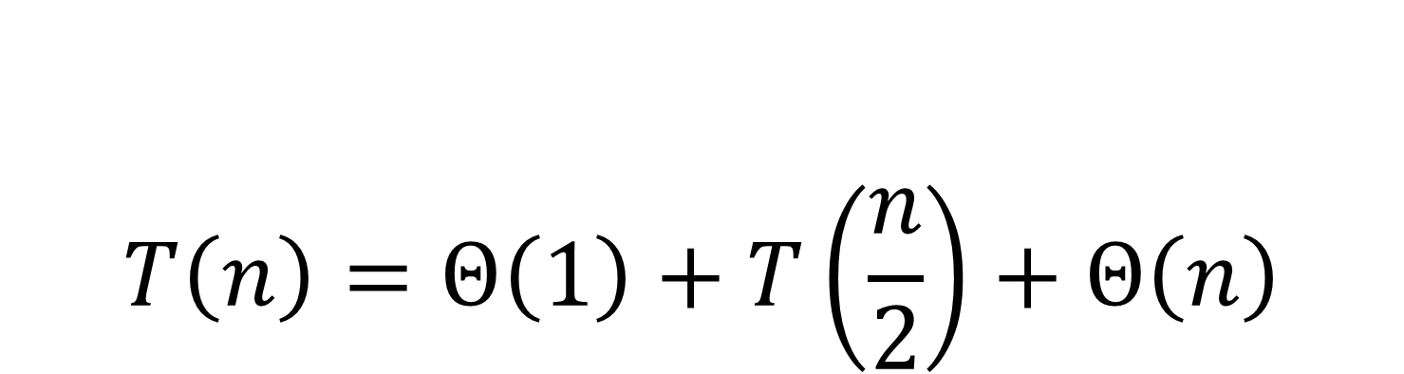
$$T\left(n\right)=Θ\left(1\right)+T\left(\frac{n}{2}\right)+Θ\left(n\right)$$
The time complexity of Merge Sort

Slide 18
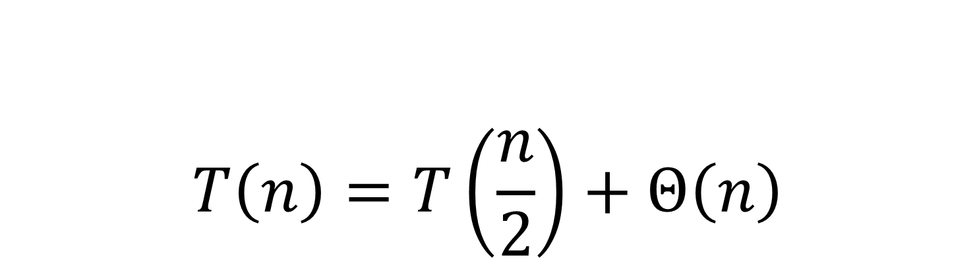
$$T\left(n\right)=T\left(\frac{n}{2}\right)+Θ\left(n\right)$$
The time complexity of Merge Sort

Slide 19

It’s drawing time!

Slide 20
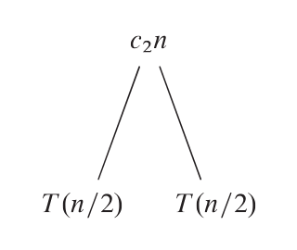
Recursion tree

Slide 21
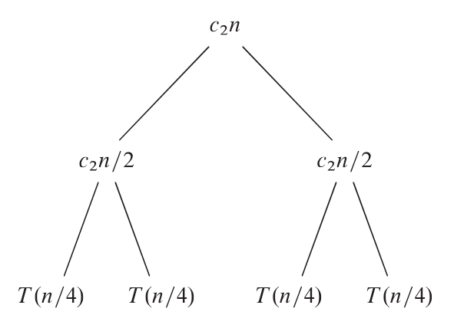

$$T(n/2)$$

Slide 23
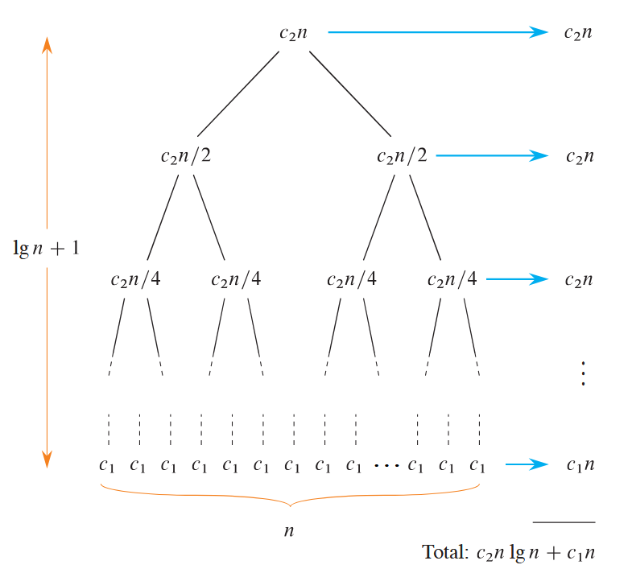

Slide 24
Exercises

Slide 25
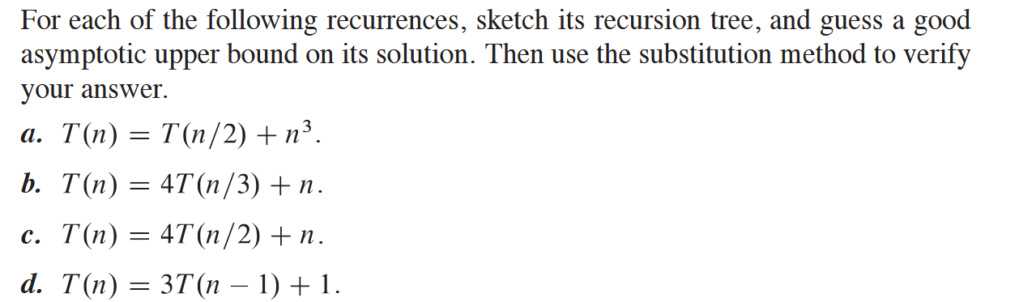

Slide 26
Master theorem (method)

