Slide 1

Data Structures and Algorithms I.
University of Szeged
Robert Nagy
2025/26. Autumn Semester

Slide 2

Sorting Algorithms

Slide 3

Why is sorting important?

Slide 4

Database systems

Slide 5
Searching
Naive approach $O(n)$
Naive approach 𝑂(𝑛)
Binary search $O\left(\log_{2}{(n)}\right)$
Binary search 𝑂(log_2⁡〖(𝑛)〗 )

Slide 6
Naive search (Brute force)
Task: Find 3
7, 4, 5, 9, 2, 3, 0, 1, 8

Slide 7
Naive search (Brute force)
Task: Find 3
7, 4, 5, 9, 2, 3, 0, 1, 8

Slide 8
Worst case scenario?

Slide 9
Binary search
Task: Find 3
7, 4, 5, 9, 2, 3, 0, 1, 8

Slide 10
Binary search
Step 1: Sort the input
0, 1, 2, 3, 4, 5, 7, 8, 9

Slide 11
Binary search
Step 2: Find the midpoint
0, 1, 2, 3, 4, 5, 7, 8, 9

Slide 12
Binary search
Step 3: Cut the search space in half
0, 1, 2, 3, 4, 5, 7, 8, 9

Slide 13
Binary search
Step 4: Repeat steps 1-3 until the key is found
0, 1, 2, 3, 4, 5, 7, 8, 9

Slide 14
Binary search
0, 1, 2, 3

Slide 15
Binary search
3

Slide 16

But how quickly can we sort?

Slide 17
Different approaches to sorting
Comparison based
Non comparison based
Hybrid
Read more: https://www.geeksforgeeks.org/dsa/sorting-algorithms/

Slide 18
Stable sorting
Unstable sorting

Slide 19
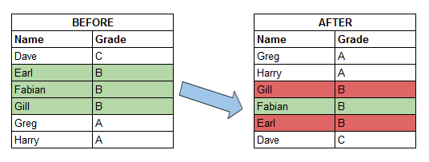

Slide 20

Comparison based sorting

Slide 21
We have already seen
Insertion sort - O(n)
Merge sort – O($n∗log⁡(n)$)
Merge sort – O(𝑛∗log⁡(𝑛))

Slide 22
Characteristics
Insertion sort
Fast for almost sorted datasets
Efficient for small datasets
Low memory usage
Stable
Merge sort
Efficient for large datasets
Uses extra memory
Stable

Slide 23
Heapsort

Slide 24
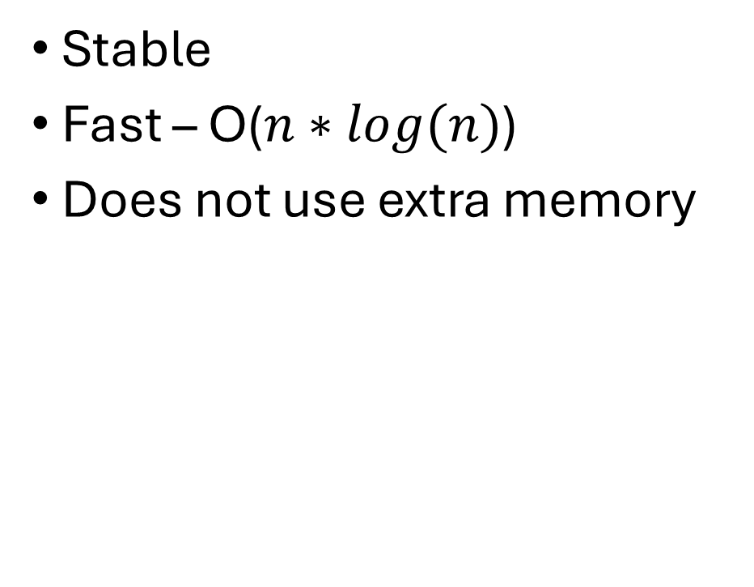
Heapsort
Stable
Fast – O($n∗log(n)$)
Does not use extra memory

Slide 25
New concept
The “HEAP” – A data structure!

Slide 26
Pseudocodes – For Your Information

Slide 27
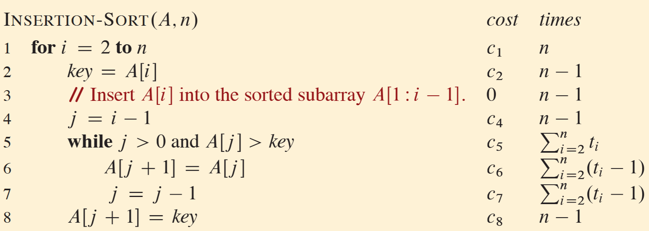
Insertion sort – F.Y.I

Slide 28
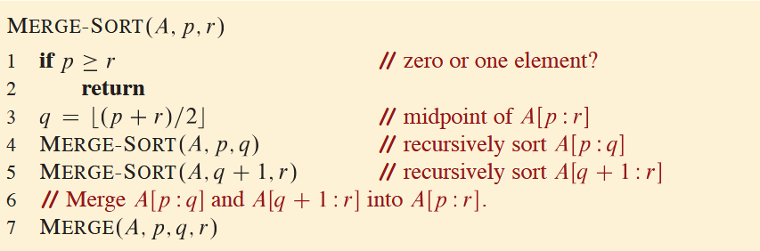
Merge sort – F.Y.I

Slide 29
