Slide 1

Data Structures and Algorithms I.
University of Szeged
Robert Nagy
2025/26. Autumn Semester

Slide 2

Imagine that you’re building a house

Slide 3
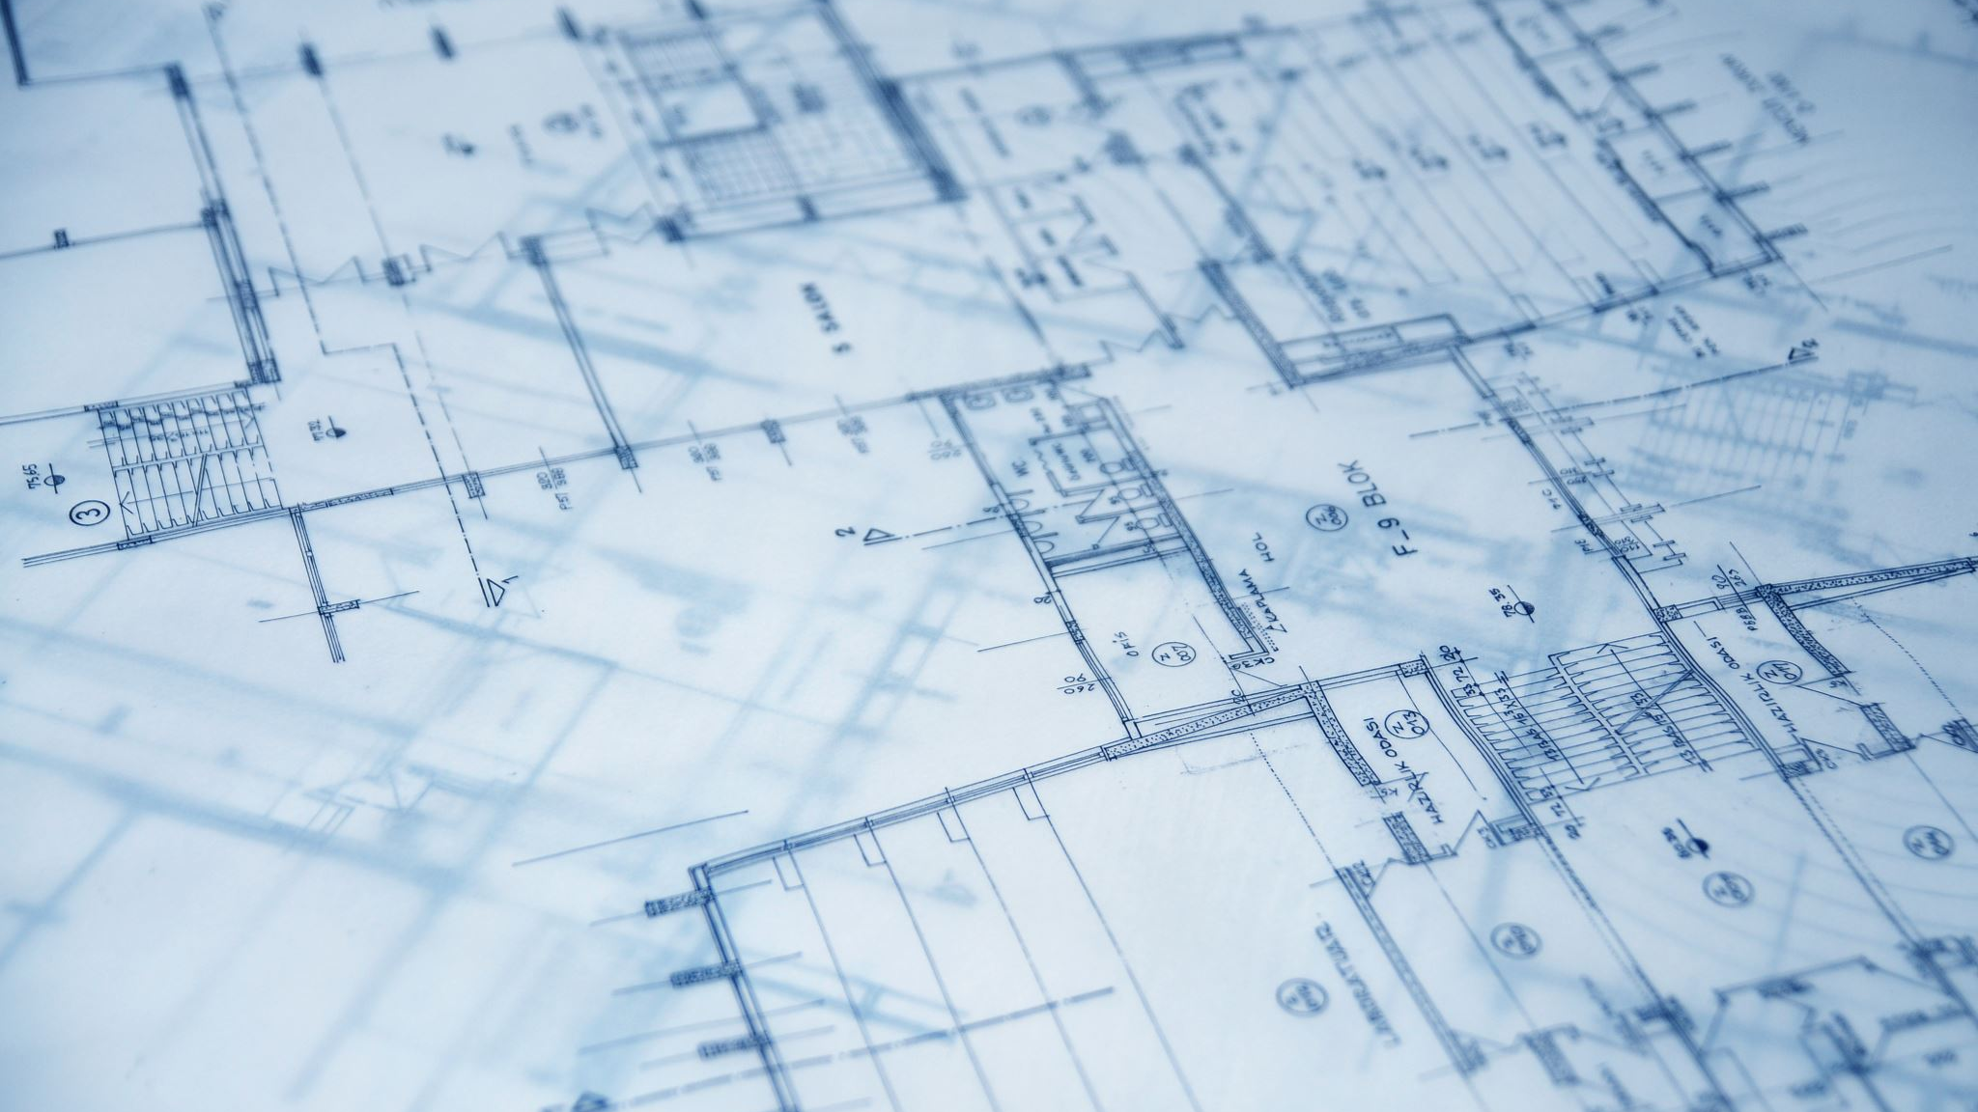
The blueprint – an algorithm

Slide 4

The materials – provide the structure

Slide 5
Even if the blueprint is flawless, low-quality materials can make the house collapse early.

Slide 6

Data - the building blocks for software

Slide 7
Building metaphor
Simple Building blocks
Primitive data types
Compound data types
Material type
Fixed / rigid
Flexible / Dynamic
Compound Building blocks
Data structures

Slide 8
Primitive data types – fixed size in memory
Int
Float, Double
Char
Boolean
Pointer
https://www.geeksforgeeks.org/dsa/data-types-in-programming/

Slide 9
Compound data types – fixed size in memory
Objects (Class instances)
ANSI C specific:
  Struct
  Union

Slide 10
Material types
Rigid
Fixed, contiguous place in memory
Flexible
Usually a chain of Nodes
Nodes have a fixed size
The node-chain can grow indefinitely

Slide 11
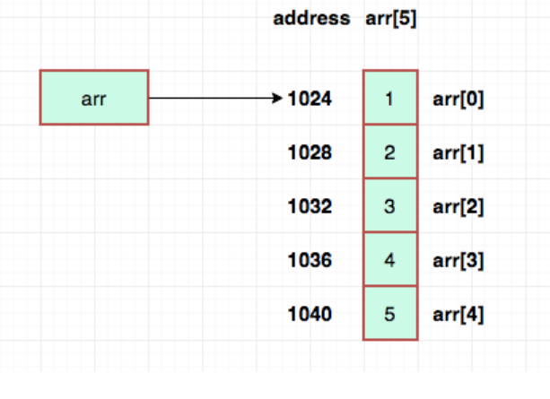
Array – contiguous memory addresses
Array that stores 32-bit integers
https://sites.duke.edu/writing270_02_ss12021_ecyoung/2021/06/28/data-structures-in-our-everyday-lives-arrays/

Slide 12

Pointer
A variable that stores a memory address
A memory address is just a number

Slide 13
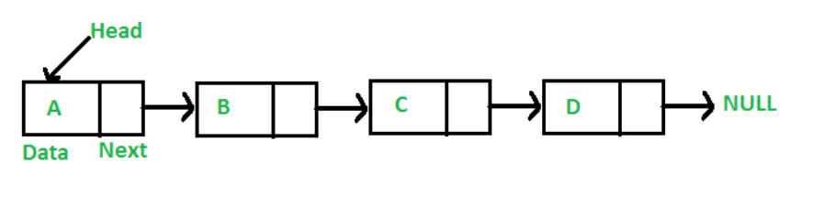
Nodes with pointers to other nodes

Slide 14
Data Structures

Slide 15
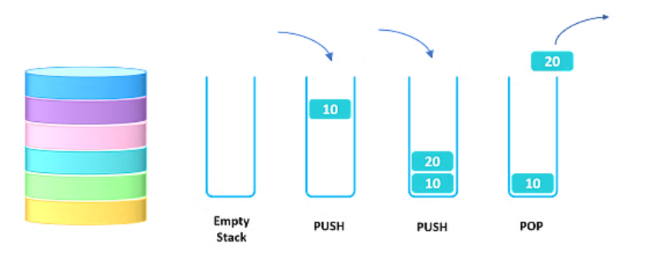
The Stack - LIFO

Slide 16
Usage - Examples
Recursion –
  Transforming recursive code into iterative code
  Call stack

Slide 17
Usage - Examples
Recursion –
  Transforming recursive code into iterative code
  Call stack
Backtracking algorithms
  Maze solvers

Slide 18
Usage - Examples
Recursion –
  Transforming recursive code into iterative code
  Call stack
Backtracking algorithms
  Maze solvers
Undo/Redo operation

Slide 19
Usage - Examples
Recursion –
  Transforming recursive code into iterative code
  Call stack
Backtracking algorithms
  Maze solvers
Undo/Redo operation
Navigation in web browsers and web apps

Slide 20
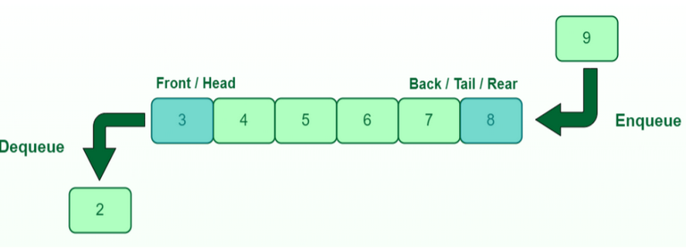
The Queue - FIFO

Slide 21
Usage - Examples
Operating systems
  Task scheduling

Slide 22
Usage - Examples
Operating systems
  Task scheduling
Network routers and switches
  Data packet management

Slide 23
Usage - Examples
Operating systems
  Task scheduling
Network routers and switches
  Data packet management
Printers
Customer service systems

Slide 24

Exercises

Slide 25
The following data stream arrives: 1, 6, 8, 13, 42, 7, 4
  Build a queue, starting with the first element, moving left to right
  Dequeue all the elements one by one, and push them onto a stack
  Pop all elements from the stack

Slide 26
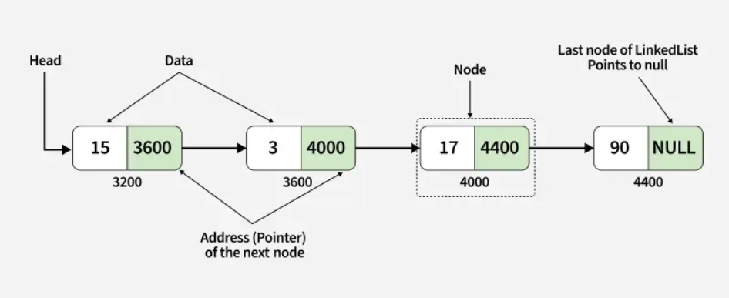
Linked List

Slide 27

Binary heap
Read more: https://www.programiz.com/dsa/heap-data-structure

Slide 28
2 Types
Min heap
Max heap

Slide 29
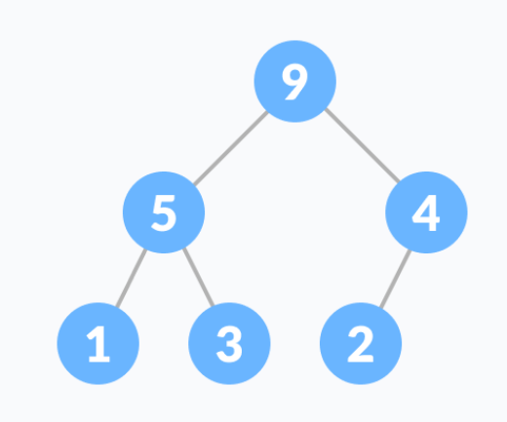
Max heap

Slide 30
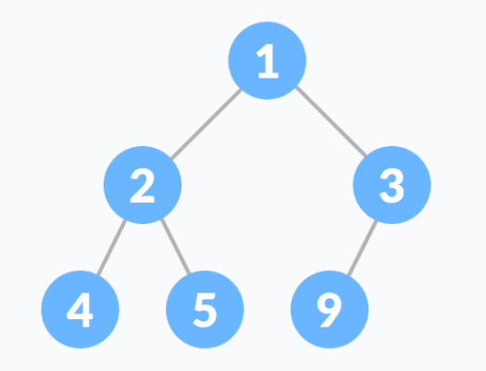
Min heap

Slide 31

Heap properties & functions
A heap is a complete binary tree
“Heapify” procedure

Slide 32
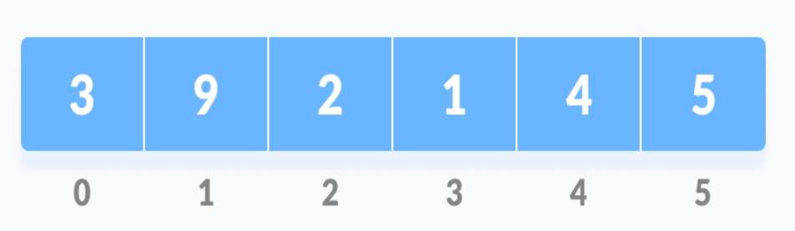
Heapify
Step 1: Input array

Slide 33
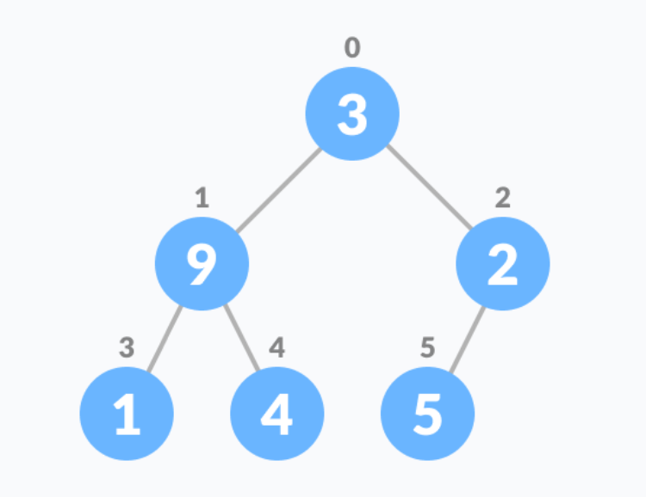
Complete Binary Tree
Step 2 – Construct the CBT From the input array

Slide 34
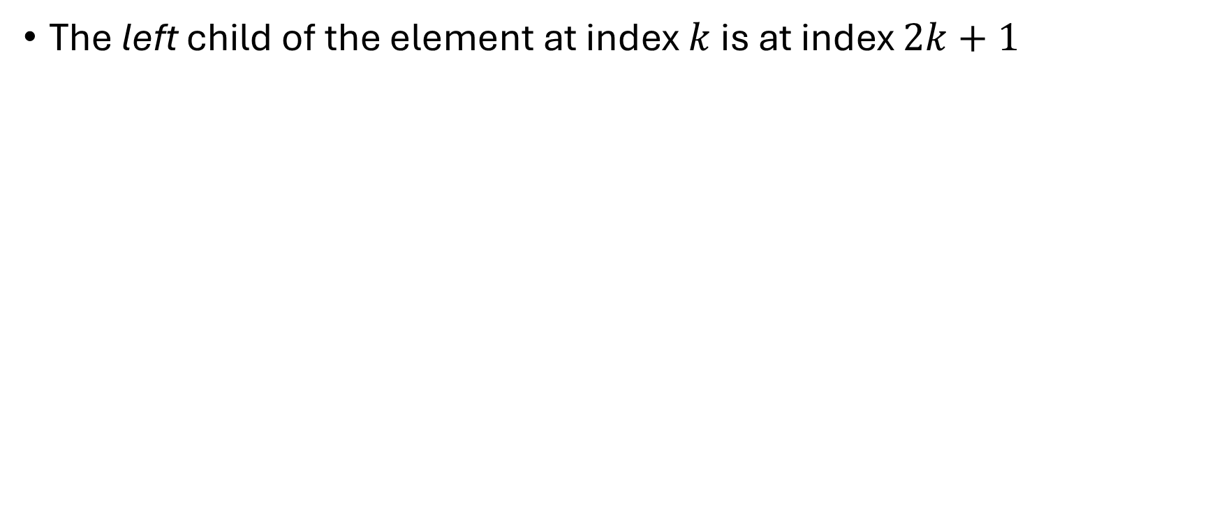
How?
The left child of the element at index $k$ is at index $2k+1$

Slide 35
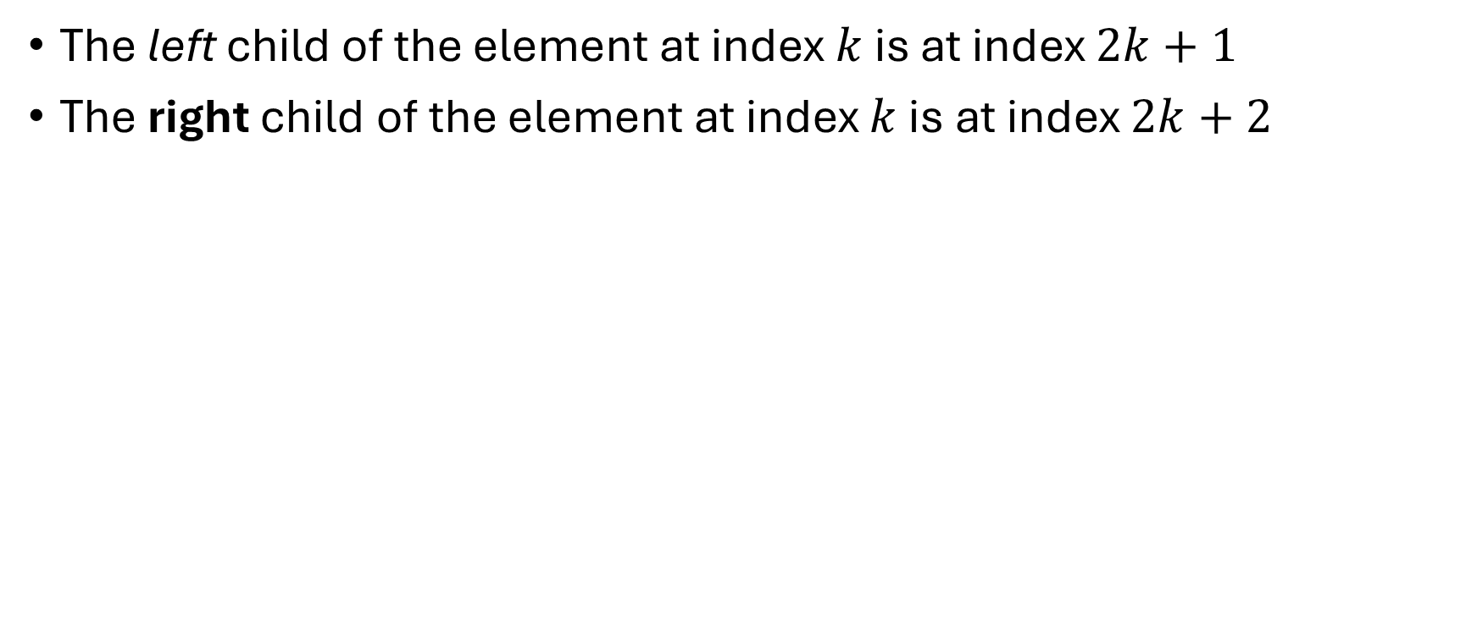
How?
The left child of the element at index $k$ is at index $2k+1$
The right child of the element at index $k$ is at index $2k+2$

Slide 36
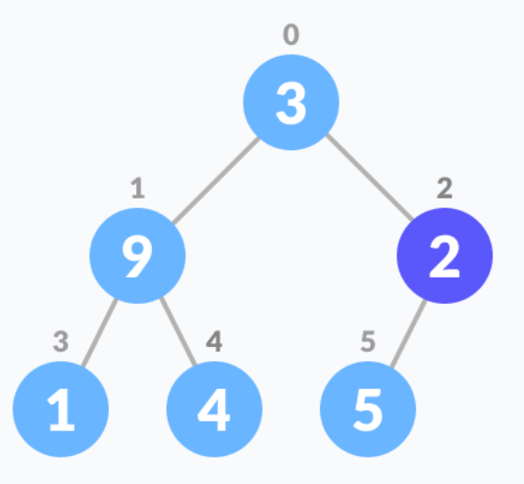
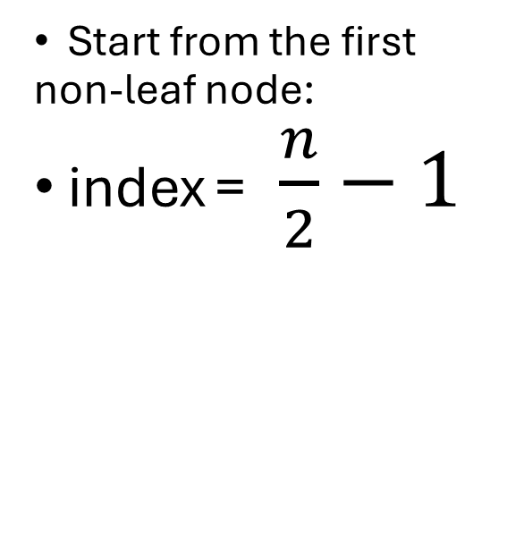
Step 3: “Heapify” – “Bubble up”
Start from the first non-leaf node:
index = $\frac{n}{2}−1$

Slide 37
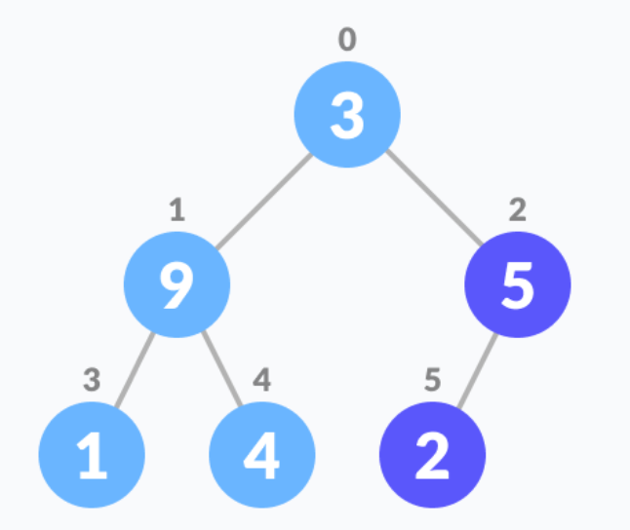
Swap the element with its biggest child
Repeat until done

Slide 38

Example

Slide 39
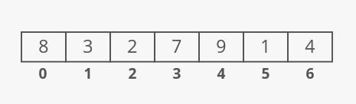

Slide 40
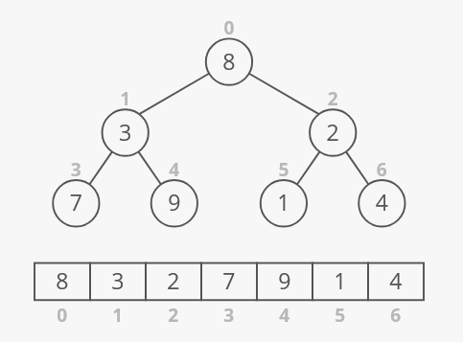

Slide 41
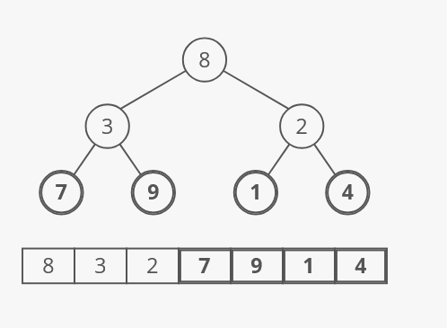

Slide 42
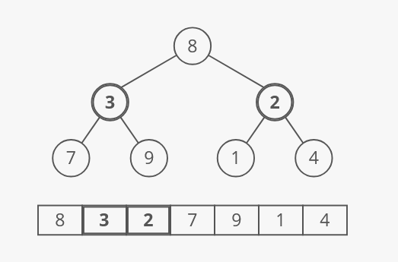

Slide 43
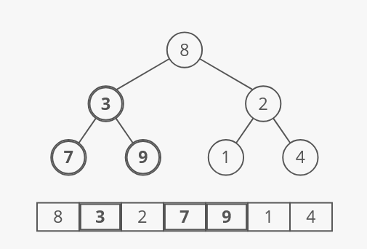

Slide 44
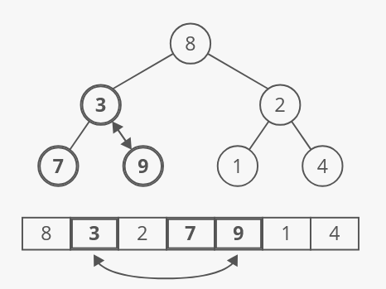

Slide 45
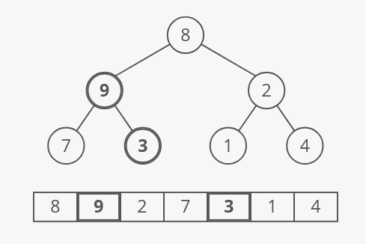

Slide 46
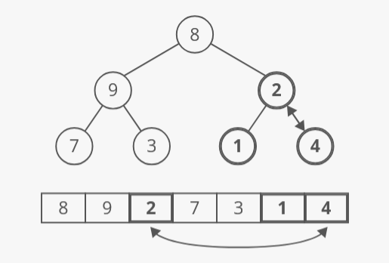

Slide 47
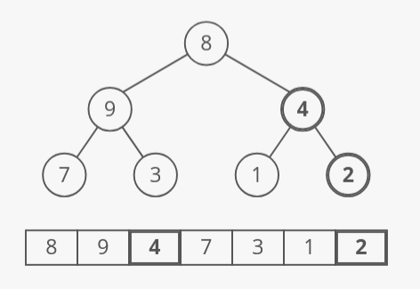

Slide 48
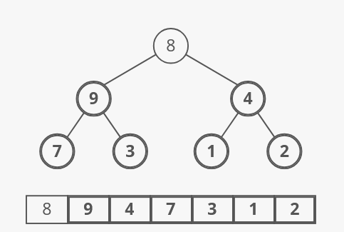

Slide 49
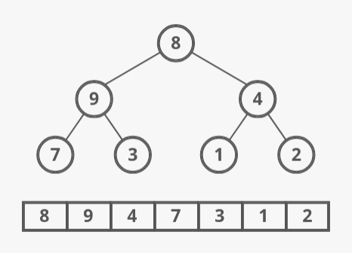

Slide 50
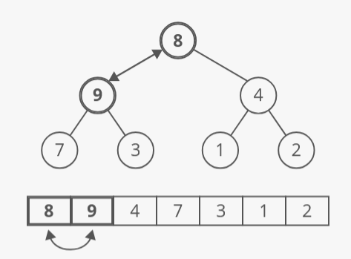

Slide 51
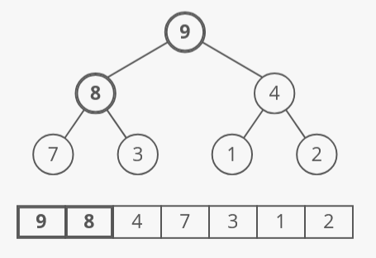

Slide 52
Priority queue

