Slide 1

Data Structures and Algorithms I.
University of Szeged
Robert Nagy
2025/26. Autumn Semester

Slide 2

Sorting Algorithms

Slide 3

Why is sorting important?

Slide 4

Database systems

Slide 5
Searching
Naive approach $O(n)$
Naive approach 𝑂(𝑛)
Binary search $O\left(\log_{2}{(n)}\right)$
Binary search 𝑂(log_2⁡〖(𝑛)〗 )

Slide 6
Naive search (Brute force)
Task: Find 3
7, 4, 5, 9, 2, 3, 0, 1, 8

Slide 7
Naive search (Brute force)
Task: Find 3
7, 4, 5, 9, 2, 3, 0, 1, 8

Slide 8
Worst case scenario?

Slide 9
Binary search
Task: Find 3
7, 4, 5, 9, 2, 3, 0, 1, 8

Slide 10
Binary search
Step 1: Sort the input
0, 1, 2, 3, 4, 5, 7, 8, 9

Slide 11
Binary search
Step 2: Find the midpoint
0, 1, 2, 3, 4, 5, 7, 8, 9

Slide 12
Binary search
Step 3: Cut the search space in half
0, 1, 2, 3, 4, 5, 7, 8, 9

Slide 13
Binary search
Step 4: Repeat steps 1-3 until the key is found
0, 1, 2, 3, 4, 5, 7, 8, 9

Slide 14
Binary search
0, 1, 2, 3

Slide 15
Binary search
3

Slide 16

But how quickly can we sort?

Slide 17
Different approaches to sorting
Comparison based
Non comparison based
Hybrid
Read more: https://www.geeksforgeeks.org/dsa/sorting-algorithms/

Slide 18
Stability
Stable sorting
Unstable sorting

Slide 19
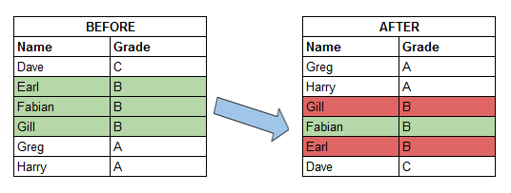

Slide 20

Comparison based sorting

Slide 21
We have already seen
Insertion sort - O($n^{2}$)
Insertion sort - O(𝑛^2)
Merge sort – O($n∗log⁡(n)$)
Merge sort – O(𝑛∗log⁡(𝑛))

Slide 22
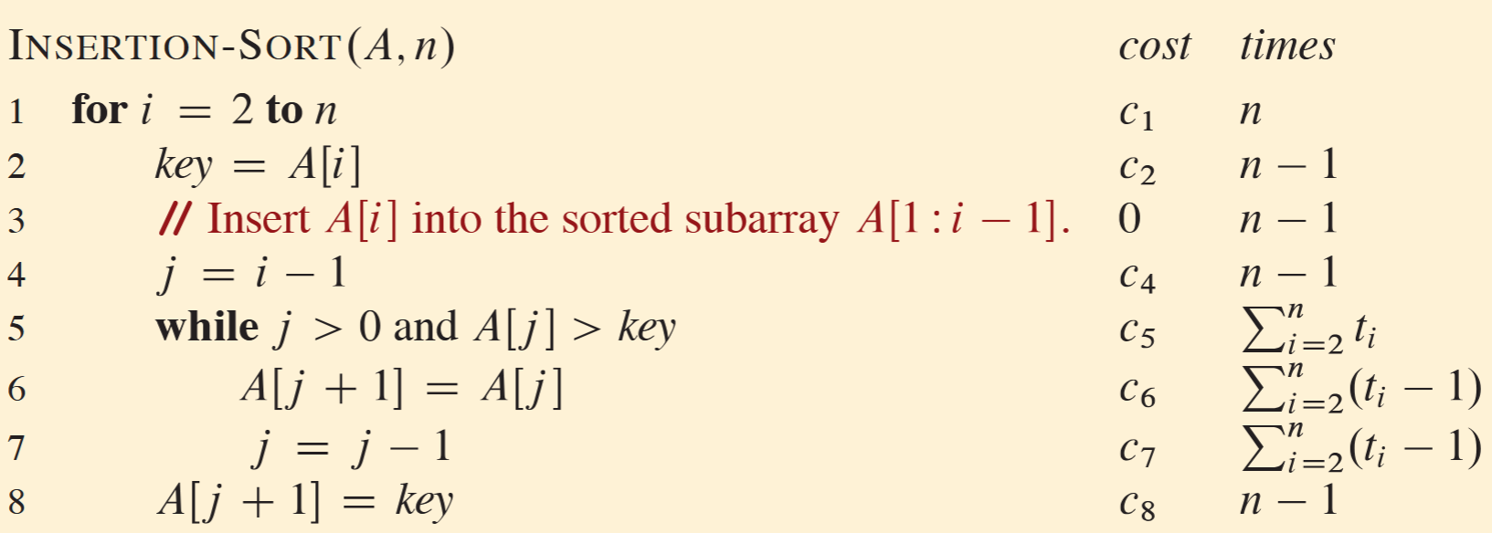
Insertion sort – F.Y.I

Slide 23
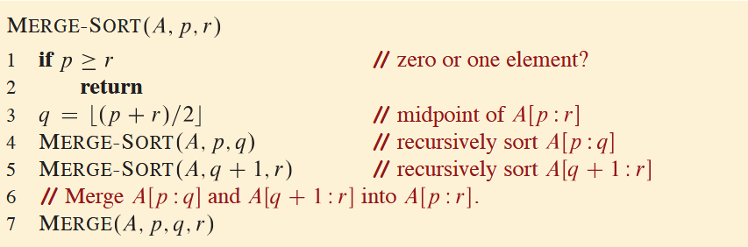
Merge sort – F.Y.I

Slide 24
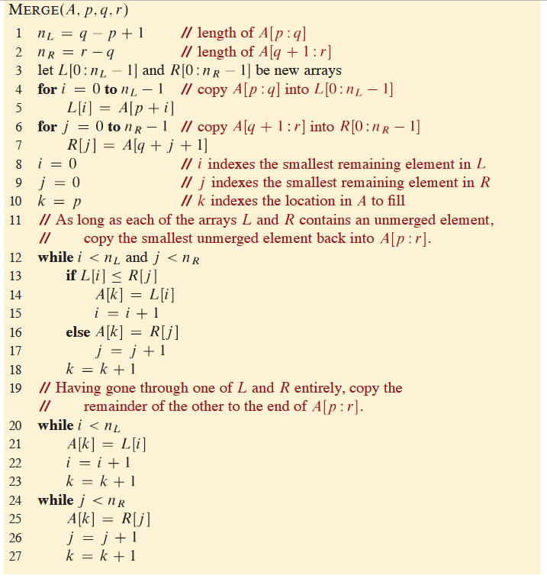

Slide 25
Characteristics
Insertion sort
Efficient for small datasets
Low memory usage
Stable
Merge sort
Efficient for large datasets
Uses extra memory
Stable

Slide 26
Heapsort

Slide 27
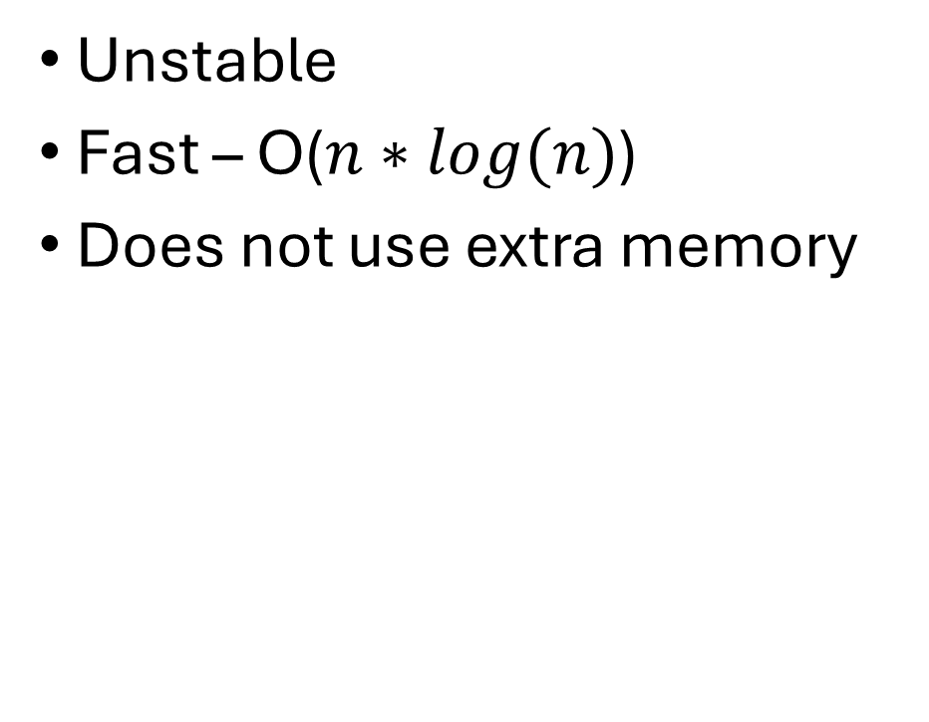
Heapsort
Unstable
Fast – O($n∗log(n)$)
Does not use extra memory

Slide 28
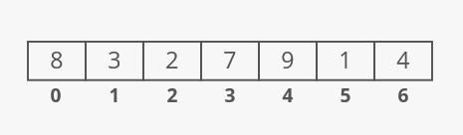
https://www.interviewcake.com/concept/java/heapsort

Slide 29
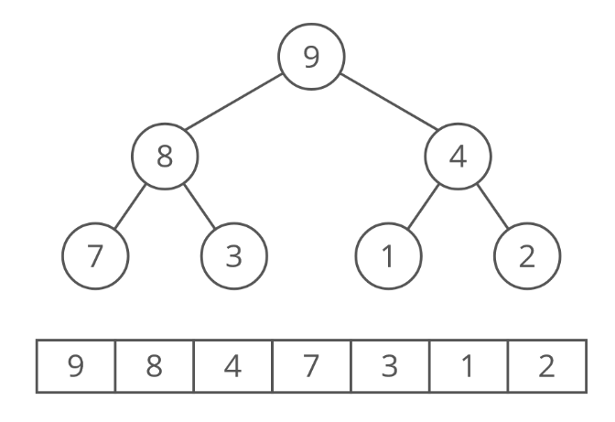

Slide 30
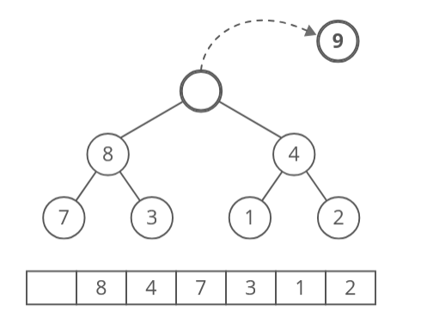

Slide 31
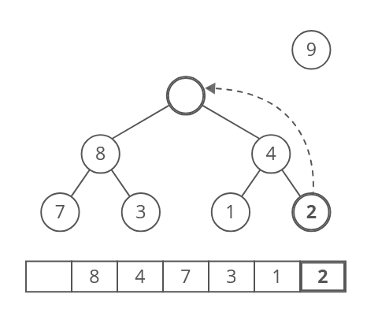

Slide 32
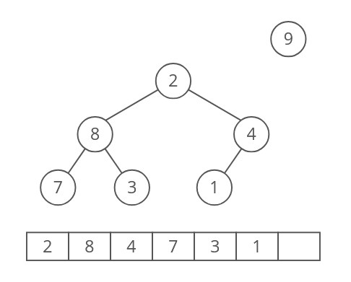

Slide 33
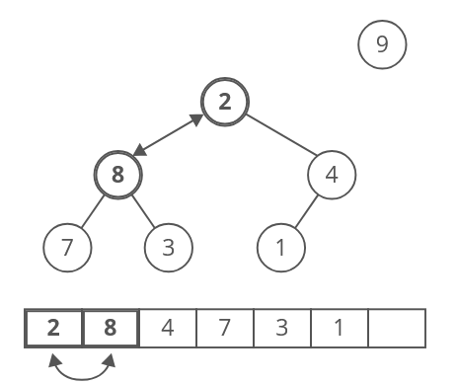

Slide 34
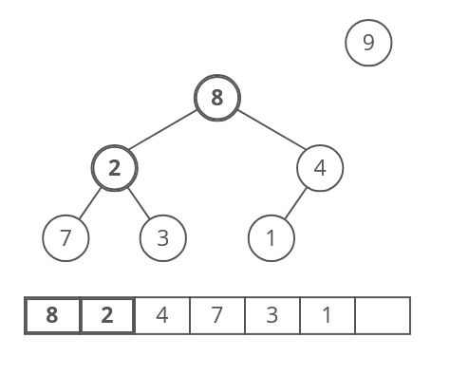

Slide 35
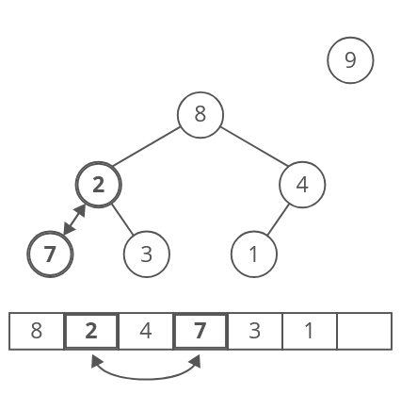

Slide 36
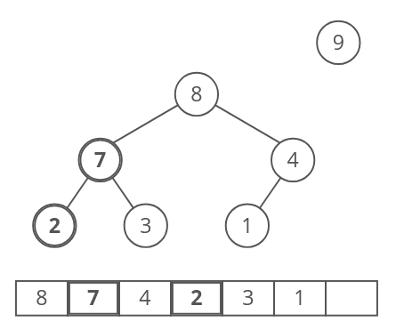

Slide 37
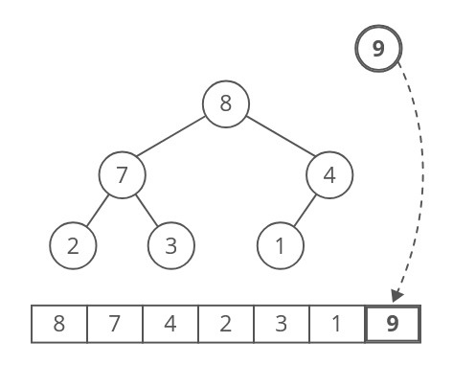

Slide 38
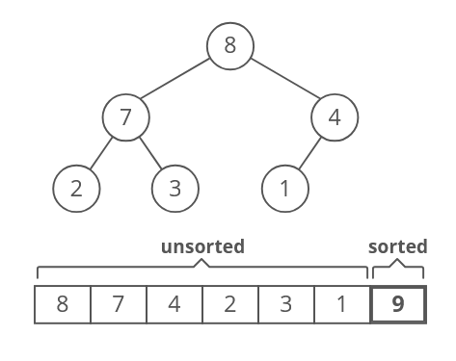

Slide 39
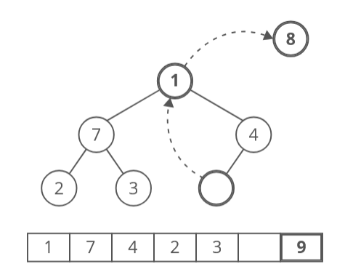

Slide 40
You can guess the rest…
https://www.interviewcake.com/concept/java/heapsort

Slide 41
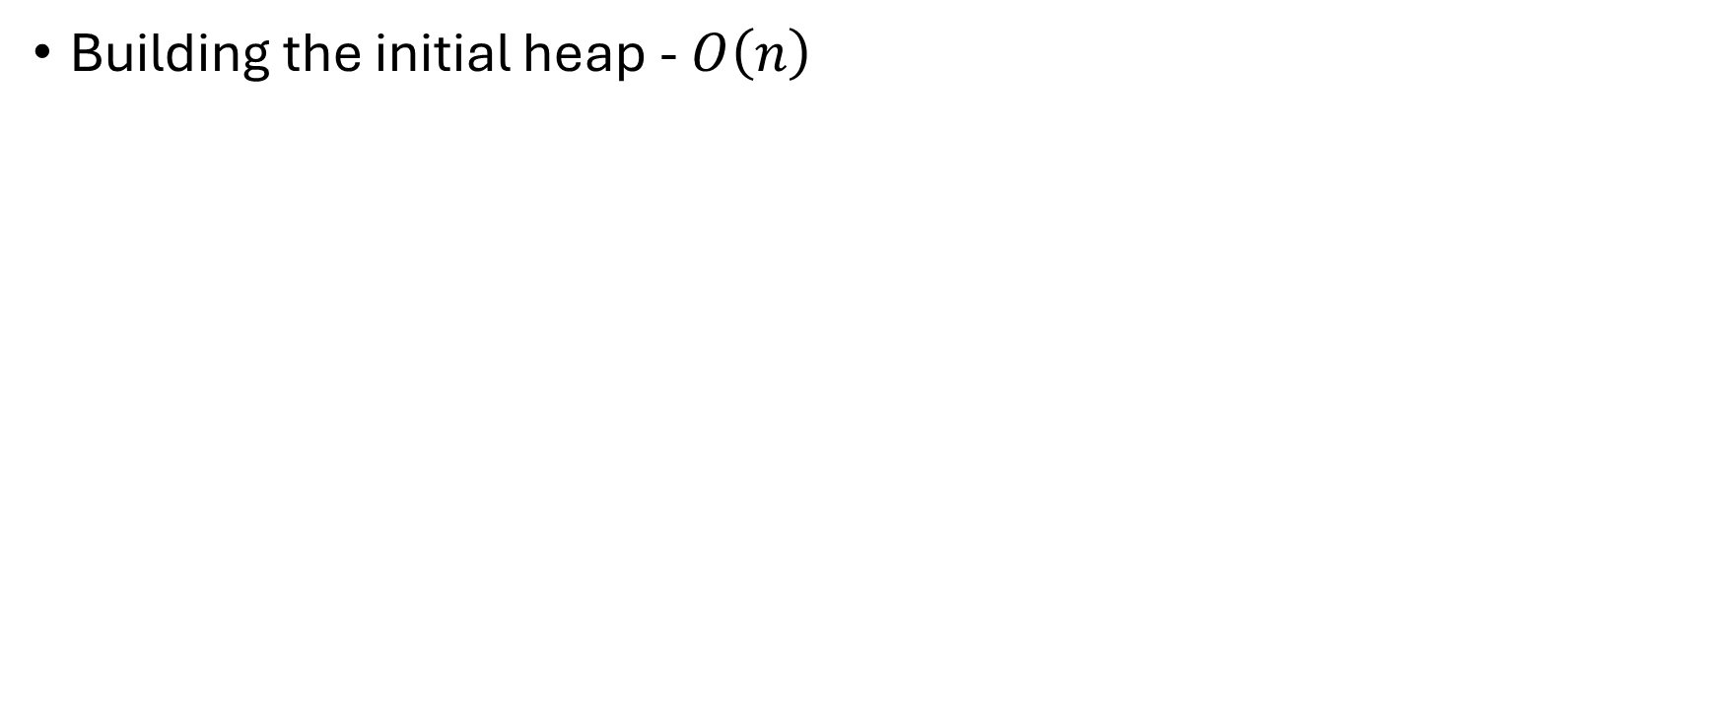
Complexity
Building the initial heap - $O\left(n\right)$

Slide 42
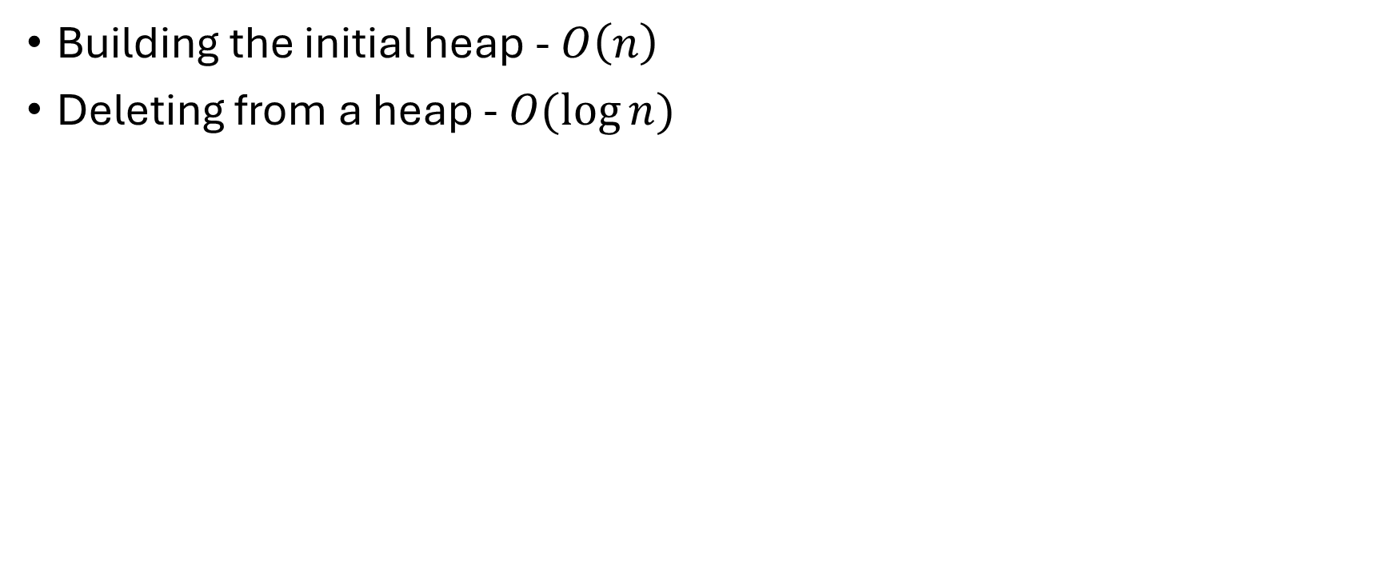
Complexity
Building the initial heap - $O\left(n\right)$
Deleting from a heap - $O(\log{n})$

Slide 43
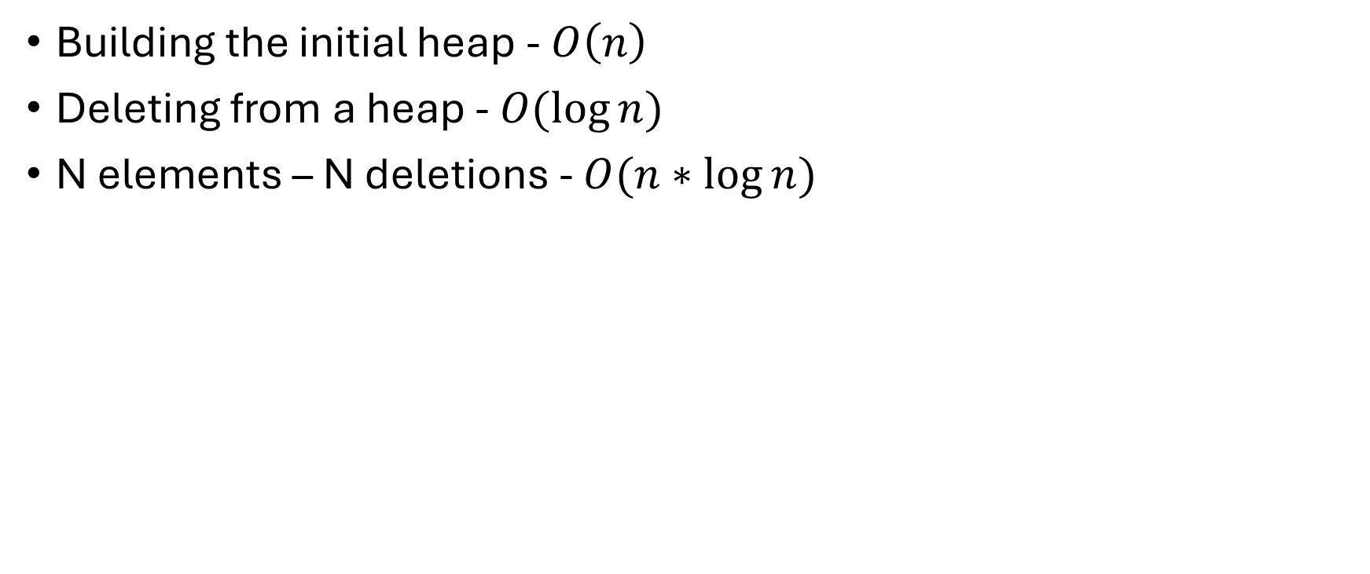
Complexity
Building the initial heap - $O\left(n\right)$
Deleting from a heap - $O(\log{n})$
N elements – N deletions - $O(n∗\log{n})$

Slide 44


The fastest sorting algorithm in the west?
Heapsort
$$O(n\log{n})$$

Slide 45

A new foe appeared!
Quicksort

Slide 46
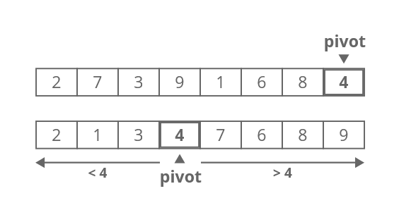
Quicksort
https://www.interviewcake.com/concept/java/quicksort

Slide 47
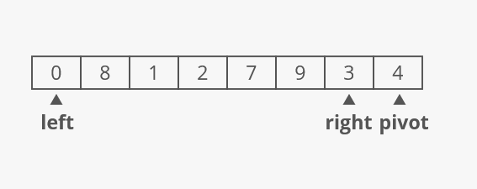
Quicksort

Slide 48
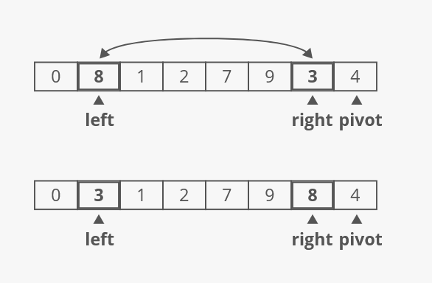

Slide 49
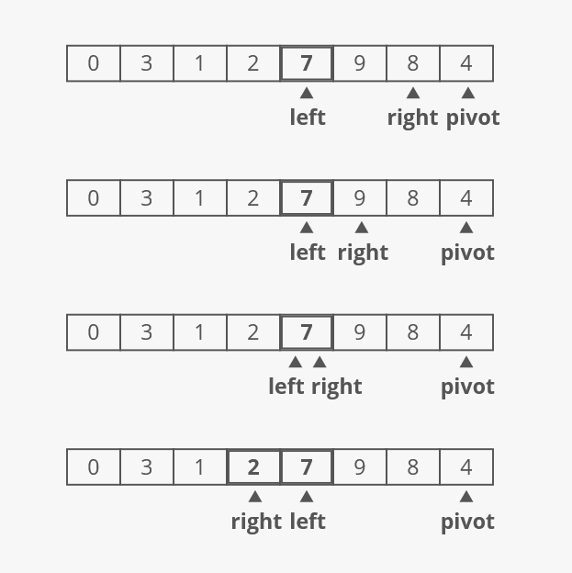

Slide 50
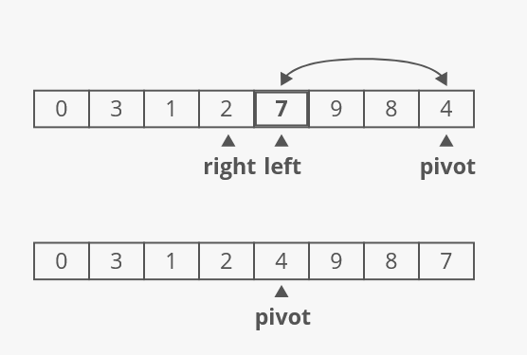

Slide 52
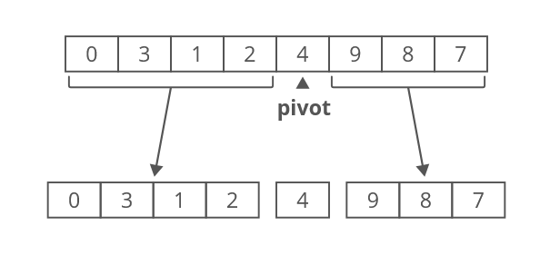
Recursively sort the two halves

Slide 53
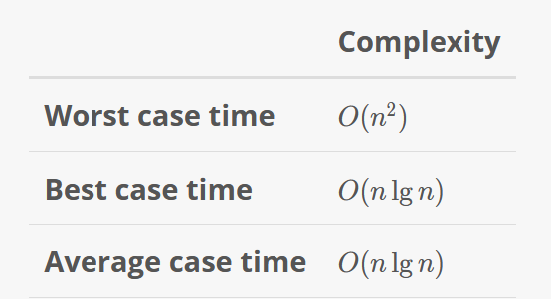
Time complexity

Slide 54
Time complexity

Slide 55
Space Complexity
Recursion allocates a stack frame for each recursive call

Slide 56
Space Complexity
Recursion allocates a stack frame for each recursive call
How tall will the recursion tree be?

Slide 57
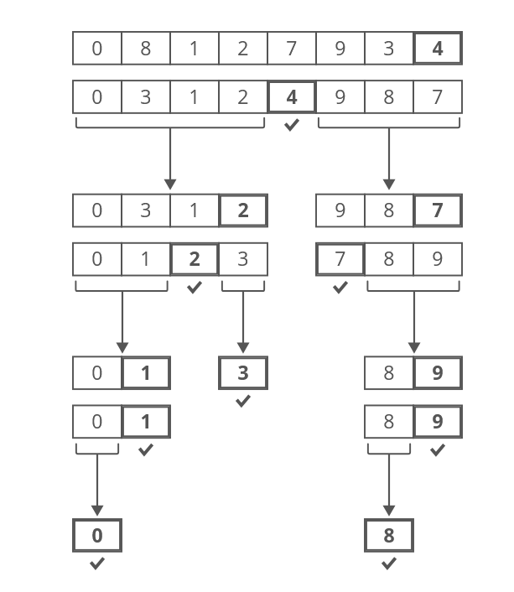
Space Complexity – best case
The pivot is the median
Space complexity is O(lg(n))

Slide 58
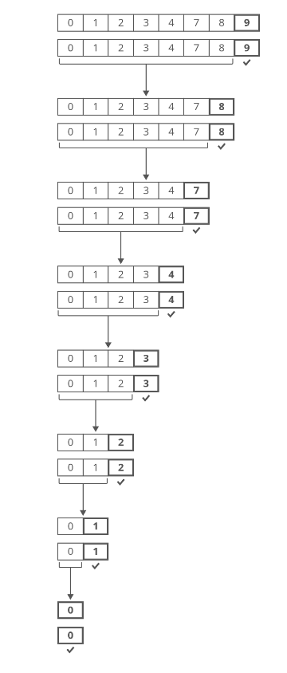
Space Complexity – worst case
The input array is sorted & the pivot is the last elem.
Space complexity is O(n)

Slide 59
Who wins?
Heapsort
Faster in the worst-case scenario
Slower on average
Uses no extra space
Quicksort
Much faster on average
Much slower in the worst-case scenario
Uses extra space

Slide 60
Linux uses Heapsort! – F.Y.I
https://github.com/torvalds/linux/blob/master/lib/sort.c#L53

Slide 61
