Slide 1

Data Structures and Algorithms I.
University of Szeged
Robert Nagy
2025/26. Autumn Semester

Slide 2

Dynamic Programming

Slide 3
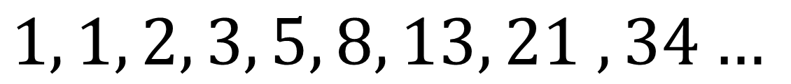
Fibonacci numbers
$$1, 1, 2, 3, 5, 8, 13, 21 , 34…$$

Slide 4
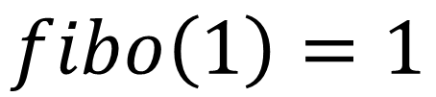
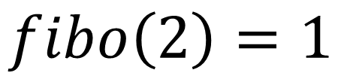
Fibonacci numbers
$$1, 1, 2, 3, 5, 8, 13, 21 , 34…$$
$$fibo\left(1\right)=1$$
$$fibo\left(2\right)=1$$
$$fibo\left(n\right)=fibo\left(n−1\right)+fibo(n−2)$$

Slide 5
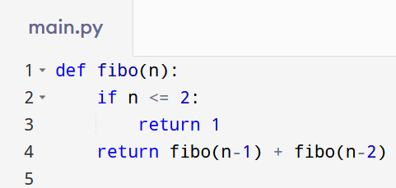

Slide 6
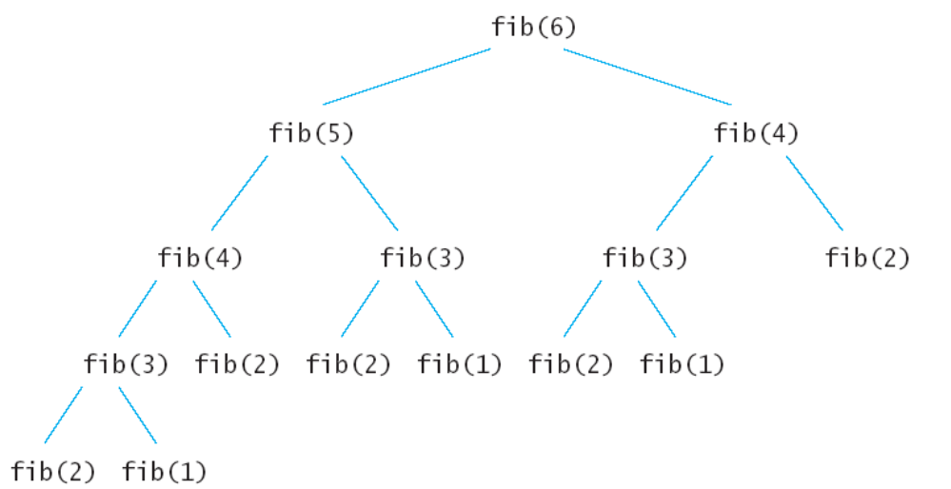
https://www.artofcse.com/learning/introduction-to-dynamic-programming

Slide 9
D.R.Y. – Don’t Repeat Yourself

Slide 10
Memoization
The solution we need!

Slide 11
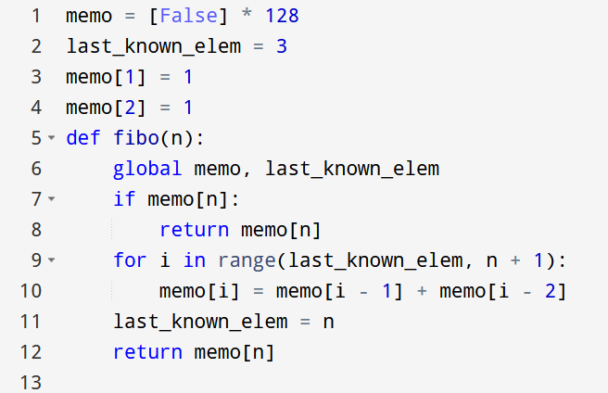

Slide 16
Optimization problems

Slide 17

Coin Change problem

Slide 18
Example

Slide 19


https://www.youtube.com/watch?v=jgiZlGzXMBw
$$coins=[1, 2, 5]$$
$$target amount=11$$

Slide 20
Two approaches
Top-down
Bottom-up

Slide 21
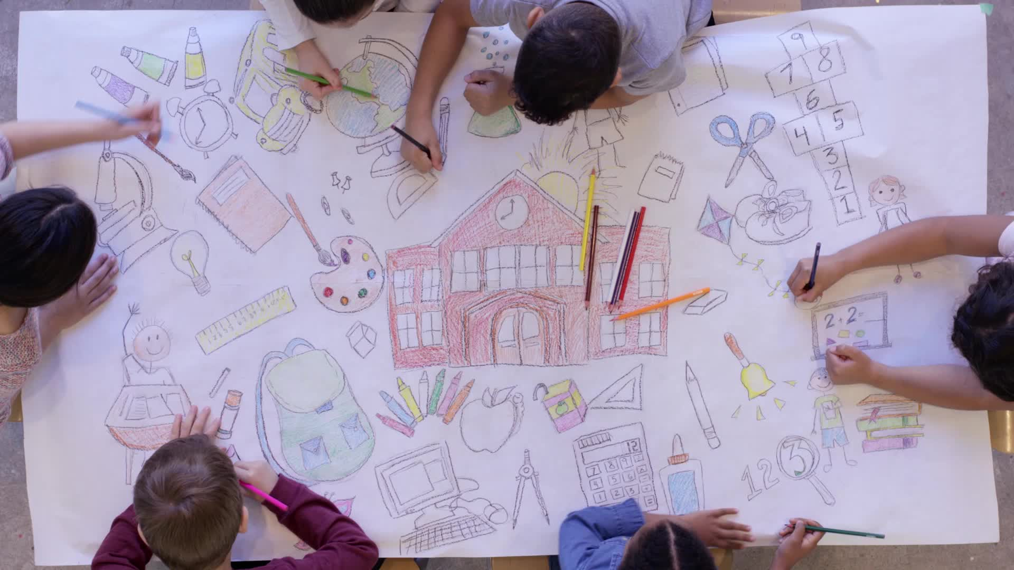
It’s drawing time!

Slide 22
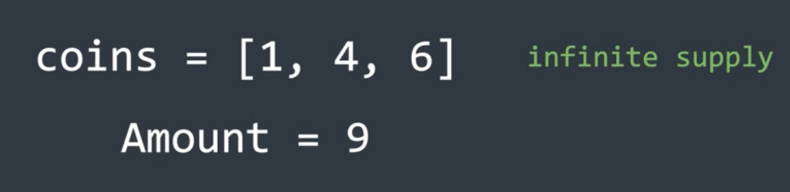
https://www.youtube.com/watch?v=KnWorqyDSLA

Slide 23
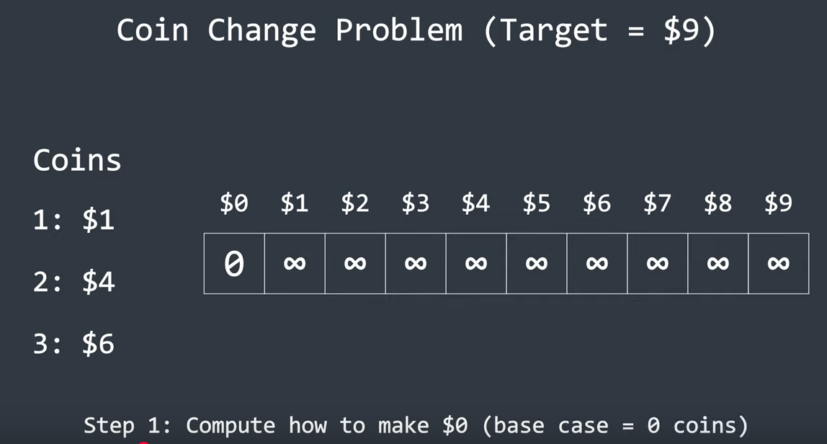
https://www.youtube.com/watch?v=KnWorqyDSLA

Slide 24
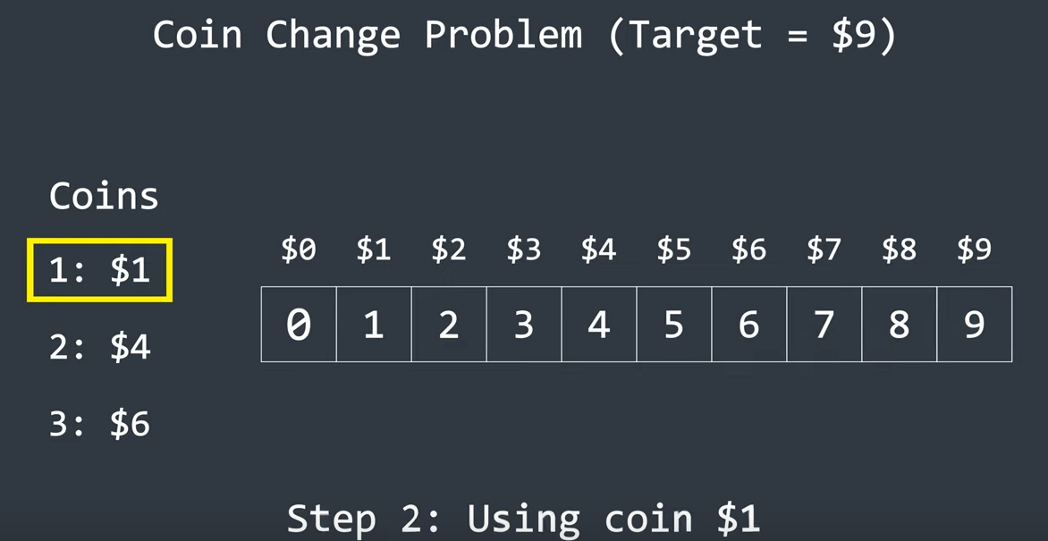
https://www.youtube.com/watch?v=KnWorqyDSLA

Slide 25
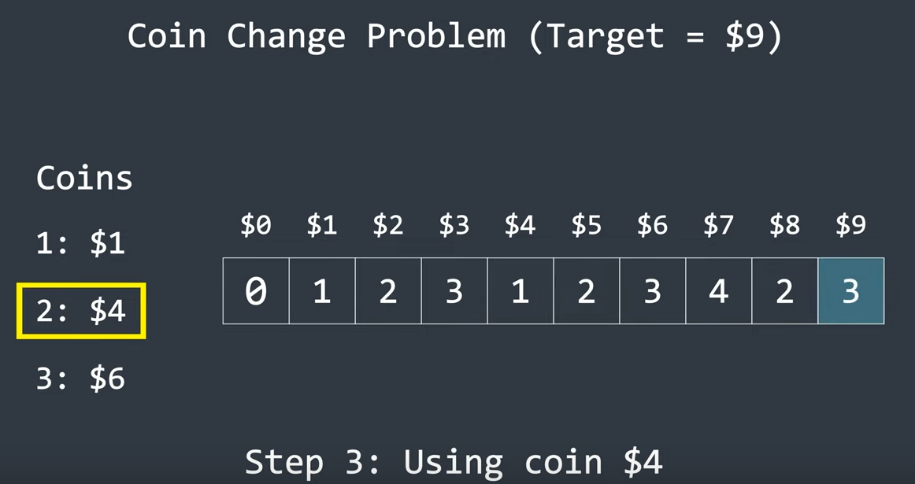
https://www.youtube.com/watch?v=KnWorqyDSLA

Slide 26
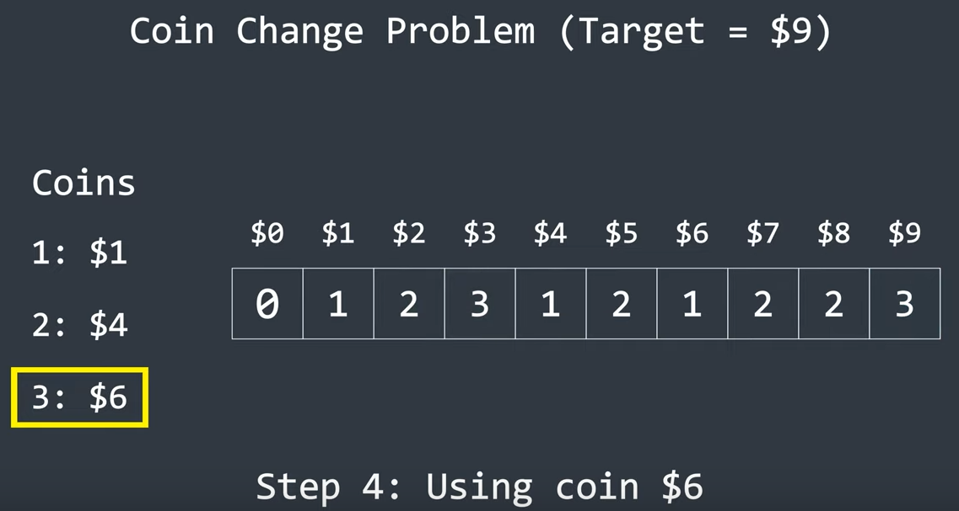
https://www.youtube.com/watch?v=KnWorqyDSLA

Slide 27
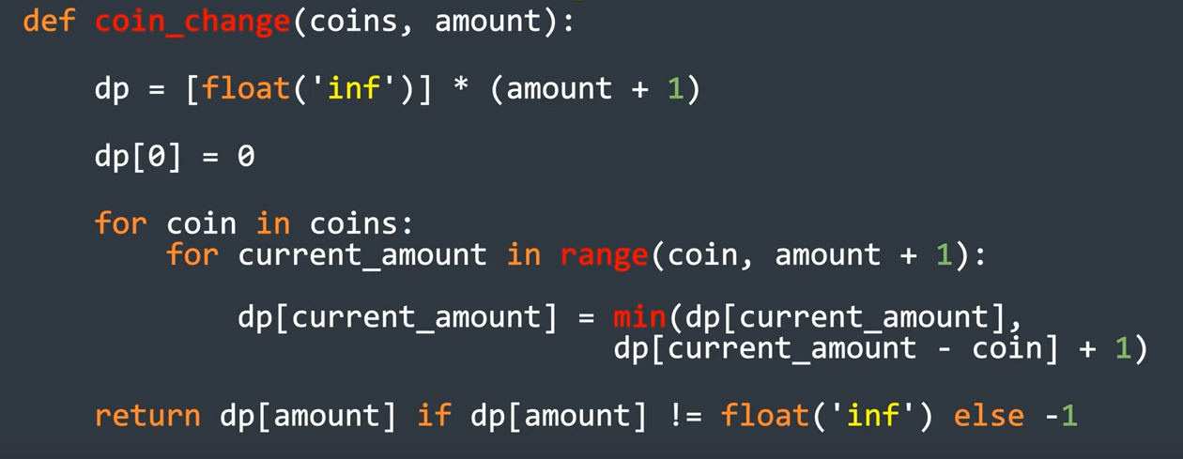
https://www.youtube.com/watch?v=KnWorqyDSLA

Slide 28
https://www.youtube.com/watch?v=KnWorqyDSLA

Slide 29
https://www.youtube.com/watch?v=KnWorqyDSLA

Slide 30
https://www.youtube.com/watch?v=KnWorqyDSLA

Slide 31
Knapsack problem

Slide 32
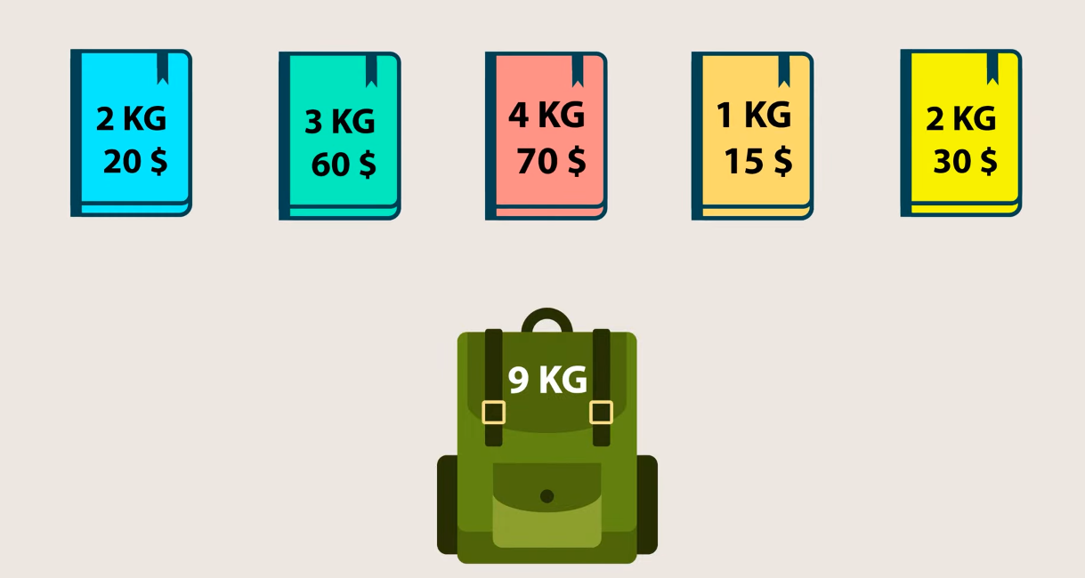
https://www.youtube.com/watch?v=qxWu-SeAqe4

Slide 33
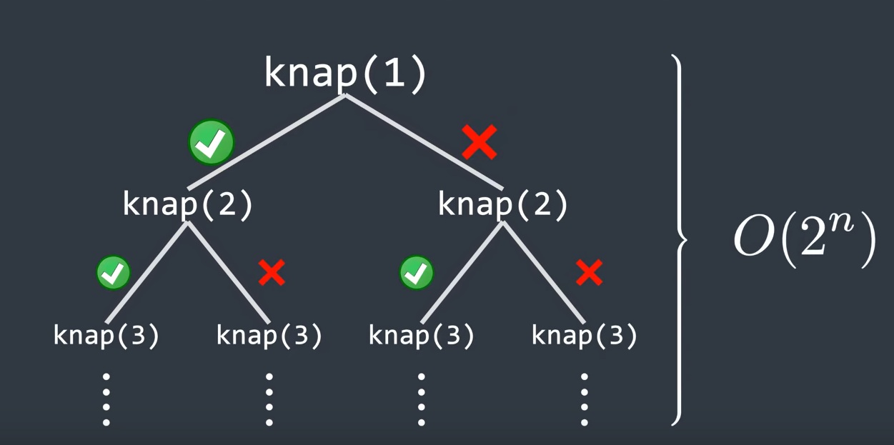
https://www.youtube.com/watch?v=qxWu-SeAqe4

Slide 34
It’s drawing time!

Slide 35
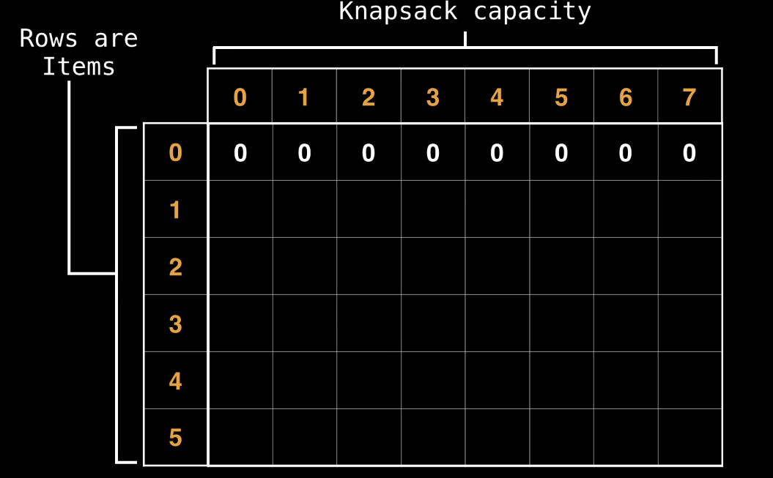
https://www.youtube.com/watch?v=cJ21moQpofY

Slide 36
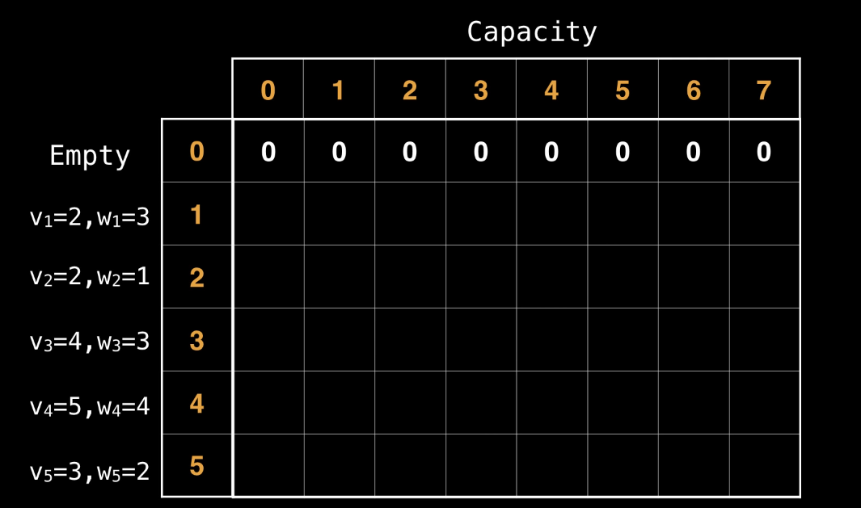
https://www.youtube.com/watch?v=cJ21moQpofY

Slide 37
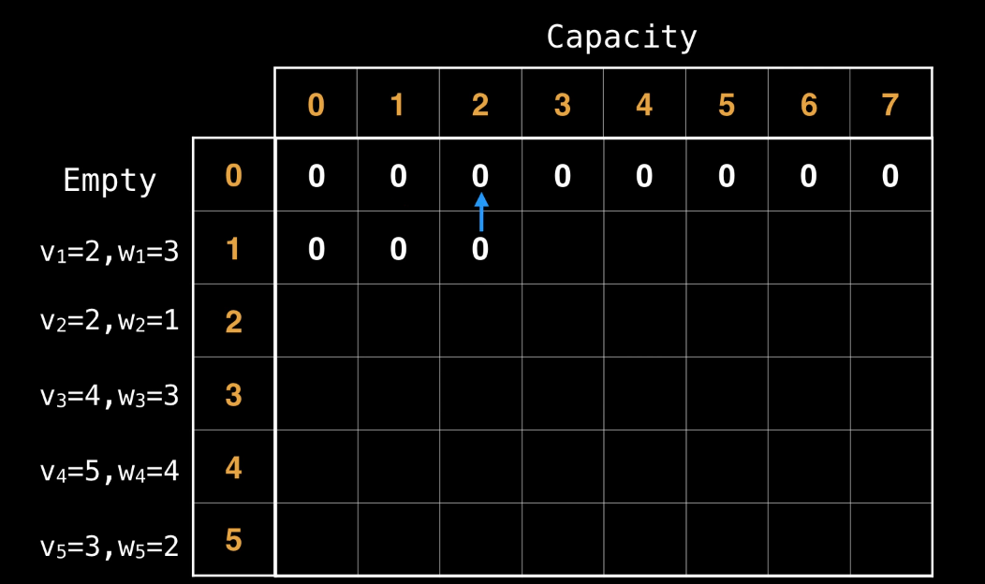
https://www.youtube.com/watch?v=cJ21moQpofY

Slide 38
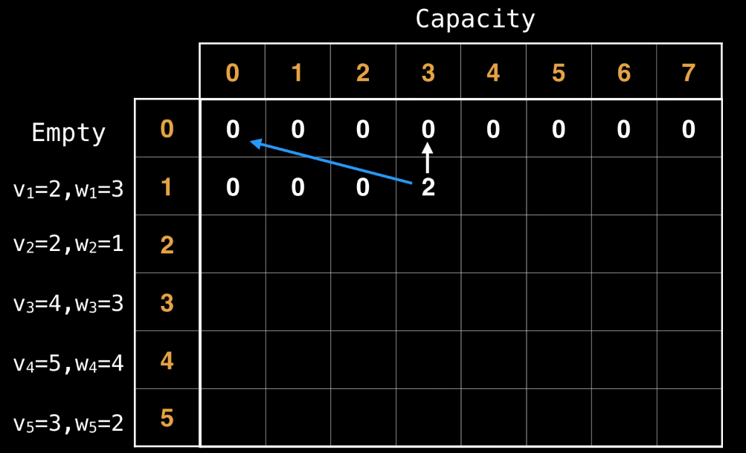
https://www.youtube.com/watch?v=cJ21moQpofY

Slide 39
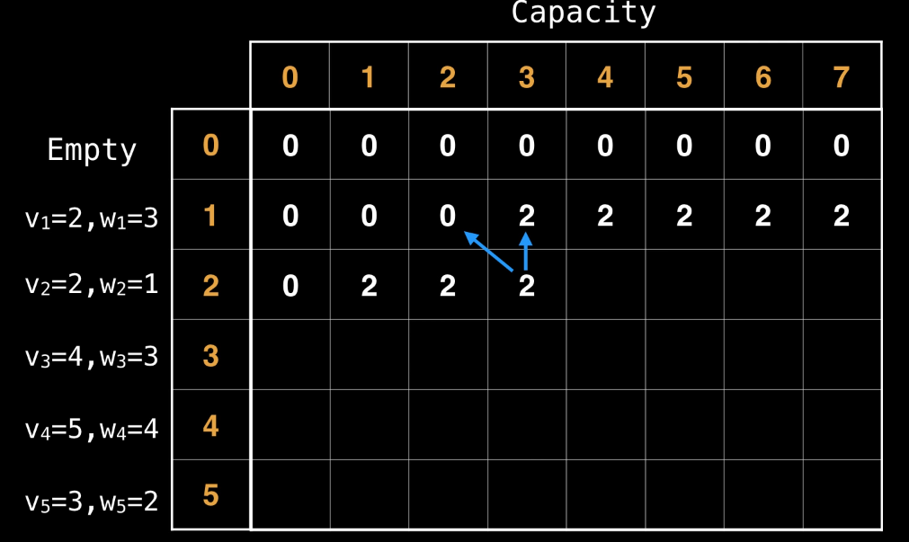
https://www.youtube.com/watch?v=cJ21moQpofY

Slide 40
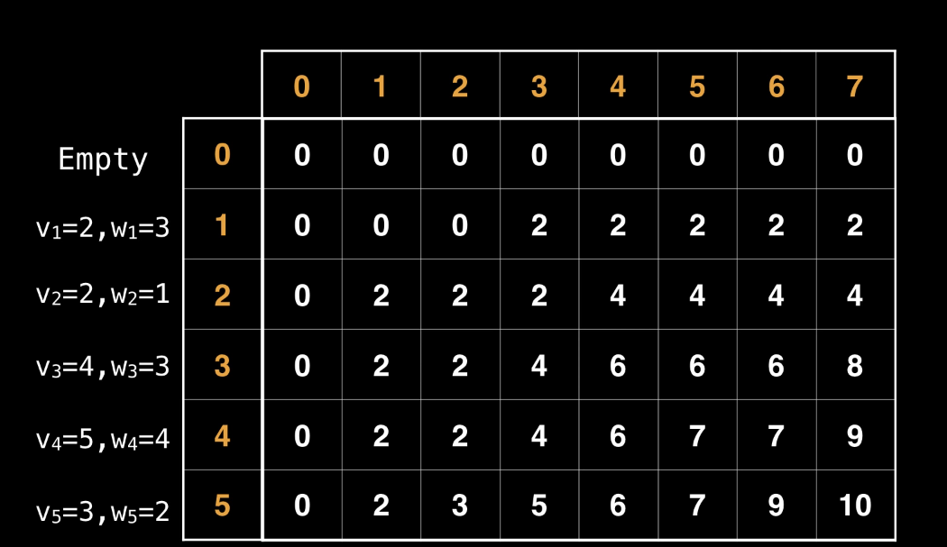
https://www.youtube.com/watch?v=cJ21moQpofY

Slide 41
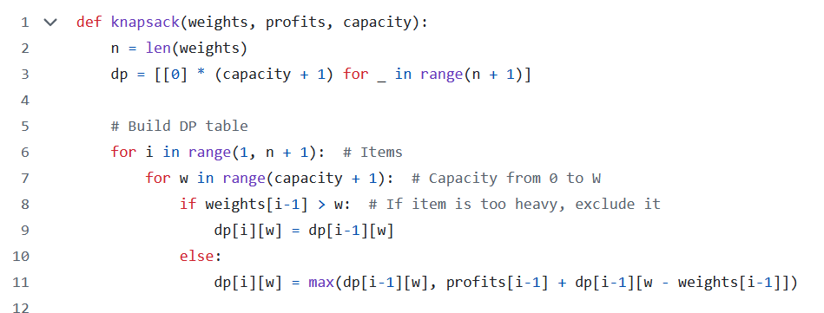
https://github.com/ByteQuest0/Implemention_codes/blob/main/Dynamic%20Programming/knapsack.py

Slide 42
https://github.com/ByteQuest0/Implemention_codes/blob/main/Dynamic%20Programming/knapsack.py

Slide 43
https://github.com/ByteQuest0/Implemention_codes/blob/main/Dynamic%20Programming/knapsack.py

Slide 44
https://github.com/ByteQuest0/Implemention_codes/blob/main/Dynamic%20Programming/knapsack.py

Slide 45
Appendix

Slide 46
What does recursion really look like?

Slide 47
https://www.artofcse.com/learning/introduction-to-dynamic-programming

Slide 48
https://www.artofcse.com/learning/introduction-to-dynamic-programming

Slide 49
https://www.artofcse.com/learning/introduction-to-dynamic-programming

Slide 50
https://www.artofcse.com/learning/introduction-to-dynamic-programming

Slide 51


https://www.artofcse.com/learning/introduction-to-dynamic-programming

Slide 52



https://www.artofcse.com/learning/introduction-to-dynamic-programming

Slide 53




https://www.artofcse.com/learning/introduction-to-dynamic-programming

Slide 54




https://www.artofcse.com/learning/introduction-to-dynamic-programming

Slide 55




https://www.artofcse.com/learning/introduction-to-dynamic-programming

Slide 56



https://www.artofcse.com/learning/introduction-to-dynamic-programming

Slide 57


https://www.artofcse.com/learning/introduction-to-dynamic-programming

Slide 58



https://www.artofcse.com/learning/introduction-to-dynamic-programming

Slide 59



https://www.artofcse.com/learning/introduction-to-dynamic-programming

Slide 60






https://www.artofcse.com/learning/introduction-to-dynamic-programming

Slide 61





https://www.artofcse.com/learning/introduction-to-dynamic-programming

Slide 62



https://www.artofcse.com/learning/introduction-to-dynamic-programming

Slide 63




https://www.artofcse.com/learning/introduction-to-dynamic-programming

Slide 64


https://www.artofcse.com/learning/introduction-to-dynamic-programming

Slide 65



https://www.artofcse.com/learning/introduction-to-dynamic-programming

Slide 66



https://www.artofcse.com/learning/introduction-to-dynamic-programming

Slide 67


https://www.artofcse.com/learning/introduction-to-dynamic-programming

Slide 68



https://www.artofcse.com/learning/introduction-to-dynamic-programming

Slide 69

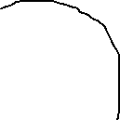



https://www.artofcse.com/learning/introduction-to-dynamic-programming

Slide 70


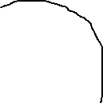
5 + 3 = 8

Slide 71
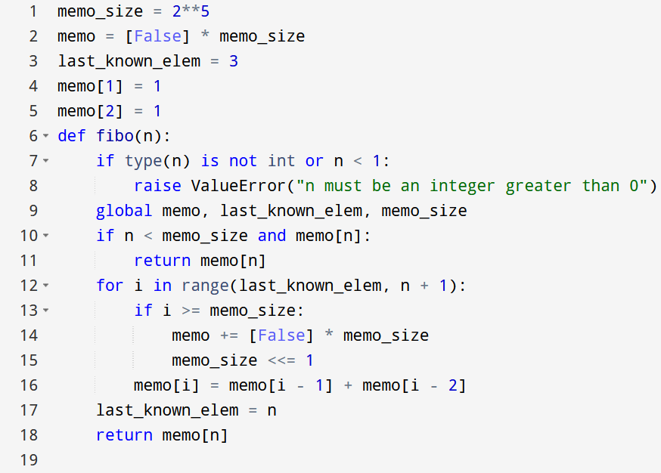

F.Y.I.

