Slide 1
Basket Probabilities?
How “Deterministic” Funding Math Becomes Uncertain

Slide 2
Fair Value is NOT Real Life
Probably the biggest trip up for junior analysts, and even some new-medium experienced FIRV traders is the over confidence in FV modeling.
Markets are uncertain, random, and move in bursts with the newest narratives and regimes being, by definition, near impossible to map with math alone.
As such, when a market gives and rich or cheap regime, this may not be a signal of mean reversion but rather a new macro narrative moving the economy.

Slide 3
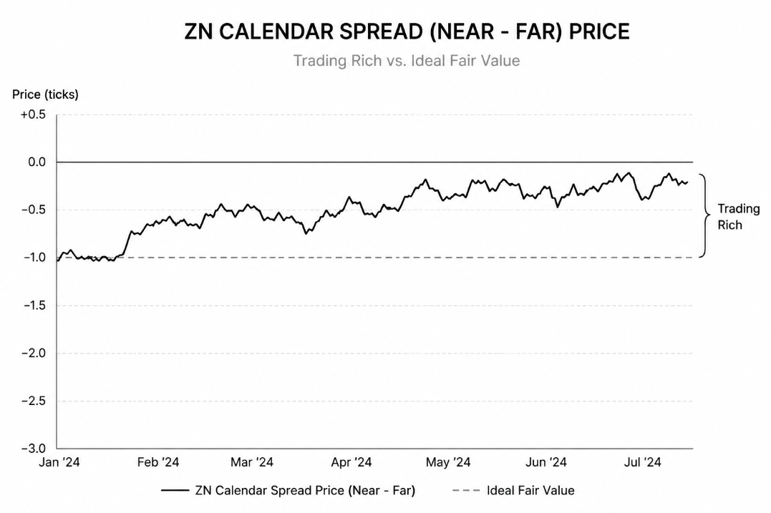

Slide 4
CTD Switching, NOT just Macros
This nuance is HUGE, CTD switching, which already can occur frequently farther out from delivery in FV models, isn’t simply tied to hypothetical funding.
There are many factors such as implied optionality (the deliverer covering short futures contract has a synthetical ‘put’ option), ease of use for futures speculation on rates, retail trading, and even the solvency of special repo providers.
In summary, the macros matter, but more so if the plumbing around the CME Futures ecosystem isn’t clogged.

Slide 5
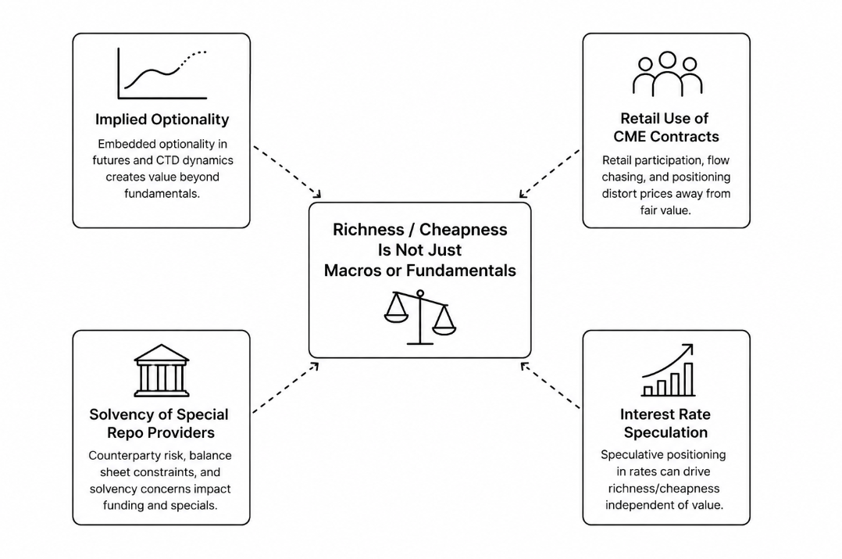

Slide 6
Flows, narrative Dependent
If contract flows themselves, and LP solvency becomes a major source of uncertainty, couldn’t one simply model that? Yes, but no.
Interest Rate speculation for instance is heavily narrative dependent. Low PPI on credit fears, massive long slamming. Hot labor data on energy, emergency duration escape. During panic flows, most probabilistic modeling breaks on the microstructure.
Hence a more accurate way is to estimate what the current narrative is, and what cluster of events can cause multiple std dv events that are context dependent

Slide 7
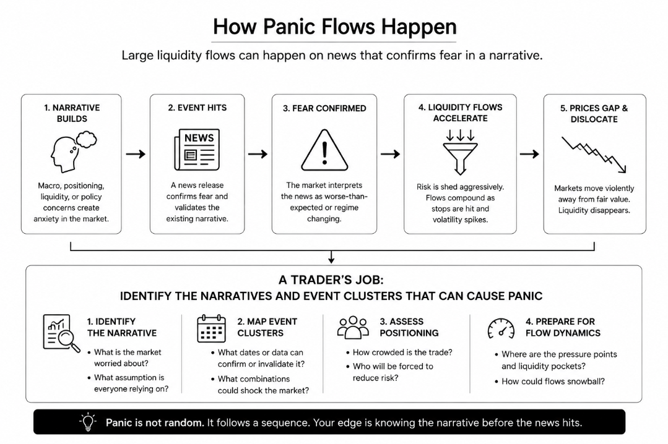

Slide 8
Repo Stress, the Ultimate Black Swan
If basket funding is relied on special repo, probabilities modeling on dollar repo, and basis/calendars of the futures on dollar repo, how could you possibly manage real time probabilities modeling in repo stress? Dirty secret, you can’t!
During an overnight decorrelation event the options-based probabilities, calendar spreads on futures, and CTD based on market futures becomes almost completely random, with the true flows being in overnight rates and the fed response. Qualitatively, the game becomes mapping the projected fed response!

Slide 9
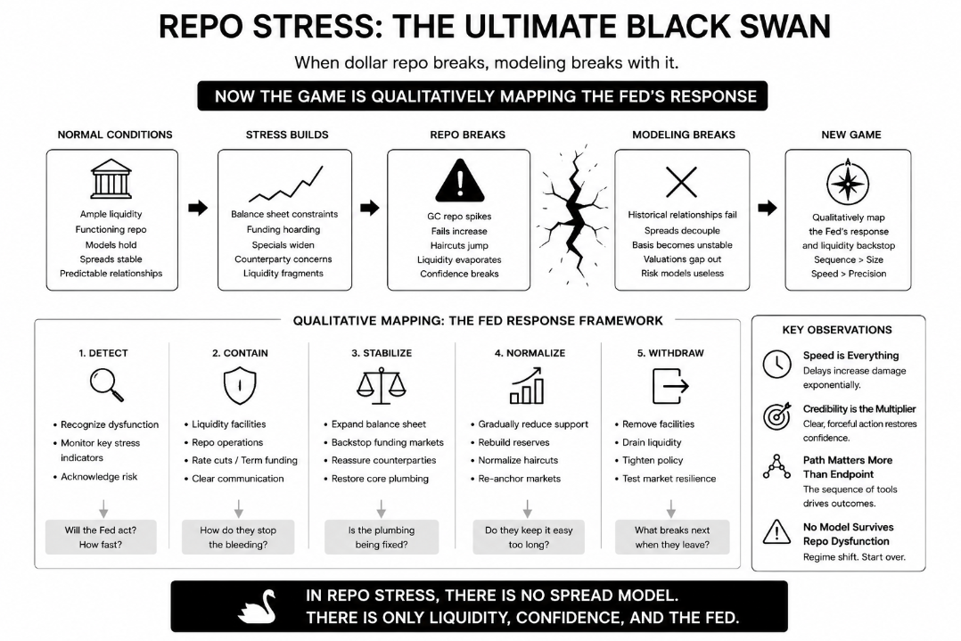

Slide 10
Where are the Basket Probabilities?!
This is where FIRV becomes an art, not a math formula. There is no perfect model, framework, or even trade for this aspect of the CTD basket. Instead, it turns to quant skill and veteran experience.
For instance, Senior MMF traders saved many balance sheets in the COVID crash as they understood the run on short duration and projected fed response sometimes days before the rest of their teams.
Experienced quants helped stop duration bleeding during our recent bond selloff by understanding Stochastics for short term exits.

Slide 11
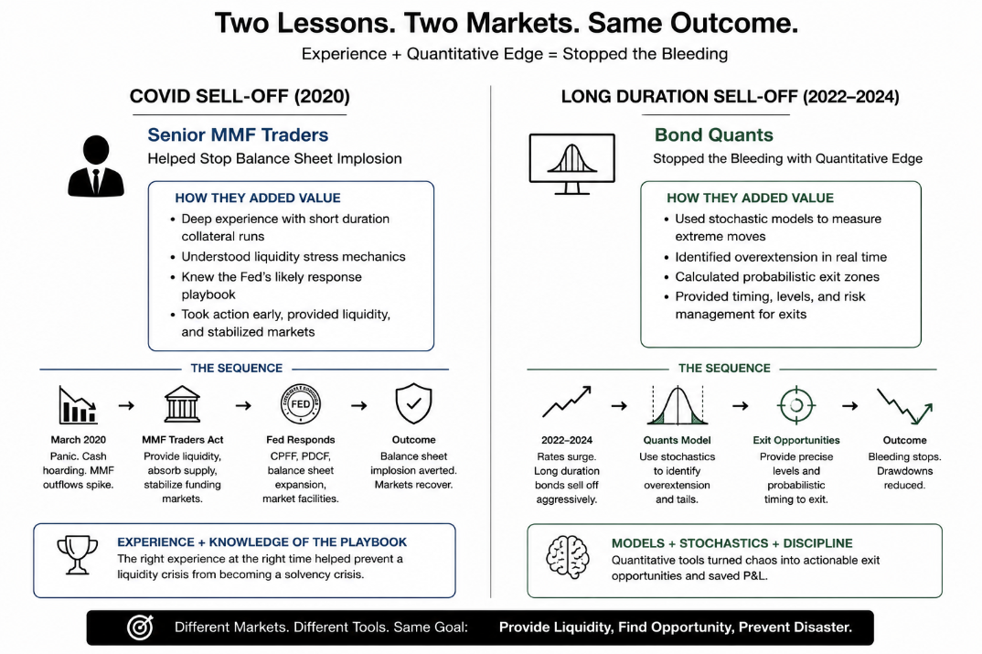

Slide 12
Thanks For Listening!

