Slide 1
CTD Basket Explained
CME US Treasury Economics

Slide 2
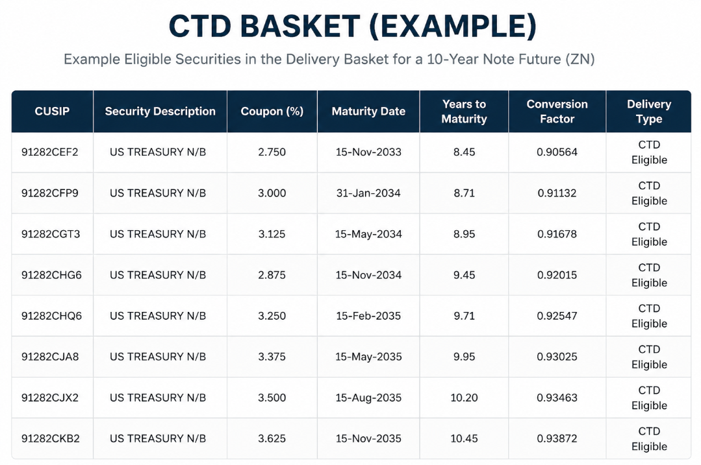
What is a Basket?
Each CME UST contract has a specific bundle of bonds that qualify for being “cheapest to deliver”, this isn’t a blanked maturity range but those that quants at the Mercantile deem eligible.

Slide 3
What is “Cheapest to Deliver”
Being CTD means that this bond has the best delivery economics (think carry adjusted total return) for the LONG cash SHORT futures position, known as the deliverer
A student way to think of this is to simply look for the lowest number when subtracting he invoice price from the bonds dirty price.
The CTD then becomes the cash representation of what the futures contract ideally represents, and in nominal liquidity environments much of the fututres trade revolves around CTD dynamics.

Slide 4
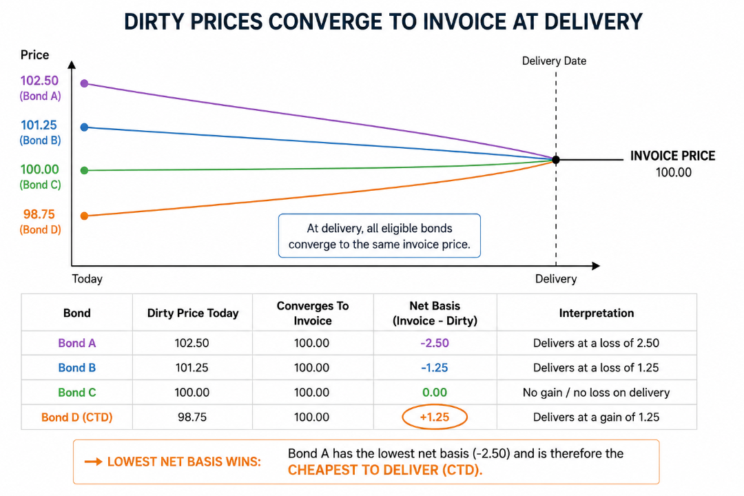

Slide 5
Ideal FV versus Market Traded
Nuance to add to the CTD selection is that not always the financially determined bond (via textbook fundamentals, not desk physics lol) will be what the market observed CTD is.
This is when the FV Futures and Market Futures spot diverge significantly, with the implied financing rate trading heavily rich or cheap to the Ideal Futures Repo.
On a spot price basis this looks like a large “gap” of the Market to Repo FV futures, on a curve this is when you see a much steeper/flatter futures curve than the FV one.

Slide 6
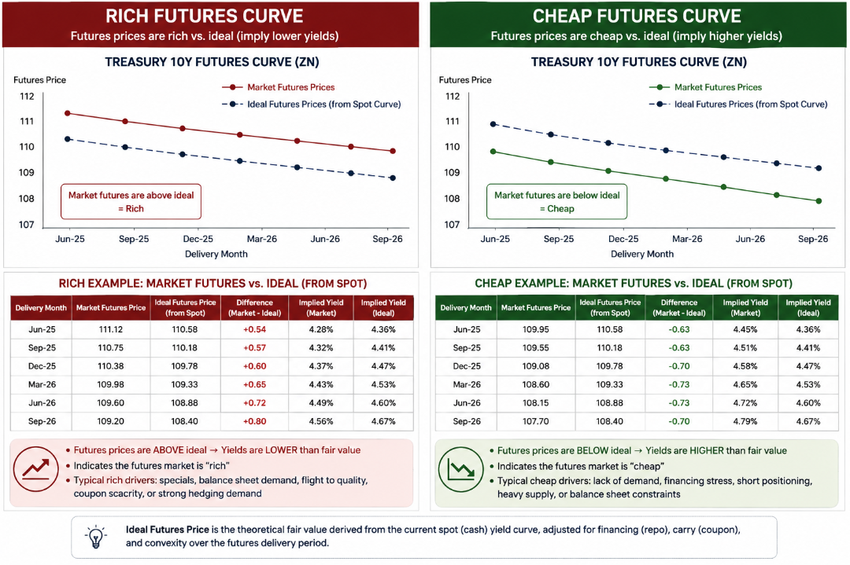

Slide 7
Why This Matters
For trading desks CTD dynamics are massive. Firstly, much of the nominal Futures dynamics are tied directly or to the financing of the CTD within the basket, so even extremely basic positions like a spot Futures (long/short) speculation trade is structurally impossible without knowing its underlying CTD.
Considering the advanced desk trades involving swaps, calendars, yield curve FIRV, the entire engine of modern Rates Trading via Futures sits on the engine of CTD baskets and its financing.

Slide 8
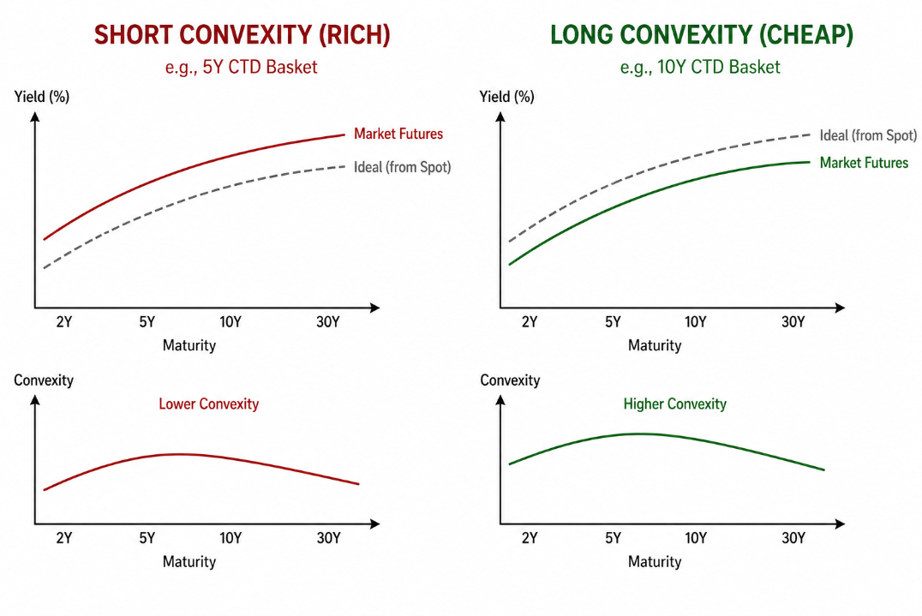

Slide 9
Final Nuance for Rates Quants
The math engine behind the CTD basket can get messy fast, special repo, SOFR curves, second+ order convexity can quickly make it feel as though modeling the basket is impossibly. Which is true.
CTD dynamics and the delivery of Government Securities MUST be identified by looking how the market prices the basket and explaining the math secondly. Especially in modern overnight leveraged markets, feeling confident in a proprietary model can, and usually is, the end of many FIRV desks.

Slide 10
Thanks For Listening

