Slide 1
How Energy Drives the Curve
Commodities Macro and its FI Consequences

Slide 2
Yields are not Magic Numbers
When entering FI, after surviving paragraphs of unreadable jargon and formulas you don’t understand, it becomes easy to assume everything is blackbox magic.
But fundamentally the UST yields are a textbook combination of financialized USD inflation, and Real Growth (TIPS) outlooks.
Energy remains the largest commodity sector that can impact both, quickly, and last for extended periods. Simply put, oil moves industrialization, consumer sentiment, and abstract credit.

Slide 3
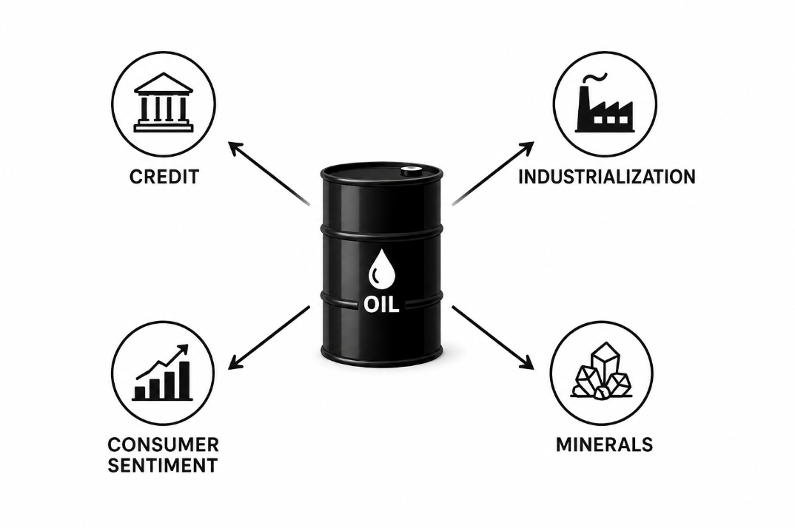

Slide 4
Crude Curve, Liquidity Monster
Knowing that energy is a primary driver of the economy, the crude curve priced by futures becomes more than simply a storage cost trade, but a reflexive look into primary stress.
The efficiency, liquidity, shape, and volatility of the crude oil curve (Both Brent and CL) can drive calendars on CME UST Futures, the SOFR complex, and even equities volatility.
This shock on Futures funding complex structurally moves into the yield curve, with violent repricing.

Slide 5
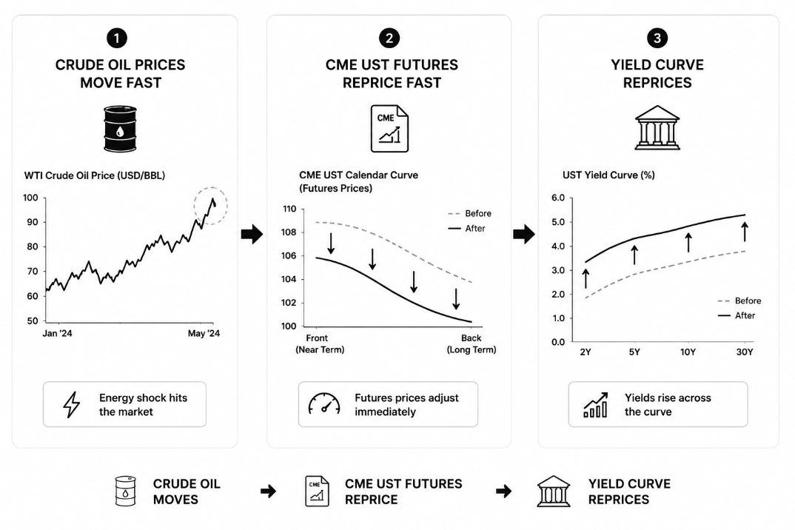

Slide 6
Energy Lasts, with REAL Impact
Not only is there a massive reflexive trade to Oil and Energy, but the implications of energy price movements have direct, structural ties to the entire economy that cannot be abstracted away.
Consumer spending at the pump, petroleum powered trade routes, airline costs, minerals industrialization, even credit card solvency has measured impacts that correlate very close with the price of a barrel.
Even credit moves on energy can have further order consequences on Corporate Bonds and Venture Capital.

Slide 7
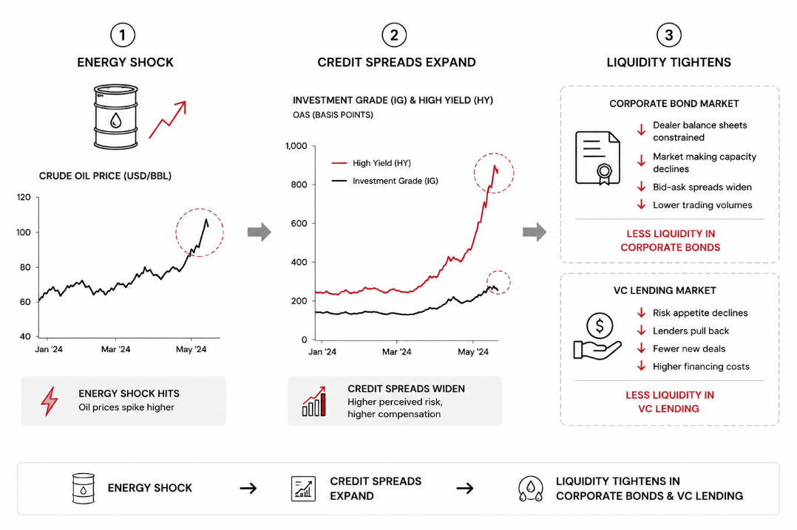

Slide 8
Energy Repricing's are Unavoidable
With almost every plumbing, credit, and corporate bond pipeline having some exposure to Crude, not only is a yield curve repricing unavoidable with energy shocks, but the deep true impact being much deeper than a natural curve drift on a trade.
Hence, transmission economists spend much of their careers at rate desks unraveling how deep, sticky, and long an Energies driven regime can last.
Curve traders are also hyper vigilant to their trades are CTD switching and liquidity thinning are directly tied to oil as well.

Slide 9
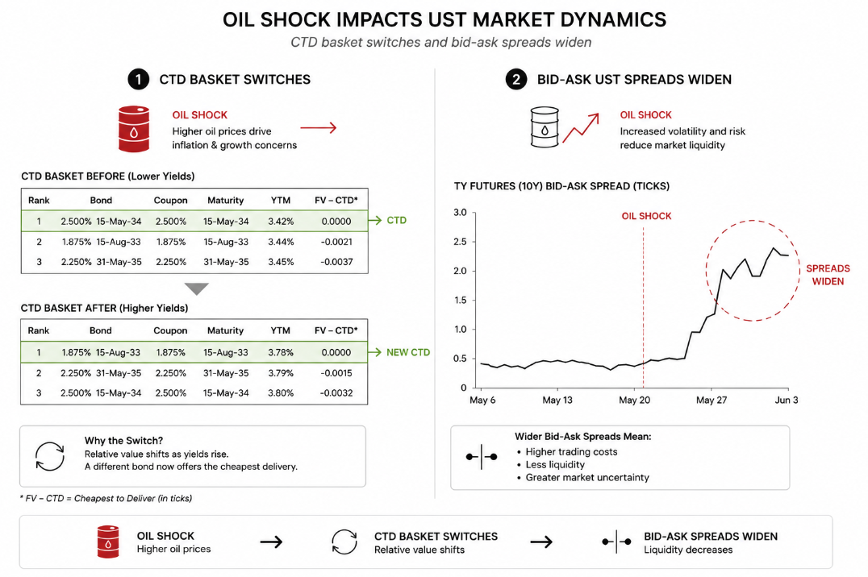

Slide 10
Final Conclusions
Energy shocks don’t just move the textbook price of a curve, they also can distort liquidity and financing of the Treasury Markets.
Credit, Corporate Bonds, and VC lending also are impacted by oil moves as well.
The deep economic impact means that Central Bank policy is structurally tied to oil moves when prices start to lose control, regardless of what Finance wants.
Consumer sentiment doesn’t lie, CPI can behave as a “gas station index” for long stretches of time.

Slide 11
Thanks For Listening

