Slide 1
Long Duration Earnings Analysis
A Hedge Adjusted TR Model for Earnings Quant Analysis

Slide 2
Earnings are Relative to Cost, Not Absolute
The numbers on earnings are useful metrics, but they aren’t the absolute impact on investors. EPS, Debt Metrics, etc. are useful for fundamental analysis but don’t reflect the immediate impact FELT on cashflows.
Shares of a company are, by definition, a bet on future cashflows. Earnings metrics reflect a quarterly cashflow metric but aren’t the immediate modeled impact of these cashflows.
Instead, the reaction and anticipation of the company's DEBT leading up to and on earnings are a true structural reflection of the transmission of metrics to real quality and cost of capital. Earnings should be analyzed from the lens of the corporate debt of a firm, not from idealism made up or quoted from a textbook.

Slide 3
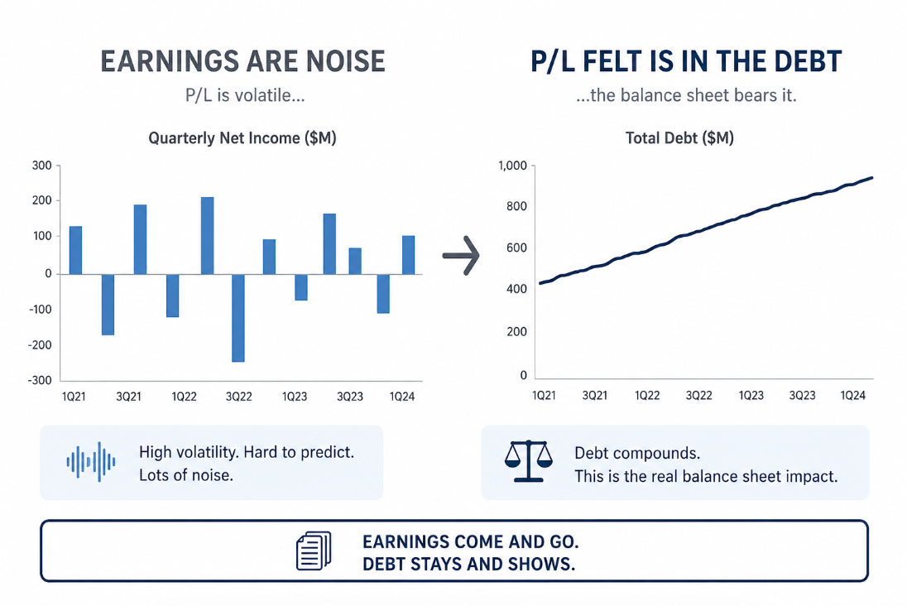

Slide 4
Hedge Adjusted TR, Not Just Yield
Because the aim is to measure actual balance sheet impact of the debt trade running into earnings, analysis shouldn’t simply be on bond prices or yields.
Focus on a true total return Metric, one that reflects costs from liquidity, hedging, and the special of the bond rather than global factors like USD repo or general CDS index prices.
TR = Yield – bid/ask – hedge duration – hedge credit – special repo

Slide 5
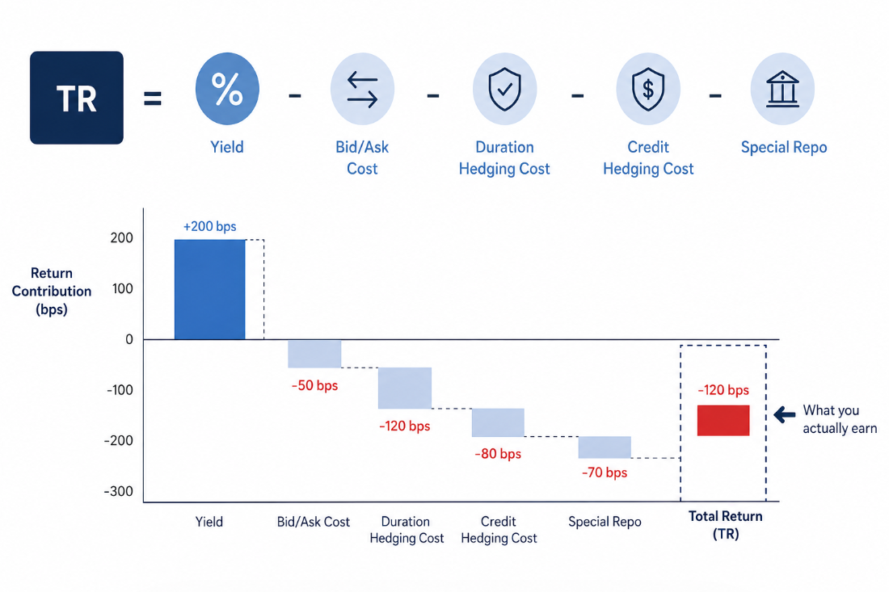

Slide 6
TR as a RV Observation, not Single Variable
Now that corporate yields are observed not as a spot but a complex total return, consider the performance of this TR with the general rating index of other corporates around it.
For instance, if you analyze a BBB+ Bond on a TR basis nearing the Company’s, take a BBB+ index such as the BofA and adjust it to TR with its CDX index, Duration Hedge approximation, and Average repo.
Unless you have a sophisticated Bond Desk, approximations will likely be your use. Which is fine, SOFR+Credit, CDX data, and duration gives an accurate enough approximation for RV.

Slide 7
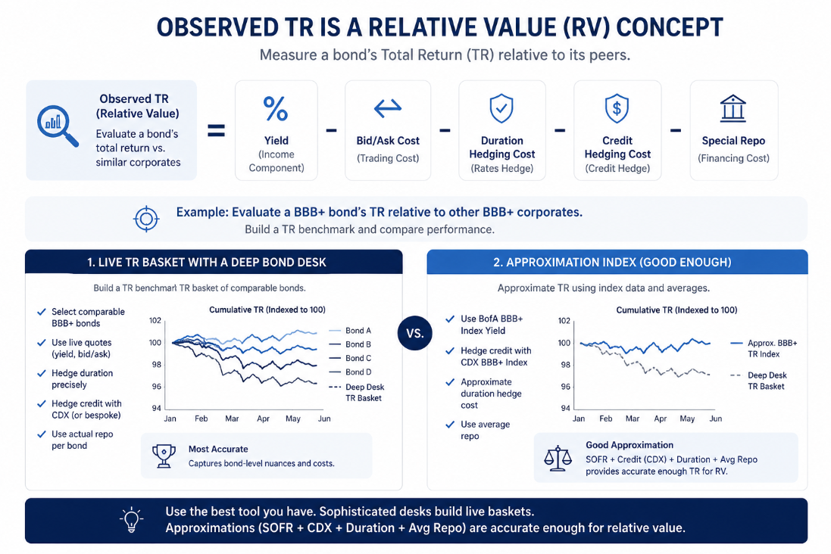

Slide 8
Why Long Duration?
Now the final point is for Both the Credit Index and the Bond From the underlying, I use the longest duration possible. This is for multiple reasons.
Firstly, long duration tends to be the most sensitive bond within the curve. It has exposure to reflexivity on long term growth, global inflation expectations, liquidity stress, and even equity narratives. This may seem like noise, but the noise is what we want to measure with equity earnings analysis.
Secondly, the longest duration bond has the most cashflows within it (typically), so TR on it reflects the most equal weighted cost of capital sensitivity on a balance sheet. Though positioning in reality isn’t equal across the corporate curve, the cashflow sensitivity make the long bond my favorite still for analysis.

Slide 9
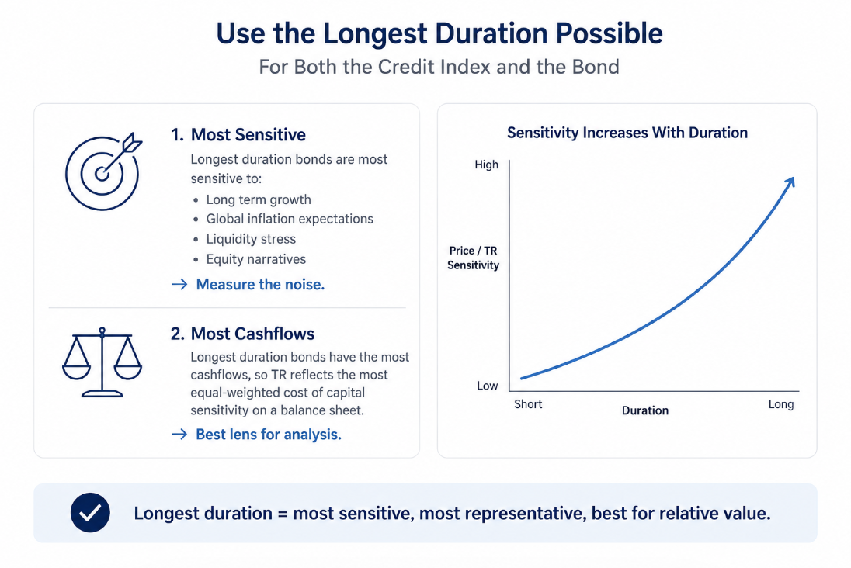

Slide 10
Analysis, TR Cashflows Don’t Lie
During the noise of earnings season analysts, memes, and narratives make a proper earnings reading feel like a roller coaster. And, unfortunately, how modern reporting works trying to build a strategy based on previous earnings can sometimes boil down to making an iron condor selling your favorite strikes and post-hoc justifying that position.
But the most honest metric in the room is the Hedge Adjusted TR performance of a company’s debt, which reflect a large skew of variables and show true impact on balance sheets, not just reflexivity. You can measure just how positive or negative the relative carry of holding a corporate bond is running into earnings, which is a significant statistical advantage into predicting range and directionality of the RESPONSE to earnings, not the numbers themselves.
Equities will tend to reflect the true cost of capital of a firm on its balance sheet, not how good or bad the numbers or call makes you feel.

Slide 11
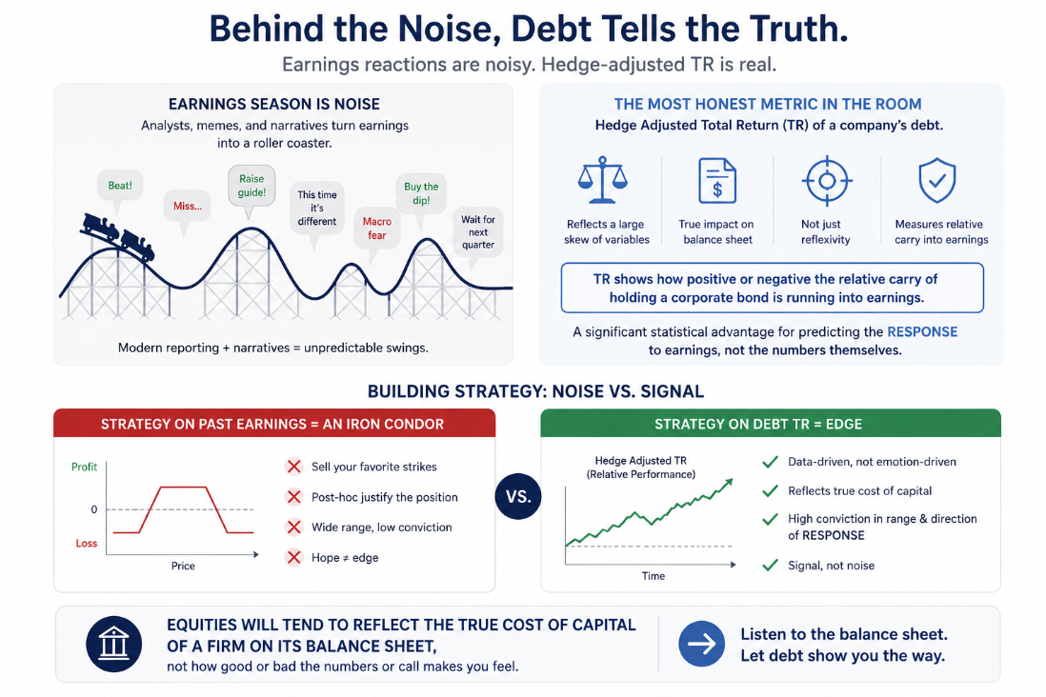

Slide 12
Thanks For Listening!

