Slide 1
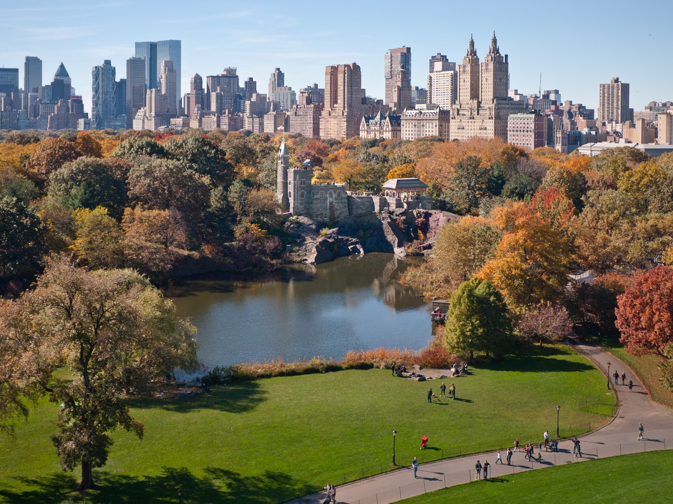
Central Park

Slide 2
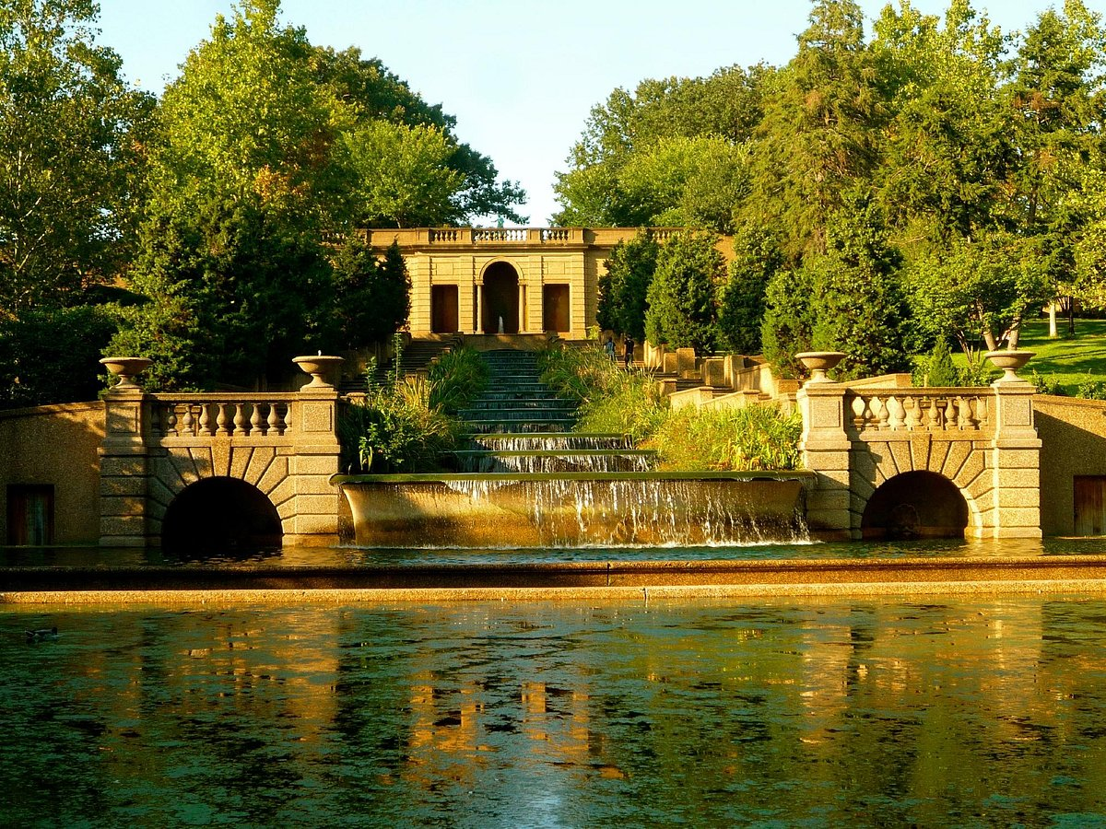
Meridian Hill Park

Slide 3
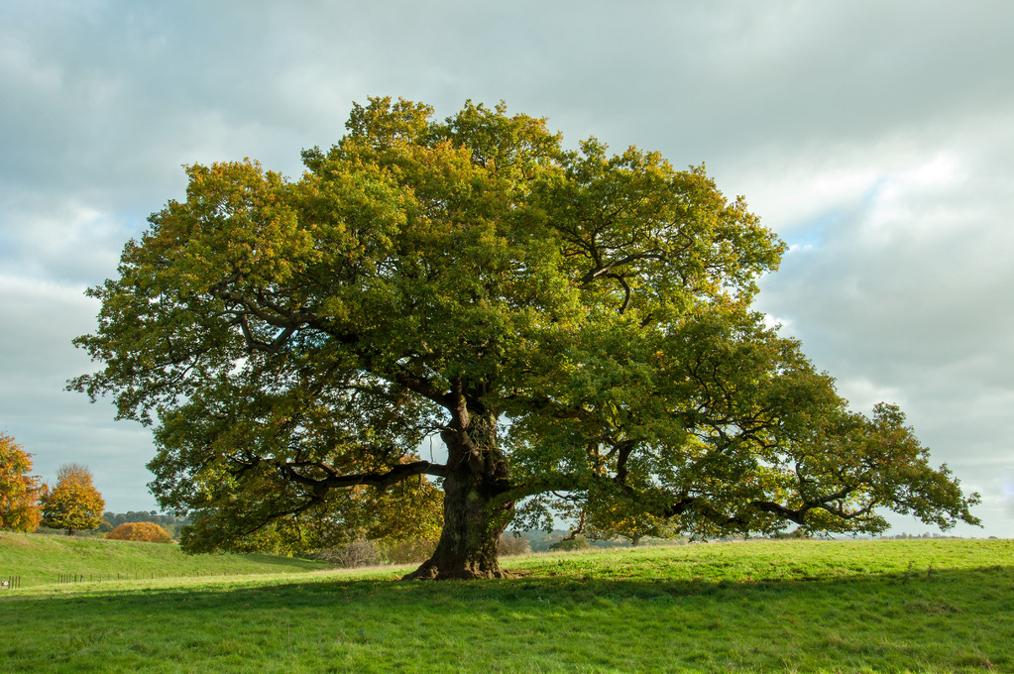
My Favorite Park
By David Parks

Slide 4
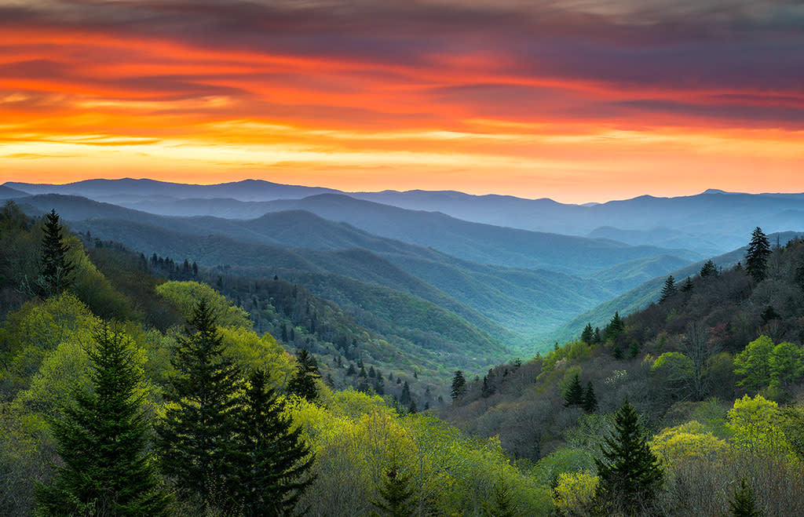
Great Smoky Mountains National Park

