Slide 1
Shapes I Think are Neat

Slide 2
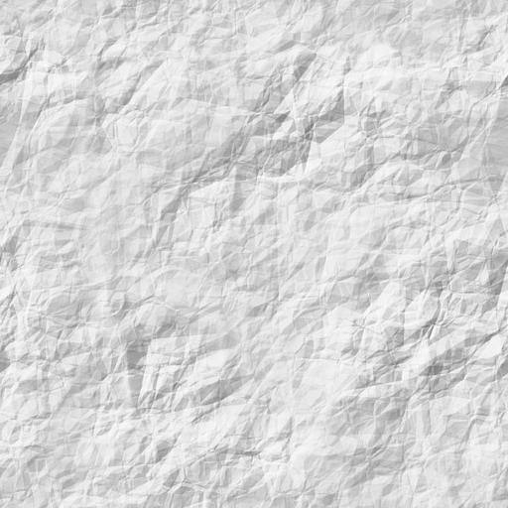
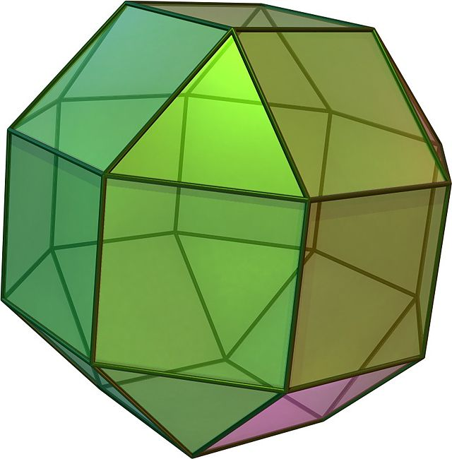
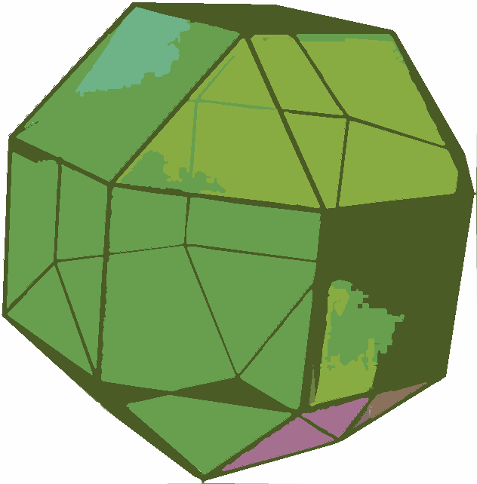
Rhombicuboctahedron:

Slide 3
ANY QUESTIONS?

