Slide 1
Top 3 Piano Songs to Know!

Slide 2
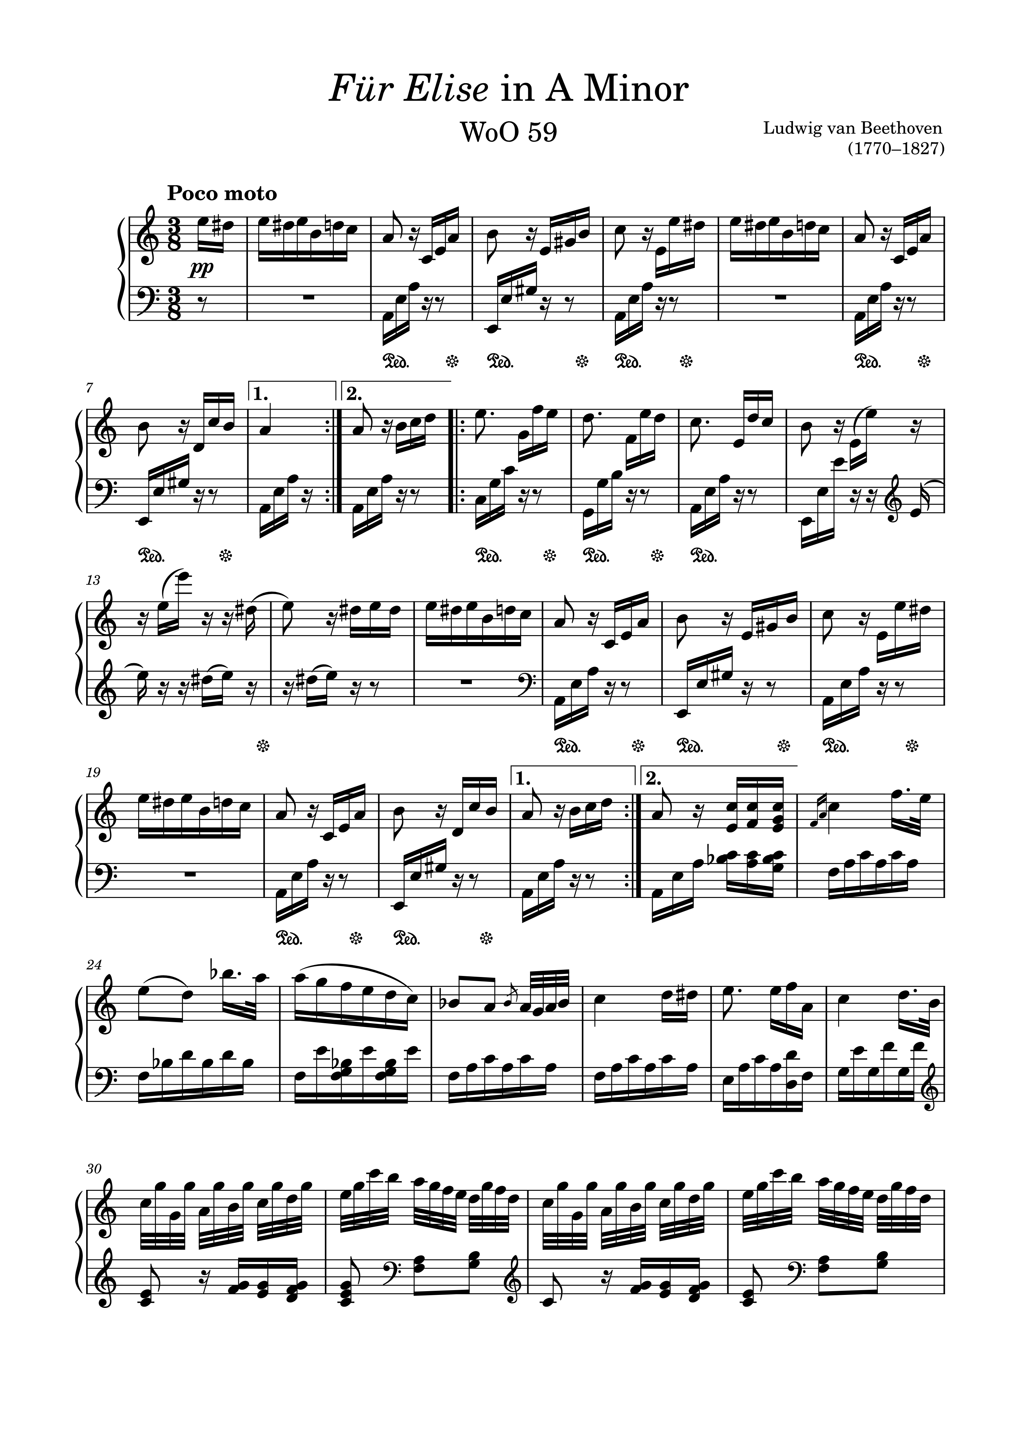
Number 1: Fur Elise
Fur Elise

Slide 3
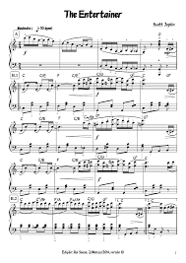
Number 2: The Entertainer
The Entertainer

Slide 4
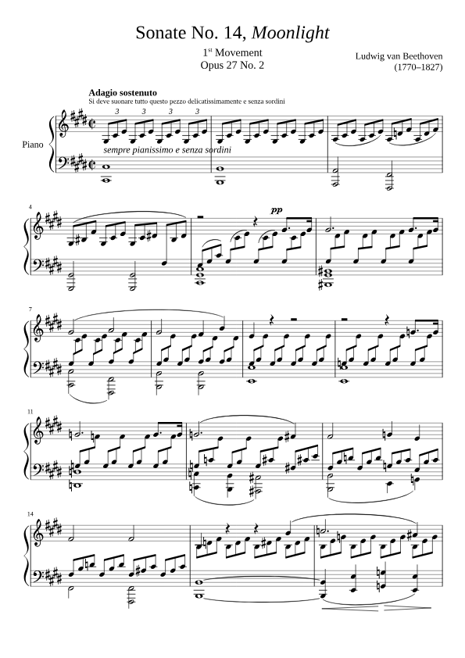
Number 3: Moonlight Sonata
Moonlight Sonata
a

