Slide 1
Predict the fuel burnt (kg)
PRC Data Challenge 2025
October 2025
Team details:
Your team name is: understated-zucchini
Your submission bucket is : prc-2025-understated-zucchini

Slide 2
Principles
Read Fuel Train records
compute time difference seconds = fuel record end – fuel record start
Compute fuel flow kg per seconds = fuel kg / ( fuel record end – fuel record start )
Link to Flight List using the flight id
Compute fuel burn relative start = fuel burnt start – takeoff (from the related flight list)
Compute fuel burn relative end = fuel burnt end – takeoff (from the related flight list)
Extend fuel records with attributes coming from the flight list
Add origin longitude, origin latitude, origin_elevation
Add destination longitude, destination latitude, destination elevation
Add flight distance Nautical Miles and flight duration seconds

Slide 3
Data Model
Flight Data
Flight id
TimeStamp relative start
Fuel Data
Airport Data
origin airport ICAO code
destination airport ICAO code
Flight id
Flight List Data
Aircraft Data
Aircraft ICAO code

Slide 4
Set takeoff and landing date type as UTC Compute flight distance compute flight duration Extract year from takeoff Extract month from takeoff Extract day of the year (1..365) from takeoff Compute distance (great circle) between departure and arrival compute flight duration between takeoff and landing Principles is to get rid of absolute datetime
Extend Flight list records

Slide 5
Extend flight list data
Suppress airport names
Compute distance (Nautical miles) between departure and arrival airport
Convert all Date Time instant to UTC
Compute flight time between flight takeoff and flight landed
Use time difference for all instant versus flight takeoff
Add Year and month including day number in the current year (range 1 to 365)
Suppres absolute dates as they are replaced by relative ones from takeoff instant

Slide 6
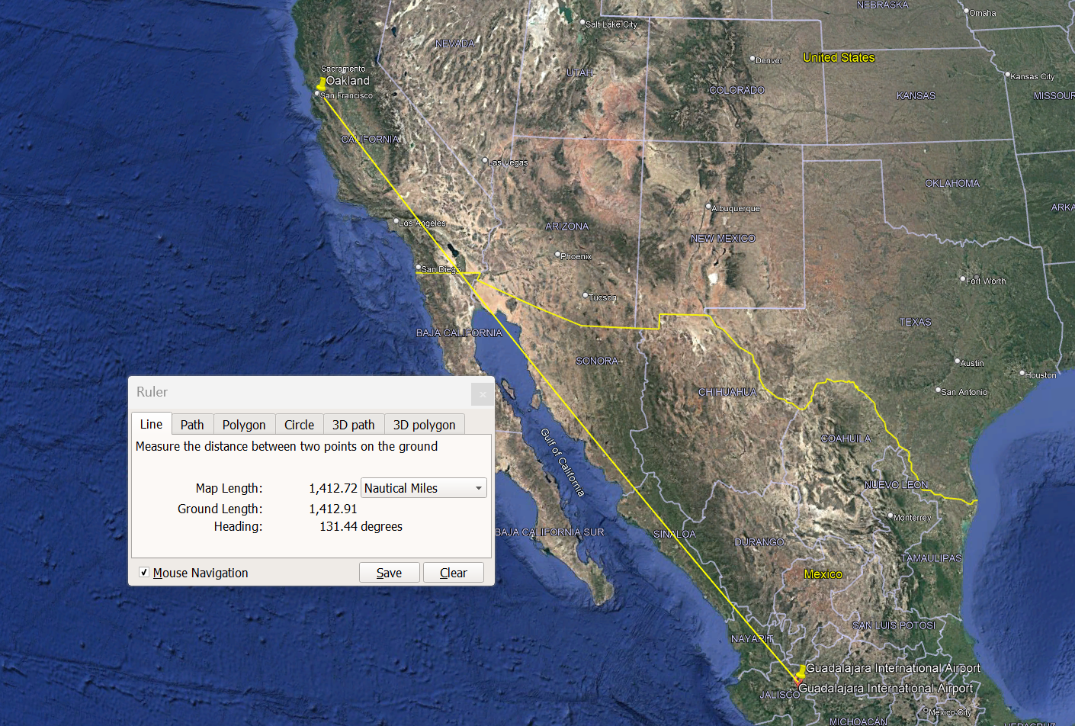
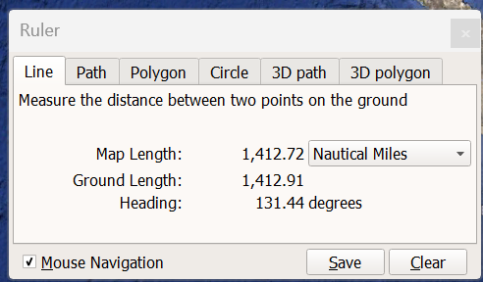
Check great circle distance (in nautical miles)
origin_icao | origin_name | destination_icao | destination_name | flight_distance_Nautical miles
MMGL | Guadalajara International Airport | KOAK | Oakland International Airport | 1427.58

Slide 7

Feature engineering https://skybrary.aero/articles/heading-track-and-radial
Heading. The direction in which the longitudinal axis of an aircraft is pointed, usually expressed in degrees from North (true, magnetic, compass or grid). (Source: ICAO)
Track. The projection on the earth’s surface of the path of an aircraft, the direction of which path at any point is usually expressed in degrees from North (true, magnetic or grid). (Source: ICAO)
Radial. A magnetic bearing extending from a VOR/VORTAC/TACAN. (Source: UK CAA)
Bearing. The horizontal direction to or from any point, usually measured clockwise from true north, magnetic north, or some other reference point through 360 degrees. (Source: US FAA)

Slide 8
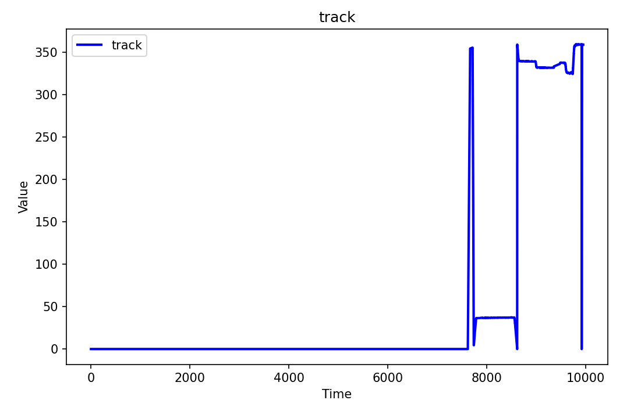
Feature engineering of track angles
The track angle is given in Decimal degrees
Les angles ne font pas de bonnes entrées de modèle : 360° et 0° doivent être proches l'un de l'autre et s'enrouler en douceur.

Slide 9
Feature engineering of aircraft track angles
Mais la donnée « aircraft track angle » sera plus facile à interpréter pour le modèle si vous convertissez les colonnes de direction et de vitesse de l’avion en un vecteur vitesse
import numpy as np
''' convert track angles from degrees to radians '''
track_radians = df.pop('track')* np.pi / 180
groundSpeedMax = df['groundspeed'].max()
groundSpeed = df.pop('groundspeed')
# Calculate the aircraft speed x and y components.
df['groundspeed_x'] = groundSpeed * np.cos(track_radians)
df['groundspeed_y'] = groundSpeed * np.sin(track_radians)

Slide 10
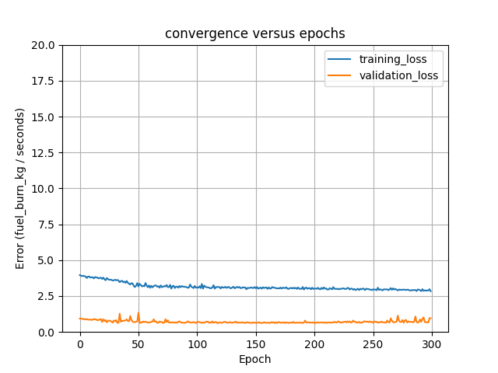

Training versus Validation loss
16 october 2025
Y = fuel flow kg per seconds
All train records
133984 train fuel records
11085 train flight files
Make the val_loss as low as possible

Slide 11
Do not
You do not need to scale the Y of train data as the algorithm or model will set the parameter values to get least Cost (error), that is k {Y (output)-Y (original)} anyway.

Slide 12
steps
Read fuel records
Extend each fuel record with flight data
Scale and encode aircraft icao code
Read Flight list records
Extend fuel records with flight list data
Y column is fuel flow kg per seconds
Compute fuel flow kg per seconds
Encode aircraft_icao_code
Scale all columns
Compute flight distance (Nm)
Compute flight duration (seconds)
Use fuel start end relative stamp to link with flight record timestamp
Timestamp inside start – end of fuel record

Slide 13

Leveraging TensorFlow for Regression Problems: Techniques and Applications
Exploring tools and methods to improve regression modeling
Notes:
AI-generated content may be incorrect. --- This presentation explores how TensorFlow can be effectively used to solve regression problems. We will cover foundational regression concepts, TensorFlow’s features, practical implementation of regression models, and advanced methods to enhance model performance. Image source: Microsoft 365 content library

Slide 14

Presentation Agenda
Introduction to Regression Analysis
Overview of TensorFlow and Its Capabilities
Implementing Regression Models in TensorFlow
Advanced Techniques and Best Practices
Notes:
--- We will begin with an introduction to regression analysis, its types and applications. Next, we will look at TensorFlow’s capabilities and setup. Then, practical steps to implement regression models using TensorFlow. Finally, advanced techniques and best practices for improving regression models. Image source: Microsoft 365 content library

Slide 15
Introduction to Regression Analysis
Notes:
Regression analysis is a key statistical method for modelling relationships between variables. Understanding its basic concepts, types, and real-world use cases lays the foundation for applying TensorFlow in regression tasks.

Slide 16

Fundamental concepts of regression
Definition of Regression
Regression estimates relationships between dependent and independent variables to understand their connection.
Predicting Continuous Outcomes
The goal of regression is to predict continuous variables based on input data from other variables.
Understanding Variable Influence
Regression helps identify how independent variables influence the dependent variable in a measurable way.
Notes:
--- Regression involves estimating the relationship between dependent and independent variables. We aim to predict continuous outcomes and understand how variables influence each other. Image source: Microsoft 365 content library

Slide 17

Types of regression problems
Linear Regression
Linear regression models the relationship between variables using a straight line for simple, direct trends.
Polynomial Regression
Polynomial regression handles complex data by fitting a curved line to capture non-linear relationships.
Logistic Regression
Logistic regression models probabilities for classification problems using an S-shaped logistic curve.
Notes:
--- Common regression types include linear, polynomial, and logistic regression. Each type addresses different data patterns and modelling needs, from simple linear relationships to complex non-linear dependencies. Image source: Microsoft 365 content library

Slide 18
Overview of TensorFlow and Its Capabilities
Notes:
TensorFlow is a powerful open-source framework widely used for machine learning. Understanding its key features and setup helps leverage its full potential for regression tasks.

Slide 19

Key features of TensorFlow
Flexible Architecture
TensorFlow provides a flexible architecture suitable for a wide range of machine learning models and workflows.
Deep Learning Support
TensorFlow supports deep learning applications, enabling complex neural network designs and training.
Efficient Computation
TensorFlow efficiently utilizes CPUs and GPUs to accelerate computation for faster training and inference.
Community Support
TensorFlow benefits from extensive community support, offering resources, tools, and collaboration opportunities.
Notes:
--- TensorFlow offers flexible architecture, support for deep learning, efficient computation on CPUs and GPUs, and extensive community support, making it ideal for various machine learning tasks. Image source: Microsoft 365 content library

Slide 20
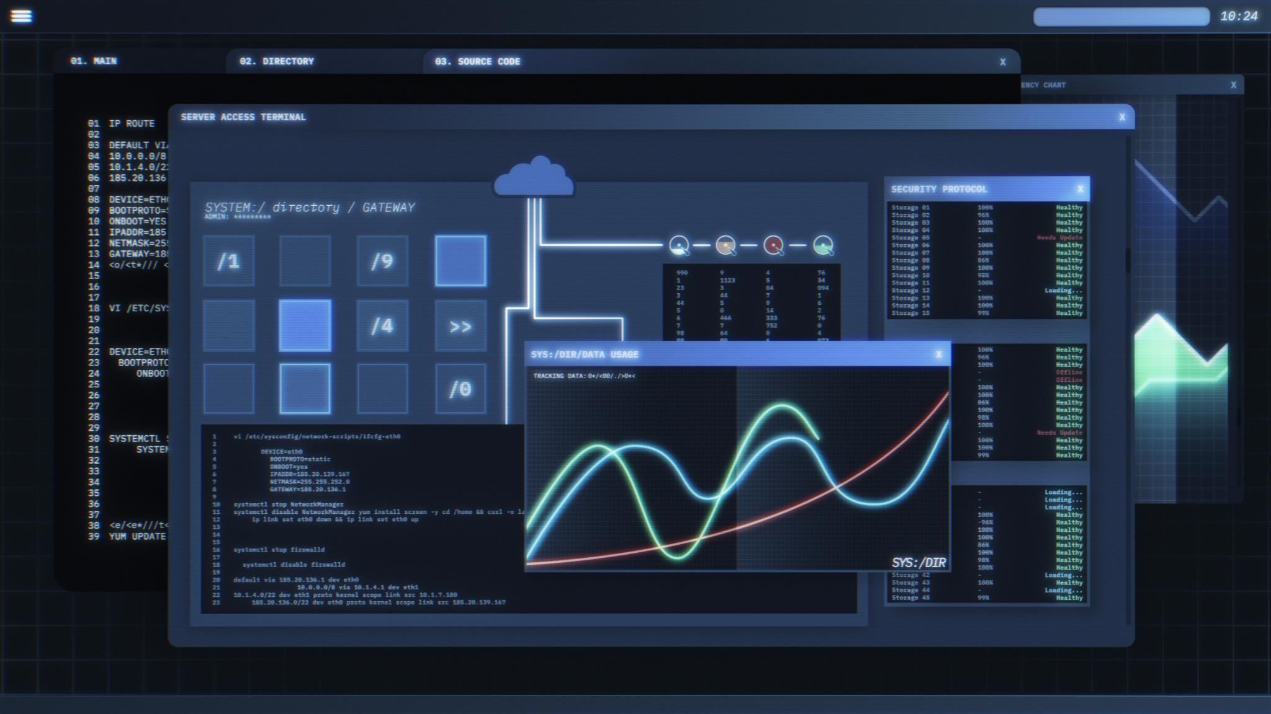
Setting up TensorFlow for machine learning
TensorFlow Installation
Install TensorFlow library using package managers like pip for efficient machine learning workflows.
Environment Configuration
Configure programming environments such as Python and virtual environments for smooth TensorFlow usage.
Dataset Preparation
Prepare and preprocess datasets to ensure compatibility and accuracy in regression model training.
Notes:
--- Setting up TensorFlow involves installing the library, configuring environments, and preparing datasets. Proper setup ensures smooth implementation of regression models. Image source: Microsoft 365 content library

Slide 21

Advantages of TensorFlow for regression tasks
Scalable Model Building
TensorFlow supports scalable construction of regression models suitable for various data sizes and complexities.
Data Pipeline Integration
TensorFlow easily integrates with diverse data pipelines ensuring smooth data flow for regression tasks.
Robust Training and Evaluation
TensorFlow offers comprehensive tools for training, evaluation, and optimisation of regression models.
Notes:
--- TensorFlow provides scalable model building, easy integration with data pipelines, and robust tools for training and evaluation, facilitating effective regression modelling. Image source: Microsoft 365 content library

Slide 22
Implementing Regression Models in TensorFlow
Notes:
Implementing regression models in TensorFlow involves data preparation, model construction, training, and evaluation. Each step is crucial for building accurate predictive models.

Slide 23

Preparing data for TensorFlow regression
Data Cleaning
Removing errors and inconsistencies from data is essential for accurate regression model training.
Data Normalisation
Normalising data scales values to a common range, improving model convergence and performance.
Training and Testing Split
Splitting data into training and testing sets helps evaluate model accuracy and avoid overfitting.
Notes:
--- Data preparation includes cleaning, normalising, and splitting data into training and testing sets to ensure the model learns effectively without bias. Image source: Microsoft 365 content library

Slide 24
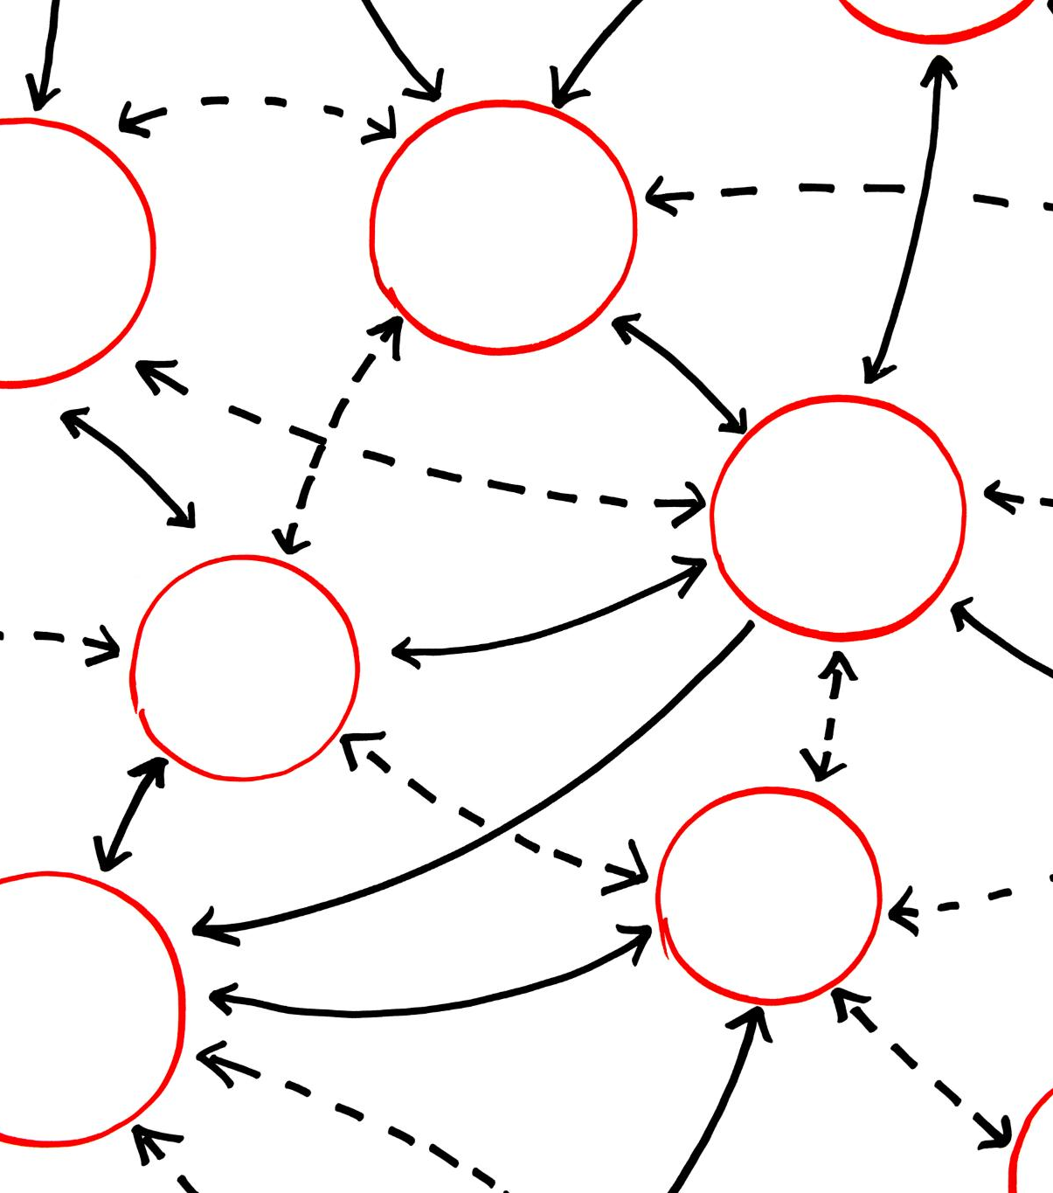
Building a linear regression model
Model Structure
Linear regression uses layers to connect input features with output predictions clearly and efficiently.
Weight Optimization
Weights are adjusted during training to minimise prediction errors and improve model accuracy.
Notes:
--- A linear regression model in TensorFlow is built using layers to represent input features and output predictions, with weights optimised during training to minimise errors. Image source: Microsoft 365 content library

Slide 25
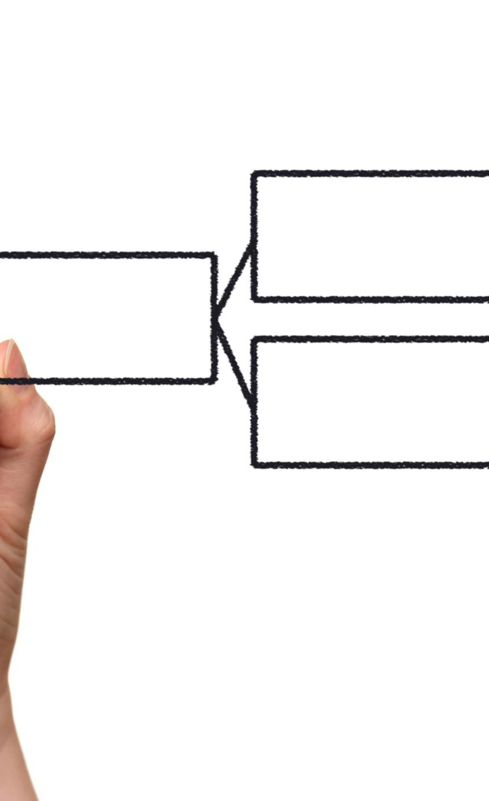
Training, evaluation, and interpretation
Model Training Process
Training involves feeding data through the model and adjusting its parameters to improve performance.
Evaluation Metrics
Evaluation metrics like mean squared error measure the model's accuracy and performance.
Model Interpretation
Interpretation helps understand insights from the model to explain its predictions and behaviour.
Notes:
--- Training involves feeding data through the model and adjusting parameters. Evaluation metrics like mean squared error assess performance, while interpretation helps understand model insights. Image source: Microsoft 365 content library

Slide 26
Advanced Techniques and Best Practices
Notes:
Advanced methods such as using neural networks for non-linear regression, preventing overfitting, and effective visualisation enhance regression model accuracy and interpretability.

Slide 27

Handling non-linear regression with neural networks
Neural Networks Structure
Neural networks use multiple stacked layers to capture complex non-linear relationships in data.
Activation Functions
Activation functions introduce non-linearity, enabling neural networks to model varied data patterns beyond linear regression.
Advanced Regression Modeling
Neural networks extend regression capabilities by effectively handling complex, non-linear data relationships.
Notes:
--- Neural networks in TensorFlow can model complex non-linear relationships by stacking layers and using activation functions, expanding regression capabilities beyond linear patterns. Image source: Microsoft 365 content library

Slide 28

Preventing overfitting and improving model performance
Regularisation Techniques
Regularisation adds penalty terms to reduce model complexity and prevent overfitting in training.
Dropout Method
Dropout randomly disables neurons during training to improve model generalisation and reduce overfitting.
Early Stopping Strategy
Early stopping halts training when validation performance declines, avoiding overfitting on training data.
Notes:
--- Techniques like regularisation, dropout, and early stopping help prevent overfitting, ensuring the model generalises well to new data and maintains predictive accuracy. Image source: Microsoft 365 content library

Slide 29
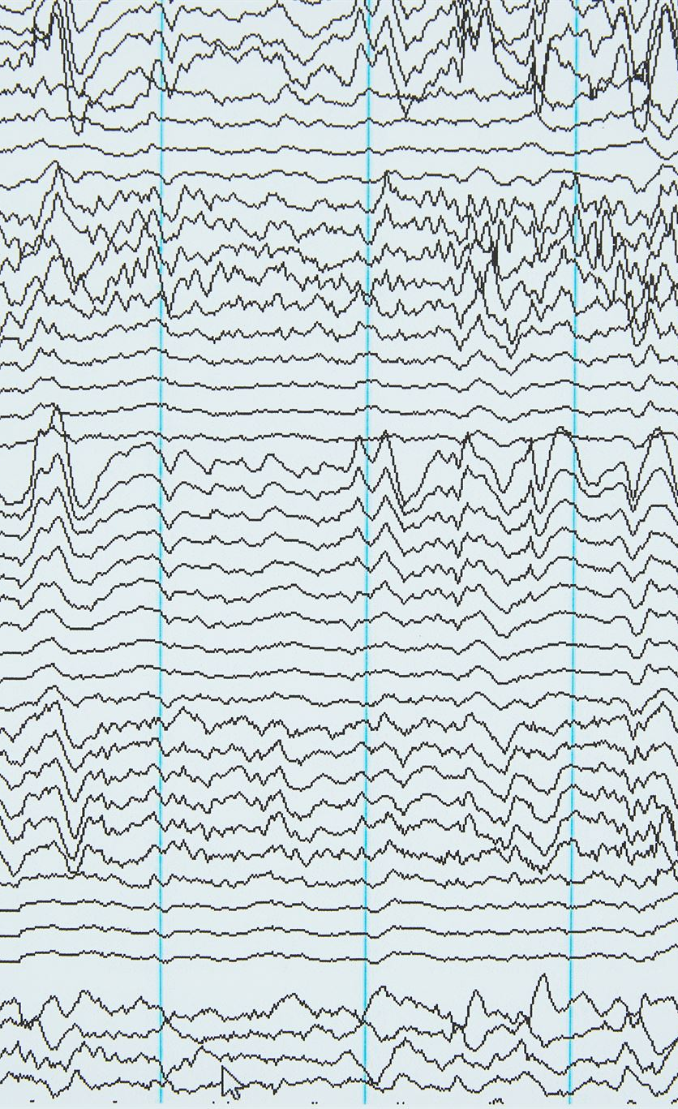
Visualising and interpreting results
Loss Curves Insight
Loss curves help track model performance over training, revealing convergence or overfitting trends.
Regression Plot Utility
Regression plots illustrate relationships between variables, helping interpret model predictions and fit quality.
Residual Analysis Importance
Residual analysis exposes model errors and biases, supporting diagnosis and improvement.
Notes:
--- Visual tools like loss curves, regression plots, and residual analysis aid in understanding model behaviour, diagnosing issues, and communicating results effectively. Image source: Microsoft 365 content library

Slide 30
Conclusion
Versatile Platform
TensorFlow offers a flexible platform supporting various regression analysis techniques for diverse applications.
Comprehensive Tools
The platform provides comprehensive tools enabling both foundational and advanced regression modelling.
Powerful Predictive Solutions
Applying TensorFlow’s techniques unlocks powerful predictive solutions across multiple domains and industries.
Notes:
TensorFlow is a versatile platform that empowers effective regression analysis through comprehensive tools and flexible modelling. Applying foundational and advanced techniques unlocks powerful predictive solutions across domains.

