Slide 1
Chair of Computing in Civil Engineering
Katrin Jahr B.Sc. Robert Schlich B.Sc.
Decentralized autonomous sensor fault detection using neural networks
“Anleitung zu wissenschaftlichem Arbeiten”

Slide 2
Structural health monitoring
Structural health monitoring (SHM):
“structural evaluation method
that uses any of several sensors
which are attached to [...] a structure”
Luke A. Bisby. An introduction to structural health monitoring.
Canada, 2014

Slide 3
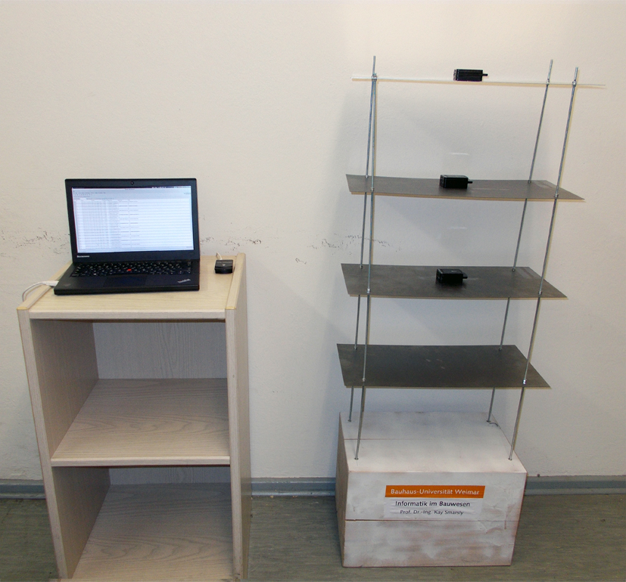
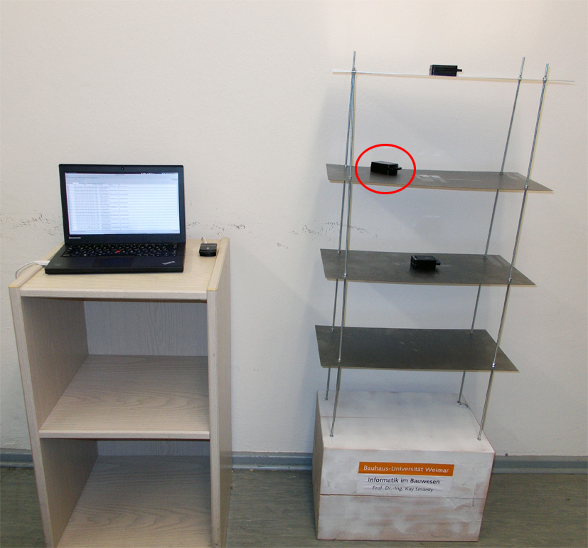
Structural health monitoring
Laboratory setup
Laboratory setup Simulated sensor fault

Slide 4
Structural health monitoring
SHM Tasks
Fault
detection
Data
acquisition
Data
processing
Data
transmission
Data
storage

Slide 5
Structural health monitoring
Dataflow
Sensor nodes
Neural
network
Fault
detection
Sensor
values
Data
acquisition
Natural
frequency
Data
processing
Natural
frequency
Data
transmission
Sensor nodes
Sensor nodes
Basestation
Natural
frequency
Data
storage
MySQL
Database
User
application
Host computer
Host computer
Host computer

Slide 6
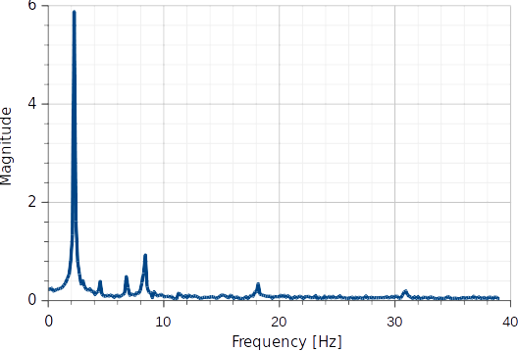
Structural health monitoring
Data processing – frequency spectrum

Slide 7
Sensor fault detection
Sensor fault detection
Analytical redundancy is realized
through training neural Networks
to predict sensor measurements

Slide 8
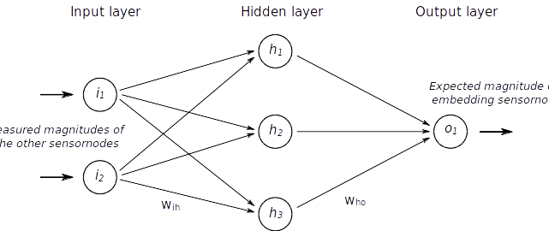
Sensor fault detection
Neural network

Slide 9
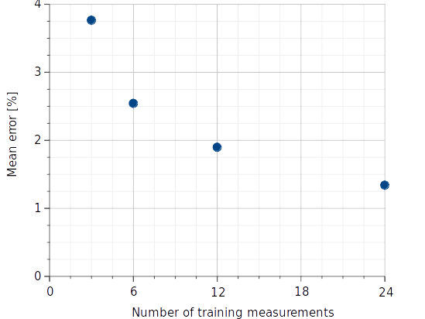
Sensor fault detection
Mean error after training phase

Slide 10
Sensor fault detection
Sensor fault simulation
Laboratory setup Simulated sensor fault

Slide 11
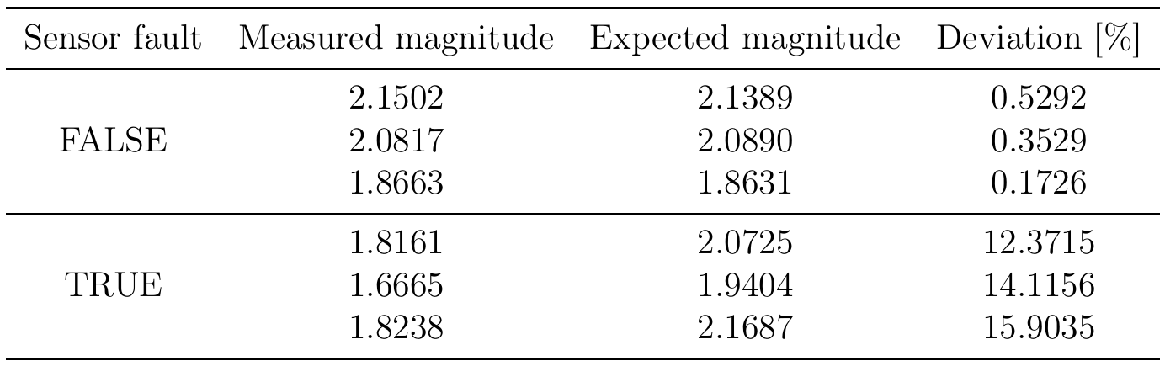
Sensor fault detection
Deviation after fault detection

