Slide 1
Chair of Computing in Civil Engineering
Katrin Jahr Robert Schlich
Decentralized autonomous sensor fault detection using neural networks
“Anleitung zu wissenschaftlichem Arbeiten”
Notes:
We will present a wireless structural health monitoring system,
which is capable of autonomous sensor fault detection

Slide 2
Structural health monitoring
Structural health monitoring (SHM):
“structural evaluation method
that uses any of several sensors
which are attached to [...] a structure”
Luke A. Bisby. An introduction to structural health monitoring.
Canada, 2014
Notes:
To prevent structural failure, faults and deforminities have to be detected and repaired
From the outside, cracks and fractures are hard to distinguish
Structural Health Monitoring is used
Sensors collect data like acceleration, temperature and strains
Observation over time,
Detemining changes in material and geometric behaviour

Slide 3
Structural health monitoring
SHM Tasks
Fault
detection
Data
acquisition
Data
processing
Data
transmission
Data
storage
Data
analysis
Notes:
Data acquisition
Data processing
Data transportation
Data storage
Data analysis

Slide 4
Structural health monitoring
Dataflow
Sensor nodes
Neural
network
Fault
detection
Sensor
values
Data
acquisition
Natural
frequency
Data
processing
Natural
frequency
Data
transmission
Sensor nodes
Sensor nodes
Basestation
MySQL
Database
Data
storage
User
application
Data
analysis
Host computer
Host computer

Slide 5
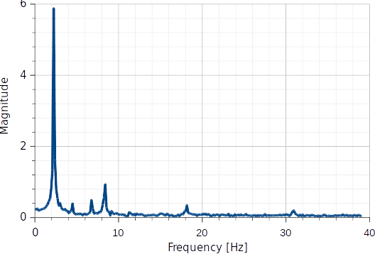
Structural health monitoring
Data processing – frequency spectrum
Notes:
lot of data is collected
Has to be processed, transmitted, stored, and analyzed
Data reduction strategy:
Changes in the natural frequency indicate structural changes
Natural frequency is calculated, using a fast fourier transform
Returns a frequency spectrum, which shows the frequencies of a vibration and their magnitudes
Highest magnitude = natural frequency
Data is reduced to only 2 values for every measurement
Changes in highest magnitude are used for sensor fault detection

Slide 6
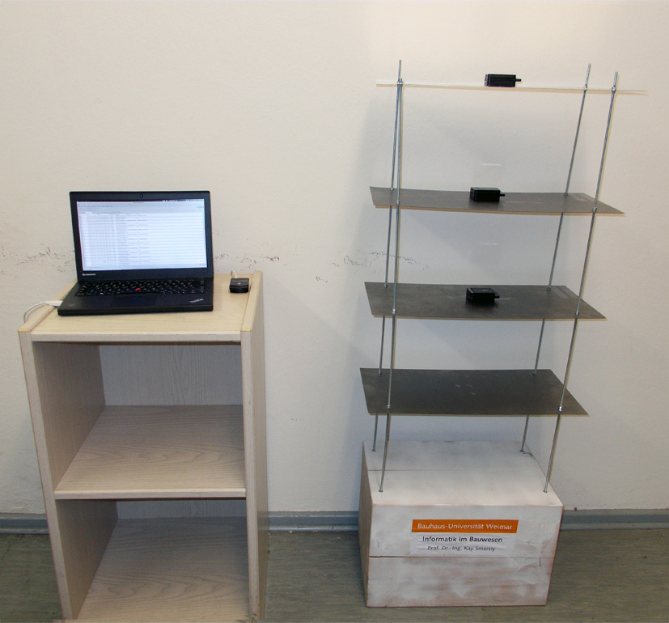
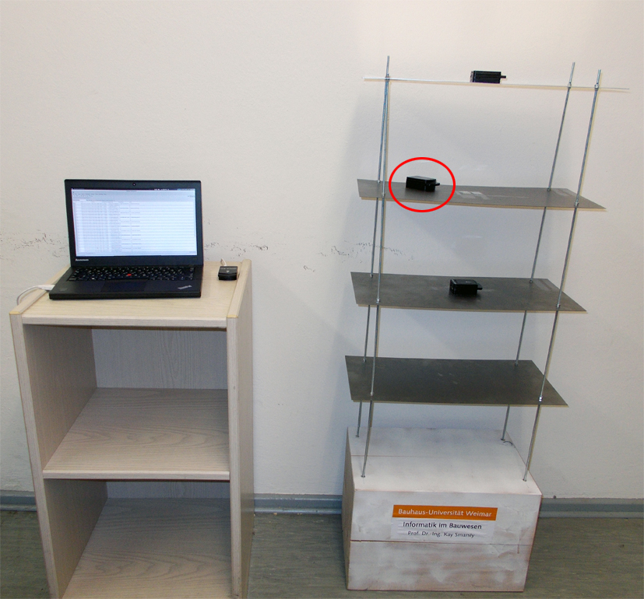
Structural health monitoring
Laboratory setup
Laboratory setup Simulated sensor fault
Notes:
Installed shm system on a test structure
4 story shear frame structure
One sensor node per story
Excitation by a deflection of the top of the structure

Slide 7
Sensor fault detection
Sensor fault detection
Analytical redundancy is realized
through training neural Networks
to predict sensor measurements

Slide 8
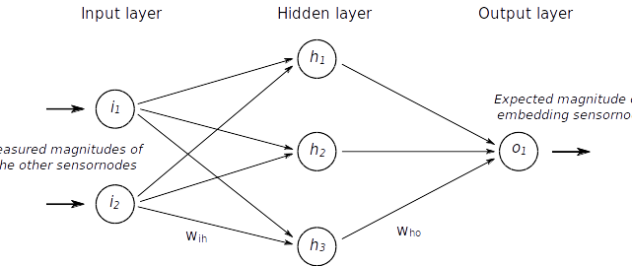
Sensor fault detection
Neural network

Slide 9
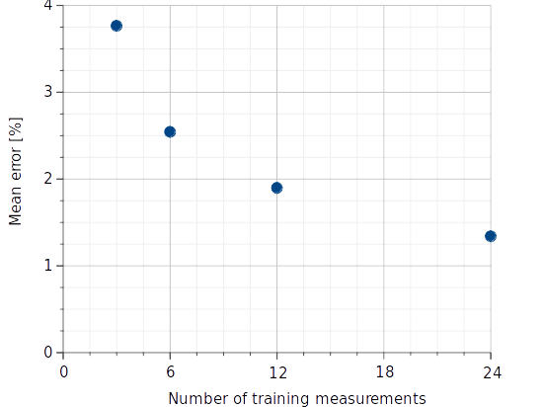
Sensor fault detection
Mean error after training phase

Slide 10
Sensor fault detection
Sensor fault simulation
Laboratory setup Simulated sensor fault

Slide 11
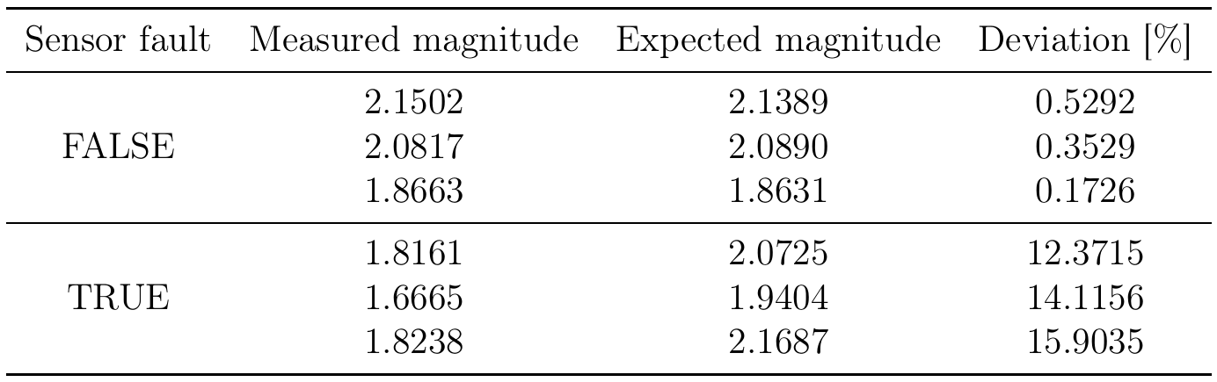
Sensor fault detection
Deviation after fault detection

