Slide 1

IMS Project
By Robert Tolley
Notes:
Hello my name is:
Today ill be taking you through the progress of my IMS proejct
The general overview of this was to provide a user with the means to access a program that he could input and output data by simply typing out a few options that were presented before him

Slide 2
What have I learned?
Github
MySQL
Java / Eclipse
Notes:
To truly make the most of this project
Utilize github – version control
Mysql – data storage
Java – provide the bridge for the user to the database

Slide 3
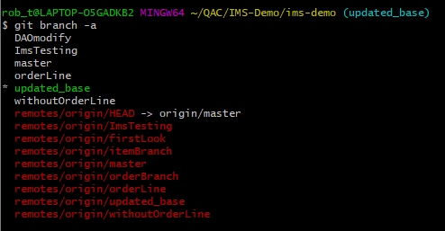
Github
Allowed me to start my project
Provided a way for me to safely integrate new code
Branching
Restoring
Reverting
A final repository for all aspects of the project
Key to version control

Slide 4

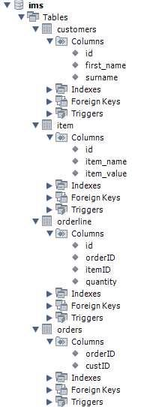
MySQL
Language used to input data into a database
Creating primary and foreign keys to link tables
Knowing the correct syntax to be able to manipulate data
Notes:
This is the language we will need to input the data
As well as create the tables and columns in which to store the data.
This includes the primary and foreign keys to link the data together

Slide 5
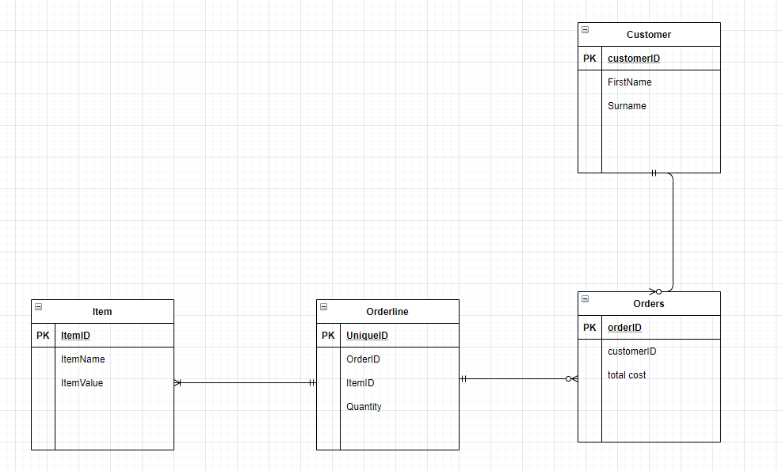
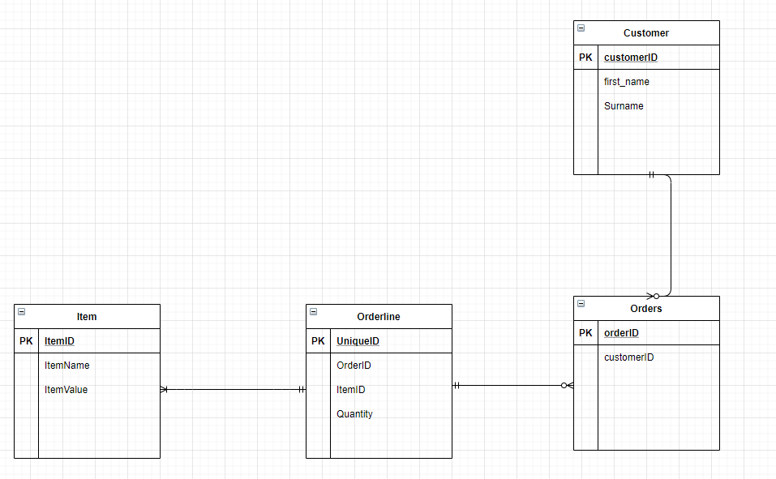
Initial Entity Relationship Diagram
Final Entity Relationship Diagram
Notes:
Total cost was stored in the java methods which would be called apon with the primary keys to link the items and cost

Slide 6

Java / Eclipse
The foundation for the application
Required to adapt and integrate with previously written code
Able to create virtual links to different classes/methods to replicate a database
Methods that would provide a user easy access to a database they don’t have to interact with
Notes:
I was required to integrate with previously written code that I gained when cloning the repository, this was a hurdle in itself however turned out to be advantages for my own development.

Slide 7
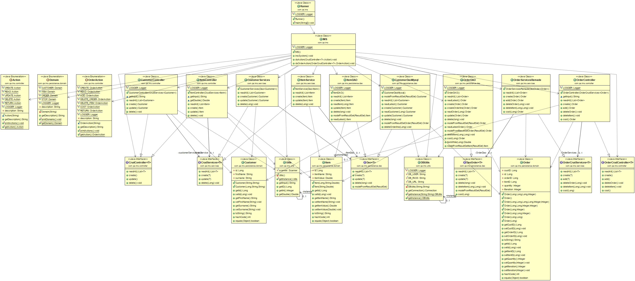
UML diagram
Main class
Controllers + Data Access Classes
Initialization
User Interface
Table Classes
Utility Classes
Notes:
Controller + Data access classes are the heart of the project, providing the methods that take in the users input and turns that into a language that can then transfer this information to the database
Tables classes are temporary data storage for what the user inputs to then be called apon to be turned into an sql syntax

Slide 8
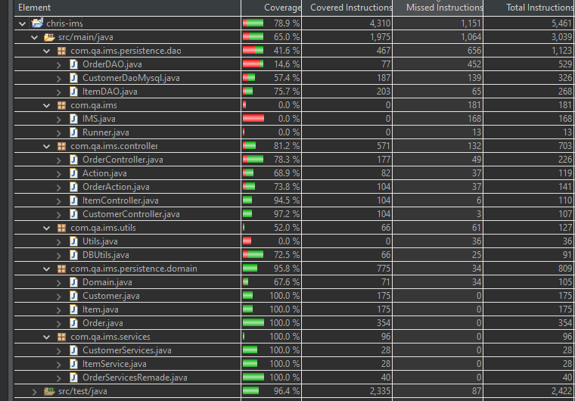
Testing / Coverage
65% Total coverage
Easily attainable 80%

Slide 9

Demonstration
What we will go through:
Creating a customer
Creating 2 items
Create an order with both items
The total cost for these items

Slide 10
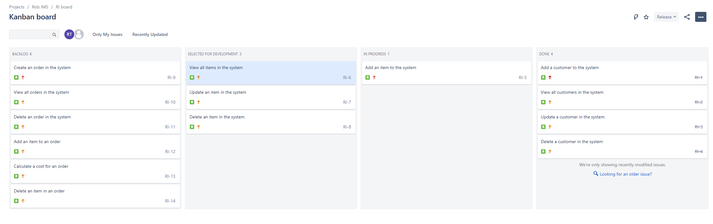
Sprint Review Day One

Slide 11
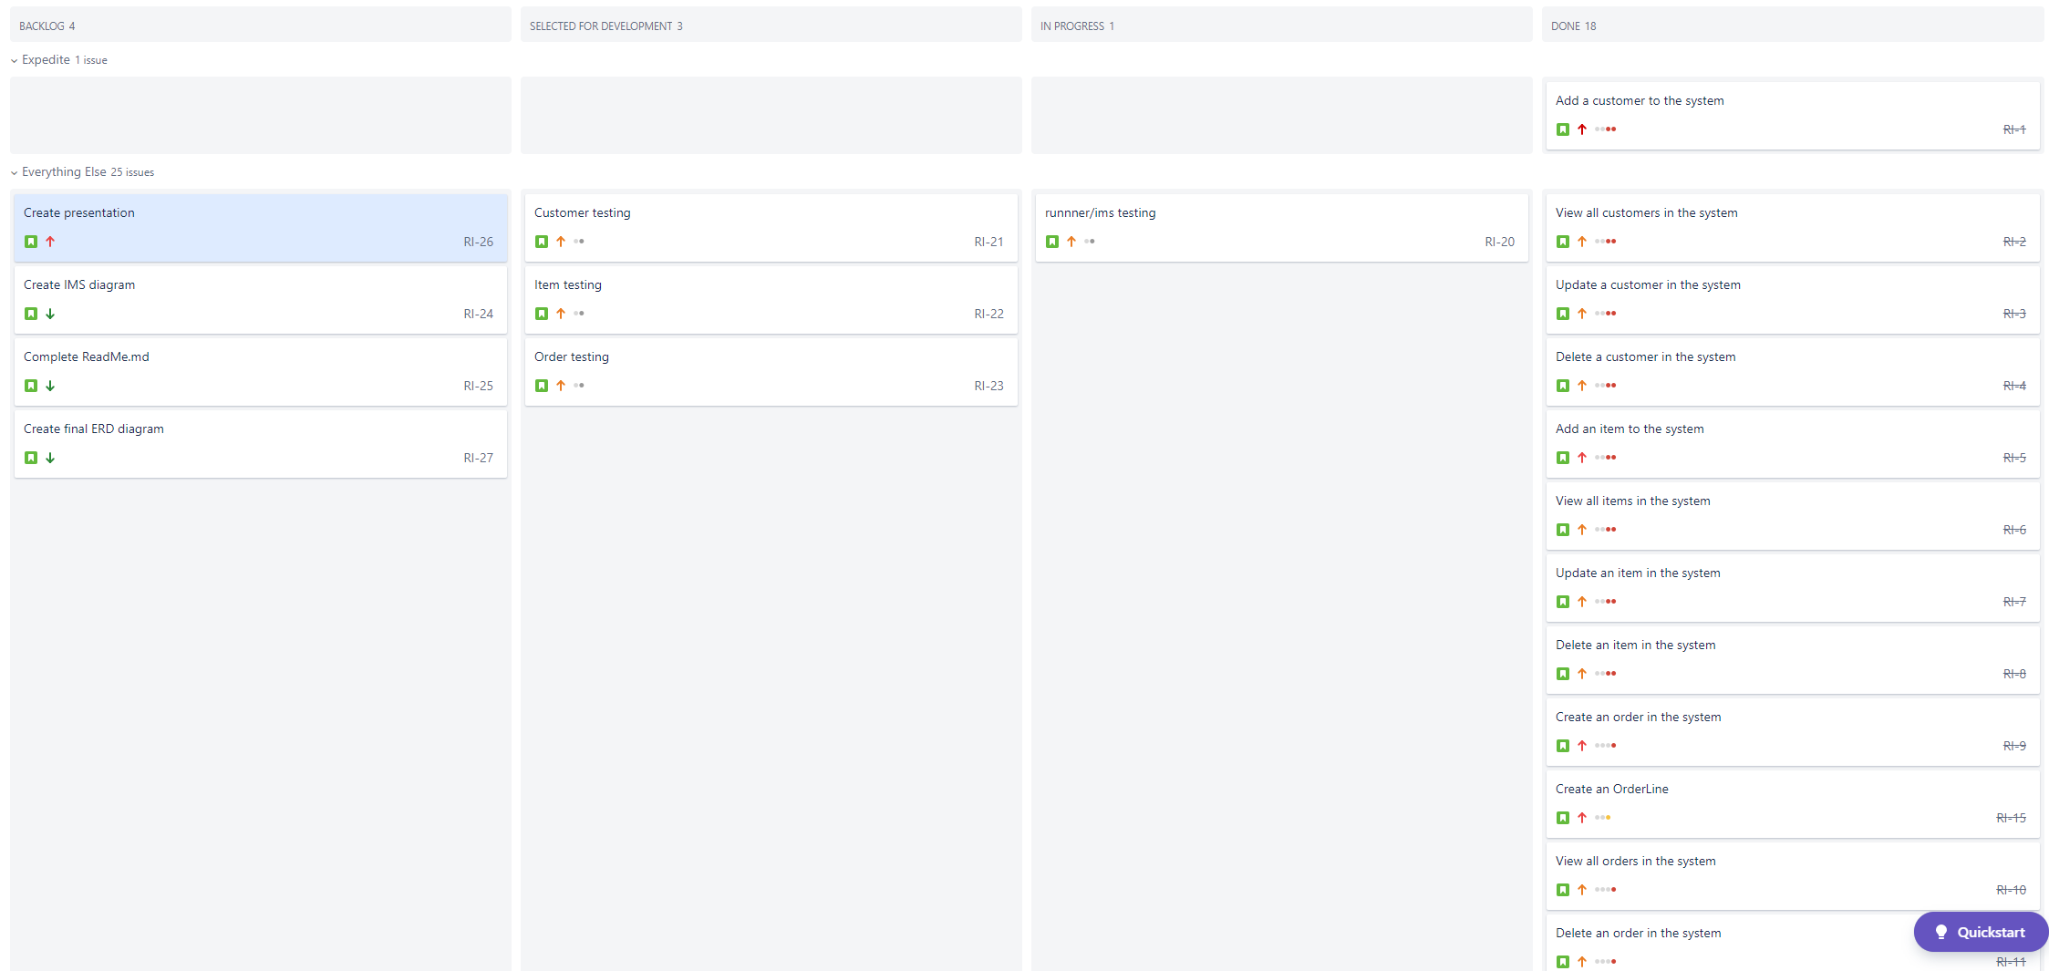
Later Sprint Review

Slide 12
Final sprint review
Pros:
Provided minimum requirements for project to be complete
Added post project completion objectives
Clear with order & priorities
Cons:
Could have provided more detail into each step
Should have broken each step down into smaller steps

Slide 13
To conclude:
Project was a success
minimum viable product completed
Took full advantage of git integration
Developed new techniques from previously created code
To work on:
Junit testing
Test along the way
Provide more time

Slide 14

Thank you for your time!
Any Questions?

