Slide 1

Heat Transfer
Conduction Heat Transfer
Dr. Guice Yao ( 姚贵策 )
PhD, Associate Professor
School of General Engineering
Beihang University
Email: yaoguice@buaa.edu.cn Office: New main building D1105

Slide 2
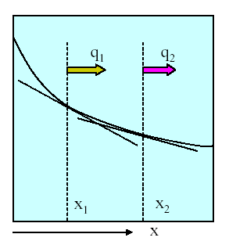
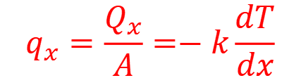
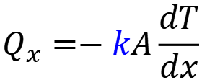
HT Week 2 recall
The heat transfer rate is material-dependent. (e.g., plastic, metal, etc.)
The constant of proportionality is called thermal conductivity k, W/m·K
$$Q_{x}=−kA\frac{dT}{dx}$$
heat rate:
heat flux:
$$q_{x}=\frac{Q_{x}}{A}=−k\frac{dT}{dx}$$
Fourier’s law
Note:
the minus sign – the heat is transferred in the direction of decreasing temperature

Slide 3
HT Week 2 Review - Introduction to Conduction-
Heat Diffusion Equation:
Cartesian
Cylindrical
poisson equation
Laplace's equation

Slide 4
HT Week 2 Review - Introduction to Conduction-
additional conditon: boundary condition
1、geometrical conditions
2、Physical properties
3、time conditions
４、boundary conditions
(1)第一类边界条件(fixed temperature boundary condition)
(2)第二类边界条件(given heat flux distribution)
(3)第三类边界条件(convectively cooled conditions)

Slide 5
HT: Conduction
L3: Steady-State Conduction
——One Dimensional
Learning Objectives:
Heat conduction in plane wall (planar wall)
Heat conduction in cylinder wall
Thermal resistance (muitiple layers)
Heat conduction in Fin structure

Slide 6
3. One-Dimensional, Steady-State Condution
3.1 The plane wall
3.2 Cylinder
3.3 Thermal resistance
3.4 HC from Fin Surfaces

Slide 7
3.1 The plane wall
T
The first case of interest is the planar wall made of a single material as sketched
Heat diffusion equation：
k
A
T_{S1}
T_{S2}
q
additional conditions：
L
x
1、geometrical conditions: plane wall, single layer, thickness L
2、Physical properties: Given constant ρ、c、λ, no inner heat source
3、time conditions: Steady-state
４、boundary conditions:Fixed temperature condition

Slide 8
3.1 The plane wall
Therefore:
T
Heat diffusion equation：
k
A
T_{S1}
T_{S2}
q
Integrated:
L
x
Boundary condition:

Slide 9
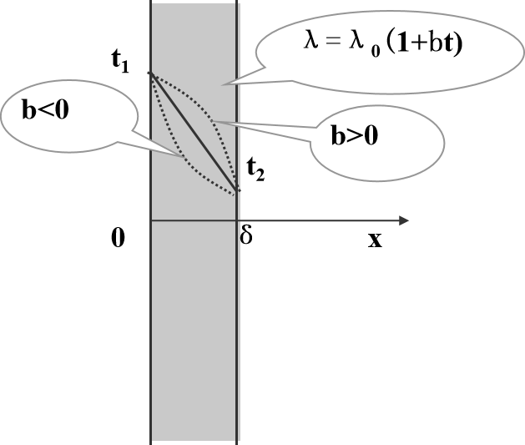
3.1 The plane wall
Linear distribution
T
k
A
T_{S1}
Fourier’s Law
T_{S2}
q
L
x
How does the temperature distribution if the
thermal conductivity changes with the temperature?

Slide 10
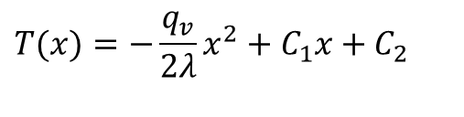

3.1 The plane wall
⇓
How does the temperature distribution
if inner heat source exist?
t
t_{w1}
δ
The governing equation in this case is:
Integrating this equation twice yields a quadratic equation in x with two unknown constants of integration:
t_{w2}
$$\frac{d^{2}T}{dx^{2}}+\frac{q_{v}}{λ}=0$$
0
x
$$T(x)=−\frac{q_{v}}{2λ}x^{2}+C_{1}x+C_{2}$$

Slide 11
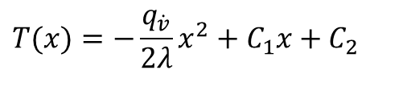
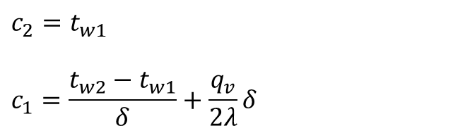
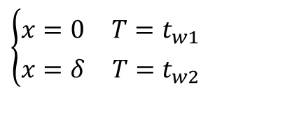
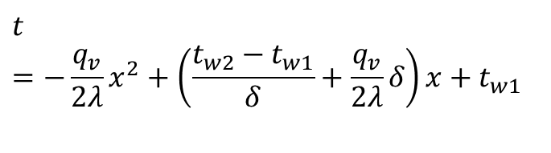
3.1 The plane wall
⇓
boundary condition:
t
$$\left\{\begin{aligned}&x=0 T=t_{w1} \\ &x=δ T=t_{w2}\end{aligned}\right.$$
t_{w1}
δ
t_{w2}
$$T(x)=−\frac{q_{\dot{v}}}{2λ}x^{2}+C_{1}x+C_{2}$$
0
x
$$c_{2}=t_{w1}$$
$$c_{1}=\frac{t_{w2}−t_{w1}}{δ}+\frac{q_{v}}{2λ}δ$$
therefore：
$$t=−\frac{q_{v}}{2λ}x^{2}+\left(\frac{t_{w2}−t_{w1}}{δ}+\frac{q_{v}}{2λ}δ\right)x+t_{w1}$$

Slide 12



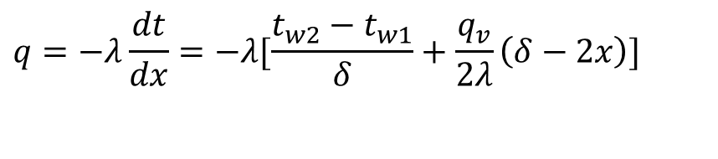
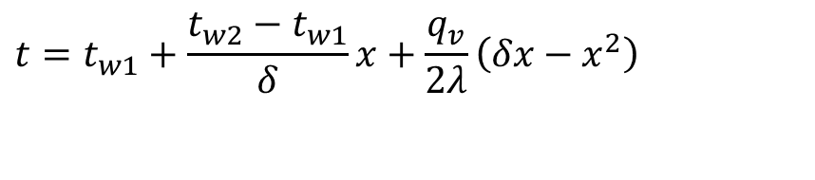
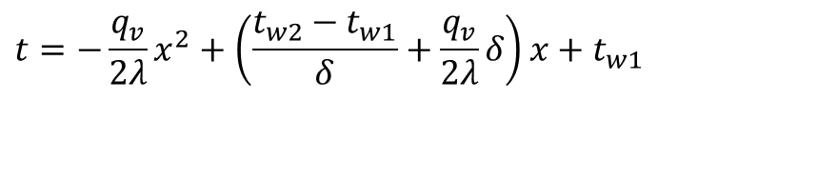
3.1 The plane wall
Temperature distribution:
T_{w2}
$$t=−\frac{q_{v}}{2λ}x^{2}+\left(\frac{t_{w2}−t_{w1}}{δ}+\frac{q_{v}}{2λ}δ\right)x+t_{w1}$$
$$q_{v}>0$$
T(x)
$$t=t_{w1}+\frac{t_{w2}−t_{w1}}{δ}x+\frac{q_{v}}{2λ}\left(δx−x^{2}\right)$$
$$q_{v}=0$$
T_{w1}
$$q_{v} <0$$
-L
L
Heat flux:
$$q=−λ\frac{dt}{dx}=−λ[\frac{t_{w2}−t_{w1}}{δ}+\frac{q_{v}}{2λ}\left(δ−2x\right)]$$
What if t_{w1}=t_{w2}?
the temperature distribution follows conic curve ，Note: the inner heat source can be a varible rather than a constant

Slide 13
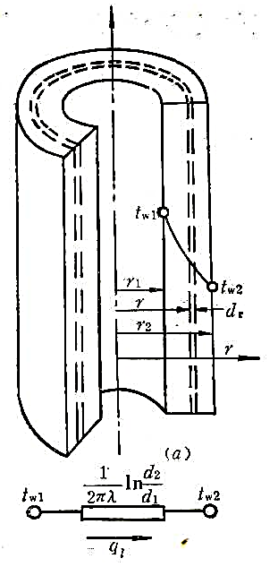
3.2 Heat conduction in cylinder
when the length(height) of the cylinder is larger than 10 times radius of the cylinder, and the temperature is uniform distributed in the circumferential direction, the heat conduction in the cylinder could be recognized as a one dimentional case.
additional conditions：
1、geometrical conditions: cylinder wall, single layer, Radius r1,r2
2、Physical properties: Given constant ρ、c、λ, no inner heat source
3、time conditions: Steady-state
４、boundary conditions:Fixed temperature condition

Slide 14
3.2 Heat conduction in cylinder
The temperature distribution of cylinder is logarithmic.

Slide 15
3.2 Heat conduction in cylinder
what’s the shape of the curve?

Slide 16
3.2 Heat conduction in cylinder
(3)the heat flux and distribution:
⇒
Now think of the consequences of these results.
First, the temperature does not vary linearly, rather it varies with the natural logarithm of r.
Second, while the heat rate is constant, the heat flux is not, but varies as 1/r.

Slide 17



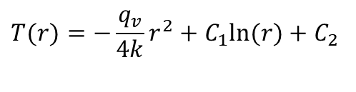
3.2 Conduction with Thermal Energy Generation
Radial Systems
Radial systems are very similar. The governing equation is:
Which after integrating twice yields:
T_{s}
R
$$\frac{1}{r}\frac{d}{dr}\left(r\frac{dT}{dr}\right)+\frac{q_{v}}{k}=0$$
T_{o}
$$T(r)=−\frac{q_{v}}{4k}r^{2}+C_{1}ln⁡(r)+C_{2}$$
$\frac{dT}{dr}=0$
Critical r
$\frac{d^{2}T}{dr^{2}}$
Judge the trend of the curve

Slide 18
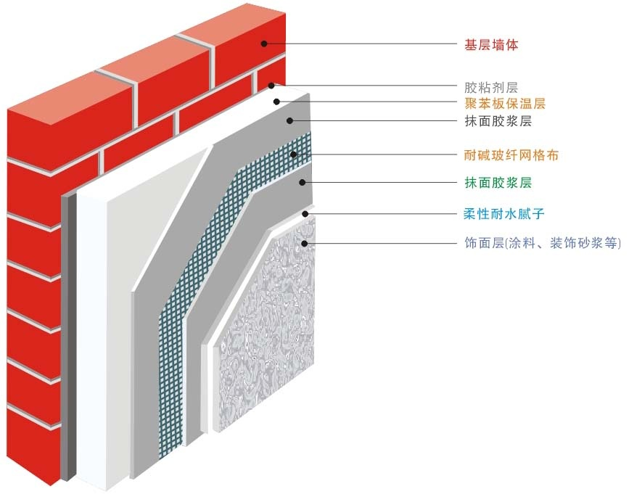
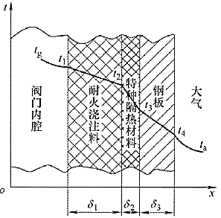
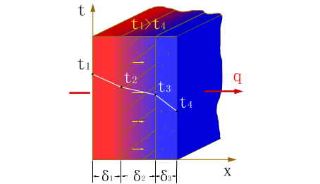
3.3 Multiple plane wall (cont.)
structure：consist of several layers with different materials
Assume that each layers contact well and no temperature gradient within the interface
例：
多层保温墙壁
高温阀门壁

Slide 19




3.3 Multiple plane wall (cont.)
A more complicated version of this problem is to combine multiple walls of different materials.
For each wall section we have:
But, it must also be true that
since energy is not stored inside the wall.
$$q_{1}=\frac{λ_{1}A}{δ_{1}}\left(T_{1}−T_{2}\right)$$
$$q_{2}=\frac{λ_{2}A}{δ_{2}}\left(T_{2}−T_{3}\right)$$
λ ₁
λ ₂
λ ₃
$$q_{3}=\frac{λ_{3}A}{δ_{3}}\left(T_{3}−T_{4}\right)$$
δ₁
δ₂
δ₃
T
$$q_{1}=q_{2}=q_{3}=q_{x}$$
T₁
T₂
T₃
T₄
x

Slide 20
3.3 Multiple plane wall (cont.)
First layer：
λ ₁
λ ₂
λ ₃
Second：
δ₁
δ₂
δ₃
T
T₁
Nth：
T₂
T₃
T₄
x

Slide 21

3.3 Multiple plane wall(cont.)
This give three equations, and 3 unknowns (q_{x}, T₂, T₃) if the two wall temperatures are given (T_{w1},T_{w2}).
Solving for the q_{x} yields:
This result can be generalized to any multilayer composite wall by introducing the concept of thermal resistance, R_{t}.
Thermal resistance plays the role in heat conduction as electrical resistance does in electrical conduction.
$$q=\frac{T_{w1}−T_{w2}}{\sum_{i=1}^{n}{\frac{δ_{i}}{λ_{i}}}}$$

Slide 22
3.3 Multiple plane wall(cont.)
Using an analogy to flow of electrical current, if the temperature change is the potential difference and q the flux rate, then:
The total resistance offered by this composite wall is similar to resistors in series:

Slide 23
3.3 Multiple plane wall(cont.)
Using an analogy to flow of electrical current, if the temperature change is the potential difference and q the flux rate, then:
The total resistance offered by this composite wall is similar to resistors in series:

Slide 24
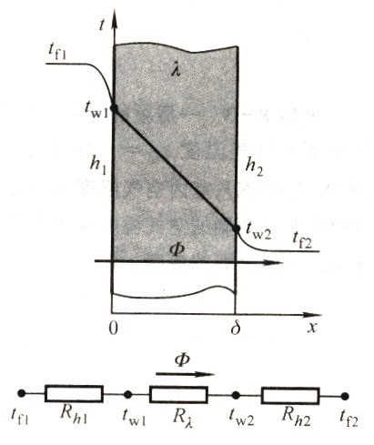
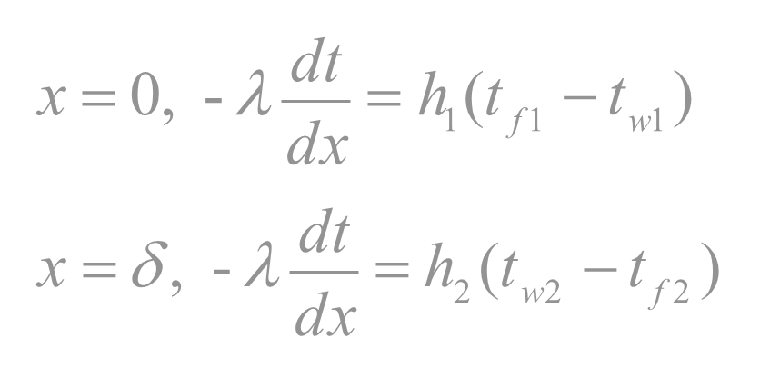

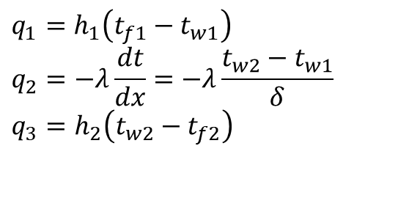
3.3 Multiple plane wall(cont.)
The heat conduction within a plane wall with convective condition(第三类边界条件)
$$q_{1}=h_{1}\left(t_{f1}−t_{w1}\right)$$
$$q_{2}=−λ\frac{dt}{dx}=−λ\frac{t_{w2}−t_{w1}}{δ}$$
$$q_{3}=h_{2}\left(t_{w2}−t_{f2}\right)$$
Convection thermal resistance
$$k=\frac{1}{\frac{1}{h_{1}}+\sum_{i=1}^{n}{\frac{δ_{i}}{λ_{i}}}+\frac{1}{h_{2}}}$$
Heat transfer coefficient

Slide 25
3.3 Multiple plane wall(cont.)
Indeed it is a 2D/3D problem:
Assume that the λ is similar and there is no heat transfer between interface in horizonal direction. We can recognize this as 1D.
∑ R =
1
λ
1
1 1
+
+
^{R}λ A1 ^{+ R}λ B
^{R}λ E1
^{R}λ A2
R_{λ C}
^{+ R}λ E2 ^{R}λ A3 ^{+ R}λ D ^{+ R}λ E3

Slide 26
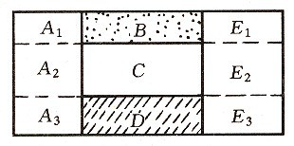
3.3 Multiple plane wall(cont.)
1
∑ R = R_{λ A} +
R
λ
1 1 1
λ E
+ +
^{R}λ B ^{R}λ C ^{R}λ D

Slide 27
3.3 The plane wall (cont.)
Contact Resistance
One assumption that has been made in the previous development is that heat flow easily between the different layers of material.
In fact, when two solids are in contact, their surface roughness results in voids separating the two materials.
How easily heat flows between the two materials then depends upon the amount of direct contact between them and the fluid filling the gaps.
T_{A}
T_{B}
Voids

Slide 28
3.3 The plane wall (cont.)
Contact Resistance
To account for this effect, the Contact Resistance is defined by:
Unfortunately, it is very difficult to accurately predict the contact resistance and experimentation is usually necessary.
Factors which effect the how much contact resistance there is are surface preparation, contact pressure and the void fluid.
Two polished surfaces will make better contact, thus reducing resistance from the voids.

Slide 29
3.3 The plane wall (cont.)
Contact Resistance
Joining two materials by force increases the contact area through the surface by the deformation of the faces under load - thus reducing resistance.
Filling the voids with more conductive fluids such as oil or thermal greases reduces the resistance of the voids themselves.
Finally, placing a thin foil of a highly ductile and conductive material such as lead or indium between two surfaces before joining them with force acts to effectively fill the voids.
See the book for typical thermal contact resistance values.

Slide 30
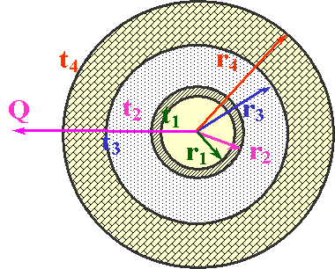
3.3 The Cylinder
Conduction thermal resistance
For composite radial layers, the situation is analogous to the composite planar wall.

Slide 31
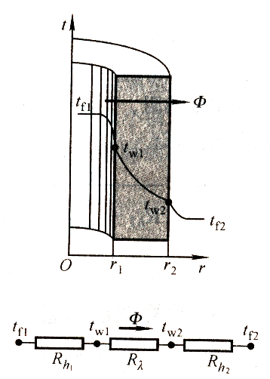
3.3 The Cylinder
The heat transfer in cylinder with convective boundary conductions
single：
h₁
h₂
Multiple：

Slide 32
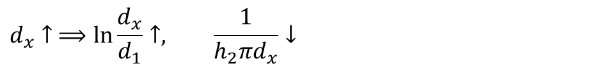
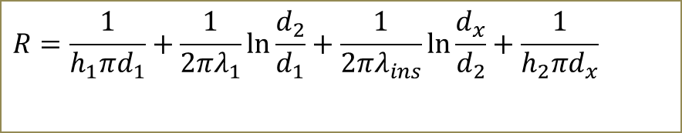
3.3 insulation layer
Normally, we cover some insulating material outside the cylinder to protect the temperature reduction.
The thicker the insulation layer is, the better performance it has?
$$R=\frac{1}{h_{1}πd_{1}}+\frac{1}{2πλ_{1}}\ln{\frac{d_{2}}{d_{1}}}+\frac{1}{2πλ_{ins}}\ln{\frac{d_{x}}{d_{2}}}+\frac{1}{h_{2}πd_{x}}$$
For a specific pipe, h1, h2, d1, d2, λ, λins are already know
$$d_{x}↑ ⟹\ln{\frac{d_{x}}{d_{1}}}↑, \frac{1}{h_{2}πd_{x}}↓$$
Not monotonically increasing/decreasing, rather decrease first and increase

Slide 33
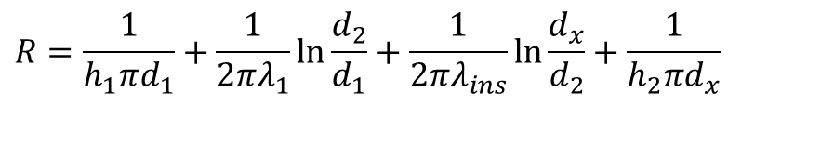
3.3 insulation layer
$$R=\frac{1}{h_{1}πd_{1}}+\frac{1}{2πλ_{1}}\ln{\frac{d_{2}}{d_{1}}}+\frac{1}{2πλ_{ins}}\ln{\frac{d_{x}}{d_{2}}}+\frac{1}{h_{2}πd_{x}}$$
Critical diameter leads to the smallest thermal resistance. How to determine the critical diameter dc?

Slide 34
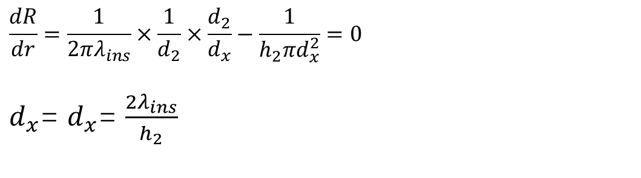
3.3 insulation layer
$$\frac{dR}{dr}=\frac{1}{2πλ_{ins}}×\frac{1}{d_{2}}×\frac{d_{2}}{d_{x}}−\frac{1}{h_{2}πd_{x}^{2}}=0$$
$d_{x}$= $d_{x}$= $\frac{2λ_{ins}}{h_{2}}$
Note that if d2 < dc, if the thickness of the insulation is less than d3, the heat transfer is even higher than that with no insulation.
How to determine the d3?

Slide 35
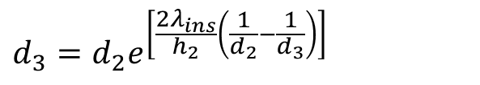
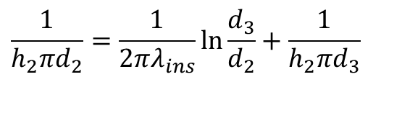
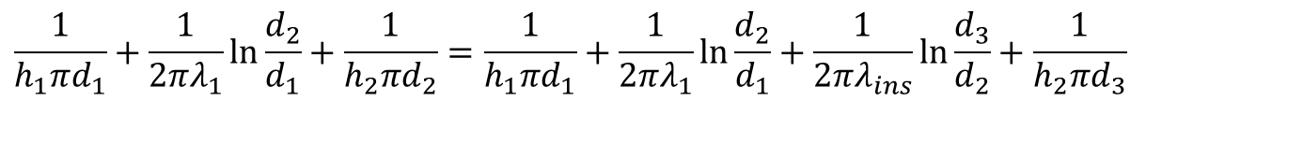
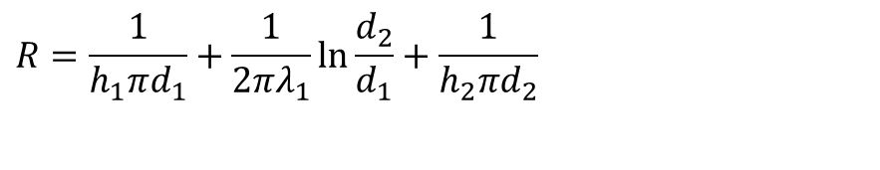
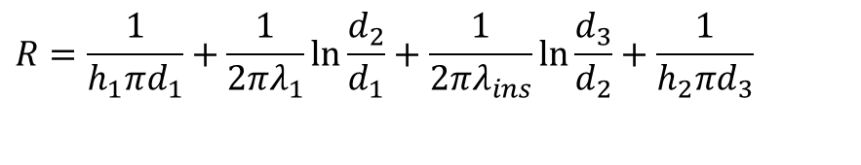
3.3 insulation layer
How to determine the d3?
$$R=\frac{1}{h_{1}πd_{1}}+\frac{1}{2πλ_{1}}\ln{\frac{d_{2}}{d_{1}}}+\frac{1}{2πλ_{ins}}\ln{\frac{d_{3}}{d_{2}}}+\frac{1}{h_{2}πd_{3}}$$
$$R=\frac{1}{h_{1}πd_{1}}+\frac{1}{2πλ_{1}}\ln{\frac{d_{2}}{d_{1}}}+\frac{1}{h_{2}πd_{2}}$$
$$\frac{1}{h_{1}πd_{1}}+\frac{1}{2πλ_{1}}\ln{\frac{d_{2}}{d_{1}}}+\frac{1}{h_{2}πd_{2}}=\frac{1}{h_{1}πd_{1}}+\frac{1}{2πλ_{1}}\ln{\frac{d_{2}}{d_{1}}}+\frac{1}{2πλ_{ins}}\ln{\frac{d_{3}}{d_{2}}}+\frac{1}{h_{2}πd_{3}}$$
$$\frac{1}{h_{2}πd_{2}}=\frac{1}{2πλ_{ins}}\ln{\frac{d_{3}}{d_{2}}}+\frac{1}{h_{2}πd_{3}}$$
$$d_{3}=d_{2}e^{\left[\frac{2λ_{ins}}{h_{2}}\left(\frac{1}{d_{2}}−\frac{1}{d_{3}}\right)\right]}$$
e.g. a condoct with tape. λ=0.04 w/(mK), h_{air}=10 w/(m²K)

