Slide 1

Heat Transfer
Conduction Heat Transfer
Dr. Guice Yao ( 姚贵策 )
PhD, Associate Professor
School of General Engineering
Beihang University
Email: yaoguice@buaa.edu.cn Office: New main building D1105

Slide 2
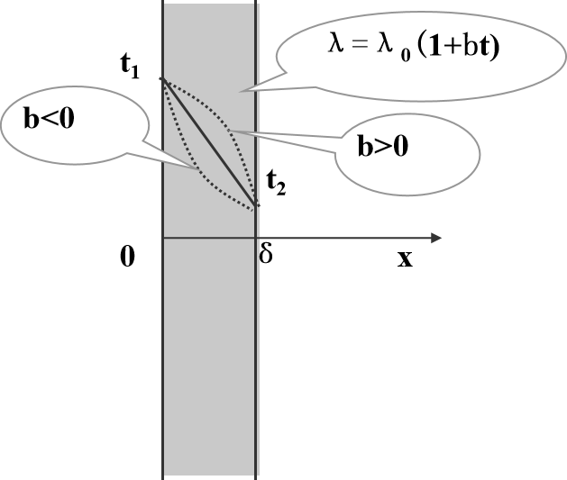



HT Week 3 recall
Heat conduction in a plane wall
T
Linear distribution
k
A
T_{S1}
Fourier’s Law
T_{S2}
q
L
x
(1) λ varies with T
(2) With inner
heat source
T_{w2}
$$q_{v}>0$$
T(x)
T_{w1}
$$q_{v}=0$$
$$q_{v} <0$$
-L
L

Slide 3
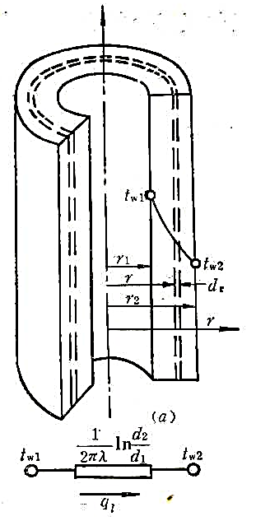
HT Week 3 recall
Heat conduction in a cylinder wall
what’s the shape of the curve?

Slide 4
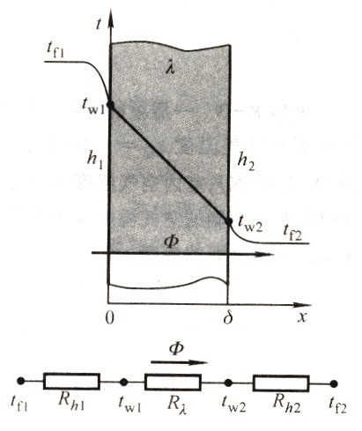
HT Week 3 recall
thermal resistance
Using an analogy to flow of electrical current, if the temperature change is the potential difference and q the flux rate, then:

Slide 5
HT Week 3 recall
thermal resistance
∑ R =
1
λ
1
1 1
+
+
^{R}λ A1 ^{+ R}λ B
^{R}λ E1
^{R}λ A2
R_{λ C}
^{+ R}λ E2 ^{R}λ A3 ^{+ R}λ D ^{+ R}λ E3
1
∑ R = R_{λ A} +
R
λ
1 1 1
λ E
+ +
^{R}λ B ^{R}λ C ^{R}λ D

Slide 6
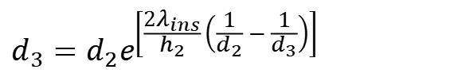
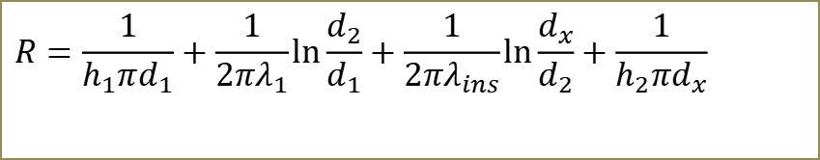
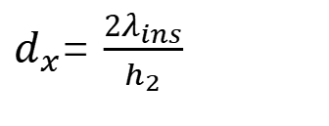
HT Week 3 recall
thermal resistance
$$R=\frac{1}{h_{1}πd_{1}}+\frac{1}{2πλ_{1}}\ln{\frac{d_{2}}{d_{1}}}+\frac{1}{2πλ_{ins}}\ln{\frac{d_{x}}{d_{2}}}+\frac{1}{h_{2}πd_{x}}$$
$d_{x}$= $\frac{2λ_{ins}}{h_{2}}$
$$d_{3}=d_{2}e^{\left[\frac{2λ_{ins}}{h_{2}}\left(\frac{1}{d_{2}}−\frac{1}{d_{3}}\right)\right]}$$

Slide 7
HT: Conduction
L4: Heat Conduction
in one dimensional fin structure & two dimensional
Learning Objectives:
Heat conduction in fin structure
fin efficiency (overall fin surface efficiency)
Methods to solve two dimensional heat conduction

Slide 8
4. Head conduction with fin
4.1 The temperature distribution in fin
4.2 The thermometer with metal-tube
4.3 Fin efficiency
4.4 two dimensional heat conduction

Slide 9
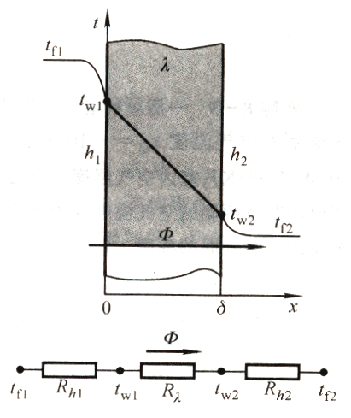
For a plane with convective boundary conditions：
How to increase the heat flux?
（1）To increase the temperature difference（t_{f1} - t_{f2}）
（2）To decrease the thermal resistance：
a) normally, (δ is small)、λ is large，the thermal conduction resistance could be neglected；
b) increase h₁、h₂，to some degree limited；
c) increase heat trasnfer area A

Slide 10
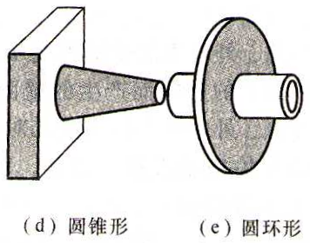
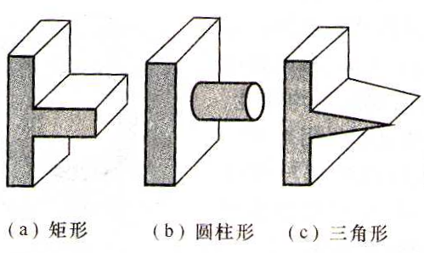
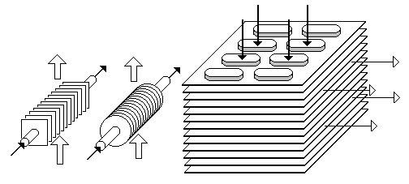
In general heat exchanger，mount fin structure on heat transfer surface is the most commonly used method.
fin structure：(straight fin)直肋、（circular fin）环肋；（cross section with same area)等截面、(cross section with changing area)变截面

Slide 11
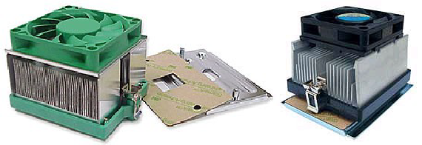
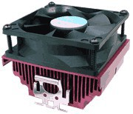
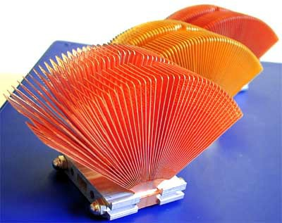
Electronic device cooling

Slide 12
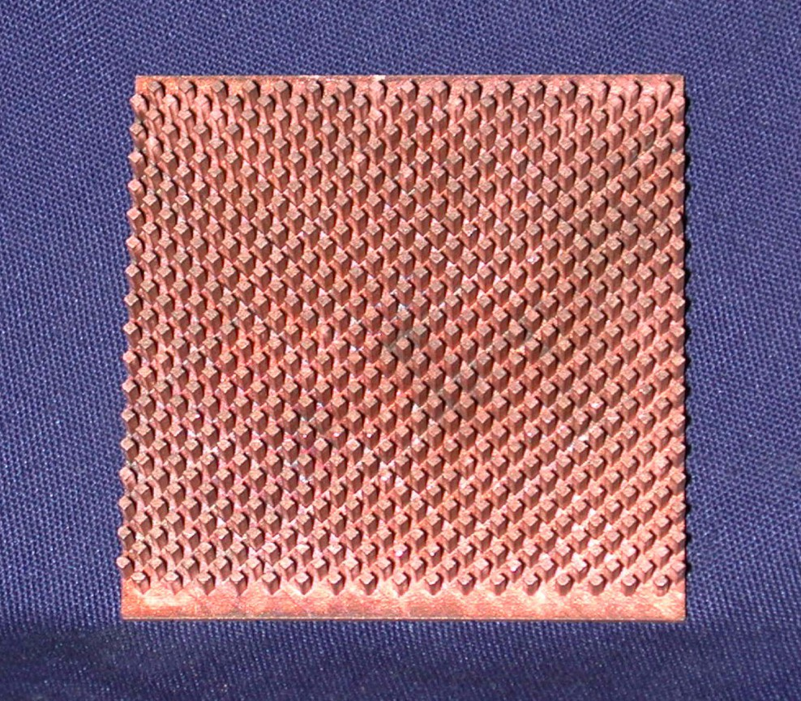
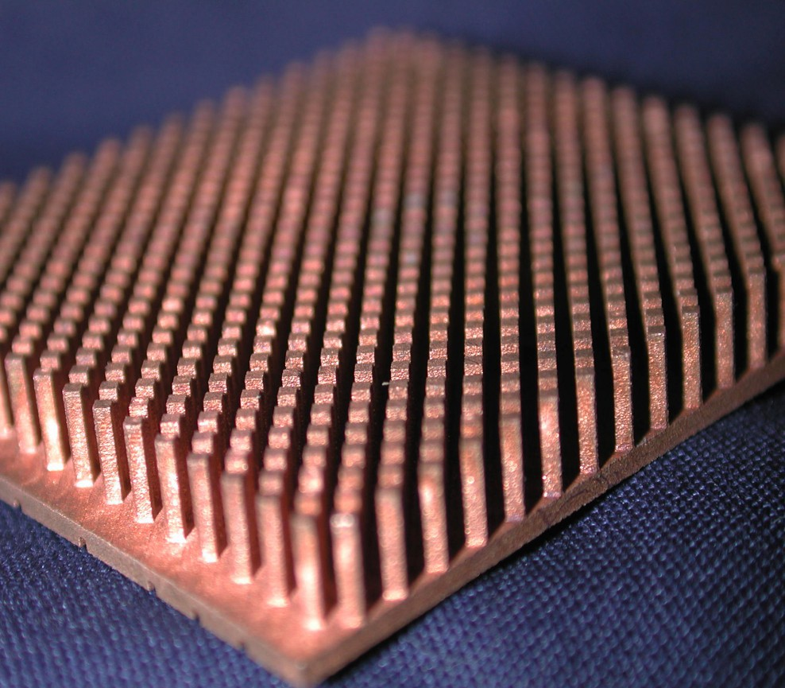
micro pin-fin

Slide 13
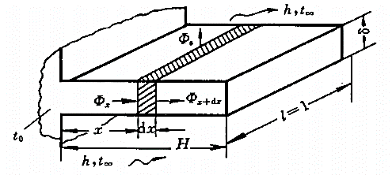
1、heat conduction in rectangular straight fin
Given：
rectangular straight fin；
The temperature of the bottom of the fin is t₀，and t₀ > t∞ ；
the convective heat transfer coefficient h between fin and the environment；
λ，h andA_{c} keeps constant；
what’s the temperature distribution and heat flux within fin?

Slide 14
Analysis：Strictly speaking，the heat conduction within fin is three dimentional, steady-state and no inner heat source. The boundary condition is convective heat transfer condition.
Simplify：(a) l >> δ and H ⇒ the temperature is uniformly distributed in l direction ⇒ l = 1；
(b) λ is large enough and δ << H，therefore the temperature along δ direction is same.
Boundary：bottom：fixed temperature；top：adiabatic；surrounding：convective heat transfer
solution：From two sides：
(a) heat diffusion equation
(b) Energy conservation＋Fourier law

Slide 15
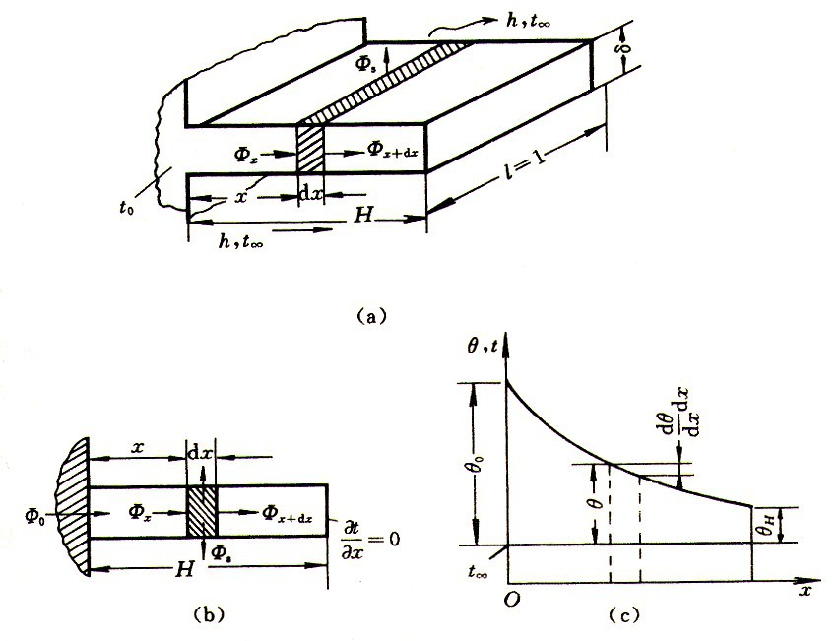
Micro element：cross-section area A,
Perimeter P ，
heat convection area Pdx
[P = 2(l + δ ), A = lδ ]
Energy conservation
Φ = Φ +Φ
x x+dx c

Slide 16
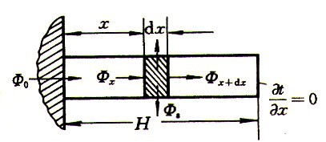
boundary condition：
excess temperature
Given: 及
then：
BC：

Slide 17
solution：
with boundary condition：
therefore the temperature distribution within fin：
sinh(hyperbolic sine)
cosh
tanh

Slide 18
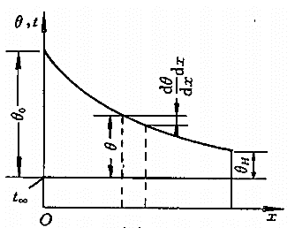
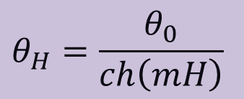
the (excess) temperature at top： x ＝ H
Steady-state：the heat flux through fin = the heat flux through the bottom of the fin

Slide 19
note that：
(1)The heat transfer on top of the fin is recognized as adiabatic. For practical cases, expecially for thin and high fin, it is OK. If such heat transfer must be considered, we can use H_{c}=H + δ /2 instead.
(2)The temperature field is one dimentional。
when Bi=hδ/λ ≤ 0.05，the error is less than 1%。for others , two dimentional temperature field, are not suitable；Actually，the convective heat transfer coefficient h is not uniform

Slide 20
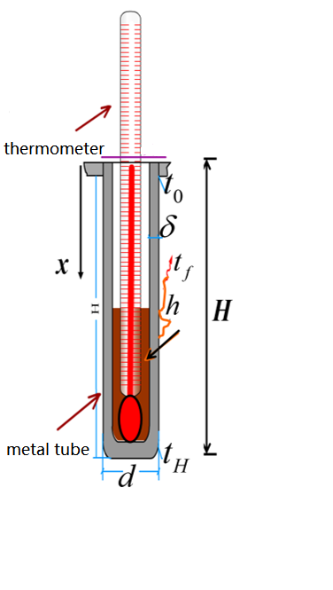
(1) What kinds of metals (copper or steel) are more suitable for temperature measurement?

Slide 21
(2)Heat transfer process：
(a)Neglect the thermal contact resistance, therefore T = bottom temperature of the tube
(b)The temperature distribution is uniform in circumferential direction。The heat conduction within tube only consider the wall (cs=πdδ)

Slide 22
因此套管顶端温度不等于被测的流体温度。
(c) The heat transfer between the bottom and the environment
1. The radiation heat transfer；
2. The convection heat transfer btween tube and air。
if t_{f} is higher，then the tube absorbs heat from flow. Some conducts to the root and some radiates to the wall.
t_{H} < t_{f}

Slide 23
4.2、Fin efficiency
to judge the degree of the heat transfer augment ，we use fin efficiency to represent
t_{m} = t₀， η _{f} = 1 — indicates λ → ∞

Slide 24
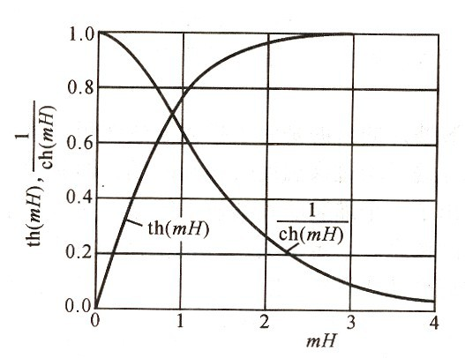
Parameters to affect the fin efficiency: λ, h, geometry
th(mH) fisrt increase rapidly and tends to a saturate value as mH increase
1
ch(mH )

Slide 25
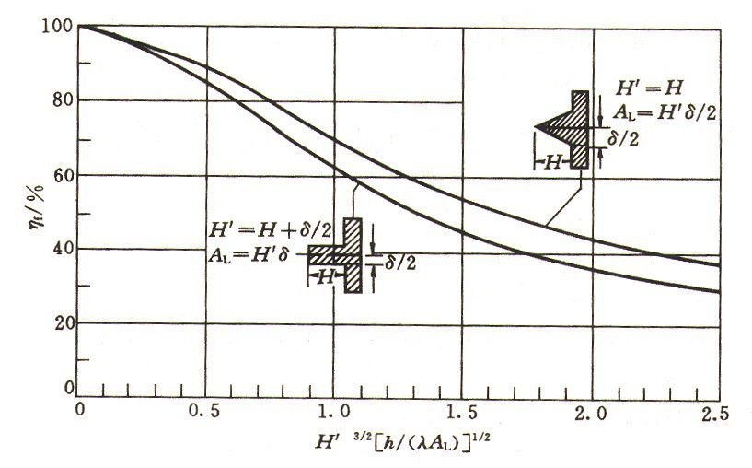
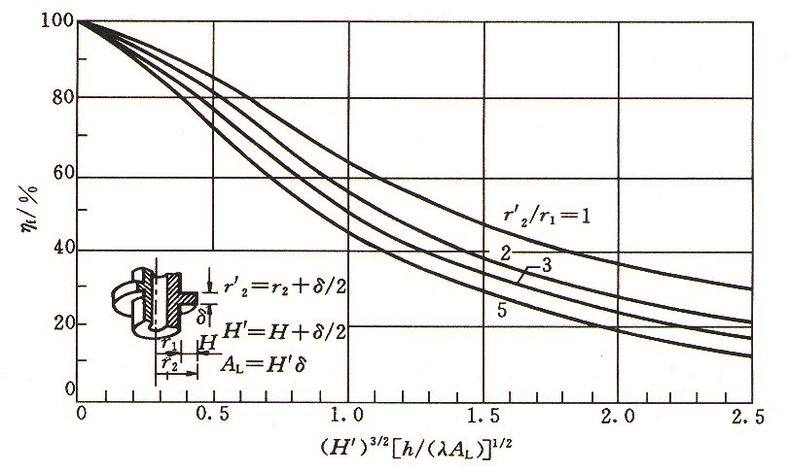
⇒

Slide 26
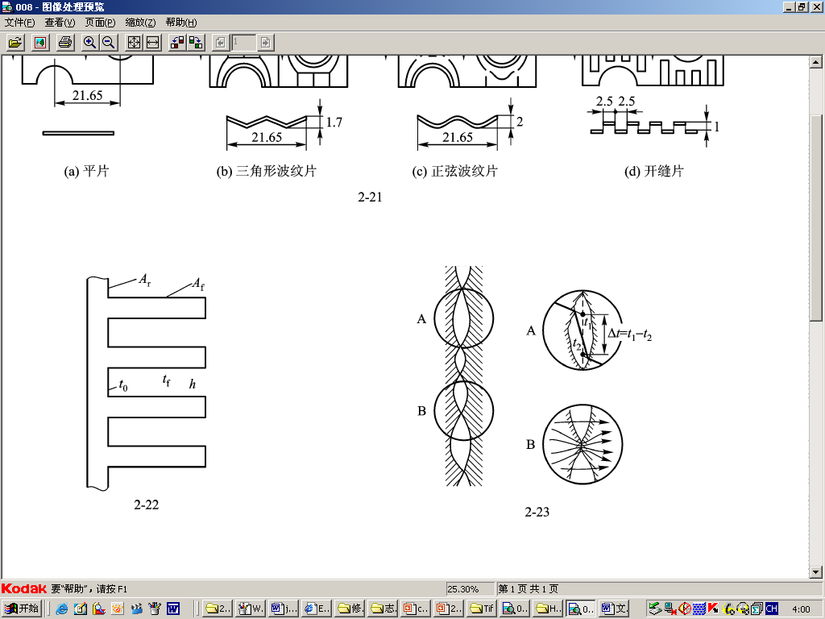
the whole system with fin structure:
overall fin efficiency

Slide 27
Two-Dimensional Heat Transfer
Thus far, we have only considered cases where heat fluxes (or temp. variations) are in one main direction.
Lets go beyond this and consider cases of 2-D heat transfer in both simple and complex geometries.
We won’t do 3-D, but it uses the same methods as 2-D - just harder.
The governing equation for multidimensional, steady heat conduction is:

Slide 28
The Laplacian Operator
In 2-D Cartesian Coordinates, the Laplacian operator is nothing more than:
This operator is a great “smoothing” function
The solution of this equation is smooth and continuous, except possibly at discontinuous boundaries.
The maxima and minima of the solution occur on the boundaries (if = 0)
This equation represents many common physical problems such as electromagenetic flux, gravitational potential, inviscid and incompressible flow, and the deflection of elastic membranes.
As a result, this equation has been studied for many years.

Slide 29
The Laplacian Operator (cont)
Let’s consider 3 ways of solving this equation.
Analytic mathematical solutions:
Fairly easy to obtain for simple geometries and simple BC’s.
A horror to find on complex geometries and/or BC’s.
Gives complete, continuous solutions of T(x,y)
Graphical solutions:
Approximate method which exploits “smoothness” feature.
Relatively painless - but more of an art than a science.
Numerical solutions:
Hard to program, but once the code exists, pretty easy to use for many different cases.
Only provides solutions of T and discrete points.

Slide 30
Analytic 2-D Solutions
Consider the simply geometrical case as shown - a retangular region the same temperature on 3 sides, but different on the fourth.
To solve this problem, we use the technique of Separation of Variables. First, let’s simplify the BC’s by defining
With this change, our governing eqn. and BC’s for no heat generation are:
T₂
y
T₁
W
T₁
L
T₁
x

Slide 31
Analytic 2-D Solutions (cont.)
Now, assume that the solution will have the form:
So that, after substituting into the governing eqn:
Or

Slide 32
Analytic 2-D Solutions (cont)
Thus, the single 2nd order PDE becomes two 1st order ODE’s:
Which have the general solutions for X(x) and Y(y):
Or, the general solution with BC’s is:

Slide 33
Analytic 2-D Solutions (cont.)
To satisfy the first BC, , it must be true that C₁ = 0.
To satisfy the second, , we must have C₄ = -C₃
To satisfy the second, , the product λL must be a multiple of π. Or
Thus, we don’t have a single solution, but a whole series of them which can be superimposed:

Slide 34
Analytic 2-D Solutions (cont.)
To simplify this a little, lets introduce the sinh function and group all the constants into a single term:
To get:
To get this last constant (or series of constants!) we apply the final BC:

Slide 35
Analytic 2-D Solutions (cont.)
This last equation appears impossible to solve. However, there is a little mathematical trick.
Let’s take this equation, multiply both sides by sin(mπx/L) and integrate from 0 to L.
The trick is that the integral on the right hand side is zero UNLESS m=n, when it becomes L/2. This result is related to the concept of orthogonal functions. Thus:

Slide 36
Analytic 2-D Solutions (cont.)
Finally, the integral on the left hand side will be zero for even values of n. For odd values it has the solution 2L/nπ.
Or, playing algebra games:
And our final solution for this problem is:

Slide 37
Analytic 2-D Solutions (cont.)
All this effort. And this was a simple problem!
Also, while this solution has the value of being continuous in x and y, it also involves an infinite sum.
In practice, we might only include the first 10 or so terms, but where we truncate the sum can effect the solution.
By the way, if we evaluate this sum, the solution for θ(x,y) looks something like:
θ=1
y
0.75
0.5
0.25
θ=0
θ=0
0.1
θ=0
x

Slide 38
Graphical Method for 2-D Conduction
The second method of 2-D conduction analysis is called the Graphical Method.
In this method, isotherms (lines of constant T) and adiabats (line of constant heat flux) are sketched based on simple geometric rules and a desire to achieve “smoothness”.
As a result, this method is approximate - but it can be fairly accurate if the “artist” has experience.
The method is also relatively quick - an advantage if only preliminary results are needed and the boundaries have known temperatures.

Slide 39
Graphical Method for 2-D Conduction
Begin any problem by identifying lines of symmetry - which should also be adiabats!
Lines of
symmetry
Begin any problem by identifying lines of symmetry - which should also be adiabats!
Next sketch in “smooth” isothermal lines, making sure they are perpendicular to the adiabats.
T₂
T₁
Isotherms

Slide 40
Graphical Method (cont)
Draw adiabats in as lines perpendicular at every crossing with the isotherms.
Finally begin iterating on the lines trying to obtain equal arc distances on opposing sides using:
When finished, you have a graphical (qualitative) idea of the heat flux patterns.
adiabats
c
d
a
b

Slide 41
Graphical Analysis (cont)
To get quantitative results from the graphical diagram, use the following procedure.
If properly drawn, there will be M lanes (space between adiabats) of equal heat heating rate.
Similarly, there will be N temperature steps (space between isotherms) of equal temperature increments.
If the plot was drawn correctly, with balanced side lengths, then the total heat flux is just:
where is the width in the 3rd dimension.

Slide 42
The Conduction Shape Factor
A simply way to represent analytical or graphical results for 2-D (or 3-D) heat conduction is in the form of a shape factor, S:
This representation depends upon having two well defined surface temperatures, T₁ and T₂.
Also not the the thermal resistance for this case is just:
Some common shape factors are giving in some textbook or manual.
The process is simple: find the desired geometry, calculate S, find q or R from the above eqns.

Slide 43
Numerical Solutions
The governing equation for multidimensional heat conduction may also be solved using a number of different numerical solutions.
The book discusses the classical Finite Difference solution method
However, the CFD program like Ansys provided uses the Finite Element method of analysis.
We will not worry about how to set up the solutions, just how to apply the program to different cases and conditions.

